Slide 1
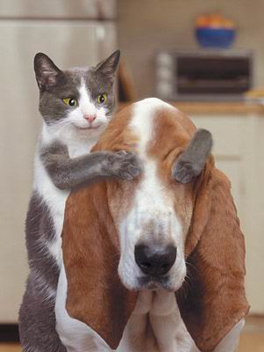
Be careful to safeguard sensitive/classified material from unauthorized eyes
Always use appropriate-level Document Cover Sheets, shield the document from unauthorized observation, and check with your FSO to verify a proposed recipient’s clearance authorization and need-to-know prior to sharing the contents of the classified document.

