Slide 1
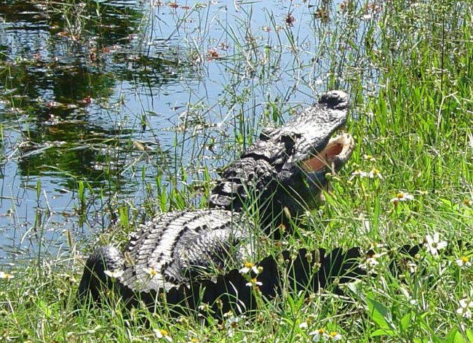
SNAP decisions can be costly when security procedures aren’t followed
It pays to be Security Aware....and that’s no Croc!

