Slide 1
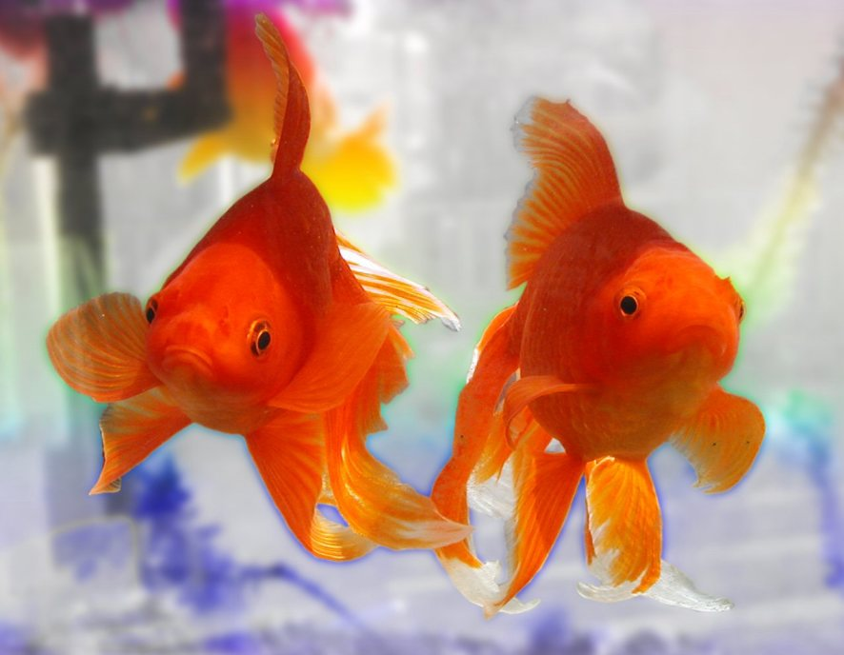
BE SECURITY AWARE…..If something looks fishy it probably is
IF YOU SEE SOMETHING, SAY SOMETHING!

