Slide 1
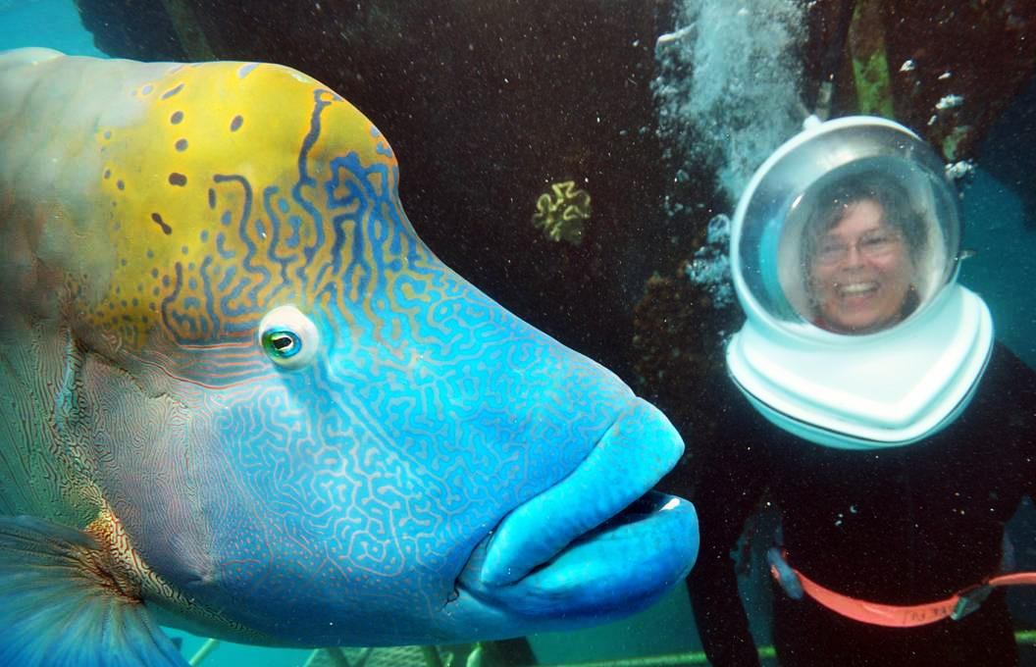
If something looks fishy, it probably is...
Protect classified information entrusted to you by using proper security safeguards
(use cover sheets for hard copies and watch what you say, who you say it to and and were you say it)
Photo taken at Great Barrier Reef during Reef Magic Cruise with giant maori wrasse

