Slide 1

Technology Control Plans
for Cleared Defense Contractors
Michael Miller
University of Central Florida

Slide 2


Agenda
TCP Essentials
  What is a TCP?
  Who needs to implement a TCP and when?
  What are the critical elements of a TCP?
Regulatory Authorities and Agencies
Developing a TCP - Agency Expectations
Monitoring Effectiveness
Training
Violations

Slide 3

What is a Technology Control Plan?
A Roadmap of how a company will control its technology. “How to do it” document that explains how the ITAR, EAR and NISPOM will be carried out.
  Ensures classified defense information (“CI”) or controlled unclassified information (“CUI”) is not provided to a foreign person (employees, visitors, affiliates).
A protection plan to control access to and dissemination of CI and CUI
  Includes information, items, articles and technical data
Ensures program team are informed, aware, and
understand their obligations and responsibilities.
Not a replacement for traditional security programs
(SPP), but an enhancement to existing practices.

Slide 4
Core Principles
Multiple variations of the title “TCP”, content and layout
Based on corporate policy, federal laws and regulations and facility clearance requirements
Identifies the controlled “things” (e.g. CI, CUI, EAR, ITAR, materials, technical data, and services)
Proscribes access and dissemination controls of the “things”
Defines duties and responsibilities
A TCP is only as strong as the training you provide to the staff who must execute the plan.

Slide 5
Three Main Parts
The Plan
Non-Disclosure Statement
Acknowledgement
We will get into specific elements found in each section of the plan later.

Slide 6
Types of TCPs
Facility type plan
  Plan to possess export-controlled or other restricted information
  Your personalized controls not specified in the NISPOM
Project specific plan
  Implement a security bubble around elements of a program, i.e. access to various parts of a facility, or compartmentalization methods:
    Area quarantine
    Time blocking
    Locked storage and electronic security
    Communication security
Activity-related plan
  Visits, IT systems, launch activities, shared services, etc.
Person specific plan
  Foreign person employees – a plan for the work activities.

Slide 7
Who Needs a TCP?
Cleared defense contractors
  FOCI arrangements (in addition to SPP)
  Cleared facilities with foreign persons on-site
    Foreign employees
    Short-term and long-term visitors
  Foreign person export licenses - before transfer of hardware, software, tech data or defense services
Uncleared Defense Contractors, Manufacturers, Distributors, Brokers subject to ITAR/EAR
  Registration Requirement w/ DDTC
  ITAR facilities w/ FN employees, visitors, plant visits, shared facilities
  Needed even for unlicensed foreign persons w/o access to anything
  Required for licensed foreign persons or other Government Approval
  Mandated by Proviso / license condition

Slide 8
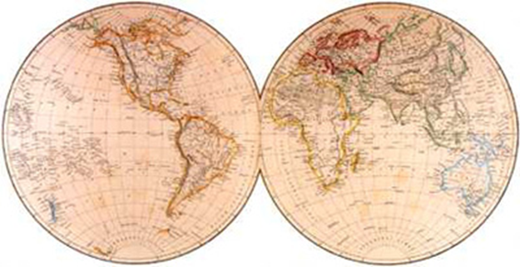
Who Needs a TCP?
Service Providers
  Researchers, institutes, universities for unclassified export controlled information
  Certain exports of Cat XV USML space projects and launch activity providers
  Certain encryption technology providers
  FMS Freight Forwarders
  EAR: “TCPs are a good practice for all holders of export controlled technology”

Slide 9
Regulatory Authorities
Export Controls Agencies
U.S. Department of State, Directorate of Defense Trade Controls
  International Traffic in Arms Regulations
Department of Commerce, Bureau of Industry & Security
  Export Administration Regulations
Department of Defense Agencies
Department of Defense, Defense Security Service
  National Industrial Security Program
Department of Defense, Defense Technology Security Administration
  National Defense Authorization Act
    Public Law 105-261, Title XV

Slide 10

State Department
Arms Export Control Act
International Traffic in Arms Regulations (“ITAR”) , 22 CFR Parts 120 – 130
Part 126 “General Policies and Provisions”
  126.13(c) License applications for foreign person employees: TCP required when foreign persons are employed at or assigned to security-cleared facilities.
  126.18(c)(2) Exemptions for Intra-company transfer of unclassified defense articles to foreign person employees: TCP required as a condition to use exemption, in addition to complying with other ITAR requirement (126.1 country prohibition, NDA, screening
  for substantive contacts, travel, allegiance, business
  relationships, etc.
  126.5, Supplement 1, Note 14. Canadian Exemptions:
  (Revision to Prior TCP Requirement No specific TCP but
  rather a semi-annual report to state.

Slide 11

Commerce Department
Export Administration Act
Export Administration Regulations (“EAR”) , 15 CFR Parts 730 - 744
Part 752.11, Internal Control Program Requirements
  ICP is the basis for a TCP under the EAR, required for deemed export and technology exports licenses.
  Essential elements:
    Corporate commitment to export compliance
    Physical security plan
    Information security plan
    Personnel screening procedures
    Training and awareness program
    Self evaluation program
References:
  http://www.bis.doc.gov/index.php/forms-documents/doc_download/387-intermediate-deemed-exports-pdf
  http://www.bis.doc.gov/images/pdfs/deemedexports/foreignationals.pdf

Slide 12
Commerce Department
Part 734.2(b)(2)(ii) Deemed Exports
  734.2(b)(2)(ii) Deemed Export: Release of technology is deemed to be to the home country of the foreign national, e.g. tours, foreign national employees involved in certain R&D and manufacturing activities, foreign students/scholars, hosting foreign nationals at your facility.
Licensing of Deemed Exports: No specific EAR reference to TCP; however, license requires “safeguards to restrict access” i.e. TCP.
  Required when foreign nationals are employed at or assigned to facilities that handle export-controlled items or information
  BIS Licensing Guidance - Internal Technology Control Plan - Applicant should describe measures to prevent unauthorized access by foreign nationals to controlled technology or software. The measures may include the applicant’s internal control program to prevent unauthorized access to controlled technologies or software.

Slide 13
Commerce Department
License Conditions
  The applicant will establish procedures to ensure compliance with the conditions of this license, particularly those regarding limitations on access to technology by foreign nationals. The applicant's key export control management officials will ensure that the foreign national complies with conditions 1- 5. A copy of such procedures will be provided to DoC/BIS.
  The applicant will ensure that the foreign national does not have access to any unlicensed controlled technology.
  The transfer of controlled technology and software shall be limited to the minimum needed by the foreign national in his/her role as described in the license application.
  http://www.bis.doc.gov/images/pdfs/deemedexports/foreignationals.pdf

Slide 14
Defense Technology Security Administration
Arms Export Control Act
International Traffic in Arms Regulations (“ITAR”) , 22 CFR Parts 120 – 130
Part 124 “Agreements, Off-Shore Procurement, and Other Defense Services”
  124.15(a)(1) Special Export Controls for Defense Articles and Services Controlled Under Cat. XV “Space Systems and Space Launches”: Technology Transfer Control Plan (TTCP) and Encryption Technology Control Plan (ETCP) required for use of any exemption, government approval or for any export license related to Category XV.
  Special processing procedure & rules. DTSA must monitor compliance for proliferation.
  DTSA has a TTCP Development Guideline manual
  Approved by DoD, DOS, DTSA, and NSA.
  Note Export Control Reform: Commercial satellites & related items transferring from the ITAR to the EAR. ITAR will retain primarily military, intelligence, and certain remote sensing satellites) and related ground systems, components, parts, software, and technical data and defense services. Services include assistance related to ANY satellite launch, satellite/launch vehicle integration, and satellite launch failure analysis.

Slide 15

Defense Security Service
NISPOM 2-307 – Foreign Ownership, Control or Influence (FOCI)
  A TCP shall be implemented by companies cleared under FOCI action plans that prescribes all security measures to reasonably foreclose the possibility of inadvertent access by non-U.S. citizen employees and visitors to information for which they are not authorized.
  Referenced in 22 CFR 126.13(c) (ITAR)
NISPOM 10-509 – International Visits & Control of Foreign Nationals
  A TCP is required to control access by foreign nationals assigned to, or employed by, cleared contractor facilities… The TCP shall contain procedures to control access for all export-controlled information.
DSS CDSE Webinar on Technology Control Plan under the NISPOM
  http://www.cdse.edu/catalog/webinars/industrial-security/technology-control-plan.html

Slide 16

FOCI Required Plans
Technology Control Plan
Affiliated Operations Plan
  Shared Services, e.g. IT, banking, etc.
Electronic Communications Plan
  IT Systems, Tele/video conferencing
  Ensures no unallowable Technology Transfer
Visitations Plan
  Foreign / U.S. company meetings
Facility Location Plan
  Close proximity, shared, and co-located
http://www.dss.mil/isp/foci/foci_info.html

Slide 17
Developing a TCP – Agency Expectations
Write your own plan and tailor it to your specific situation
Know what needs to be protected and describe the things that are subject to agency controls
  Ex. Information, articles, USML, CCL, Classification
Describe procedures for protection and controls
  Controls should make sense
  If it is in your plan, do it
  Agency specific requirements (e.g. FOCI)
Designate & empower company officials
  Technology Control Officer / Export Control Officer
  Facility Security Officer
Educate personnel – critical.

Slide 18
Standard Sections of the Plan
Introduction (scope, purpose, background, definitions)
Corporate policy
Identification of restricted technology
Protection guidelines
  Physical security
  Personnel security
  Operational security** NSDD-298
  Signal security (if applicable)
  Computer security
  IT Network security
**Deny adversaries export controlled or public info that are unclassified

Slide 19

Standard Sections Cont.
Licensing Procedures (TAA, MLA, Foreign Person Employees)
Plant / Site visit
Foreign travel
International shipping
Training requirements
Recordkeeping
Accountability and violation penalties

Slide 20
Optional Customized Sections
Unique facility elements
  Identification of escorted areas
  Unescorted areas
  Segregated work areas
Identification of team members & responsibilities
  Responsible Company Officials
Investigation procedures
Employee Separation

Slide 21

Best Practice Examples

Slide 22
Introductory information
Introduction, scope, purpose, background, definitions
  Delineates and informs employees and visitors:
    The existence and description of technology controls,
    What areas of the company controls apply, i.e. “territories, divisions, units” etc.
    Why they are necessary, i.e. “purpose”
    Specific provisions applicable to your company’s defense trade function or facility clearance, i.e. “DTRADE Registration No.”
    Definition of Terms as they relate to the TCP, i.e. “foreign persons”

Slide 23
Introductory information

Slide 24
Statement of Commitment
Corporate Directive or policy
  Reference to FCL, NISPOM, federal regulations and other commitments
  Required by the ITAR – corporate commitment http://www.pmddtc.state.gov/compliance/documents/compliance_programs.pdf
  TCP should reference the corporate directive
  May include specific “foreign person” policy

Slide 25
Identification of Technology
Identification and enumeration of restricted technology
  Commodity Jurisdiction determines which regulatory regime and procedures will govern the activity.
    Security Classification(s)
    U.S. Munitions List Category and Subcategory
    Export Control Classification Number (“ECCN”)

Slide 26
Identification of Technology
U.S. Munitions List Category and Subcategory

Slide 27
Physical Security
Cross-reference with SPP if necessary
Facility layout with diagram
Physical barriers and separators
  Building access
  Locking requirements
  Offices, doors, file cabinets
  Production, lab, manufacturing areas
  Visual access inhibitors
Badges and badging
  Employee
  Visitor
  Foreign person
  Contractor
Key control – log of who has what keys / electronic combinations

Slide 28
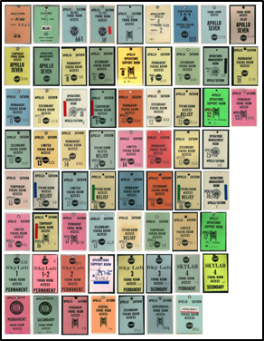
Badges & Badging
Example

Slide 29
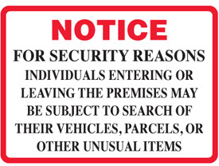
Personnel Security
Written employee responsibilities
  Can be broken down by function or division (general employee, supervisor, engineer, business development, security, HR, etc.)
Foreign person in-residence responsibilities
  Licensing procedures
  Indoctrination procedure
  Monitoring
  Separation
Third party responsibilities
  Custodian, maintenance, delivery, building management
Random personnel inspections
  Entering and exiting the facility
  Bags, parcels, media, electronic devices
  Notification posted on premises

Slide 30
Example – Foreign Person Disclosure

Slide 31
Example - Indoctrination

Slide 32
Example - Responsibilities

Slide 33
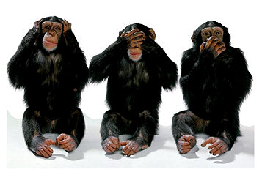
Access Control
Procedures for controlling and restricting access to:
  Work areas
  Information
    Uncontrolled and public
    Controlled
    Classified
    Proprietary
    Derived information
    Storage, destruction, transmission, dissemination
    “All information that needs to be protected must be appropriately marked or otherwise identifiable to all personnel”
  Equipment, hardware, production facilities, etc.

Slide 34
Example – Identification of Information

Slide 35
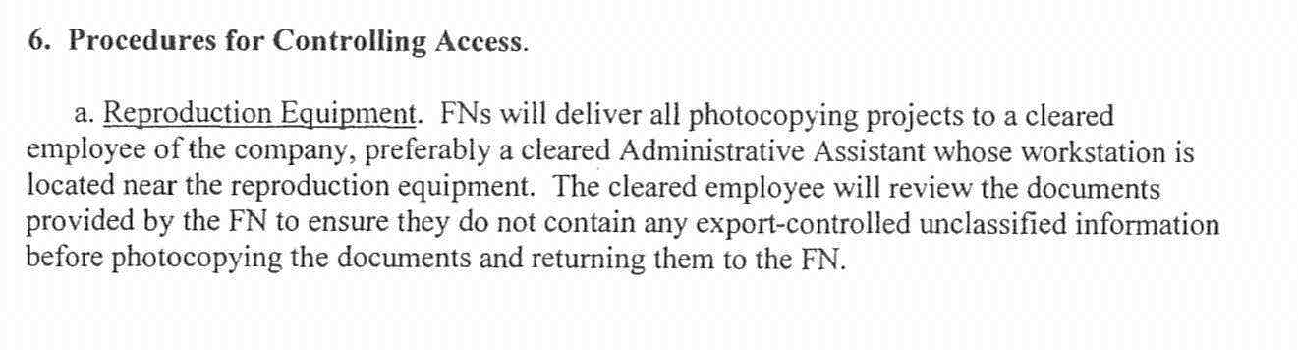
Example - Hardware

Slide 36
Access Controls

Slide 37
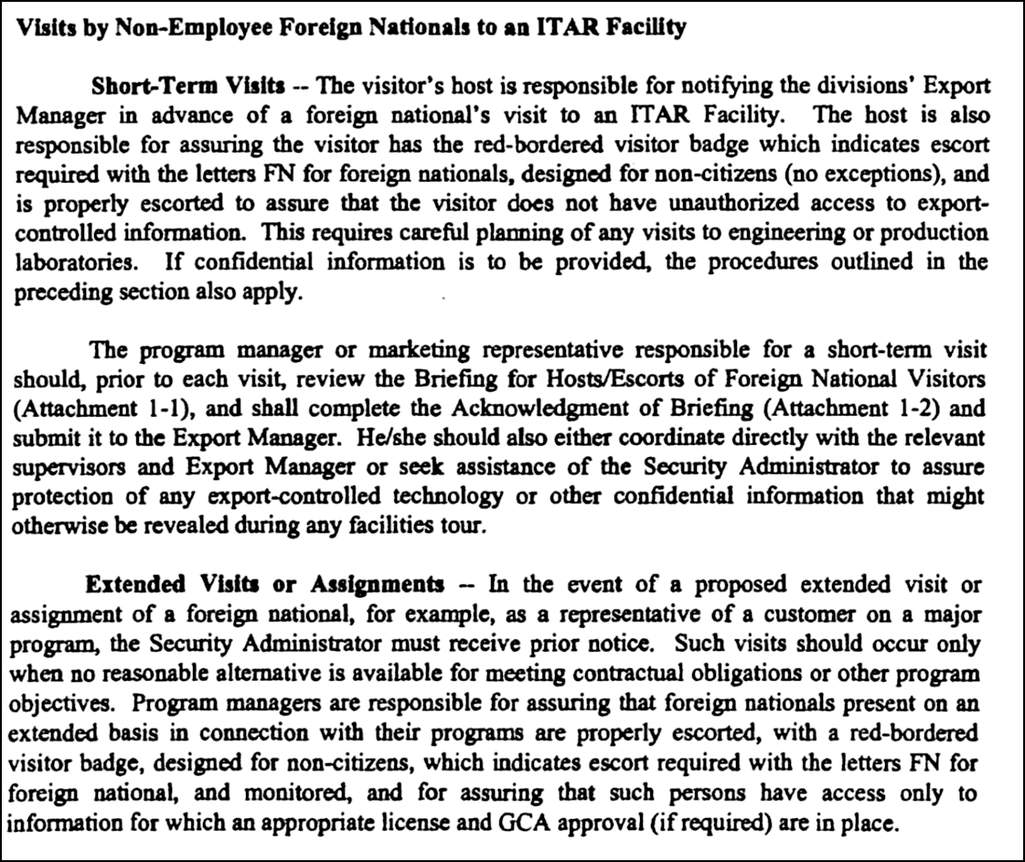
Site Visits
Plant and site visit procedures
  Pre-visit screening
  In-processing, log, facility notification, badging & briefing
  Host escort and acknowledgement

Slide 38
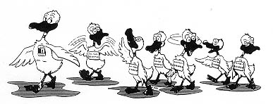
Escorts
Escorts are responsible and must be trained
Must be able to control visitors at all times
Do not allow wandering, pictures, embarrassing incidents, unannounced changes, unannounced visitors, video crews, misinterpretations, multiple requests, etc.
Waiting room areas can be designated “safe harbor”
Lock-up restricted information / articles
Escorts
The PI and approved project personnel will ensure that foreign nationals are not present when measurement is taking place. All foreign persons must be are escorted within the lab area. Foreign nationals are not permitted independent, unescorted 24 hour access to a work area until such time as all export controlled activity has ceased.

Slide 39

Computer & Network Security
Computer security
  Use NIST standard as a baseline
  User IDs, login, passwords, encryption, etc.
  Company email only, no clouds
IT Network security
  Procedures to maintain control of networked systems
  Domain access restrictions
  Repository (fileserver) for restricted CUI, proprietary, trade secret
  Drawings, configuration management

Slide 40
NDA

Slide 41
TCP Acknowledgement

Slide 42
TCP Acknowledgement

Slide 43

Monitoring
Internal Self Assessment
  Annual review of TCPs should be conducted
  Checklist of items, measures and benchmarks that should be reviewed
    Employee knowledge
    Adherence to access procedures
    Corrective action plan for findings uncovered
    Penalties for violations must be enforced
Recurring Training
  Personnel subject to TCP should be trained annually
  Training should review policy, procedure, legal requirements and TCP protocols

Slide 44
TCP Violations
Procedure for handling violations

Slide 45
Self-Disclosure
Regulatory Requirements 127.12(c)(2)

Slide 46

Contact Information
Mike Miller
Assistant Director for Export Controls
University of Central Florida
EM: Michael.Miller@ucf.edu
PH: 407-882-0660

