Slide 1
Suspicious Mail and Packages
Florida Industrial Security Working Group
September 26, 2012
René Lewis
Supervisor, Receiving & Distribution

Slide 2
Suspicious Mail and Packages

Slide 3

Suspicious Mail and Packages

Slide 4
Suspicious Mail and Packages
“Routine”

Slide 5
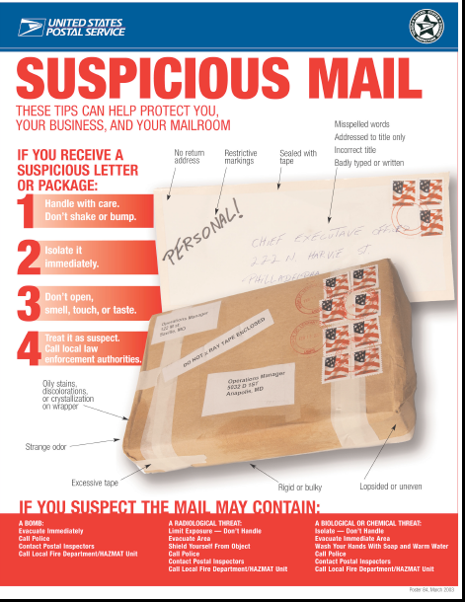
Suspicious Mail and Packages

Slide 6
Volume of Receipts/Packages
Harris
- PB Receiving
-- 44,400 receipts per year
-All Receiving Sites
--132,000 receipts per year
Mailcenter
-- PB Mailcenter - 1,680 packages per year
-- USPS - 750 packages per year
-- CHQ Mailcenter - 14,110 packages per year
-- All Campuses 16,550 packages per year

Slide 7
Volume of Receipts/Packages
Harris
- PB Receiving
-- 44,400 receipts per year
-All Receiving Sites
--132,000 receipts per year
Mailcenter
-- PB Mailcenter - 1,680 packages per year
-- USPS - 750 packages per year
-- CHQ Mailcenter - 14,110 packages per year
-- All Campuses 16,550 packages per year
x 3

Slide 8
Procedures
Posted (written)
Practical
Practiced

Slide 9
Critical Actions To Take
Identify
Isolate
Inform

Slide 10
Critical Actions To Take
IDENTIFY—Characteristics of Suspicious Packages/Letters include:
  No return address
  Odd smell or sounds coming from the package
  Oily stains, leaking or seepage from the package
  Wires protruding from the package
  Written directions indicating only a specific person is to open the package
  Packages that are addressed to a title only, without a name, or incorrect titles
  Restrictive markings, like “personal” “private” or “to be opened only by.”
  Excessive postage, no postage or non-canceled postage
  Excessive use of tape or unprofessionally wrapped packages
  A rigid or bulky envelope
  Misspelled words, poor handwriting, printing or typing
  Postmark showing a very different location than return address

Slide 11
Critical Actions To Take
ISOLATE—If you determine that the package or letter is suspicious:
  Gently set the package down and secure the area by closing doors.
        Do not open any suspicious letter or package and do not touch any suspicious material.
  Do not shake or empty the contents of any suspicious material.
  Do not carry to other areas, show it to other people, or allow others to examine it.
  Put the package or envelope down on a stable surface.
  Do not sniff, touch, taste, or look closely at it or any contents which may have spilled.
  Do not try to clean up material if the letter or package has already spilled.
  Wash your hands with soap and water and shower with soap and water as soon as possible.
  Remove any contaminated clothing and place in a plastic bag that can be sealed; give the bag to law enforcement personnel. Clothing that is not contaminated does not pose any significant risk, does not need to be discarded, and can be washed in the regular laundry.
  Do not use bleach or disinfectant on your skin.
  Do not attempt to further handle the package. This will keep fingerprints to a minimum and will assist the police in identifying potential offenders.
  Do not attempt to destroy the package on your own.
  Evacuate the area if ordered to do so by your supervisor or security.

Slide 12
Critical Actions To Take
INFORM—Contact your supervisor or in case of emergency dial *89.
- Notify all personnel in the area of the presence of a
suspicious package.

Slide 13
The Three “3s”
Material is handled at least three times after it arrives at Harris
Procedures should be 1) posted, 2) practical, and 3) practiced
Critical actions to take: 1) identify, 2) isolate, & 3) inform

Slide 14
Suspicious Mail and Packages
Rule of Thumb
Use the same common sense at your workplace that you would use at your own home !!

Slide 15
Suspicious Mail and Packages
Questions
???
René Lewis
Supervisor, Receiving & Distribution
Phone: (321) 727-4225
Cell: (321) 288-1224
Fax: (321) 727-4817
Email: mlewis11@harris.com

