Slide 1

Florida Industrial Security Working Group
10 July 2014

Slide 2
Jeff Morgan
UCF Director of Emergency Management
Regional Domestic Security Task Force (RDSTF)
  Higher Education Co-Chair
State Working Group
  Campus Security – Voting member
  Critical Infrastructure – Voting member
Central Florida Intelligence Exchange (CFIX)
  Intelligence Liaison Officer Education Sector Coordinator
International Association of Emergency Managers (iAEM)
  FEMA Region IV, UCC Alternate Representative
Florida Emergency Preparedness Association (FEPA) - Member
ASIS -Member
UCF College of Health and Public Affairs – Adjunct Professor
Notes:
University and College Caucus

Slide 3
Summary
About Emergency Management at UCF
  Structure
Roles and Responsibilities
  Plans and Programs
  Training and Exercises
  Logistics and Administration
  Critical Infrastructure
  Resources
  Response Roles

Slide 4
About UCF
Largest campus population in Florida
2rd Largest campus population in U.S. (<AZ)
~10,000 students live on campus
7th Largest employer in region
UCF population ranks higher than 28 of 67 Florida Counties
Special events
  Arena 10,000+
  Stadium 45,000+

Slide 5
Daily Attendance vs. Local Attractions
TEA/ERA Attraction Attendance Report 2011

Slide 6
Population vs. Local Cities
UCF Facts 2011-12 and US Census 2010

Slide 7
Growth Since 2004/5 Hurricanes
$630 million additional Operating Budget (+82%)
16,903 additional Students (+39%)
6,314 additional Employees (+132%)
2,723 additional On-Campus Housing (+65%)
3.5 million additional Assignable Sq ft (+90%)
4.3 million additional Gross Sq ft (+78%)
56 Additional Buildings (+48%)
2 Additional Campuses (Rosen and Lake Nona)
2 Additional Public Venues (Stadium and Arena)
5 Additional Research Park buildings

Slide 8

Our Chain of Command
President
VP Administration and Finance
AVP Safety and Security and Chief of Police
Office of Emergency Management
UCF Police Department

Slide 9
The Team
Plans and Programs
Training and Exercise
Logistics and Administration
Warning and Communications
Office Manager

Slide 10
Emergency Management
Department of Homeland Security
  National Response Framework
    NIMS / ICS
Florida
  Florida Statute, Chapter 252
    Governs Emergency Management
State University System (SUS)
  Board of Governors
    BOG 3.001 Campus Emergency Management

Slide 11
Plans/Policies/Programs
Building Emergency Action Plans
Lockdown and Shelter-in-Place Plans
Incident Action Plans
University-level policies concerning emergency operations
  Essential Personnel, Bomb Threat, UCF Alert
Call Center
Local Mitigation Program
Internship Program

Slide 12
COOP
Continuity of Operations Plan
  Details protocols to ensure the continuation of operations in less than 12-hours
  Follows state guidelines
  Host workshops for departments to guide them through the planning process

Slide 13
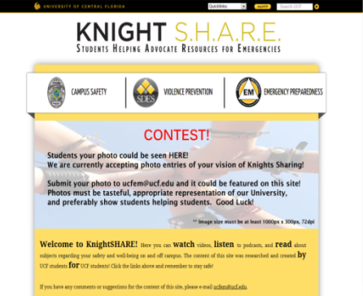
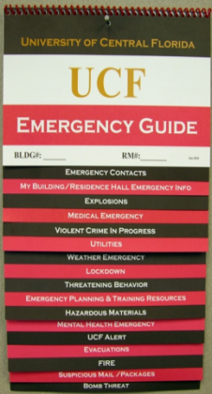
Programs
Outreach programs designed to assist students, faculty, and staff members with preparedness and response to emergencies
  UCF Alert/Shots Fired Program
  If You See Something, Say Something
  Emergency Guides
  KNIGHTSHARE
  Orientations
  Severe Weather Week
  Outreach Events

Slide 14
Training / Exercises
Compliant with all National Incident Management System Guidelines
Incident Command System
EOC/Command Post
Homeland Security Exercise & Evaluation Program (HSEEP) Compliant

Slide 15
Training / Exercise Cont.
Recent Exercises
  Sunrail Regional Tabletop
  Rollins College/Winter Park Active Shooter Full Scale
  Regional Mass Casualty Full-Scale
  Athletics Table Top
  UCF Hurricane Functional Exercises
  UF Full-Scale Active Shooter
  FSU Mag Lab Full-Scale
  Regional Mass Casualty
Upcoming Exercises
  Athletics Exercise
  2015 UCF Mass Casualty Incident Full Scale Exercise

Slide 16

Logistics and Finance
Equipment Readiness
  Maintenance
Operational Budget
  Procurement
  Property Ownership
Emergency Finance Department
  Funding Large Emergencies

Slide 17
Warning and Communication
Emergency Blue Light Phones
Radio Communication (P25 / UHF)
Satellite Communication Systems
Telephone Systems (GETS & WPS)
Emergency Recall Plan
UCF Alert
  Integration / Standards / Maintenance
Conference Lines / Webinar Capability

Slide 18



Other Tasks
Emergency Notification
Emergency Blue Light Phones
Physical Security
  Cameras
  Access Control
Critical Infrastructure and Key Resources
  Protective Security Advisor (PSA)
  ACAMS – Automated Critical Asset Management System

Slide 19
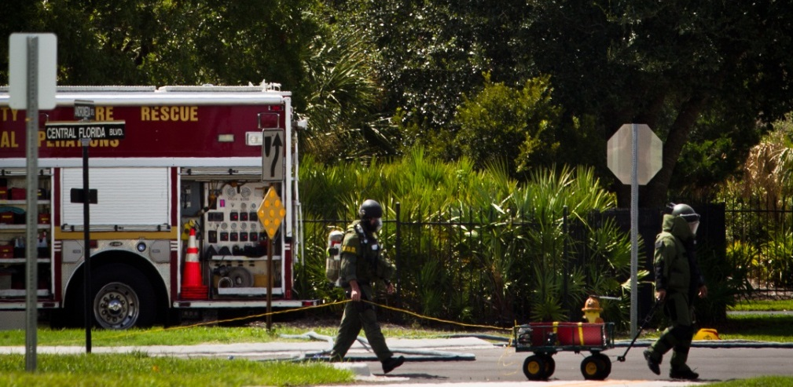
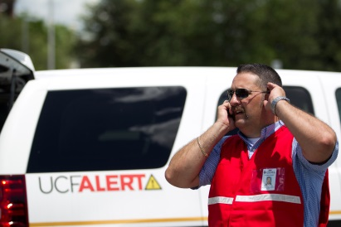
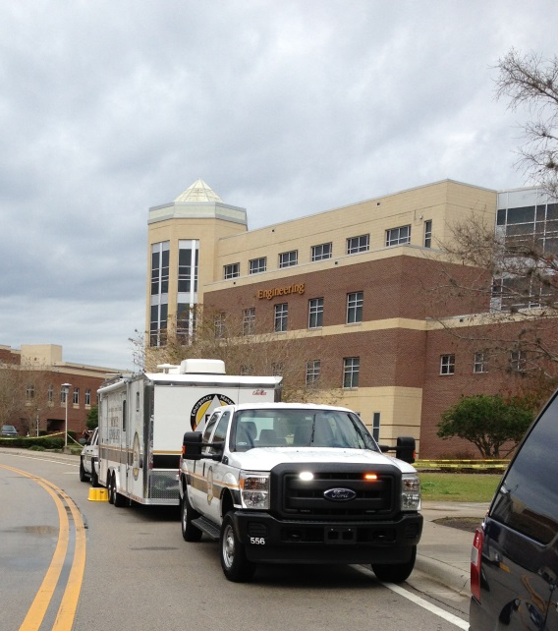
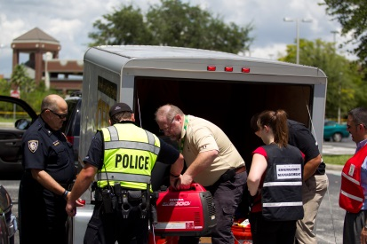
Response Roles and Responsibilities
Integration
  OEM Role on scene
Resources
  Equipment
  Emergency Operations Center
  Emergency Support Functions

Slide 20
Incident Command Structure
Incident Commander
Public Information Officer
Operations
Planning
Intelligence and Investigations
Fin / Accounting
Liaison
Logistics

Slide 21
OEM On Scene
UCF Alert
Internal Notification
  Emails and conference calls
External Notification
  State Watch Office
  Orange County Emergency Management
  Seminole County Emergency Management
  Central Florida Intelligence eXchange (CFIX)
Incident Action Plan (IAP) Development
Documentation

Slide 22
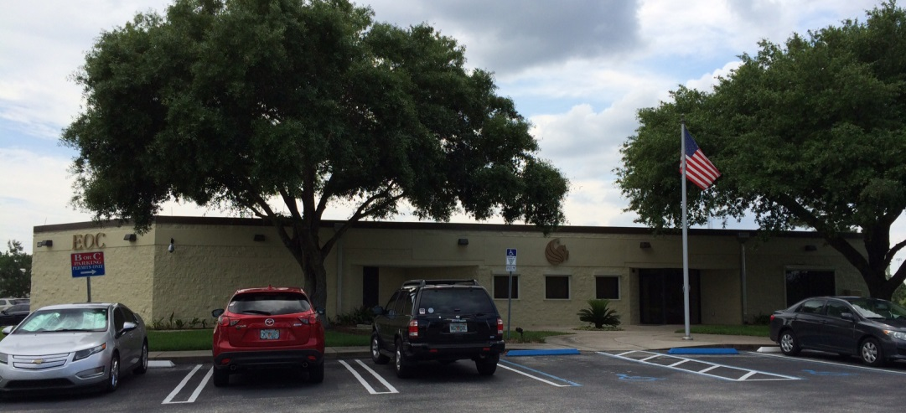
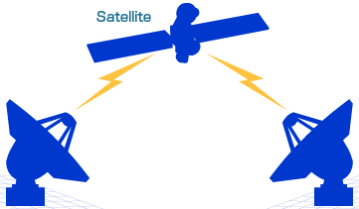
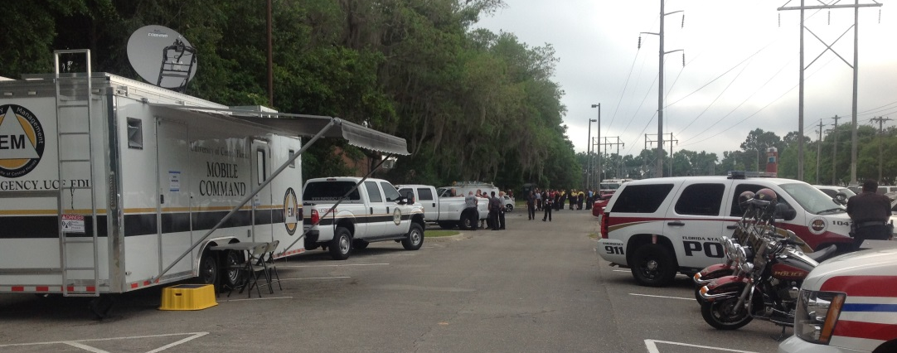
EOC / IC Interface
Mobile Command to EOC
Email
Phone calls
Video Conferencing
Access to Files
Access to video
Whiteboard sharing
  MS Lync
Best Practices
Photo sharing
  Maps
  Floor plans
  Perimeter
  On-scene
GPS location
  iPad / iPhones

Slide 23
Emergency Support Functions
ESF – 1 Transportation
ESF – 2 Communications
ESF – 3 Public Works
ESF – 4 Firefighting (Structure)
ESF – 4 Firefighting (Wildfire)
ESF – 5 Information and Planning
ESF – 6 Housing
ESF – 7 Resource Support
ESF – 8 Health and Medical (Medical)
ESF – 8 Health and Medical (Counseling)
ESF – 9, 16 Search and Rescue / Law Enforcement
ESF – 10 HAZMAT
ESF – 11 Food & Water

Slide 24
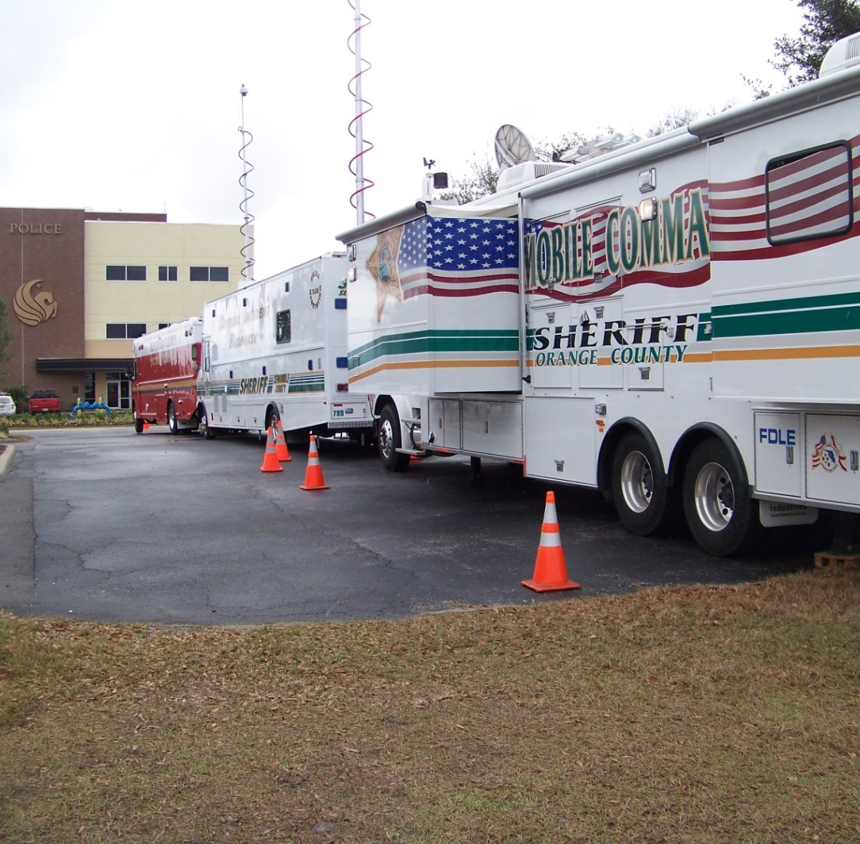
Emergency Support Functions
ESF – 12, 20 Energy / Public Utilities
ESF – 14 Public Information
ESF – 15 Volunteer Management
ESF – 19 Damage Assessment
ESF – 21 Special Needs
ESF – 22 Finance and Accounting
ESF – 23 Human Resources

Slide 25
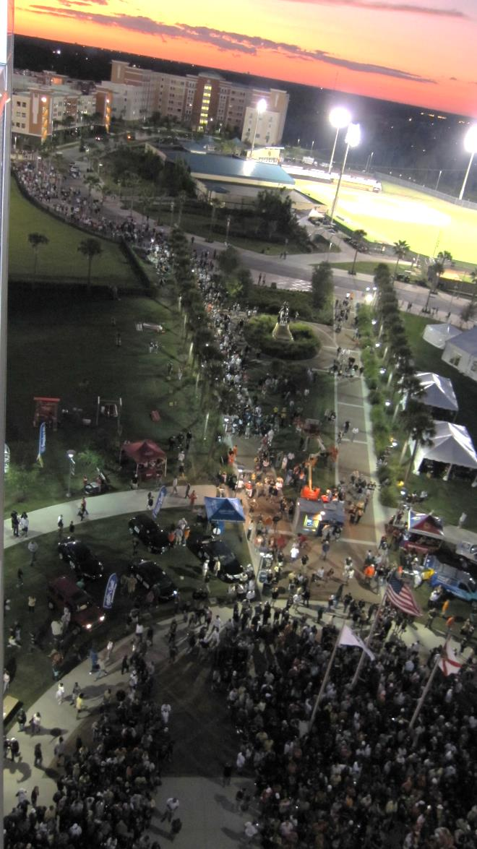
EOC, What and When?
Severe Weather
  Hurricane
VIP Visits
Large Special Events
Training
Exercises
Football Games

Slide 26

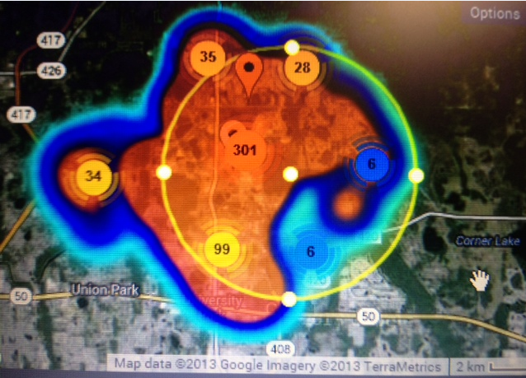
Social Media in Policing
University of Central Florida
vs South Carolina

Slide 27
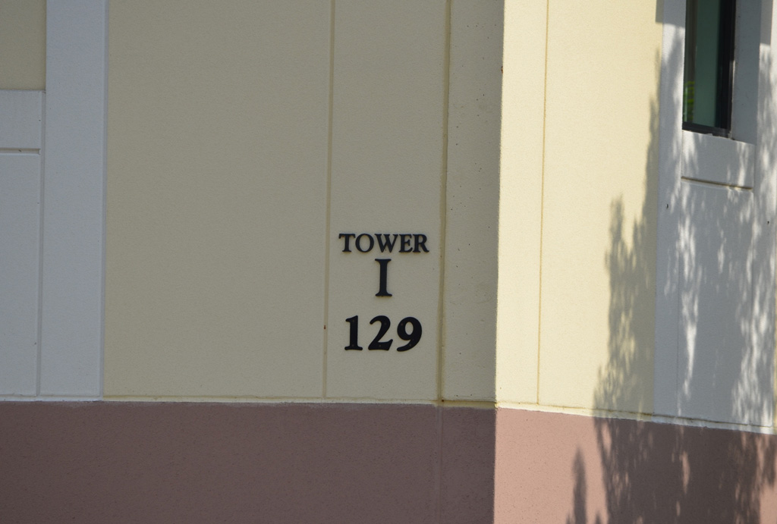

Tower 1 Incident

Slide 28
Incident Summary
On March 18, 2013 at around 0030 Hrs, UCF Police Department (PD) Dispatch received notice of a fire alarm in Tower 1. The residents of Tower 1 started to evacuate the building. While officers were responding to the alarm, UCF PD Dispatch received a 9-1-1 call from a Tower 1 resident on the third floor advising that his roommate had pointed a gun at him and that he had locked himself in his room. When UCF PD officers entered the room, they found armed subject dead by a self-inflicted gunshot wound to the head. Over the next few hours, crime scene investigations would commence, resulting in the findings of additional weapons, ammunition, explosive devices, and what appeared to be plans to carry out a larger attack on the UCF main campus. UCF PD led a joint investigation with additional local, state, and federal law enforcement agencies.

Slide 29
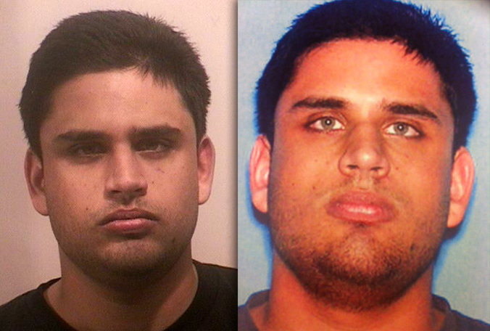
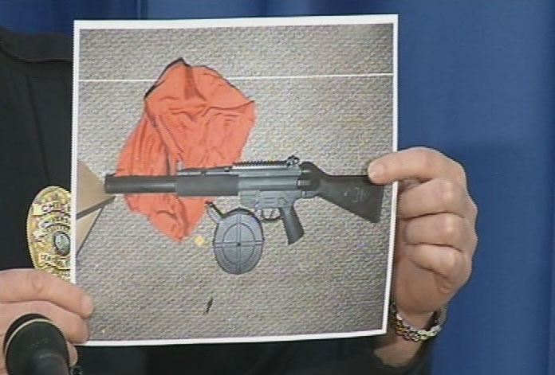
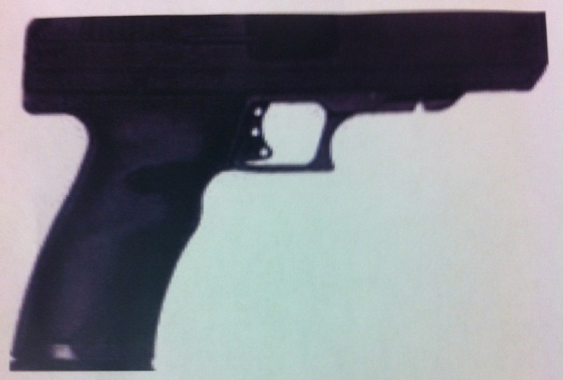
The Shooter

Slide 30
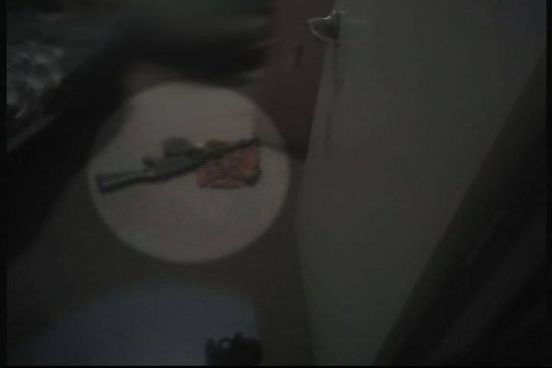
Assault Rifle

Slide 31
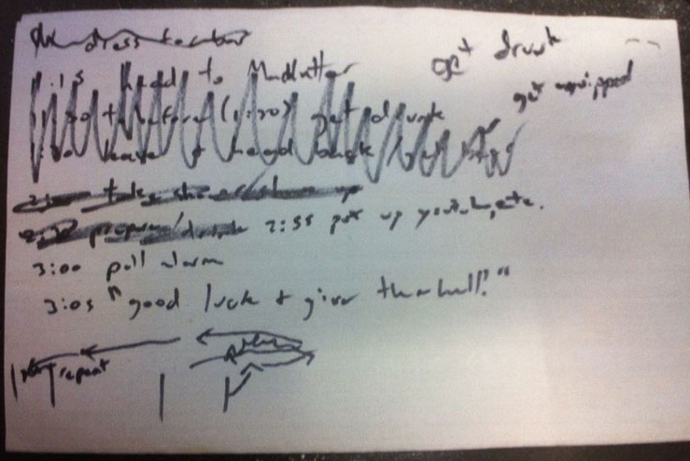
The Plan

Slide 32
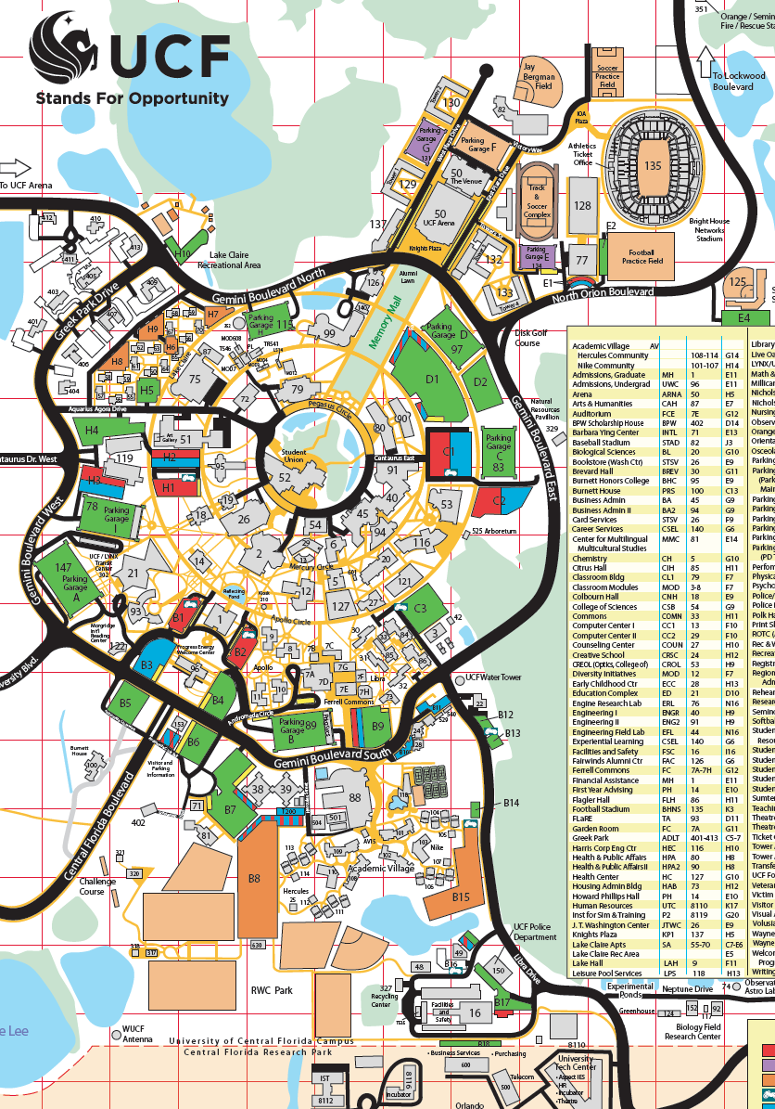
Lay of the Land
Incident
Media Conference
  Teaching Academy, Bldg 93
EOC

Slide 33
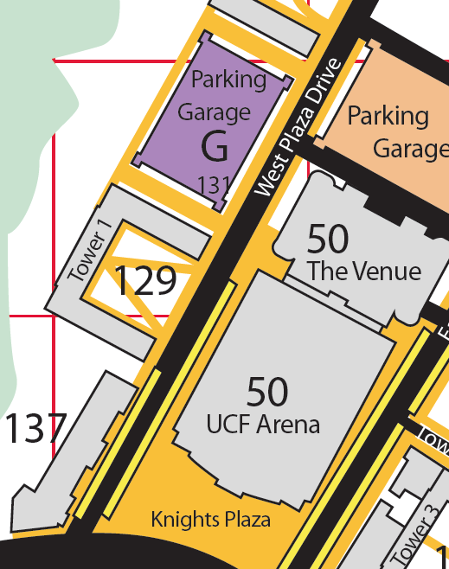
Incident Command
UCF Incident Command
EOD

Slide 34
Incident Command (Structure)
IC
UCF Chief of Police
PIO
UCF News and Information
Operations
Planning
UCF OEM
Logistics
UCF OEM
Fin / Accounting
Liaison
UCF OEM
Law Enforcement
Campus

Slide 35
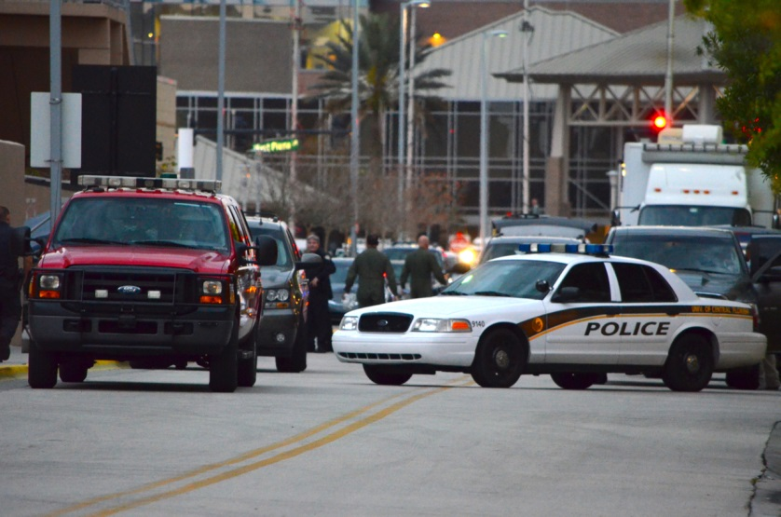
On Scene
Scene Management
Internal Notifications
  Conference Calls
External Notifications
  State Watch Office and others
Documentation
  ICS Forms
Printing
  Floor plans, photos, notes, ect…
Planning
  Current and future operational periods
Campus Needs

Slide 36
Tower 1 Rest Area
Incident
Arena
Student Union

Slide 37
Tower 1, Rest Area
0700 students were given the option to go to the Arena for rest and privacy
VA Center used as a counseling center

Slide 38
Media
Local, National, and International News on scene and making calls within hours
East Coast timeline
Official media release was at 1545hrs
  Utilized Teaching Academy Room 117
Two sites identified
  Teaching Academy for media briefing
  In front of the Alumni Center for “on scene” media

Slide 39
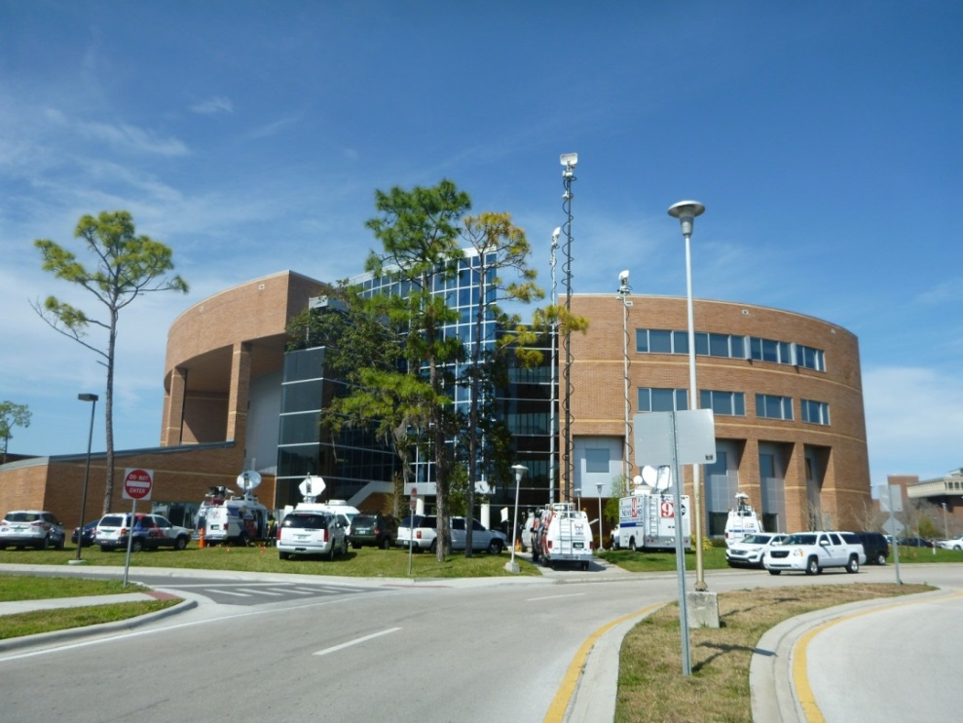
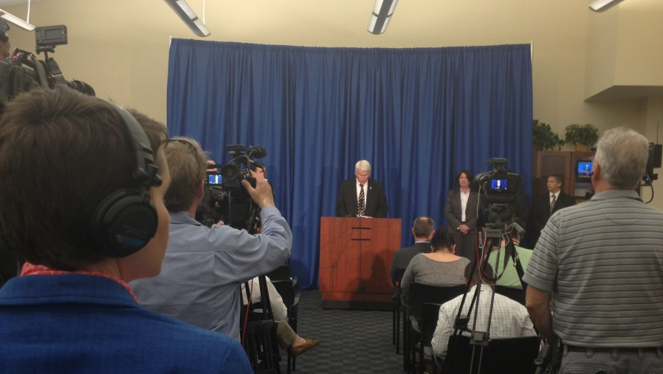
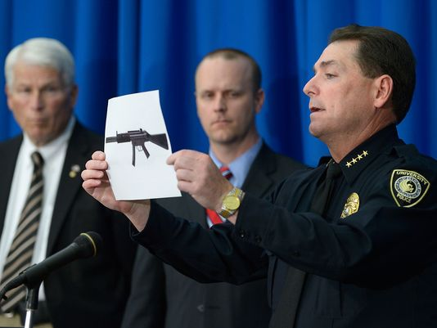
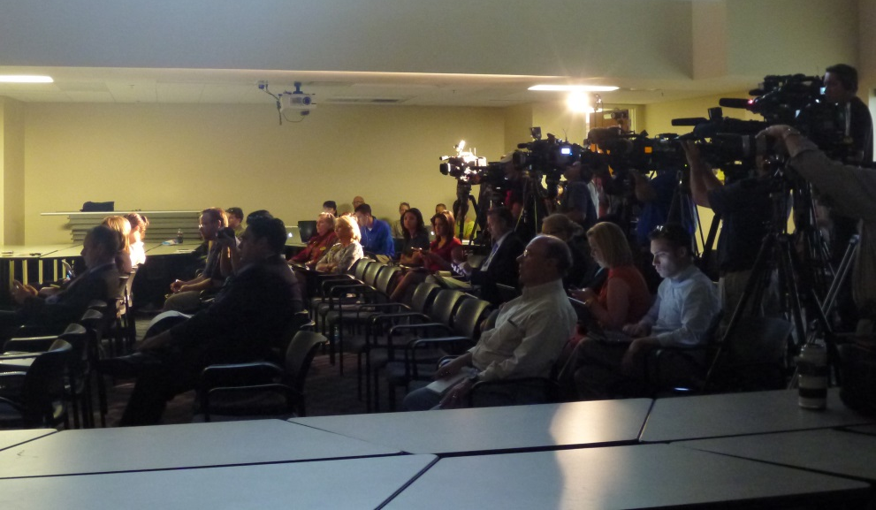
Media Cont.

Slide 40
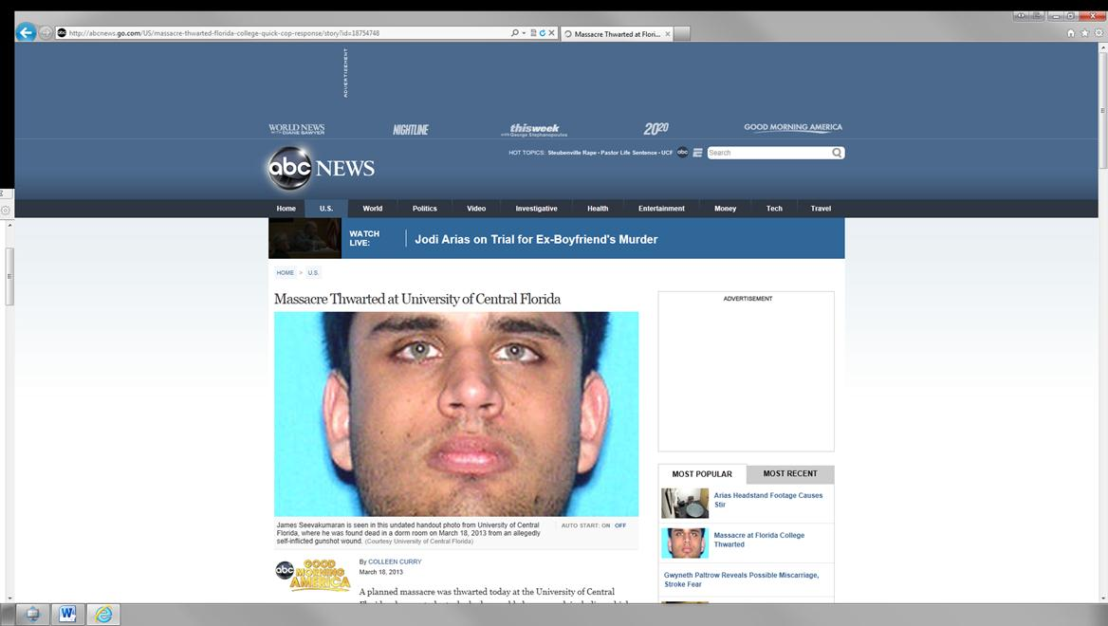
Media / ABC News

Slide 41
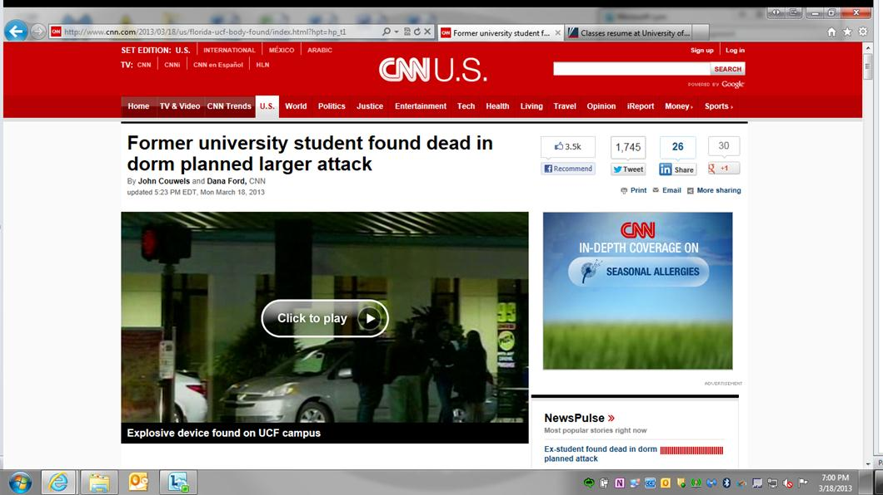
Media / CNN

Slide 42
Post Event
Fire Drills
Counseling (days after)
  Florida Crisis Response Team
Students moving out of Tower 1
Safety Forums
Letters Sent
  Students
  Parents
Phone calls and emails received from students and parents

Slide 43
Lessons Learned
Displaced Students
  Medications, cell phones, school work
Vests on scene
Conference Calls
Go Binders
Weather tracking
Floor plans
Briefing times
Catching lessons learned
Photographs
Key and Essential Personnel

Slide 44
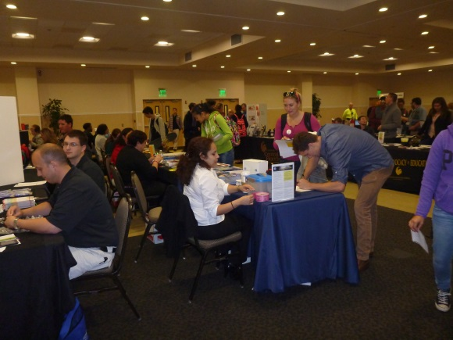
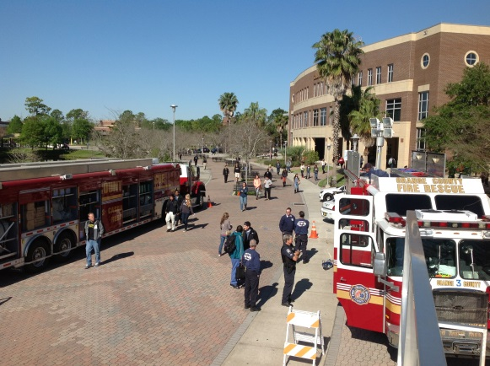
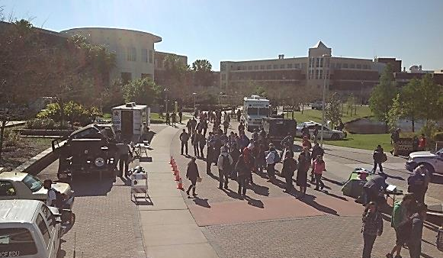
Lessons Learned Cont.
Clery Act
  Document all alerts and messages that go out to your community
  Document your timeline of events
  24 page report (OEM / N&I / PD)
After Action Review (AAR)
  92 Page report (OEM)
  Internal and external reviews
KnightShare
  Rebuilding the feeling of Safety
Notes:
ICS Form 204

Slide 45
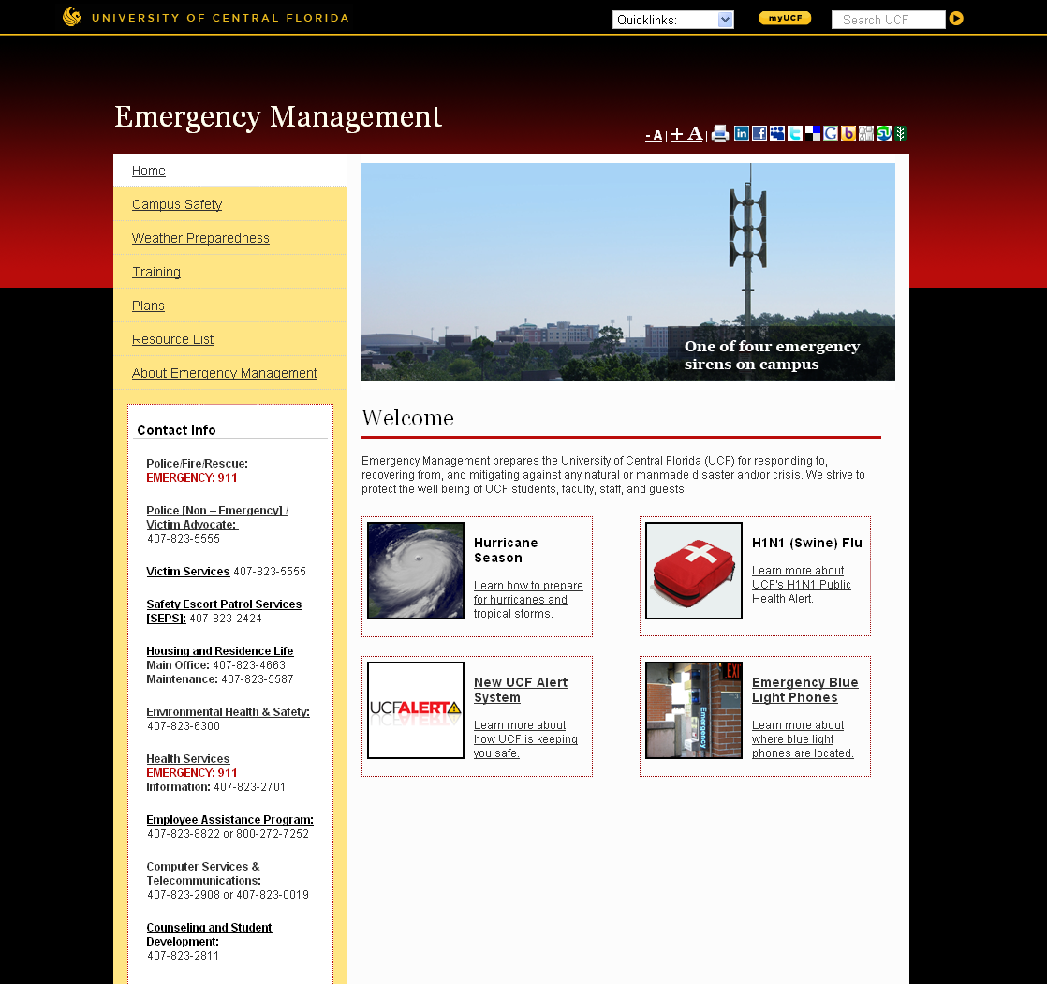
For more information…
Jeff Morgan
Director OEM
Jeff.Morgan@ucf.edu
407-882-7111
www.emergency.ucf.edu

