Slide 1
2013 DSS Rating Matrix & NISP Enhancements for Your Security Program
12 September, 2013
Brian Mannix
Northrop Grumman Melbourne
Site Security Manager & FSO

Slide 2
Security Rating Matrix
Objective is to provide a standardized approach to issuing security ratings throughout DSS
Provides a quantitative approach to assessing facilities utilizing a standard worksheet
The worksheet is a DSS tool, designed to standardize and improve consistency
Numerically based, quantifiable, and accounts for all aspects of a facility’s involvement in the NISP

Slide 3
Security Rating Matrix
Points based rating system
All facilities start with the same score (700)
Points are added for identified National Industrial Security Program (NISP) Enhancements
Points are subtracted for vulnerabilities by NISPOM reference
Acute/Critical and Non-Acute/Non-Critical vulnerabilities are weighted separately
Points are subtracted by NISPOM reference, not by number of occurrences
Accounts for size and complexity of a facility

Slide 4
Security Rating Matrix – 2013 Update
Implemented September 1st
Not a drastic change from previous approach
builds upon the original implementation to further add clarity, drive consistency, and encourage more robust security programs
DSS collected feedback on original system from field personnel and industry partners
Objective is to refine a more transparent, consistent, objective process designed to identify and mitigate vulnerabilities while recognizing practices in place that enhance security programs beyond baseline NISPOM requirements

Slide 5
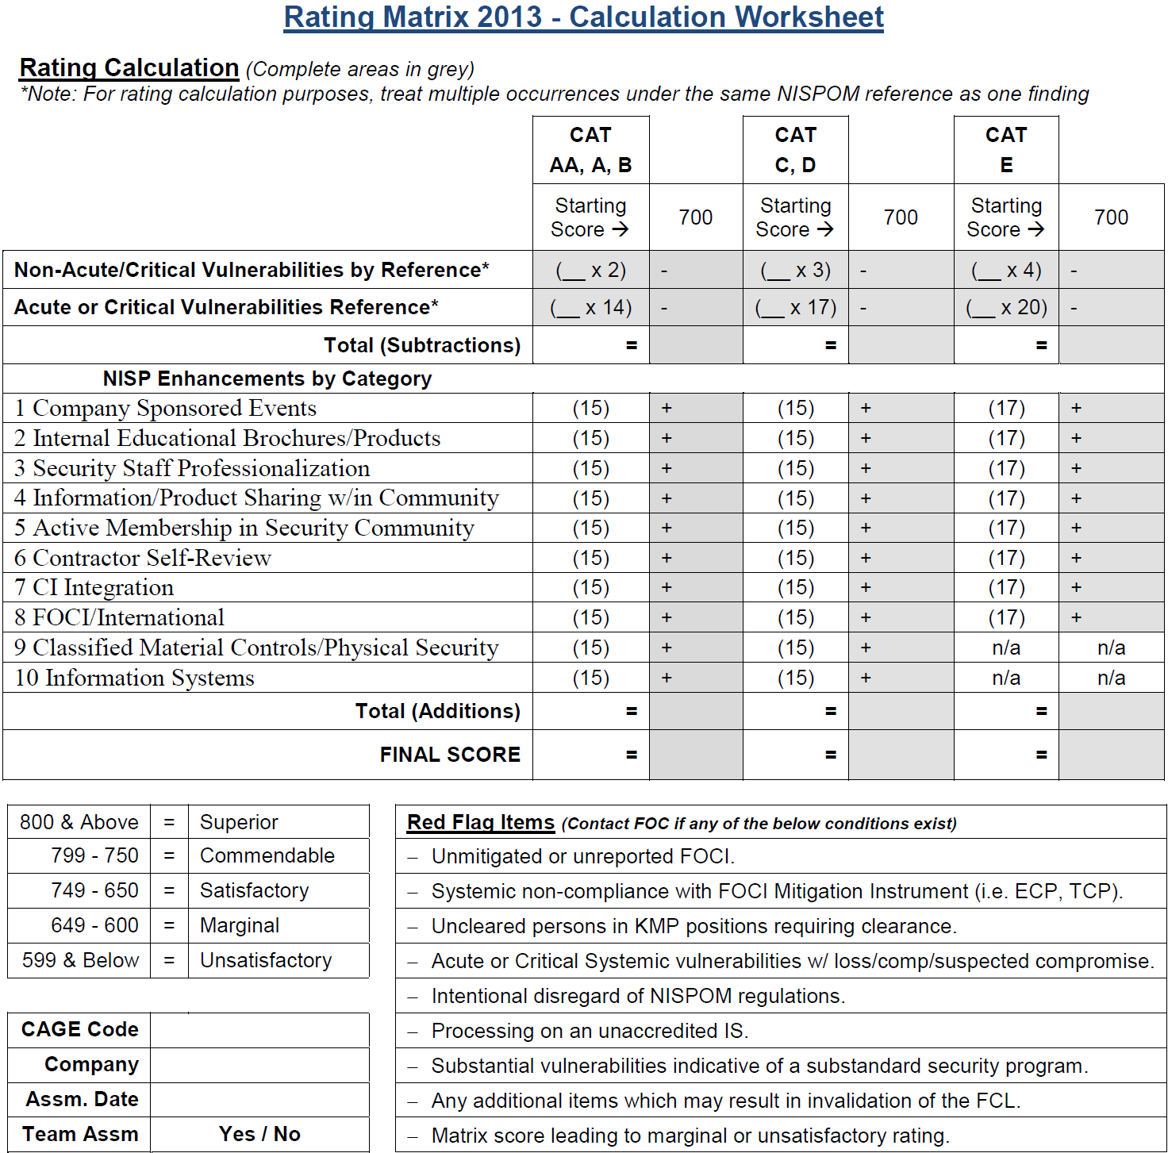
2013 Rating Matrix

Slide 6
Changes to Enhancement Categories
Removed Cyber Security from Counterintelligence Integration
Combined FOCI & International
Combined Membership/Attendance in Security Community Events & Active Participation in the Security Community
Removed Personnel Security

Slide 7
Vulnerabilities
Acute Vulnerability – Vulnerabilities that put classified information at imminent risk of loss or compromise, or that have already resulted in the compromise of classified information. Acute vulnerabilities require immediate corrective action.
Critical Vulnerability - Those instances of NISPOM non-compliance vulnerabilities that are serious, or that may place classified information at risk or in danger of loss or compromise
Once a vulnerability is determined to be acute or critical, it is further categorized as either “Isolated”, “Systemic”, or “Repeat”
All other Vulnerabilities are defined as non-compliance with a NISPOM requirement that does not place classified information in danger of loss or compromise

Slide 8
Common Vulnerabilities
Failure to initiate a preliminary inquiry upon notification of a report of loss, compromise, or suspected compromise of classified information
Failure to appropriately mark classified information and material
Retaining classified information from an expired contract beyond the authorized two-year retention period without obtaining written retention authority from the government contracting activity
Failure to change safe combinations to closed areas/containers when employees having access were terminated
Operating an information system that is or will process classified information without appropriate approval
Failure to perform audits on classified systems
Lack of anti-virus software
Unreported FCL change conditions
Periodic reinvestigations out of scope

Slide 9
Enhancements
A NISP enhancement directly relates to and enhances the protection of classified information beyond baseline NISPOM requirements
Directly related to the NISP and does not include other commonplace security measures or best practices
NISP enhancements will be validated during the assessment as having an effective impact on the overall security program
In order for an enhancement to be granted the facility must meet the baseline NISPOM requirements in that area
An enhancement directly related to a NISPOM requirement cited for a vulnerability may not be granted
If there are other effective enhancement activities in a specific category unrelated to a specific vulnerability in that category the enhancement credit may still be granted

Slide 10
Rating Matrix Categories
Category 1: Company Sponsored Events
Category 2: Internal Educational Brochures/Products
Category 3: Security Staff Professionalization
Category 4: Information & Product Sharing within Security Community
Category 5: Active Membership in Security Community
Category 6: Contractor Self-Review
Category 7: Counterintelligence Integration
Category 8: FOCI / International
Category 9: Classified Material Controls/Physical Security
Category 10: Information Systems

Slide 11
Presentation of Enhancements
Must be presented at the beginning of the assessment
Provide documentation supporting enhancements to the DSS rep
DSS must be able to validate the enhancement
Make the validation as easy as possible
Identify the enhancements that you believe you qualify for and state why you feel your program qualifies for it
Provide all supporting documentation
Keep it neat, organized, and concise
Consider using a binder, folder, or some other mechanism to provide all supporting information in one place

Slide 12
Category 1: Company Sponsored Events
The facility holds company sponsored events
Intent of this category is to encourage cleared contractors to actively set time aside highlighting security awareness and education. This should not be a distribution of a paper or email briefing, but rather some type of interactive in person activity.
Security awareness month/week, Lunch & Learn session, Guest Speaker, Hosting Security Webinar
Free speakers available within Government & Industry (use the contacts you make today)
Lunch sessions don’t require a charge number
Consider a raffle or give-away to boost attendance
Host a FISWG/NCMS meeting (guest speaker will be coordinated for you)
Invite your employee population
Conduct training at a customer location or have employees attend training at another contractor facility
Be sure to document attendance at all training/briefing session for your validation file

Slide 13
Category 2: Internal Educational Brochures/Products
A security education and awareness program that provides enhanced security education courses or products to the entire employee population
Monthly/weekly security updates or notices or write an article for a corporate publication
Have department heads brief it in their staff meetings or better yet have them let you brief it
Distribute security education information received from outside sources (Government, security organizations, professional societies etc.)
Be sure that the content is relevant to your Security program (comment on the newsletter/article; identify how it is applicable at your facility)
Many sources available
FBI Tampa National Security Threat Awareness Monthly Bulletin
Develop training products for uncleared employees that train them on companies FCL and how it may affect them
Suspicious contact reports, adverse information reports, how to recognize unprotected classified information and how to properly report it
Posters/brochures posted around facility
Keep them updated, they are available free of charge from many sources
FISWG Website http://fiswg.research.ucf.edu/education.html
DSS CDSE http://www.cdse.edu/resources/posters.html
IOSS OPSEC Posters https://www.iad.gov/ioss/department/posters-10016.cfm?startPage=31
Google “Security Posters” (be sure to not violate any copyright protection)
Items not considered as an Enhancement
Forwarding the DSS newsletter, annual refresher training for cleared population, PII training

Slide 14
Category 3: Security Staff Professionalization
Security staff training exceeds NISPOM and DSS requirements and incorporates that knowledge into NISP administration
Intent of this category is to encourage security program’s key personnel to actively strive to learn more and further their professional security expertise beyond mandatory requirements
Obtaining and maintaining professional certifications
Certified Protection Professional (CPP), SPeD Certification, Computer Information Systems Security Professional (CISSP), Industrial Security Professional (ISP) etc.
Partial completion of a training program (beyond base training requirements per NISPOM 3-102 and 8-101b)
Final training certificate is not a requirement to receive credit
Additional CDSE courses, STEPP courses, NCMS “brown bag” training sessions
Items not considered as an Enhancement
Currently possess a certification but has not taken any training or ongoing certification maintenance within the assessment cycle
Taking a 20 minute CDSE course won’t meet the criteria, must show that a significant effort has been made to further education on topics relative to your operation

Slide 15
Category 4: Information/Product Sharing within Community
Facility Security Officer (FSO) provides peer training support within the security community and/or shares security products/services with other cleared contractors outside their corporate family
Intent of this category is to encourage cleared contractors to actively reach out to other cleared contractors to assist those who may not have the expertise or budget and provide them with security products, services, etc.
Sharing classified destruction equipment with the local security community or serve as a source for fingerprinting employees from other cleared contractors
Provide training and support for new facilities
Electronic Facility Clearance (eFCL), JPAS, Electronic Questionnaire for Investigations Processing (eQIP), Technology Control Plans, Transportation Plans, Self Inspection etc.
Serve as a mentor to another security professional
In most cases the mentor gets just as much out of the relationship as the mentee
Items not considered as an Enhancement
Sharing or providing products/services to companies or agencies that are not participating in the National Industrial Security Program
Any of these activities related to or in conjunction with security organizations such as Industrial Security Awareness Council (ISAC), National Classification Management Society (NCMS), American Society for Industrial Security (ASIS), etc. Items relating to these types of groups would fall under Category 5.

Slide 16
Category 5: Active Membership in Security Community
Security personnel are members and actively participate with NISP/security-related professional organizations
Intent of this category is to encourage security programs to actively collaborate with their local security community to identify best practices to implement within their own NISP security programs
Membership and active participation in NCMS, FISWG, NISPPAC, AIA, NDIA, ASIS, ISAC etc.
Just being a member won’t count as active participation
Hold a board member position, participate on a committee, or volunteer to assist at an event
Attend as many sessions as possible and keep attendance certificates/meeting documentation for your validation file
Verification of enhancement is aimed at determining what were the take-aways from events, how do they apply to the facility’s security program and how is the security staff implementing this information
Security personnel unable to attend meetings on a regular basis can collaborate virtually via the organization’s websites, email etc. (document for validation)
Hosting or speaking at professional organization meeting or seminar

Slide 17
Category 6: Contractor Self Review
Implement a thorough, impactful review of your security posture
Intent of this category is to encourage cleared contractors to maintain an effective, on-going self-review program to analyze and identify any threats or vulnerabilities within their program and coordinate with DSS to address those issues prior to the annual assessment
Provide DSS with a detailed report of your self-review to include identified threats or vulnerabilities, analysis, and countermeasures to mitigate vulnerabilities, and collaborate with DSS to correct prior to the annual assessment
Conduct multiple documented self-reviews providing an on-going, continuous evaluation of the security program
Participate in an internal corporate review program and have another site review your program
Participate in a review with another contractor that you have a contractual relationship with
i.e. prime contractor assisting a subcontractor or a consultant with an applicable need-to-know (DD254)
Items not considered as an Enhancement
Using only the CDSE Self-Inspection Handbook for Contractors or sending the checklists to DSS without a comprehensive analysis and vulnerability mitigation plan
Conducting partial or incomplete self inspections and not closing out actions to mitigate vulnerabilities found

Slide 18
Category 7: Counterintelligence Integration
Build a counterintelligence (CI) focused culture by implementing processes within their security program to detect, deter, and expeditiously report suspicious activities to DSS through submission of suspicious contact reports (SCR)
Intent of this category is to encourage cleared contractors to develop vigorous and effective CI programs that thwart foreign attempts to acquire classified and sensitive technologies. Critical elements of a vigorous and effective CI program include timely reporting, understanding the threat environment, and agile and authoritative decision making to neutralize or mitigate vulnerabilities and threats.
Implement effective foreign travel pre-briefings and de-briefings designed to identify contacts or activities displaying potential espionage indicators
Conduct in person or by phone
Use relevant information to the where is individual is traveling
Implement an effective Insider Threat program designed to identify employees displaying potential espionage indicators
Notify DSS of all incoming and outgoing foreign visitors prior to occurrence and assist with IC activities, to include implement briefing and debriefing program for persons hosting foreign visitors
cooperate with Intel and Law Enforcement communities when pursuing potential penetrators
Items not considered as an Enhancement
Using sterile travel laptops with full disk encryption for employees travelling OCONUS
Utilizing a centralized mailbox to collect potential SCR notifications
Effective awareness program that ensures all employees (cleared and uncleared) are cognizant of individual reporting responsibilities

Slide 19
Category 8: FOCI / International
Implement additional effective procedures to mitigate risk to export controlled items and/or FOCI
Intent of this category is to encourage cleared contractors to implement an enhanced export control program increasing the effectiveness. For FOCI mitigated facilities, intent is to encourage activities above mitigation instrument requirements to further minimize foreign influence at the facility.
Items which are requirements of the mitigation instrument may not be counted as enhancements
International
Establish briefing and debriefing program for persons hosting foreign visitors
Develop a Foreign Visitor management system to include foreign national visitors being approved by export control and security before arrival
Conduct security briefs for all FN visitors on the TCP
Conduct, or have outside experts conduct, ongoing export compliance audits and share the results with interested U.S. Government Agencies
FOCI
Performs significant trend analysis of internal governance processes and interactions with the foreign parent company and affiliates
Implement and maintain a system for automatic designation of emails to/from foreign parent/affiliates
Require that all electronic communications to the parent or affiliates obtain advance approval
Outside Directors, Proxy Holders, or Trustees interact directly with the cleared contractor site employees (training program, vulnerability assessment, compliance visits, etc.) with effective impacts
Appoint additional Outside Directors, Proxy Holders, or Trustees
Must demonstrate the benefit in additional FOCI oversight these persons add (i.e. OD is assigned specifically to monitor and report on X)

Slide 20
Category 9: Classified Material Controls / Physical Security
Deploy an enhanced process for managing classified information and/or implement additional Physical Security measures, with built-in features to identify anomalies.
Intent of this category is to encourage security programs to maximize the protection and accountability of classified material on-site by implementing effective processes, regardless of quantity of classified holdings
100% inventory and accountability for Secret and Confidential material
Working papers are fully marked and accounted for regardless of date of creation
Safe custodian performs 100% check-in/check-out of materials & reviews material for appropriate markings and classification
Monitored and recorded CCTV, card access readers, biometric equipment strategically positioned around controlled areas with on-going analysis of data
Enhance supplemental controls with written procedures outlining guard personnel responsibilities to include:
verifying safes, closed areas, etc. are properly secured and verifying areas are free of classified information and maintain documentation of performance
Items not considered as an Enhancement
Establishment of documented tracking system for inspections of areas above and below false ceilings/floors in Closed Areas
Combination changes more frequently than required
100% inventory conducted during self-inspection does not count towards enhancement
Enhanced supplemental controls that do not have an impact on protection of classified information are not counted as enhancement

Slide 21
Category 10: Information Systems
Incorporating process enhancements and leveraging tools to expand the overall security posture of accredited information systems
Intent of this category is to encourage security programs to maximize protection of classified information on IS
Development and use of a formalized SOP and a comprehensive checklist to augment a detailed weekly audit review process which describes what is performed during the review of large, complex IS (LANs/WANs) with multiple Operating Systems
Additional IS oversight processes put in place to enhance security of classified information residing on IS
Develop, implement, and utilize significant and effective (LAN/WAN based) Information System audit trail reduction/collection or analysis tools/scripts
These tools help focus on real security relevant events while minimizing the amount of non-security relevant data extracted within the audits
Use of a file or scripts that tracks downloaded files, unauthorized classified downloads, or unauthorized USB connections and review/auditing of report outputs
Utilize scripts to maintain compliance to the SSP and ODAA's baseline
The scripts validate Security Relevant Object (SRO) settings and report back if discrepancies are found
ISSM reviews and acts on report findings

Slide 22
Category 10: Information Systems
Items not considered as an Enhancement
ISSM or ISSO is certified (this would fall under Category 3)
Employing a color coded labeling system for components for both classified and unclassified networks
Providing additional user training, briefings, etc. to people who are going to hold the privileged user position
Developing reports that identify when a system is due for re-accreditation, systems that are in the ODAA process for a period of time, when audits should be performed on accredited systems
Developing a method to patch and maintain time on air gapped systems
Utilizing scripts to apply and maintain antivirus definition updates
Utilize a method to track SID numbers

