Slide 1
Classified Material Courier
April 2017

Slide 2
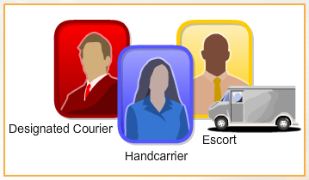
Introduction
Why use a Classified Material Courier?
Mission requirements, sensitive materials, and time constraints sometimes make the use of a classified courier the preferred method for transporting sensitive materials either between our company facility locations locally or to other government customer facilities and/or industry partner facilities over long distances.
Couriering classified material by hand poses special risks. To mitigate these risks, the National Industrial Security Program Operating Manual (NISPOM) and other associated customer-specific documents specify certain requirements and procedures that must be followed.
One such requirement is a training briefing to inform classified material couriers of their of their responsibilities and obligations in performing their duties.

Slide 3
Introduction
Purpose of this Briefing
A briefing is required whether an individual is taking a single classified document to the building next door or escorting truckloads of classified hardware across the country.

Slide 4



Introduction
Definitions
Designated Courier
  An individual who has been properly briefed and authorized in writing to transport classified material between contractor to government or contractor to contractor facilities and is cleared and authorized access for the material being transported.
Handcarrier
  An individual who has been authorized to transport classified material in a local geographic area and is cleared and authorized access for the material being transported.
Escort
  An individual who is responsible for maintaining positive control of sensitive classified material in transit but is not cleared for the information nor permitted access to it.

Slide 5



Pre Trip Considerations
The material must be properly prepared for shipment
Couriered material must be inventoried, wrapped and marked in a very specific manner which, in most cases, MUST be done by your security officer.

Slide 6
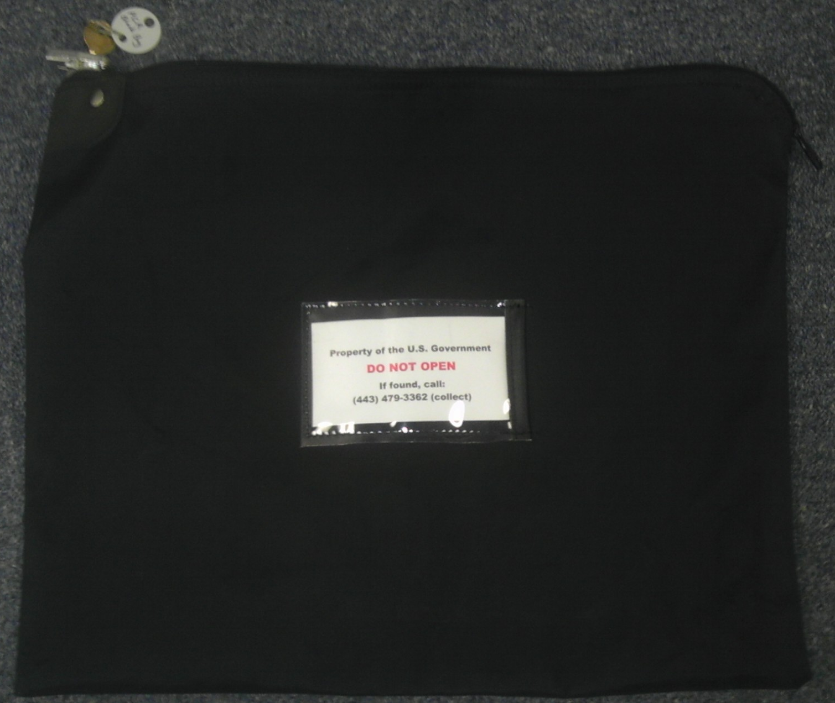


Pre Trip Considerations
The material must be properly prepared for shipment
In some cases, material may not need to actually be wrapped but instead may be placed within a set of two locking briefcases.

Slide 7

Pre Trip Considerations
Ensure travel documents are in order
Your Security Officer may issue you either a courier badge (usually for frequent local missions) or a courier authorization letter. Government regulations require the courier authorization letter to contain the following information:
  Name of the company
  Full name and description of the courier
  Type and description of the ID the individual will present
  Description of the material being carried
  Point of departure, destination and known transfer points
  Effective dates of authorization
  Name, title and signature of official authorizing the mission
  Name, title and phone number of government agency authorizing the mission

Slide 8


Pre Trip Considerations
Carry proper identification
In addition to carrying a form of government picture identification such as a driver’s license or passport, the NISPOM requires that all couriers have an identification card or badge that includes the contractor’s name, the employee’s name, and a photograph of the employee.
  Your company ID badge meets this requirement.
Defense Division

Slide 9


Pre Trip Considerations
If traveling by commercial airline…
Non-stop flights should be booked whenever possible.
U.S. flag carriers should be used whenever possible.
You must abide by all normal airport security screening (X-ray, etc.).
It may be necessary for your Security Officer to make prior arrangements with the airport, airline and/or Transportation Security Administration (TSA) to ensure you move through their security checkpoints with no problems.

Slide 10

Pre Trip Considerations
Prepare for contingencies
Prepare your route
  Know where you are going and how to get there. Research your route and print out a map if you are unfamiliar with your destination.
Stay in contact
  If something unforeseen happens during your trip, have a means of contacting emergency assistance and/or someone back at the office to keep them informed or to request assistance or guidance.

Slide 11
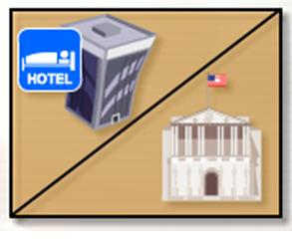
Pre Trip Considerations
Prepare for contingencies
Make storage accommodations in advance
  If you know in advance that a stop is likely going to be necessary while in transit, the Security office should make prior arrangements with an authorized facility to store the material overnight.

Slide 12

En Route Considerations
Keep the material in your constant possession
DO NOT store the package in an unauthorized way
  Do not store the material even temporarily at home, in a hotel safe, airport locker, etc.
  If an emergency occurs en route which requires temporary storage of the material, contact your security officer or the nearest Defense Security Service field office who will make arrangements and provide guidance.

Slide 13



En Route Considerations
Maintain a low profile and use good judgment
DO NOT discuss the material in public
  Be discreet when discussing your mission, even with official personnel.
DO NOT open the package
  Do not, under any circumstances, open the package for airport screeners or other law enforcement officials.
  If pressed by an airport screener, discreetly ask to speak with a supervisor and, if necessary, cancel your trip and return with the material to your originating location.
DO NOT impair yourself in any way during the mission
Do not drink alcohol or take any medications that may impair your judgment

Slide 14





En Route Considerations
Using a public restroom
When nature calls…
Use a stall next to a hard exterior wall and set the material on the floor next to that wall.

Slide 15


En Route Considerations
When transporting in a vehicle…
  Keep the material in the passenger compartment with you (size permitting) vice storing it in the trunk.
  DO NOT deviate from the schedule or planned route
    Make no unauthorized or unnecessary stops on the way to your destination
    You may not stop for a meal during a local courier run
      You may stop for a meal on a long distance courier trip; however, you must keep the material with you at all times.

Slide 16
En Route Considerations
When transporting via airline…
  Arrive early anticipating possible delays at ticket counters or when going through security checkpoints.
  DO NOT check the material in with your luggage.
  DO NOT linger in the ticket area; move through the security checkpoint as quickly as possible.

Slide 17
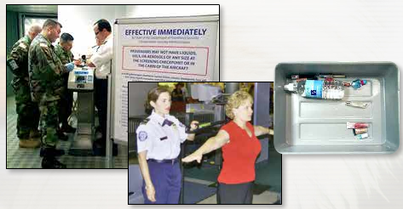
En Route Considerations
When transporting via airline…
At the security checkpoint
  Ensure you have nothing on your person that might delay your rapid progress through the checkpoint.
  Wait until the person ahead of you has collected their belongings and left the area before allowing the classified material to go through the X-Ray machine (if it is able to).
  If the Transportation Security Authority (TSA) pulls you aside for any reason it is your right and obligation to collect the couriered package (as well as your personal belongings) before they do so.
Do NOT allow the classified package to be opened at the airport!

Slide 18
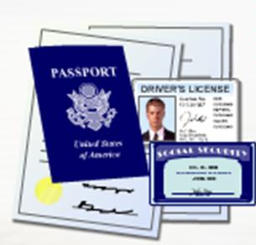


Arrival Considerations
Turnover of material
Upon arrival at the destination location, the material must be turned over only to the pre-determined and properly identified recipient.
The material should only be turned over if the recipient has an appropriately secure facility and an approved security container in which to store the material.
Be sure to obtain a receipt for the package if the material will remain at the destination.

Slide 19

Conclusion
Questions?

