Slide 1
Personnel Security Management Office for Industry Update
December 2013
Presented by:
Chuck Tench and Nick Levasseur

Slide 2
Functions of Personnel Security Management Office for Industry (PSMO-I)
Personnel Clearance
Processing
Customer Support
e-QIP submissions
Non-disclosure Agreement (SF-312)
e-Fingerprints
centralized communication
NISP Rqmts
PCL
Oversight
increased visibility
efficiency
PSMO-I
Clearance System Records Data Management
systematic vision
timeliness
Interim Clearances
Overdue PRs
collaborative effort
streamlined processes
PCL Eligibility/Access
Liaison to DoD CAF
Interim Suspension
Incident Report Oversight

Slide 3
Call Center Information
JPAS, SWFT, DCII, and non-Industry e-QIP call center functions have transitioned from the DSS Call Center to the DMDC Contact Center.
DSS Call Center:
Contact Information
1-888-282-7682
call.center@dsshelp.org
Menu Options:
1 – STEPP/ISFD/Industry ONLY e-QIP Account Lockout or Password Reset
2 – Personnel Security or Facility Clearance Inquiry
4 – e-QIP
5 – STEPP
6 – ISFD
8 – General Inquiry / Call Center Contact Information
DMDC Contact Center:
Contact Information
1-800-467-5526
dmdc.contactcenter@mail.mil
dmdc.swft@mail.mil
Menu Options:
1 – JPAS
2 – e-QIP (Non-Industry)
3 – SWFT
4 – DCII
5 – Personnel Security Inquiry
6 – General Inquiry / Contact Center Information
Click here for the DSS SAR
Click here for the DMDC PSSAR

Slide 4
JPAS and SWFT Updates
SWFT Announcement:
SWFT will be PK-enabled (Dual authentication starting in December and removal of UserID/PW in March)
4 weeks left until the electronic fingerprint submission deadline.
JPAS Release 5.2.0.0 Enhancements (18 JAN):
Remove Collab CAF from JCAVS request screens
Remove option to search records by EDIPI
Display indoctrination date on SCI and non-SCI access history
Current Eligibility will be placed on person summary screens
Comment block added to Visit Requests

Slide 5
Hot Topics
e-QIP Submission Reject Reasons
Fingerprint Cards missing
Spouse information missing
LOJ/NDM
Loss of Jurisdiction – posted when separated with open incident
No Determination Made – posted when no response to government request
JPAS – Data Quality Initiatives
Owning/Servicing Relationship required
Separation posted and still in access
https://www.dmdc.osd.mil/psawebdocs/docPage.jsp?p=JPAS
Overdue PRs
Submit overdue PRs
Subject remains eligible for “Access” unless CAF indicates otherwise

Slide 6
Hotter Topics
Security Vulnerabilities
Findings show PCLs account for 25.4% of FY13 vulnerabilities
Top 3 reasons:
JPAS Maintenance & Deny Access for D/R/LOJ
Personnel Security Clearance
SF 86 Data Retention/Destruction
Continuous Evaluation
Future efforts within DoD
Efforts include
Privileged Users (1.5K);
CECD (100K);
Access Elsewhere (3K)
New SF-312
DNI published new SF312 form dated 7/2013
Use this link here
PSMO-I will start rejecting old form January 2014
Note: Hyperlinks only work in “Slideshow View”. Click Shift+F5

Slide 7
Hottest Topics
HSPD-12
DoD implemented HSPD-12 for uncleared contractors that requires NACI background investigations for physical/logical access to systems/installations
Government is responsible for submitting, paying and adjudicating
OPM's CVS system will store HSPD-12 adjudicative determinations
FSOs should not create JPAS records for personnel who do not require access to classified information (DoD guidance forthcoming)
If a government activity is asking an FSO to enter data into JPAS for the uncleared contractor population, please contact AskPSMO-I@dss.mil and provide the government installation making the request.
RRU Changes
Stay tuned to the DSS website for upcoming changes to RRU submission criteria related to PSMO-I and DoD CAF (Research, Recertify and Upgrade)
Incident Report
National Security – start with SF86 questions
Inability to function day-to-day | performance issues | threat to workforce

Slide 8
PSI Update (as of 3 Dec 13)
PSMO-I
Total submissions in JPAS: 11,557
Oldest e-QIP: 31 Oct 13
PPR: 4,589
SSBI: 1,241
NACLC: 5,754
Resumed submissions 23 Oct 13
JPAS request from Industry: ~600/day
DoD CAF
Started adjudicating all cases: 17 Oct 13

Slide 9
Why Implement Electronic FP
1
2
3
Policy Changes
Future Interim PCL Policy Change
Compliance
OSD policy requires electronic
submission NLT December 2013
Future Interim PCL Policy Change:
Investigation Scheduled
Review FP results
Review National Databases
Review SF-86
Interim PCL process aligns to HSPD-12 and national security standards
4
5
6
Improve Efficiencies
Delay/Rework
Added Benefit
Technology and process changes can overcome policy and reject issues
14 day fingerprint rule is OPM #1 reject reason
Interim PCL granted
Rating Matrix Enhancement
BAE sharing fingerprint equipment and DMDC posting of e-Fingerprint Service Providers
Note: Hyperlinks only work in “Slideshow View”. Click Shift+F5

Slide 10
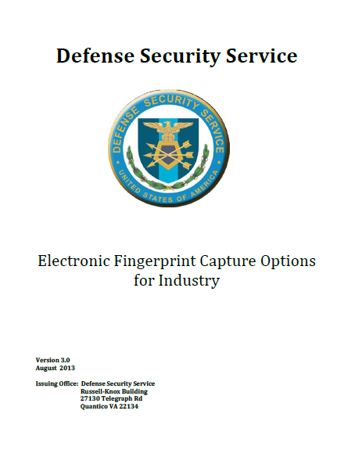
eFP Implementation Options
The December 2013 deadline for implementing an eFP solution is quickly approaching. Please review the eFP Implementation Guide to figure out which option is best for your company.
Option 1
Company purchases eFP capture equipment and submits FPs through SWFT
Costs: one time equipment + maintenance
Option 2
Multiple companies share costs to purchase eFP capture equipment and submit FPs through SWFT
Costs: one time equipment + maintenance
Contacts
Email questions:
PSMO-I: AskPSMO-I@dss.mil
SWFT: dmdc.swft@mail.mil
eFP Setup & Submission
Option 3
Cleared company submits eFPs through SWFT on behalf of other company
Costs: per transaction fee
FBI Product List
FBI Approved Channeler List
Click Here
SWFT - Registration, Access and Testing Procedures
DMDC-SWFT Homepage
Option 4
Third Party Vendor provides eFPs to cleared company to submit through SWFT
Costs: per transaction fee
Option 5
Government entity supports cleared company to submit eFPs to SWFT or OPM
Costs: none at this time, subject to availability
When submitting eFPs use:
SOI: DD03
SON: 346W
IPAC: DSS-IND
Note: Hyperlinks only work in “Slideshow View”. Click Shift+F5

Slide 11
PSMO-I Contact Information
The Personnel Security Management Office for Industry (PSMO-I) has moved!
Our new contact information is as follows:
Address: Defense Security Service
ATTN: PSMO-I
7556 Teague Road, Suite 500
Hanover, MD 21076
Phone: 443-661-1320
Fax: 443-661-1140
Email: AskPSMO-I@dss.mil
Fax SF-312s

Slide 12
Notes:
12

