Slide 1
OPSEC
Awareness Briefing
Multi-Function Printer (MFP) Security

Slide 2
What is a Multi-Function Printer (MFP)?
Most printers currently found on the market are considered to be multi-function, meaning that they can do more than just print a document.
The majority of printers now include a scanner which allows for the digital scanning of images and documents.
A large number of these devices also have fax and network transmission capability.
They may also have integral USB ports which allow the user to print directly from a thumb-drive or save scanned images.

Slide 3
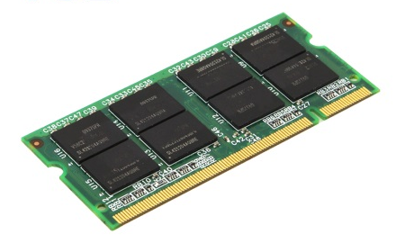
MFP Security Risks
Volatile and Non-Volatile Memory
A key issue regarding the potential risk of an MFP is whether or not the device stores information via volatile or non-volatile memory.
MFPs which contain either form of memory present a certain degree of risk, however devices with non-volatile memory signify a greatly increased threat.
Volatile memory is automatically deleted once a
device loses power.
Non-volatile memory is retained even if the device loses power.

Slide 4
MFP Security Risks
Non-Volatile Memory
Devices with non-volatile memory may retain data long after a document has been printed or scanned.
This information can be recovered and reproduced outside the document owners control.
Faulty or malfunctioning devices which require repair are particularly at risk as service professionals will have full access to any data still in memory.

Slide 5
MFP Security Risks
Mitigating Non-Volatile Memory Risks
Restrict access to MFPs with non-volatile memory.
Do not use these devices for the reproduction or scanning of sensitive information.
Take proper steps to destroy the machine’s memory when it goes out of service.
Observe any repairs made to the device by 3rd party personnel.
Coordinate with your local IT team for options on how to better secure the MFP.

Slide 6
MFP Security Risks
Mitigating Non-Volatile Memory Risks
Some modern MFPs can be configured for disk encryption, automatic disk wiping, and automatic log wiping. Each of these features can enhance security on your device. Check with your local IT Department for additional assistance.
Ascertain if your device supports passwords, and use them.
Take the time to inspect your MFP and determine its capabilities and potential vulnerabilities.

Slide 7
Other Basic MFP Security Tips
If it can be avoided, you should never print confidential or proprietary data to a shared printer. Most USB equipped printers will allow the printing of images, as well as Microsoft Word or PDF documents, directly from a thumb-drive. Hand carrying your critical documents to the printer on a USB drive is a great security practice and ensures that you keep constant control on your documents.
Don’t leave documents sitting on the printer. Even non-critical information can be misused if seen by the wrong individual.
Double-check the printer after each use. Ensure that you have recovered all your printed copies, documents on the scanner bed, and any USB drives.

Slide 8
Additional Questions?
Please contact your Facility Security Officer if you have any questions regarding this training.
For additional technical issues it is highly recommended that you discuss potential safeguards with your IT Department.

