Slide 1
The Importance of New Hire Orientation - FISWG
Karen Atkins
12 September 2013

Slide 2


Objectives
  Security - Key Role in New Hire Orientations
  Targeted Audience
  FSO New Hire Briefing
    Brief Company Overview
    Site Overview
    Security Policies
    Physical Security
    OPSEC & Social Networking
    Counterintelligence/Cyber
    Security Awareness
    Cleared Employee
    Takeaways

Slide 3


Security – Are you involved?
  Collaboration across functions
    Human Resources
    IT
    Business Development
    Program Management
    Trade
    Engineering
  Understand the business/products
    Attend PDRs, design reviews, contracts meetings, supply chain meetings, etc.

Slide 4

Target Audience
  ALL Employees
    Cleared and uncleared
    Key source of information
      Eyes and ears out in the plant
  Open Door Policy
    Create the right atmosphere
    Open minded and solution driven
    Every employee is responsible for protecting
    both unclassified and classified information, company proprietary, etc.

Slide 5

Company Overview
  Provide a Company Overview
    Headquarters / Locations (include map)
    Company History
      Mergers & Acquisitions
    Division/Group/Sector Names
    Number of employees worldwide
    Target markets/customer base

Slide 6

Site Overview
  Provide Site Specifics
    Leadership Chart
    Facility Information
      Clearance Level
    Employee Base (temps, etc.)
    Products Information
    Customer Base
      DoD
      Commercial
    Manufacturing Capabilities

Slide 7
Security policies
  Provide overview of policies
    Badge Policy
    Visitor Policy
    Technology Control Plan
    Electronic Communication Plan/IT Addendum
    Information Security
      Acceptable Use Policy
      IT Devices

Slide 8
Security Policies cont.
    Document Destruction Policy
      UNCLASSIFIED paper products
  Where are the policies located
    SharePoint / Electronic Library
    Hard Copy
    Security Office

Slide 9

Physical security
  Ensure you provide detailed information about physical security
    Building entry/exit points
    Access control
    Guards
    Lobby Inspections
    Prohibited Items

Slide 10

OPSEC and Social Networking Sites
  Brief overview on how Facebook, Twitter, etc. may provide adversaries with critical information needed to harm or disrupt your mission
  Discuss OPSEC and how it may impact their professional and personal life
  Examples
    Personal Information
      Keep sensitive, work related information off profile
      When uploading photos it is best to remove the metadata containing the date, time and location information stored in the image’s file
    Passwords
      Protect your password (Never Share)
      Ensure your password is unique

Slide 11
Counterintelligence/Cyber
  Discuss how your organization may be a prime target to adversaries
  Examples
    People (US Government, Military, Contractors)
    Sensitive movement of operations/personnel/property
    Communications/networking
    Protection of nuclear/chemical/biological materials/weapons/etc.
    Classified / Unclassified Information
    System designs / Patents
    Intellectual property
    System capabilities/vulnerabilities

Slide 12
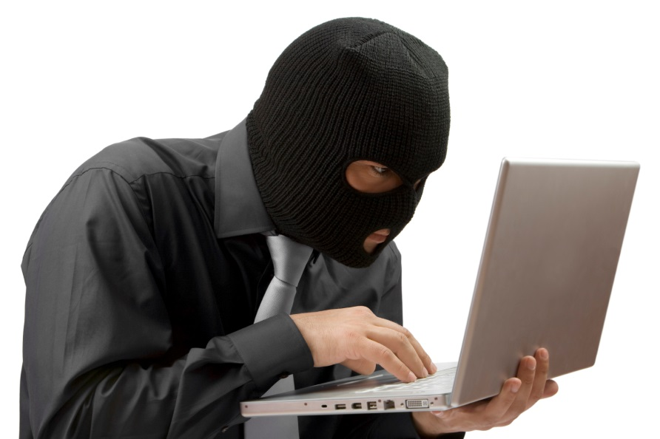
Counterintelligence/Cyber
  Brief on the Threats we face
    Competitors
    Foreign Intelligence Officers
    Hackers
    Insider Threat

Slide 13
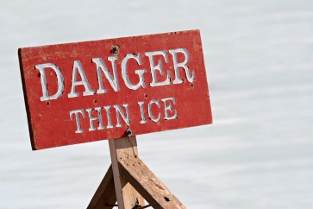
Security awareness
  Briefing should include:
    The Foreign Intelligence Threat
      The gathering of information by intelligence agents, especially in wartime, is an age-old strategy for gaining superiority over enemies.
    The Methods of Espionage
      Economic espionage is often conducted by using basic business intelligence-gathering methods.
    Indicators of Espionage
      Disgruntlement with one's employer or the U.S. Government
      Requests to obtain access to classified or unclassified information outside of authorized access

Slide 14
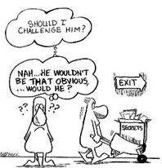
Security awareness cont.
  Briefing should include:
    Indicators of Espionage Cont.
      Cameras or recording devices, without approval, into areas storing controlled material
      Extensive, unexplained use of copier, facsimile, or computer equipment
      Attempts to conceal any activity covered by one of these counterintelligence indicators
    The Damage
      Translations - loss of trade secrets and loss of technology--in the billions--and in the loss of technological edge over our competitors, and most important it could result in the loss of lives

Slide 15

Security awareness cont.
  Briefing should include:
    Suspicious Contact Reporting
      What constitutes an SCR?
        Suspicious email, email from foreign entity, reference DSS briefing materials
      Why they should notify the FSO?
        Mandatory reporting requirements assists in protecting our warfighter and our company assets

Slide 16
Trivia - Do you know?
  How many SCR’s did your company submit?
    ??
  Top Technology Hits
    Cameras
    TWS
    Proprietary
  Contact Methods
    Company Website
    Direct email to employees

Slide 17

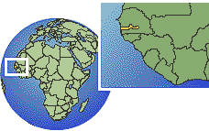
Security awareness cont.
  Briefing should include:
    Foreign Travel Reporting
      Why report?
        Safety and security advisories
      Recommend
        Face to face briefing
        Register with state department
        Follow up after travel

Slide 18


Trivia - Do you know?
  Lose a Memory Stick, Lose a Million Bucks
    PA Consulting lost the memory stick containing the details of 84,000 customers / the company had a contract work .5million terminated
  One in four users of social networking sites such as Facebook, MySpace and Friends Reunited unwittingly leave themselves open to crime by revealing personal details
  How long does it take to break your password?
    It takes a computer to guess a reasonable strong password with 5 lowercase, 2 uppercase and 4 numbers but more common passwords like “test”, “password” or “123” can be cracked in a very short time
    11 characters +80,318,101,760,000 Combinations

Slide 19

Face of security
EVERYONE IS RESPONSIBLE FOR SECURITY

Slide 20
Cleared Employee Briefing
  Recommend a Face to Face briefing within the first 2 weeks of employment

Slide 21

Takeaway
  Build your rapport with ALL employees
  Security Team must be viewed as a business partner, not a road block
  Ensure your policies are documented and available to all employees
  Be open to suggestions and new ideas
  Proactive/Solution driven
  Understand your business and know the players

