Slide 1
FISWG Spring Seminar JPAS & SWFT
Joe Jessop
March 12, 2014

Slide 2
JPAS Deletion
Inactive Account Deletion Policy
Locked at 30 days
Account removed at 45 days. This is down from the 90 day removal
Account Manager Policy
4.1.3 Mandatory Training
Cyber Awareness
PII Training
JPAS Training
Must be completed within the last year!!!!!
New Personnel Security System Access Request form PSSAR
DoD Form 2962

Slide 3
JPAS Release 5.3.0.0
Updated Mass Personnel Update functionality to only display/process subjects in a User’s SMO.
JCAVS Users will no longer be able to view and/or mass transfer subjects that are not being managed by the User’s SMO.
Enhanced Visit functionality screens to allow more data to be entered and to display additional data for the subject.
On the Visit screens, Users will now be able to add more information to an additional text field, see a subject’s current eligibility, manage a subject’s visit access, and see ‘Access Suspended’ in red font if applicable.

Slide 4
JPAS Release 5.3.0.0
Added more investigation types to be considered by the system before displaying the Indoctrinate link for a Civilian person category. The following investigations are now additionally considered as acceptable:
Special Background Investigation (SBI)
Minimum Background Investigation (MBI)
Minimum Background Investigation plus Current National Agency Check (MBIP)
Periodic Reinvestigation of Background Investigation (BIPR)
Background Investigation - 10 year scope (BITN)
Background Investigation plus Current National Agency Check (BIPN)
Background Investigation (BI)
Special Background Investigation/Single Scope Background Investigation plus Current National Agency Check (SBIP)

Slide 5
JPAS Release 5.3.0.0
Removed some of the investigation types that were being considered by the system before displaying the Non-SCI Indoctrinate link for all categories. The following investigations are no longer considered as acceptable:
Entrance National Agency Check (ENAC)
National Agency Check (NAC)
National Agency Check plus Special Investigative Inquiry (NACL)
Entrance National Agency Check plus Special Investigative Inquiry (ENAL)
Interview Oriented Background Investigation (IBI)
National Agency Check plus Partial Special Background Investigation (NPSB)
Security/Suitability Investigation Index (SII)
Information Furnished by Sources Other than a Listed Investigation (OTHR)
Single Scope Background Investigation Requested (SBIR)
Child Care National Agency Check plus Written Inquires and Credit Check (CNCI)
National Agency Check plus Credit Check (CNAC)

Slide 6
JPAS Release 5.3.0.0
Corrected the Maintain Person screen logic to allow Non-DoD categories to be deleted.
JPAS User Impact: Users will now be able to delete Non-Industry, Non-DoD categories using the Maintain Person functionality.
Corrected the Visit Person Summary screen logic to only display ‘Grade’ value for Department of Defense (DoD) categories.
Users will only see the Grade value on the Visit Person Summary screen for DoD categories
JPAS Gets a Facelift
New colors and images
Effective Date March 22, 2014

Slide 7
SWFT Update
Must use PKI after March 14, 2014 if you are a uploader
You must be using Windows 7-10
Windows IE-11 is not supported
Google Chrome and Firefox are not supported
Equipment must be approved
Cost to own $3500 to &14000
You can share with other companies
You can use a third party
Cost for 3rd party $10-$150
You do not need a SWFT account if you use the right one
Always get a DMDC receipt showing the upload

Slide 8
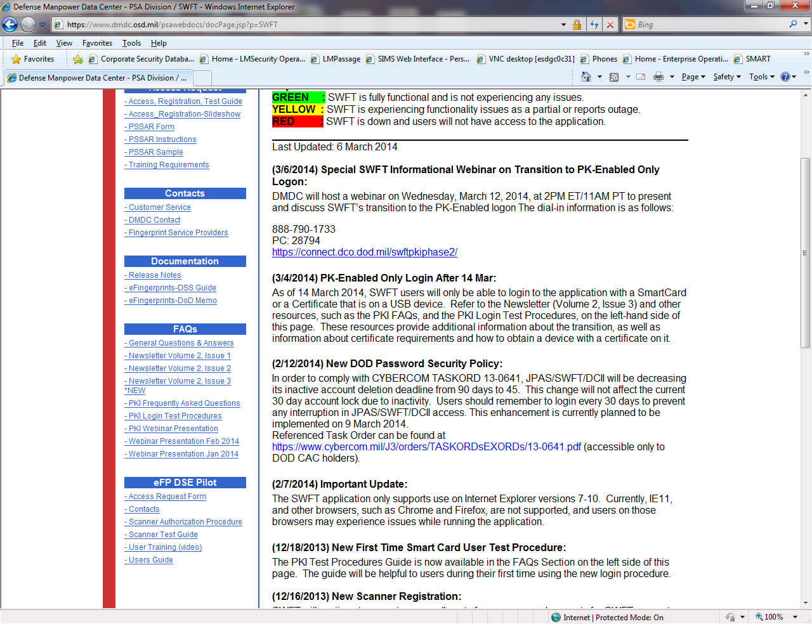
3rd party providers

Slide 9
SWFT 3rd Party Vendors
3M- $25
Industrial Security Integrators, LLC- $30
Accurate Biometrics- $25
Inquires- will not tell me without a contract
Advanced Livescan Technologies- (fingerprinting & Lease equipment)
Kinsey Consulting- $89
Community Wellness & Safety of Arizona- will not tell me without an account
National Credit Reporting- Convert to eft only
Fieldprint- fingerprinting and file conversion
Personnel Security Management- $10
Identification International Inc I3- will not tell me without an account

Slide 10
Questions?

