Slide 1
JPAS Updates
9 JulY 2014
Steve Burke

Slide 2
The JPAS Industry Team
DoD CAF Consolidation
Where is JPAS Going?
DISS
CATS Portal
Where is JPAS Now
Call Center Transition
PSMO-I
JPAS Reports
PR Timeline
Break in Access vs. Break in Service
Policy Updates
JPAS Printouts
Data Correction
Additional Resources
Keys To Success

Slide 3
The JPAS Industry Team (est. 2004)
Renita “Toni” MacDonald (Boeing)
Tanya Elliott (Analyst Warehouse)
Quinton Wilkes (L-3 Communications)
Steven Burke (Lockheed Martin)
Rene Haley (Northrop Grumman)
Susie Bryant (Raytheon)
Carla Peters-Carr (Northrop Grumman)
Shala Romandelvalle (BAE Systems)
Sheila Garland (Ball Corporation)
Notes:
August 2011 – Industry Team partnered with DSS
Team Leads
Industry Team Lead: Quinton Wilkes
JPAS PMOs – Quinton Wilkes/Tanya Elliott
DSS Lead: Chuck Tench, Chief Planning Office
Work Group includes members from:
Defense Security Service (DSS)
NCMS Government and Industry Committee (G&I)
Defense Manpower Data Center (DMDC)
Defense Information System for Security (DISS)
Office of Personnel Management (OPM)

Slide 4
DoD CAF Consolidation
Defense Adjudication Activities Facility
WHS
CAF
Joint Staff
CAF
DISCO
DOHA
Adj
Air Force
CAF
Army
CCF
Navy
CAF
Note: DoD CAF Consolidation does not include: DIA, NGA, NRO, NSA, or DOHA-AJ
Notes:
CAF Consolidation complete: JS and WHS, DISCO and DOHA, Air force, Army, Navy
Note: DoD CAF Consolidation does not include: DIA, NGA, NRO, NSA & DOHA-Due Process
Changes from an Industry Perspective
JPAS Industry Users – effective 27 Oct 2012
Eligibility shows as adjudicated by the DoD CAF
DISCO no longer a selection in any of the drop-down fields
For RRU or Incident Report submissions select “DoD CAF - Industry”
Do not select Collab CAF
International Visit Requests and Security Assurances moved to DSS HQ – 1 April 2013
DoD CAF is located in Ft. Mead, MD

Slide 5
Where is JPAS going?
Away!
JPAS
Notes:
CAF Consolidation complete: JS and WHS, DISCO and DOHA, Air force, Army, Navy
Note: DoD CAF Consolidation does not include: DIA, NGA, NRO, NSA & DOHA-Due Process
Changes from an Industry Perspective
JPAS Industry Users – effective 27 Oct 2012
Eligibility shows as adjudicated by the DoD CAF
DISCO no longer a selection in any of the drop-down fields
For RRU or Incident Report submissions select “DoD CAF - Industry”
Do not select Collab CAF
International Visit Requests and Security Assurances moved to DSS HQ – 1 April 2013
DoD CAF is located in Ft. Mead, MD

Slide 6
JPAS Present and Future
JPAS Today
Joint Adjudication Management System (JAMS)
+
Joint Clearance Access Verification System (JCAVS)
=
Joint Personnel Adjudication System (JPAS)
JPAS Future
Case Adjudication Tracking System (CATS)
+
Joint Verification System (JVS)
=
Defense Information Systems Security (DISS)
JVS is the system that will replace JPAS
(Scheduled for 2016)
Notes:
What are the plans to replace JPAS?
▪ As mandated by The Intelligence Reform and Terrorism Prevention Act of 2004 (IRTPA) and guided by relevant Executive Orders and GAO recommendations to deliver and maintain an appropriately vetted workforce, the DoD has begun to overhaul the security and suitability processes via the use of an enterprise-wide IT solution. Through a closely coordinated and phased approach, the Defense Information System for Security (DISS) family of systems will replace various security clearance and suitability systems, enabling consistent standards and reciprocal recognition for all DoD clearances. Upon full implementation of the DISS family of systems, DoD will decommission JPAS (currently scheduled for November 2016).

Slide 7
CATS Portal
Case Adjudication Tracking System CATS– to adjudicate electronic investigations
Faster and easier communication between Security Managers , FSOs and DSS/CATS
Will be able to upload and forward electronic documents (.PDF) to the new DSS PSMO
Classified Non-Disclosure Agreements (SF-312)
Incident Reports and supporting documentation
Other
DISS PMO conducted demonstrations in December and January
User Login
SMO creation, access, management
Subject record detail
Incident creation and update
Manage CAF requests (Former RRU process)
Version 4 will retool and restructure the adjudication process
Incorporates HSDP-12 determinations
Clean Secret cases will be e-Adjudicated
Non e-Adjudicated will route for human adjudication
Notes:
Security managers will be able to select the type of Request For Action (RFA), type a justification for the action, upload any documents associated with that action and forward to the new DSS Personnel Security Management Office (PSMO) for review.
IS Reps will also be able to utilize this tool to send culpability reports to the PSMO for reviewing and forwarding incidents to the DoDCAF for action.
The portal will eliminate the current multi-delivery methods used now and will enable more tracking and monitoring to ensure proper action is taken.
Training and rollout was to be completed NLT 2nd QTR FY14.
312s currently sent via hard copy or fax’d, check website for fax information

Slide 8
Where is JPAS now?

Slide 9
Call Center Transition
JPAS, SWFT, DCII, and non-Industry e-QIP call center functions have transitioned from the DSS Call Center to the DMDC Contact Center
DSS Call Center:
Contact Information
1-888-282-7682
call.center@dsshelp.org
Menu Options:
1 – STEPP/ISFD/Industry ONLY e-QIP Account Lockout or Password Reset
2 – Personnel Security or Facility Clearance Inquiry
4 – e-QIP
5– STEPP
6 – ISFD
8 – General Inquiry / Call Center Contact Information
DMDC Contact Center:
Contact Information
1-800-467-5526
dmdc.contactcenter@mail.mil
dmdc.swft@mail.mil
Menu Options:
1 – JPAS
2 – e-QIP (Non-Industry)
3 – SWFT
4 – DCII
5 – Personnel Security Inquiry
6 – General Inquiry / Contact Center Information
Click here for the DSS SAR
Click here for the DMDC PSSAR
Notes:
Security managers will be able to select the type of Request For Action (RFA), type a justification for the action, upload any documents associated with that action and forward to the new DSS Personnel Security Management Office (PSMO) for review.
IS Reps will also be able to utilize this tool to send culpability reports to the PSMO for reviewing and forwarding incidents to the DoDCAF for action.
The portal will eliminate the current multi-delivery methods used now and will enable more tracking and monitoring to ensure proper action is taken.
Training and rollout was to be completed NLT 2nd QTR FY14.
312s currently sent via hard copy or fax’d, check website for fax information

Slide 10
Personnel Security Management Office for Industry (PSMO-I)
Personnel Clearance
Processing
Customer Support
e-QIP submissions
Non-disclosure Agreement (SF-312)
e-Fingerprints
centralized communication
NISP Rqmts
PCL
Oversight
increased visibility
efficiency
PSMO-I
Clearance System Records Data Management
systematic vision
timeliness
Interim Clearances
Overdue PRs
collaborative effort
streamlined processes
PCL Eligibility/Access
Liaison to DoD CAF
Interim Suspension
Incident Report Oversight
Notes:
PSMO moved to Hanover, MD eftv October 2013
NISP Specific Activities Performed by the PSMO-I Post DISCO/CAF Consolidation:
•Electronic Questionnaire for Investigations Processing (e-QIP)
•Non-disclosure Agreement (SF-312)
•Interim Suspension
•Key Management Personnel (KMP) Oversight
•KMP Personnel Clearance (PCL) analysis affecting Facility Clearance (FCL)
•Expeditious processing of KMP PCL for FCL
•KMP Eligibility Change Notifications
•Overdue KMP Periodic Reinvestigation
•Aging Interim Clearances
•Overdue Periodic Reinvestigations (non-KMP)
•Adverse Information (Incident) Reporting
•PCL Eligibility Not Supporting Current Access

Slide 11
DSS PSMO-I Update
Research, Recertify, and Upgrade Actions (RRU)
Research
Research requests will be forwarded to the PSMO-I for action regarding any front end submission process concerning Interim eligibilities, overdue PR notifications and SF 312 processing. They can also be submitted for any official requests for information by the PSMO-I.
Recertify/Upgrade
Recertify requests will be used by the DoD CAF to assist in any adjudicative action, issues or responding to official requests for information by the DoD CAF. When requesting the reciprocity of eligibility please submit an Upgrade Request to the DOD CAF-Industry Division.
Notes:
Security managers will be able to select the type of Request For Action (RFA), type a justification for the action, upload any documents associated with that action and forward to the new DSS Personnel Security Management Office (PSMO) for review.
IS Reps will also be able to utilize this tool to send culpability reports to the PSMO for reviewing and forwarding incidents to the DoDCAF for action.
The portal will eliminate the current multi-delivery methods used now and will enable more tracking and monitoring to ensure proper action is taken.
Training and rollout was to be completed NLT 2nd QTR FY14.
312s currently sent via hard copy or fax’d, check website for fax information

Slide 12
JPAS Reports
Changed with JPAS Release 5.4.0
Removed Low Usage Reports
Changed formatting of reports exported to .CSV files
The current formatting issue when exporting reports to Comma Separated Value (CSV) format will be corrected in a deployment to be released on 19 July, and users will then be able to generate CSV reports that adhere to the previous format. Additionally, three of the most used reports will be converted to the new format by 2 July to include: PSMnet, Overdue PR, and Personnel reports
Notes:
Security managers will be able to select the type of Request For Action (RFA), type a justification for the action, upload any documents associated with that action and forward to the new DSS Personnel Security Management Office (PSMO) for review.
IS Reps will also be able to utilize this tool to send culpability reports to the PSMO for reviewing and forwarding incidents to the DoDCAF for action.
The portal will eliminate the current multi-delivery methods used now and will enable more tracking and monitoring to ensure proper action is taken.
Training and rollout was to be completed NLT 2nd QTR FY14.
312s currently sent via hard copy or fax’d, check website for fax information

Slide 13
Industry Guidance on Submitting Periodic Reinvestigations
Effective April 10, 2014, the Defense Security Service (DSS), Personnel Security Management Office for Industry (PSMO-I) will accept requests for periodic reinvestigations that are within 90 days of the investigation anniversary date. This is a change from the current 30 day timeframe and reinstates the previous 90 day submission window
Please see the following site for additional information: http://www.dss.mil/psmo-i/indus_psmo-i_updates.html
NOTE: In the near future DMDC will be working with the PSMO-I to send communications regarding any past due Periodic Reinvestigations
Notes:
Security managers will be able to select the type of Request For Action (RFA), type a justification for the action, upload any documents associated with that action and forward to the new DSS Personnel Security Management Office (PSMO) for review.
IS Reps will also be able to utilize this tool to send culpability reports to the PSMO for reviewing and forwarding incidents to the DoDCAF for action.
The portal will eliminate the current multi-delivery methods used now and will enable more tracking and monitoring to ensure proper action is taken.
Training and rollout was to be completed NLT 2nd QTR FY14.
312s currently sent via hard copy or fax’d, check website for fax information

Slide 14
Break in Access vs. Break in Employment
Break in access is the point when a cleared employee no longer has a requirement to have access to classified information.
If an employee no longer has a requirement to access classified information, remains employed by the contractor, and there is a “reasonable” expectation that the employee will require access to classified information again in the future then complete the following actions in JPAS:
“Debrief” the employee from access
Maintain an owning relationship of the employee’s eligibility record in the JPAS Personnel Security Management Network (PSM Net) until a separation action is necessary
The contractor should debrief the employee.
If the employee is no longer in your PSM-Net, then the contractor should not submit a request for a PR and is not required to provide refresher training to the employee.
The contractor should continue to submit adverse information reports in accordance with NISPOM 1-302a (and the clarifying guidance in Industrial Security Letter 2011-04) by using the “Report Incident” feature in JPAS for any employee eligible for access to classified information, regardless of whether the employee currently has access to classified information.
Notes:
Security managers will be able to select the type of Request For Action (RFA), type a justification for the action, upload any documents associated with that action and forward to the new DSS Personnel Security Management Office (PSMO) for review.
IS Reps will also be able to utilize this tool to send culpability reports to the PSMO for reviewing and forwarding incidents to the DoDCAF for action.
The portal will eliminate the current multi-delivery methods used now and will enable more tracking and monitoring to ensure proper action is taken.
Training and rollout was to be completed NLT 2nd QTR FY14.
312s currently sent via hard copy or fax’d, check website for fax information

Slide 15
Break in Access vs. Break in Employment
If the employee no longer has a requirement to access classified information, remains employed, and there is “no reasonable” expectation that the employee will require access again while employed by the company, then complete the following actions in JPAS:
“Debrief” the employee from access
Add a separation date to the record
Out-process the employee’s eligibility record from the PSM Net
The contractor should debrief the employee.
If the employee is no longer in the contractor’s PSM-Net, then the contractor should not submit a request for a PR and is not required to provide refresher training to the employee.
The contractor should continue to submit adverse information reports in accordance with NISPOM 1-302a (and the clarifying guidance in Industrial Security Letter 2011-04) by using the “Report Incident” feature in JPAS for any employee eligible for access to classified information, regardless of whether the employee currently has access to classified information.
Notes:
Security managers will be able to select the type of Request For Action (RFA), type a justification for the action, upload any documents associated with that action and forward to the new DSS Personnel Security Management Office (PSMO) for review.
IS Reps will also be able to utilize this tool to send culpability reports to the PSMO for reviewing and forwarding incidents to the DoDCAF for action.
The portal will eliminate the current multi-delivery methods used now and will enable more tracking and monitoring to ensure proper action is taken.
Training and rollout was to be completed NLT 2nd QTR FY14.
312s currently sent via hard copy or fax’d, check website for fax information

Slide 16
Break in Access vs. Break in Employment
Break in employment is the point when a cleared contractor terminates the employment of an employee with eligibility for access to classified information regardless of the reason for the termination, and regardless of whether the termination was initiated by the company, the employee (e.g., by resignation), or by mutual agreement of the company and the employee.
When a contractor terminates the employment of an employee who is eligible for access to classified information at the time of termination, the contractor must complete the following actions in JPAS:
“Debrief” the employee from access (Note: this is the verbiage in JPAS for removing access)
Add a separation date to the record
Out-process the employee’s eligibility record from the PSM Net
The contractor should debrief the employee prior to departure from the company.
When an employee who previously was eligible for access to classified information has had a break in employment greater than 24 months, the employee cannot be granted access to classified information until the employee has undergone a new (initial) investigation, regardless of the recency of any prior personnel security investigation.
Notes:
Security managers will be able to select the type of Request For Action (RFA), type a justification for the action, upload any documents associated with that action and forward to the new DSS Personnel Security Management Office (PSMO) for review.
IS Reps will also be able to utilize this tool to send culpability reports to the PSMO for reviewing and forwarding incidents to the DoDCAF for action.
The portal will eliminate the current multi-delivery methods used now and will enable more tracking and monitoring to ensure proper action is taken.
Training and rollout was to be completed NLT 2nd QTR FY14.
312s currently sent via hard copy or fax’d, check website for fax information

Slide 17
Policy Updates
Use of PKI Certificates
Please note that it is wrongful to willingly use another individual's PKI certificate for authentication/logon to JPAS as the certificate is the digital representation of another person's identity. This is considered to be a misuse of technology and will result in a security incident and potentially permanent debarment from having a JPAS account.
Deleted JPAS Accounts
If your Account was created under a previous SMO that you previously separated from, the JPAS Account will be deleted. Please ensure your account is associated with your existing SMO.
Denied, Revoked , Suspended or any other unfavorable eligibility
No owning and/or servicing SMO
Separated categories
Inactivity of 90 days
Inactive Account Deletion Policy
In order to comply with CYBERCOM TASKORD 13-0641, JPAS/SWFT/DCII will be decreasing the inactive account deletion deadline from 90 days to 45. This change will not affect the current 30 day account lock due to inactivity. Users should remember to login every 30 days to prevent any interruption in access. This enhancement is currently planned to be implemented on 9 March 2014.
Notes:
Security managers will be able to select the type of Request For Action (RFA), type a justification for the action, upload any documents associated with that action and forward to the new DSS Personnel Security Management Office (PSMO) for review.
IS Reps will also be able to utilize this tool to send culpability reports to the PSMO for reviewing and forwarding incidents to the DoDCAF for action.
The portal will eliminate the current multi-delivery methods used now and will enable more tracking and monitoring to ensure proper action is taken.
Training and rollout was to be completed NLT 2nd QTR FY14.
312s currently sent via hard copy or fax’d, check website for fax information

Slide 18
Policy Updates
Common misuses of JPAS include, but are not limited to:
Sharing of username, password, CAC or PIV cards and/or associated PIN numbers to access the system.
Allowing non-cleared individuals to access the system.
Leaving the JPAS application insecure while logged into it.
Allowing others to view data on the JPAS screen that do not have the proper authorization.
Providing printouts of JPAS data without proper authorization.
Querying the JPAS application for ‘celebrity’ records.
Querying the JPAS application for your own record. (Don’t do it!)
NO Test or “Dummy” SSNs in JPAS
JPAS is a DoD System of Record, and therefore inputting test or “dummy” SSNs into the system is a violation of system policies and is STRICTLY prohibited. If you input test SSNs into JPAS, your account will be terminated and a misuse of technology incident will be recorded on your JPAS record.

Slide 19
JPAS Printouts
Military, DoD and non-DoD Civilian Users: The printing out of the JCAVS Person Summary Screen can only be utilized when a Federal Government Agency requests the printout for reciprocity or compliance purposes and JPAS access is unavailable. JCAVS Person Summary Screen cannot be utilized for law enforcement or Privacy Act purposes. This printout screen can only be used to provide proof of investigation, eligibility, and access at that single point in time at the Federal Government Agency request.
Industry Users: The guidance to military, DoD and non-DoD civilian JPAS users does not apply to National Industrial Security Program (NISP) JPAS industry users regarding JCAVS Person Summary Screen Printouts. Industry users should continue to follow current National Industrial Security Program Operating Manual (NISPOM) and Industrial Security Letters (ISL) guidance. Contact Defense Security Service with any questions. All ISLs are located at http://www.dss.mil/isp/fac_clear/download_nispom.html. The NISPOM is located at http://www.dss.mil/documents/odaa/nispom2006-5220.pdf.
Notes:
Security managers will be able to select the type of Request For Action (RFA), type a justification for the action, upload any documents associated with that action and forward to the new DSS Personnel Security Management Office (PSMO) for review.
IS Reps will also be able to utilize this tool to send culpability reports to the PSMO for reviewing and forwarding incidents to the DoDCAF for action.
The portal will eliminate the current multi-delivery methods used now and will enable more tracking and monitoring to ensure proper action is taken.
Training and rollout was to be completed NLT 2nd QTR FY14.
312s currently sent via hard copy or fax’d, check website for fax information

Slide 20
JPAS Printouts
Industry JPAS users should continue to follow the NISPOM and the guidance in Industrial Security Letter (ISL) 2010-01, article #5. If a Government Agency asks for a printout, please notify your DSS Industrial Security Representative so that DSS can address the issue with that agency.
Contractor security functions can be accomplished without printing from JPAS.
If a visit requires access to classified information and JPAS is not available to verify the visitor's personnel security clearance (PCL) level, a visit authorization letter may be used. Reference NISPOM paragraph 6-104b.
Contractors may continue to inform employees of the status of their eligibility and access to classified information, the date of their last investigation, and consult with employees regarding their personal information in order to maintain accurate access records in JPAS in accordance with NISPOM paragraph 2-200b.
As a reminder, all JCAVS printouts must be protected from unauthorized disclosure and in accordance with the requirements for privacy/sensitive information and For Official Use Only (FOUO), Privacy Act of 1974. Privacy Act requests must be made according to the JPAS SoRN Record Access procedures.

Slide 21
JPAS Data Correction

Slide 23
JVS System Modifications
DMDC has created a JPAS Users’ Checklist for upcoming changes to JVS
In order for the person records to be properly migrated over to JVS, the JPAS team is asking that you review the company/service persons’ names and update the records.
The easiest way to find out if the Name (Last, First, Middle) does not meet the standards is to pull a JPAS report, import the data into Excel, and then perform a search on the Name fields for the invalid characters.
Names:
Certain characters are not allowed in last names:
No blanks, no numbers, no periods, i.e. SMITH JR or ST GEORGE, no parenthesis, no underscores, quotes, or asterisks, suffix should be in the suffix field and not the last name field (SMITH JR)
Alpha characters: A – Z, a – z and Hyphens are allowed.
Notes:
Security managers will be able to select the type of Request For Action (RFA), type a justification for the action, upload any documents associated with that action and forward to the new DSS Personnel Security Management Office (PSMO) for review.
IS Reps will also be able to utilize this tool to send culpability reports to the PSMO for reviewing and forwarding incidents to the DoDCAF for action.
The portal will eliminate the current multi-delivery methods used now and will enable more tracking and monitoring to ensure proper action is taken.
Training and rollout was to be completed NLT 2nd QTR FY14.
312s currently sent via hard copy or fax’d, check website for fax information

Slide 24
SMO Data
Phone Numbers:
Please ensure the SMO phone number is accurate.
Example: (123)-456-1234
SMO Email Address:
All email addresses in the SMO Email Address Field need to be updated without name, phone, rank, title, or extra wording. i.e. name@company.com; name@service.mil separated by semicolons (;).
Notes:
Security managers will be able to select the type of Request For Action (RFA), type a justification for the action, upload any documents associated with that action and forward to the new DSS Personnel Security Management Office (PSMO) for review.
IS Reps will also be able to utilize this tool to send culpability reports to the PSMO for reviewing and forwarding incidents to the DoDCAF for action.
The portal will eliminate the current multi-delivery methods used now and will enable more tracking and monitoring to ensure proper action is taken.
Training and rollout was to be completed NLT 2nd QTR FY14.
312s currently sent via hard copy or fax’d, check website for fax information

Slide 25
Additional Resources

Slide 26
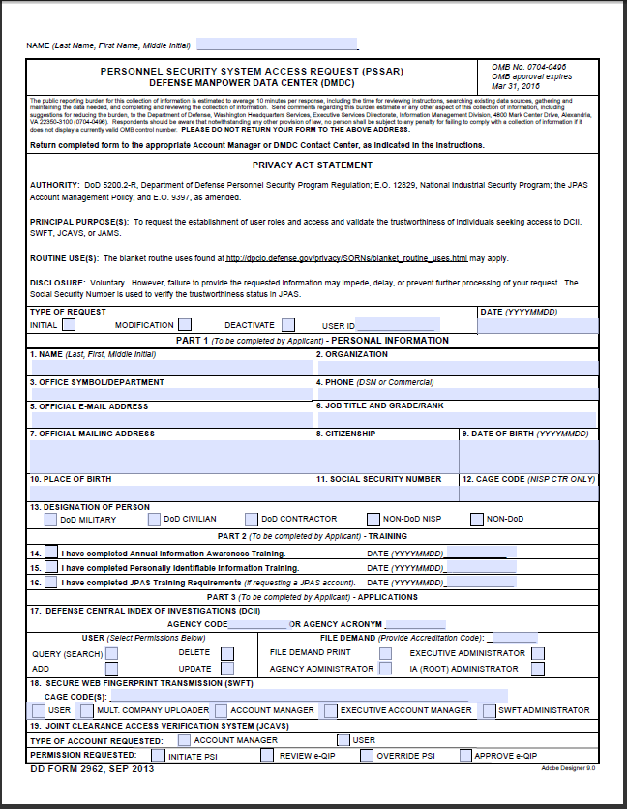
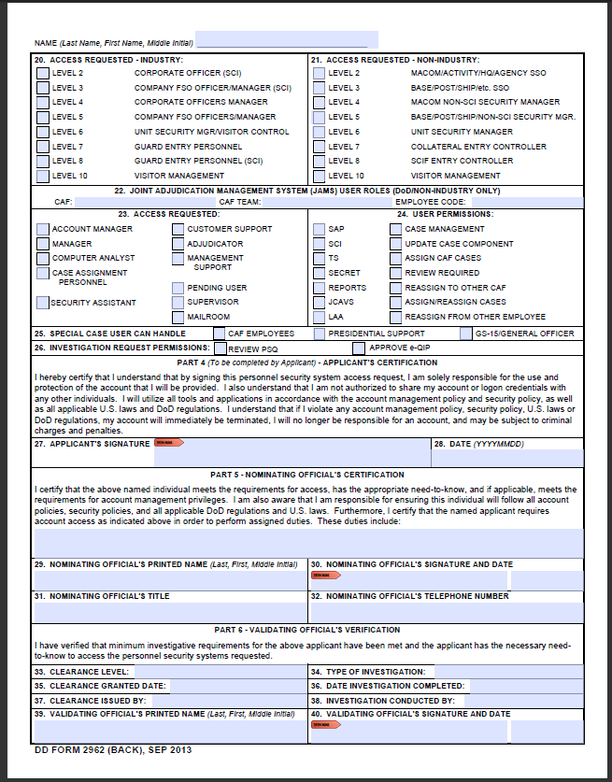
Personnel Security System Access Request
(PSSAR)
Notes:
Security managers will be able to select the type of Request For Action (RFA), type a justification for the action, upload any documents associated with that action and forward to the new DSS Personnel Security Management Office (PSMO) for review.
IS Reps will also be able to utilize this tool to send culpability reports to the PSMO for reviewing and forwarding incidents to the DoDCAF for action.
The portal will eliminate the current multi-delivery methods used now and will enable more tracking and monitoring to ensure proper action is taken.
Training and rollout was to be completed NLT 2nd QTR FY14.
312s currently sent via hard copy or fax’d, check website for fax information

Slide 27
JPAS Account Requirements
Clearance Requirements
The minimum requirement for JPAS access is Secret eligibility. Levels 2, 3 and 8 require an SSBI at minimum.
Training Requirements
JCAVS / Cyber Awareness / PII
Personnel Security System Access Request (PSSAR) Form
You must read the Account Management Policy before you can access the PSSAR.
Initial accounts for Primary Account Managers - send to the DMDC Contact Center
Subsequent accounts - send to appropriate JPAS Account Manager
Letter Of Appointment (LOA)
Required for ALL Industry Account Managers
Note: Account Managers are responsible for keeping PSSAR forms and training certificates (in case of audit or incident)
Notes:
Security managers will be able to select the type of Request For Action (RFA), type a justification for the action, upload any documents associated with that action and forward to the new DSS Personnel Security Management Office (PSMO) for review.
IS Reps will also be able to utilize this tool to send culpability reports to the PSMO for reviewing and forwarding incidents to the DoDCAF for action.
The portal will eliminate the current multi-delivery methods used now and will enable more tracking and monitoring to ensure proper action is taken.
Training and rollout was to be completed NLT 2nd QTR FY14.
312s currently sent via hard copy or fax’d, check website for fax information

Slide 28
JPAS Account Requirements
AS A FUTURE OR CURRENT JPAS ACCOUNT HOLDER, WHAT SHOULD I DO TO GAIN ACCESS TO OR MAINTAIN MY JPAS ACCOUNT?
The Defense Manpower Data Center (DMDC) Contact Center is unable to process a Personnel Security System Access Request (PSSAR) for applicants with no Owning or Servicing relationship in JPAS. When DMDC Contact Center receives a PSSAR for an applicant who is missing the required owning or servicing relationship in JPAS but has met all other requirements, the DMDC Contact Center will send the request to the DSS Facility Clearance Branch (FCB), who will establish a temporary 30-day servicing relationship for the applicant to facilitate creation of their JPAS account. FCB will notify the Facility Security Officer (FSO) of the action taken and the facility must establish a servicing or owning relationship with that subject under their own Security Management Office (SMO) within the 30-day timeframe or the account will be deleted.
Notes:
Security managers will be able to select the type of Request For Action (RFA), type a justification for the action, upload any documents associated with that action and forward to the new DSS Personnel Security Management Office (PSMO) for review.
IS Reps will also be able to utilize this tool to send culpability reports to the PSMO for reviewing and forwarding incidents to the DoDCAF for action.
The portal will eliminate the current multi-delivery methods used now and will enable more tracking and monitoring to ensure proper action is taken.
Training and rollout was to be completed NLT 2nd QTR FY14.
312s currently sent via hard copy or fax’d, check website for fax information

Slide 29
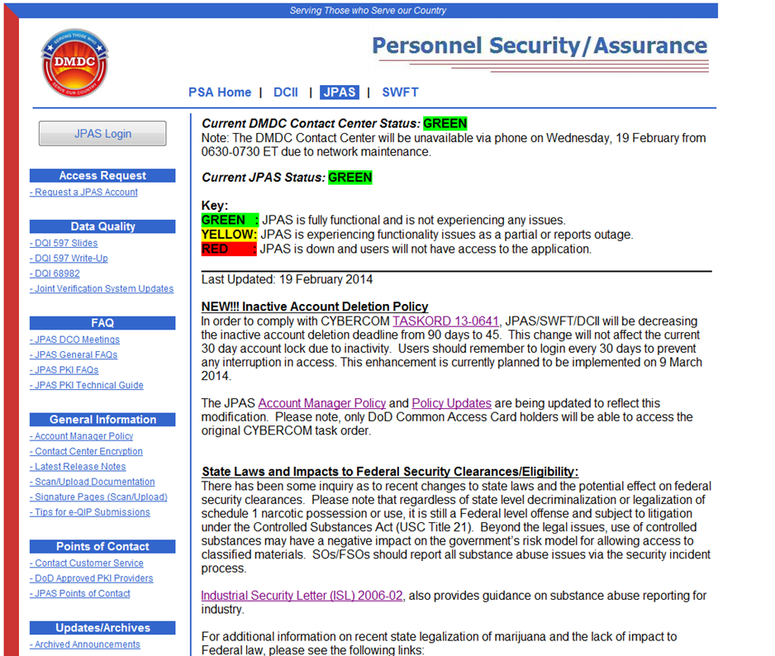
This is the page to bookmark: www.dmdc.osd.mil/psawebdocs
Alerts, notices, user guide resources, etc. are posted here.
If unable to log in via above link, try the following link that takes you to JPAS Disclosure page:
https://jpasapp.dmdc.osd.mil/JPAS/JPASDisclosure
For Customer support you can contact:
DMDC Contact Center 800-467-5526
Or:
DSS Call Center 888-282-7682

Slide 30
Channels of Communication
DSS Website
DMDC PSA
VOI
JPAS Website
NCMS
DSS Webinar
Briefings to Industry
E-Mail Listserv
ISFD
CDSE Flash
JPAS SMO emails
AskPSMO-I Webinar Participants
JPAS PMO meetings
Notes:
Industry – uses Monthly meetings with Government (DMDC/DSS/NISPAC, etc.)/NCMS/Q-Tips/facebook/twitter, etc.

Slide 31
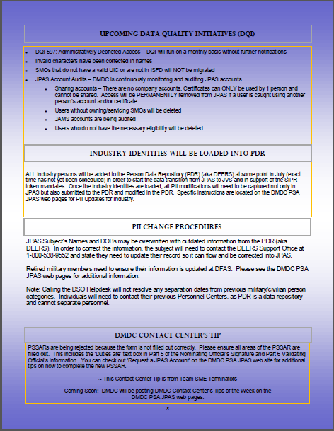
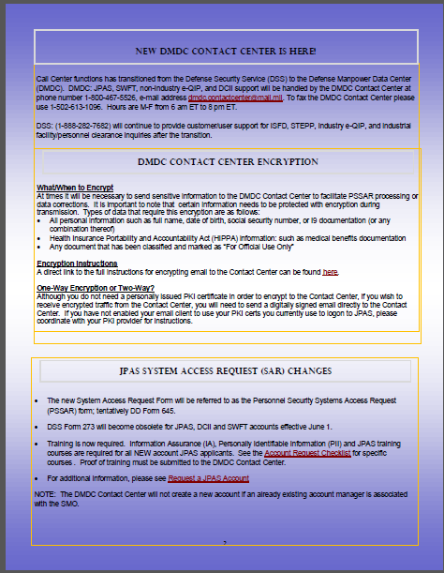
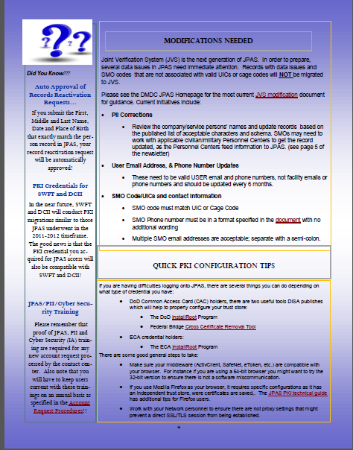
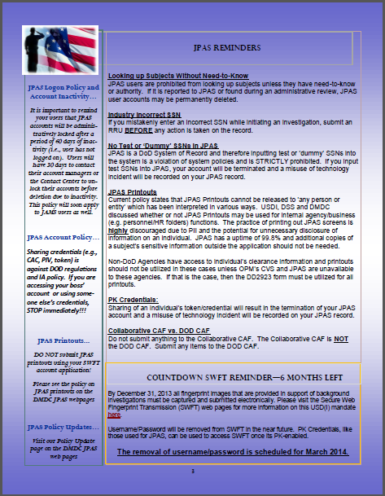
JPAS Newsletter
Notes:
Quarterly newsletter put out by DMDC.
Located via link at JPAS log-in screen

Slide 32
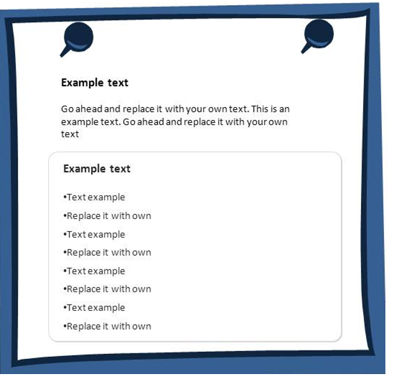
Additional Resources
Contacts
Email questions:
AskPSMO-I@dss.mil
DO NOT SEND PII
Email questions:
dmdc.swft@mail.mil
AskPSMO-I Webinars
Email DMDC Contact Center Inquiries: dmdc.contactcenter@mail.mil
Join the PSMO-I for its bi-monthly webinars where we answer specific questions related to eFP
Visit the DSS website for the webinar announcement and registration link
Be sure to submit questions during the registration process
DoD Security Services (Call) Center Inquiries:
DoD Security Services Center
eFP Setup & Submission
FBI Product List
FBI Approved Channeler List
SWFT - Registration, Access and Testing Procedures
DMDC-SWFT Homepage
When submitting eFPs use:
SOI: DD03
SON: 346W
IPAC: DSS-IND
Note: Hyperlinks only work in “Slideshow View”. Click Shift+F5

Slide 33
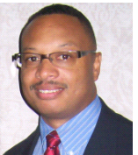
Q’ s Tips
A forum utilized to assist the Industrial Security community with additional guidance, training, and application for use of government databases and processes affecting industry
Located in members only section on NCMS website
E-mail links to Industry Team members
E-mail links to ask questions re: JPAS and SWFT
Hot Topics
Upcoming Training
NCMS Board of Directors
Industrial Security Professionals Certified (ISP)
Gov’t & Industry Committee Chair
Industry Team Subcommittee Chair
NCMS Presidential Award Winner
Notes:
Security managers will be able to select the type of Request For Action (RFA), type a justification for the action, upload any documents associated with that action and forward to the new DSS Personnel Security Management Office (PSMO) for review.
IS Reps will also be able to utilize this tool to send culpability reports to the PSMO for reviewing and forwarding incidents to the DoDCAF for action.
The portal will eliminate the current multi-delivery methods used now and will enable more tracking and monitoring to ensure proper action is taken.
Training and rollout was to be completed NLT 2nd QTR FY14.
312s currently sent via hard copy or fax’d, check website for fax information

Slide 34
Useful Websites
DMDC: https://www.dmdc.osd.mil/psawebdocs/
JPAS Homepage: https://www.dmdc.osd.mil/psawebdocs/docPage.jsp?p=JPAS
DSS website: http://www.dss.mil/
DEERS website: http://tricare.mil/mybenefit/home/overview/Eligibility/DEERS/Updating
SWFT: https://www.dmdc.osd.mil/psawebdocs/docPage.jsp?p=SWFT
ISFD: http://www.dss.mil/diss/isfd.html
STEPP: http://www.dss.mil/seta/enrol/stepp.html
NCMS: https://www.classmgmt.com/Home/

Slide 35
JPAS Industry Team Contact Information
Industry Team PMOs
Quinton Wilkes – Team Lead
quinton.wilkes@L-3com.com
Tanya Elliott
telliott@lg-tek.com
Industry Sub Team
Renita “Toni” MacDonald
renita.macdonald@boeing.com
Susie Bryant
smbryant@raytheon.com
Rene Haley
rene.haley@ngc.com
Steven Burke
steven.d.burke@lmco.com
Carla Peters-Carr
carla.peters-carr@ngc.com
SWFT Industry
Sub Team
Sheila Garland
sgarland@ball.com
Shala Roman
shala.romandelvalle@baesystems.com
DMDC Contact Center
800 467-5526
Customer Call Center
888 282-7682

Slide 36
Keys to Success
Information
Relationships
Stay Engaged
Notes:
Security managers will be able to select the type of Request For Action (RFA), type a justification for the action, upload any documents associated with that action and forward to the new DSS Personnel Security Management Office (PSMO) for review.
IS Reps will also be able to utilize this tool to send culpability reports to the PSMO for reviewing and forwarding incidents to the DoDCAF for action.
The portal will eliminate the current multi-delivery methods used now and will enable more tracking and monitoring to ensure proper action is taken.
Training and rollout was to be completed NLT 2nd QTR FY14.
312s currently sent via hard copy or fax’d, check website for fax information

Slide 37
Notes:
37

