Slide 1
Lockheed Martin

Slide 2
Topics
Insider Case
Understanding the Insider
Building an Insider Threat Program

Slide 3
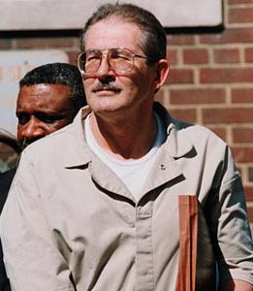
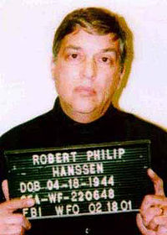
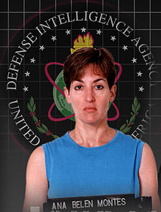
EGO
EGO
MONEY
MONEY
IDEOLOGY
Notes:
What did they have in common? Government—Classified Information—National Security—Foreign Nations. Transition to next slide

Slide 4
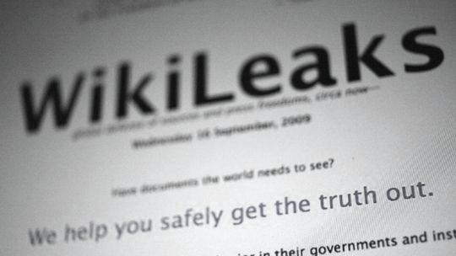
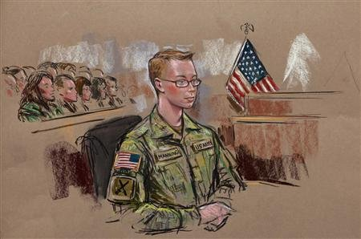
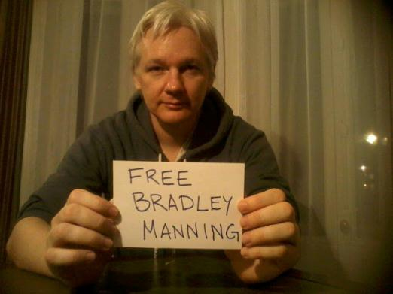
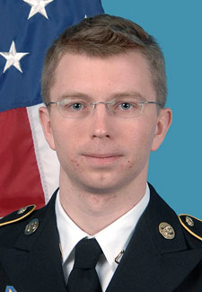
IDEOLOGY
Pvt. Bradley Manning
U.S. Army
“I was actively involved in something that I was completely against”

Slide 5
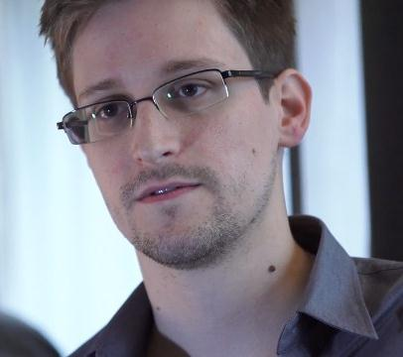
Hero or Traitor?
Edward Snowden
CIA/NSA

Slide 6
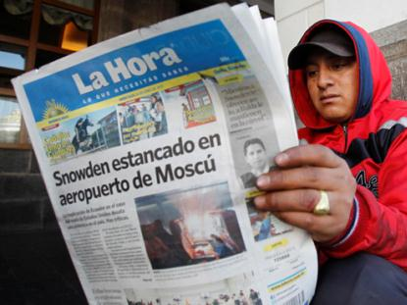
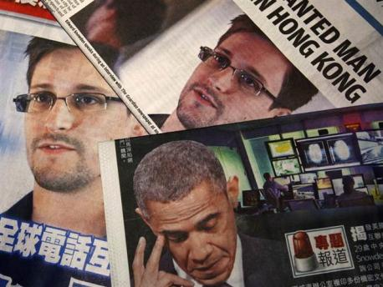
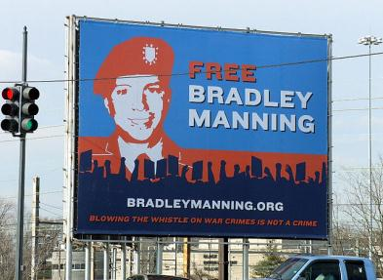
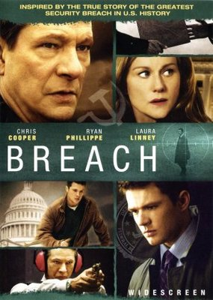
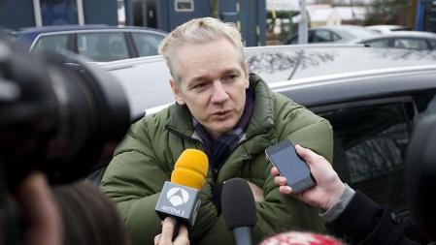
Media Coverage
Government “Spies” receive much more media coverage…
…creating common misconceptions.

Slide 7
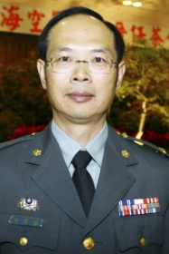
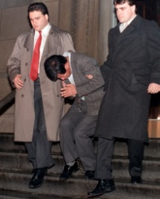
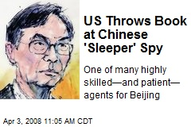
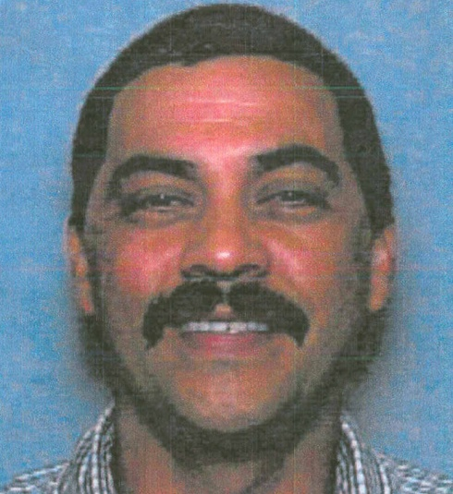
Less Media Coverage
Notes:
1-Maj Gen Hsien-Che Lo was recruited by China in 2004. Documents were recovered from his home relating to Lockheed’s Po Sheng Program. Arrested by the Taiwanese for espionage
2 Juwhan Yun, a U.S. naturalized citizen, acted for the Korean govt to procure F-16 parts and other Lockheed products. Sentenced to 57 months in prison.
3 Lo-Suen “Bill” Moo, a Taiwanese consultant used by Lockheed, attempted to purchase and redistribute a number of different U.S. defense items, including an F-16 engine, on behalf of the Chinese government. Sentenced to 6 ½ years in prison and fined $1 million
4 Chi Mak, a U.S. engineer conspired with family members to export U.S. sensitive military documents, which included LM Aegis Technologies. Sentenced to 24 ½ years in federal prison and fined $50k

Slide 8
Perspective Change
Government
Private Industry and Universities
Classified Information
Corporate Proprietary, Intellectual Property, Pre-Classified Research
National Security
US Technological Edge and Financial Prosperity
Foreign Nations
Industry Competition
“Espionage used to be a problem for the FBI, CIA and military, but now it's a problem for corporations…” - Joel Brenner, National Counterintelligence Executive, 2008
Courtesy CI CENTRE & SPYpedia

Slide 9
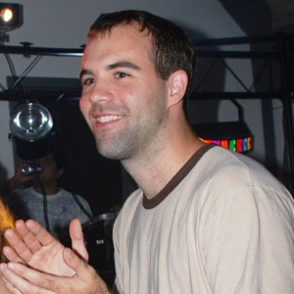
Shifting Threat Landscape
External Threat
Foreign Intelligence Service (FIS)
Foreign and Domestic Industry Competitors
Landscape Has Changed
Social Media
Hiring
Penetrations
Supply Chain
Mergers & Acquisitions
Joint Ventures & University Collaboration
Students
Insider Threat
Current or former employees, contractors, and other trusted business partners with authorized access to information
Acting on behalf of FIS or in furtherance of self interests
Notes:
Hiring: Snowden—Took pay cut job at Boose Allen in order to access NSA Classified
Students: Glenn Shriver: Wrote white papers for Chinese Gov’t—Pd $30k to take Foreign Service Exam
Pd $40 to apply at CIA

Slide 10
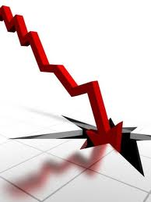
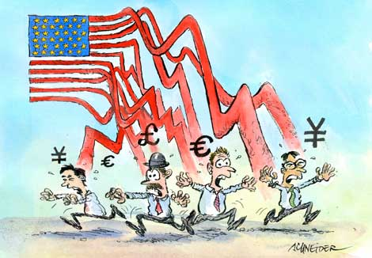
Increase in Threat of Insiders
The incidence of employee financial hardships during economic downturns
The global economic crisis facing foreign nations
The ease of stealing anything stored electronically
The increasing exposure to foreign intelligence services presented by the reality of global business, joint ventures, and the growing international footprint of American firms.
Courtesy CI CENTRE & SPYPEDIA

Slide 11
Steady Upward Trend
32% of all espionage arrests since 1945 have occurred in the last 5 years (FBI)
54% of all individuals involved with compromise of classified or proprietary information were employed in Private Sector (FBI)
Industry SCRs up 600% from 2009 (DSS)
76% increase in SCRs evaluated “of CI interest” by DSS from 2010 to 2012
IIRs from Industry reporting up 500% from 2009 (DSS)
USG Investigations & Operations predicated on Industry reporting up over 1000% from 2009 (DSS)
Courtesy:; CI CENTRE & SPYPEDIA; CERT; DSS; www.whitehouse.gov
Notes:
Bullet 1-
Based on date of arrest
Includes Foreign Nationals (collectors)
Individuals who defected pending arrest
Includes “Espionage” related arrests i.e. FARA and Economic Espionage, violation of Title 18 Section1001
Individuals who committed suicide pending arrest
Bullet 2-
Private Sector includes Gov Contractors, University employees, Journalists
Bullet 4-
Numbers reflect ALL of industry
2010 - 1,635
2011 - 1,912
2012 - 2,879
2013 (as of 5 May) - 859

Slide 12
Shifting Value in Corporate Assets
% Value
“The U.S. economy has changed over the past 20 years. Intellectual capital rather than physical assets now represent the bulk of a U.S. corporation’s value. This shift has made corporate assets far more susceptible to espionage.” - “Protecting Key Assets: A Corporate Counterintelligence Guide”, The office of the National Counterintelligence Executive (ONCIX), 2013
Source: Ocean Tomo Intellectual Capital Equity, Courtesy Office of The National Counterintelligence Executive
Notes:
The U.S. economy has changed over the past 20 years. Intellectual capital rather than physical assets now
represent the bulk of a U.S. corporation’s value. Research by Ocean Tomo Intellectual Capital Equity that is
captured in the chart below shows the transition from an economy of tangible assets (real estate, hardware,
vehicles) to one in which intangible assets (patented technology, trade secrets, proprietary data, business
process and marketing plans) now represent 81 percent of the value associated with the S&P 500. This shift
has made corporate assets far more susceptible to espionage.

Slide 13
Insider Threat Impact: Industry Reports
► Insider threat is not the most numerous type of threat
► 1900+ reported incidents in the last 10 years
► ~ 19% of incidents involve malicious insider threat actors
► Insider threats are the most costly and damaging
► Average cost $412K per incident
► Average victim loss: ~$15M / year
► Multiple incidents exceed $1 Billion
Sources:
Ponemon Data Breach Reports: ‘08, ‘09, ‘10, ’11
IDC 2008
FBI / CSI Reports: ‘06, ‘07, ’08’, ‘09, ‘10/’11
Verizon Business Data Breach Reports: ‘09, ‘10, ‘11, ’12
CSO Magazine / CERT Survey: ‘10, ‘11
Carnegie Mellon CERT 2011 IP Loss Report
Cisco Risk Report ‘08

Slide 14
Understanding the Insider Threat

Slide 15
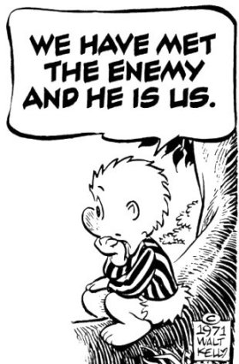
Define the Insider
Authorized people using their trusted access to do unauthorized things
Threat actors vs. threats
Boils down to actors with some level of legitimate access, and with some level of organizational trust
Inadvertent or Malicious Insiders
Notes:
Authorized= Current or Former employees, trusted partners, vendors or subcontractors.

Slide 16
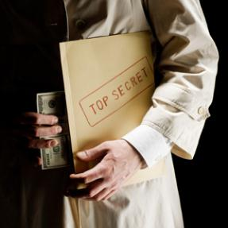
Potential Risk Indicators
Attempts to bypass security controls
Request for clearance or higher level access without need
Unjustified work pattern
Chronic violation of organization policies
Decline in work performance
Irresponsible social media habits
Unexplained sudden affluence
Outward expression of conflicting loyalties
Unreported foreign contacts / foreign travel (when required)
Maintains access to sensitive data after termination notice
Visible disgruntlement towards employer
Use of unauthorized digital external storage devices

Slide 17
Psychosocial Indicators
Disgruntlement
Responds poorly to criticism
Inappropriate response to and/or inability to cope with stress at work
Sudden Change in Work Performance
Emotional
Change in Beliefs
Unusual Level of Pessimism
Unusual Level of Sadness
Difficulty Controlling Emotions
Ego
Domineering
Harassment
Argumentative
Superiority Complex
Selfish
Manipulative
Rules Do Not Apply
Poor Teamwork
Irritability
Threatening
Retaliatory Behavior
Relationship/Financial Problems
Divorce
Marriage Problems
Stress at Home
Financial Problems
Inappropriate response to and/or inability to cope with stress at home
Unexplained Change in Financial Status
Irresponsibility
Selfish
Notes:
psy·cho·so·cial
/ˌsīkōˈsōSHəl/
Adjective
Of or relating to the interrelation of social factors and individual thought and behavior.

Slide 18
How and Why
¹ UK Centre for the Protection of National Infrastructure (CPNI)
Insider Threat Data Collection Study, Report of Main Findings, April 2013

Slide 19
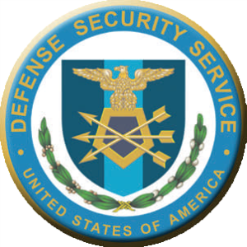
Insider Threat Program
NISPOM Conforming Change 2

Slide 20
1-202. Insider Threat Program
Requirements
Program in Accordance with E.O. 13587
Designate Insider Threat “Senior Official”
Training
Senior Official
Cleared Employee
Within first 30-days (New Employee Orientation briefing)
Annually thereafter
System to maintain training records

Slide 21
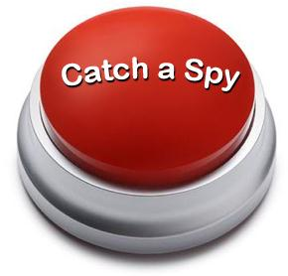
Lessons Learned
Insider threats are not hackers
Insider threat is not a technical or “cyber security” issue alone
A good insider threat program should focus on deterrence, not detection
Detection of insider threats has to use behavioral based techniques

Slide 22
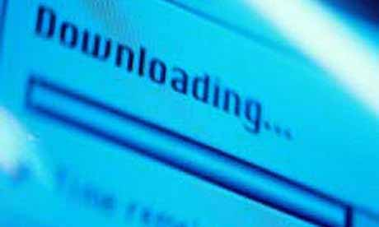
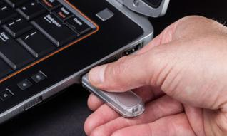
When Does it Happen?
59% of employees leaving a company admit to taking proprietary information with them (FBI)
Out of 800 adjudicated insider threat cases, an overwhelming majority of subjects took the information within last 30 days of employment (CERT; Carnegie Mellon)
60% of cases were individuals who had worked for the organization for less than 5 years (CPNI)
Majority of acts were carried out by staff (88%); 7% were contractors and 5% temporary staff (CPNI)
Courtesy www.Whitehouse.gov

Slide 23
Exploitable Weaknesses
UK study of 120 private and public cases
Clear link found between insider acts and an employer's exploitable weaknesses
Poor management practices
Poor use of auditing functions
Lack of protective security controls
Poor security culture
Poor pre-employment screening
Poor communication between business areas
Lack of awareness of risk at the senior level
Inadequate corporate governance
¹ UK Centre for the Protection of National Infrastructure (CPNI)
Insider Threat Data Collection Study, Report of Main Findings, April 2013

Slide 24
Know Your Data
What are the “crown jewels” of your organization?
Critical Programs
Critical Assets
Critical Components
What keeps your Chief Technology Officer (CTO) up at night!
What data / people would the enemy want to target?
Suppliers of Critical Components
Action:
Identify sensitive data
Rate top 5 most important systems in terms of sensitive data
Gather data about the systems/personnel
Create a Counterintelligence Support Plan (CISP)/ Insider Threat Plan
Now your supply chain!

Slide 25
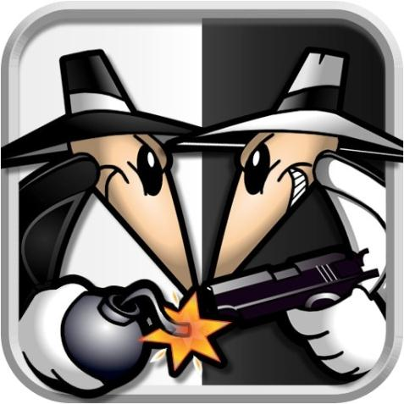
Know Your Enemy
Who would be targeting your organization?
Who would they target inside your organization?
Who are the high risk individuals in your organization?
Program Managers
Field Service Reps
Fellows
SMEs
Employees Identified on web, Public Release Announcements, etc
Published, Publications, Conference Speakers, Patents
Document in your CISP!

Slide 26
CI Program Key Partnerships
Organizational Leadership
Functional Leadership
Computer Intrusion Response Team / Chief Information Officer
Legal / Privacy
Human Resources
Ethics
Communications / Public Affairs
Chief Technology Officer
Intelligence and Law Enforcement Communities
Document in your CISP!
Courtesy www.whitehouse.gov

Slide 27
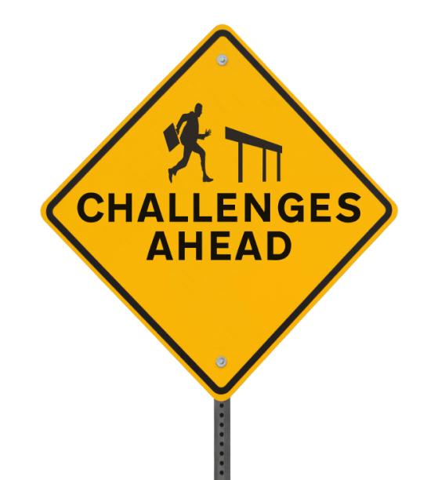
Potential CI Program Challenges
Organizational Leadership buy-in
Funding
Hiring a team of experienced CI Professionals
Organizational stovepipes
Development of key performance measures
No routine, relevant threat data from Government
No / limited access to secure DoD networks
Courtesy www.whitehouse.gov

Slide 28
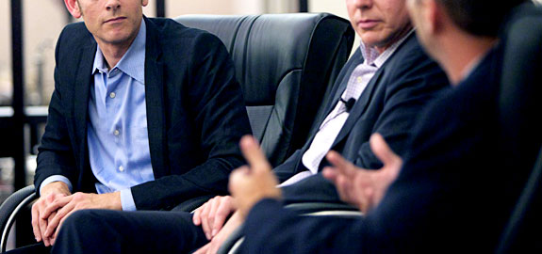
Selling the C-Suite
Hiring of Experienced CI Professionals (NISPOM Requirement)
Increasing Trends in Economic / Industrial Espionage
Examples of Cases:
DuPont
Shriver
Snowden
Corporate “Crown Jewels” (Intangible vs. Tangible Assets)
Cost Comparison (Investment vs. Potential Loss)
U.S. Chamber of Commerce: IP theft estimated to cost U.S. companies $200-$250 billion per year!
Program Benchmarking
Business Advantage
Courtesy www.NCIX.gov
Notes:
DuPont: Mar 2, 2012 - Former DuPont Co. employee Tze Chao pleaded guilty to conspiring to steal trade secrets about titanium dioxide technology from the company to Chinese….

Slide 29
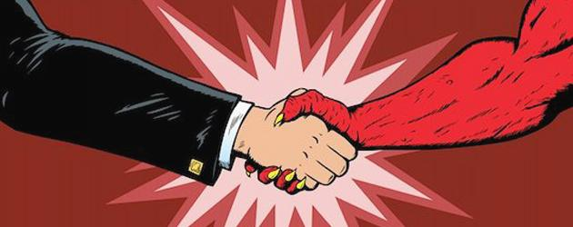
Business Advantage
Insider Threat Detection Programs are complex, expensive and may take years to achieve tangible results…
However…
The goal is survival in a hostile marketplace
If your data is secure, you can penetrate risky markets
In-depth Insider Threat Program a Business Discriminator
Your enemy is your business partner!

Slide 30
Summary
Threat is real
Nation States are quite capable
New tools in the tool bag
Social Media
Hiring
Government (DoD and IC) emphasizing CI within Private Sector
CI in Contracts
Supply Chain
Insider Threat - NISPOM Conforming Change #2
Importance of a dedicated CI program
Courtesy www.whitehouse.gov

Slide 31
Contact Info
James Scott
Security Manager
Investigations/ Counterintelligence
407-356-9396
James.o.scott@lmco.com

Slide 32
Back-up Slides

Slide 33
Government Response
Appointment of US Intellectual Property Enforcement Coordinator
Report to Congress on Foreign Economic Collection & Industrial Espionage
Executive Order 13587
Creation of the National Insider Threat Task Force
Administration Strategy on Mitigating The Theft of Trade Secrets
Anticipated NISPOM Conforming Change #2
Anticipated Insider Threat Language from the National Institute of Standards & Technology (NIST)
Pronouncement of April 26th, World Intellectual Property Day
CI Support to Contracts
CI Support to Global Supply Chain Operations
Courtesy www.whitehouse.gov

Slide 34
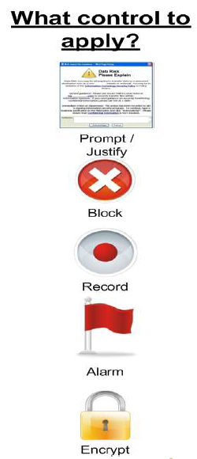
FBI Pop-up Example

