Slide 1
Derivative Classification Overview
Karen A. Demps
Industrial Security Specialist
March 12, 2014

Slide 2
General Disclaimer
Internal Use Only
All slides in this presentation are UNCLASSIED. They contain representations of classification marking solely for the purpose of training illustration.

Slide 3
Agenda
Initial Security Training
What Drove the Change
How Raytheon Company Implemented

Slide 4
Notes:
Thank you for giving me the opportunity to speak about Raytheon…
End of presentation.

Slide 5
Initial Training
Security Briefings
Initial Clearance Briefing (Instructor Lead)
Department of Defense (DoD) Annual Security Refresher (On-Line)
Security Reminders (Periodic)
Mandatory Initial and Annual Refresher Training

Slide 6
National Industrial Security Program
Internal Use Only
Established by E.O. 12829, 6 Jan. 1993
Secretary of Defense is executive agent for the NISP
Cleared employee participation in the NISP is governed by:
Contractual Obligations Standard Form (SF) 312, Classified Information Non-Disclosure Agreement (NDA)
United States Code – Title 18, United States Criminal Code
Regulations for generating, marking, handling and safeguarding classified information are governed by the National Industrial Security Program Operation Program (NISPOM)
Failure to maintain a security program in compliance with the NISPOM, or any additional guidance provided by the Cognizant Security Agency (CSA), can result in the possible loss of contract, debarment, and/or criminal sanctions (Company and/or individual) under code Titles 18 and 50
Governs the security program for defense contractors

Slide 7
Government Briefing Requirements
NISPOM paragraph 3-106
Requires an initial security briefing for all employees prior to being granted access to classified information
NISPOM paragraph 3-107
Requires annual refresher training for all cleared employees
Reinforces information provided during the initial security briefing and serves to keep employees informed of appropriate changes in security regulations
Annual refresher training accomplished via online LMS training course
LMS Course GSSDODARWB – DoD Annual Security Refresher Briefing
Employees receive automatic reminder notification via Lotus Notes
Failure to comply will result in the termination of your clearance
Annual refresher training is a mandatory DoD requirement

Slide 8
Derivative vs. Original Classification
 | Original Classification | Derivative Classification
What is it? | Initial determination that information requires protection against unauthorized disclosure in the interest of the national security | Developing new materials from existing classified information. Marking the newly developed materials consistent with the classification markings that apply to the source document
Who Does it? | ONLY government officials with authority to make original classification decisions | All cleared DoD and authorized contractor personnel who generate or create material from classified sources
Derivative Classification has far-reaching effects:
Helps protect our national security
Allows access only to cleared personnel
Impacts resources and security procedures
Defense contractors perform derivative classification only

Slide 9
Example Security Reminder
Marking Classified Material
Marking classified material (documents, media and hardware) with the proper classification is an essential step in reducing the possibility of unauthorized disclosure and loss of information
The following basic markings must appear on all cover pages, media labels and hardware tags
Overall classification (top and bottom)
Subject or title
Date originated
Contract number
Name and address of preparing facility
Derived from
Declassify on
Media labels and hardware tags used to identify the above information can be obtained from Classified Document Control (CDC)
Contact CDC for questions on marking and to obtain a guide for marking classified documents.
Unclassified
CONFIDENTIAL
Flight Scope (U)
January 4, 2008
Contract Number
Raytheon Company
6380 Hollister Avenue
Goleta, CA 93117
Derived from: Security Classification Guide No. 128, 6/12/1976, Department of Good Works
Declassify on: 04/15/2010
CONFIDENTIAL
Above example is Unclassified and is for training purposes only
Raytheon Largo/St Petersburg Security Reminder

Slide 10
Notes:
Thank you for giving me the opportunity to speak about Raytheon…
End of presentation.

Slide 11
Requirements Driven Training
Executive Order

Slide 12
Derivative Classification Training
Internal Use Only
E.O. 13526 established new standards for the classification of national security information
Prior to applying derivative classification, cleared personnel must be trained in proper application of derivative classification principles
Requires successful completion of the online “Derivative Classification Training” course available via LMS (Course SECGSSDERIVEWB)
Derivative classifiers who do not complete the online training at least once every 2 years, shall not be authorized or allowed to derivatively classify information until they have completed the required training
It is crucial that derivative classifiers follow appropriate procedures and observe all requirements when applying derivative classification marking
Must complete required training once every 2 years

Slide 13
Security Classification Guidance
Internal Use Only
Security Classification Guidance:
Any instruction or source that prescribes the classification of specific information
Purpose:
To communicate classification decisions
To ensure consistent treatment of information
To provide appropriate protection of information
3 Primary Sources of Classification Guidance
SCG & DD-254 available from Program Managers, IPT Leads, Contracts & Security
Notes:
Changed bar text at bottom.

Slide 14
Security Classification Guide (SCG)
Internal Use Only
Preferred method for communicating original classification decisions
Specific to a system, plan, program, or project
Allows Originating Classification Authority (OCA) to identify:
Classification instructions
Downgrading instructions
Declassification instructions
Special handling caveats
Relevant unclassified information
It is critical you understand what’s classified about your work!

Slide 15
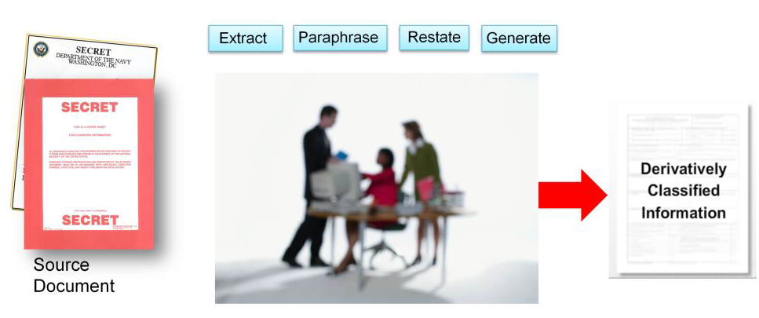
Properly Marked Source Document
Internal Use Only
Properly marked source document from which information is extracted, paraphrased, restated, and/or generated in a new form for inclusion in another document
Must complete the LMS online “Derivative Classification Training” prior to performing derivative classification
Notes:
Change applying to performing

Slide 16
Notes:
Thank you for giving me the opportunity to speak about Raytheon…
End of presentation.

Slide 17
How Raytheon Company Implemented
Raytheon – Global Security Services
Implemented Derivative Classification training in September 2013
Raytheon Learning Management System (LMS) Course for Derivative Classifiers
Raytheon – Largo and St Petersburg, FL
All cleared employees with User accounts for classified information systems required to complete LMS training
All security department employees completed training
Training expanded to capture all cleared employees

Slide 18
Raytheon Learning Management System
Course: SECGSSDERVIEWB

Slide 19
Raytheon Learning Management System
Course: SECGSSDERVIEWB

Slide 20
Raytheon Learning Management System
Course: SECGSSDERVIEWB

Slide 21
Raytheon Learning Management System
Course: SECGSSDERVIEWB

Slide 22
Raytheon Learning Management System
Course: SECGSSDERVIEWB

Slide 23
Notes:
Thank you for giving me the opportunity to speak about Raytheon…
End of presentation.

Slide 24
References
Defense Security Service (DSS) Website
www.dss.mil
Security Training, Education and Professionalization Portal (STEPP).
Derivative Classification IF103.16
Derivative Classification Training Job Aid (Booklet)
Center for Development of Security Excellence
www.cdse.edu

Slide 25
Notes:
Thank you for giving me the opportunity to speak about Raytheon…
End of presentation.

Slide 26
QUESTIONS?
Karen Demps
727.302.3415
Karen_A_Demps@raytheon.com

