Slide 1

Defense Security Service
Risk Management Framework (RMF) For Cleared Industry Partners
Version 1.0 – January 2017

Slide 2
RMF Basics
What is Risk Management Framework (RMF)?
    A unified information security framework for the entire federal government that replaces legacy Certification and Accreditation (C&A) processes applied to information systems (ISs).
    A key component of an organization’s information security program used in the overall management of organizational risk.

Slide 3
RMF Basics
When will RMF replace C&A?
    Effective on October 3, 2016, Multi-User Standalones (MUSA) and Single-User Standalones (SUSA) must execute the RMF process for expiring C&A accreditations and new submittals.
    Transition date for Local Area Networks (LAN) and Wide Area Networks (WAN) will be determined by DSS National Industrial Security Program Authorization Office (NAO) in early 2017. We encourage being proactive beginning with training and planning for RMF transition.

Slide 4
Key Factors Driving the Transition to RMF
Effective and Efficient Risk Management
Shift from a static, “check-the-box” mentality to a flexible, dynamic approach to assess and manage risk more effectively and efficiently.
Common Foundation for Information Security
Implement a common foundation for information security that aligns to federal government standards and ensures a more uniform and consistent approach to manage risk associated with the operation of a classified IS.
DSS is implementing the RMF process to assess and authorize IS.
Trust Across the Federal Government
Build reciprocity with other federal agencies to develop trust across the federal government through a more holistic, flexible, and strategic process.
Streamline DSS processes
Streamline DSS processes to support the authorization of cleared contractors’ ISs processing classified information as part of the NISP.

Slide 5
RMF Transition Information
Local Area Network, Wide Area Network or Interconnected System between August 1, 2016 – 28 February 2017
System Type | Transition Timeline / Instructions
Multi-User Standalone (MUSA)/Single-User Standalone (SUSA) | Execute RMF Assessment and Authorization through the Defense Assessment and Authorization Process Manual (DAAPM). Standalones are no longer allowed to be self-certified under the C&A Process. Be Proactive and Plan Ahead. RMF is a new process for both ISSPs/SCAs and ISSMs. Therefore, RMF Authorizations may take additional time depending on RMF training, knowledge, and tools. Existing C&A Accredited MUSA/SUSA – Develop a Plan of Action and Milestones (POA&M) for transition to RMF.
Local Area Network (LAN)/ Wide Area Network (WAN) | Phase 1: Continue using the current C&A process with the latest version of the ODAA Process Manual. ATO will last no greater than 18 months starting October 3, 2016. Within six months of authorization termination date, develop a POA&M for transition to RMF. Phase 2: Execute RMF Assessment and Authorization process through the DAAPM. (Timeline TBD.)

Slide 6
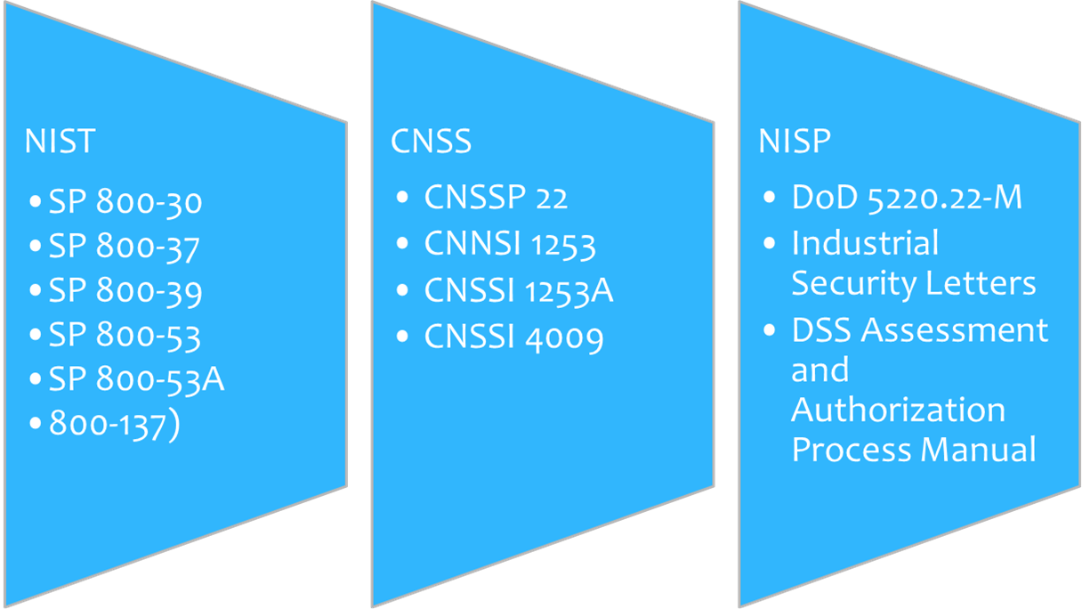
RMF Policy References
Local Area Network, Wide Area Network or Interconnected System between August 1, 2016 – 28 February 2017

Slide 7
RMF Process Stakeholders – New Terminology
Many RMF stakeholder titles have been revised in the transition from C&A. The following table outlines former terms in the C&A process as well as the corresponding new terms in the RMF process. Both sets of terms will continue to be used during the transition to RMF.
Old Term in the C&A Process | New Term in the RMF Process
Designated Approving Authority (DAA) | Authorizing Official (AO)
Regional Designated Approving Authority (RDAA) | Regional Authorizing Official (RAO)
Office of the Designated Approving Authority (ODAA) | NISP Authorization Office (NAO)
Information Systems Security Professional (ISSP) | ISSP/Security Control Assessor (SCA)
Customer, Government Contracting Activity (GCA) | Information Owner (IO)
Contractor | Information System Owner (ISO)
*Information Systems Security Manager (ISSM) | ISSM
*Information Systems Security Officer (ISSO) | ISSO
*Titles will remain the same in RMF.

Slide 8
Connecting the Dots – What is Changing? What is staying the same?
Process | C&A | RMF
ODAA Business Management System (OBMS) | Same | Same
System Security Plan (SSP) Template | C&A Template | RMF Template
Categorization | Basic, Med, High PLs | Low, Mod, High Accessibility
Certification Statement | Same | Same
Risk Acknowledgement/Tailoring-out | Risk Acknowledged | Tailored-Out/Risk Acknowledgement
MOU | MOU | MOU/ISA
Standing-Up Like System | Self- Certification | Type Authorization
Controls | NISPOM Refs | NIST Controls
Approval to Process | Accreditation | Authorization

Slide 9
Connecting the Dots – What is Changing? What is staying the same?
Process | C&A | RMF
Submit Artifacts within OBMS | SSP Certification Statement Profile | SSP Certification Statement POA&M Risk Assessment Report SSP Supporting Artifacts
Issues Related to Authorization | Comments Form | Terms & Conditions/System Assessment Report (SAR)

Slide 10
RMF Process Walk Through: Introduction
Starting Point
1. CATEGORIZE Information System
ISSM conducts risk assessment to determine system categorization (confidentiality, integrity, and availability).
6. MONITOR
Security Controls
2. SELECT Security Controls
ISSM continuously tracks and reports IS changes to the ISSP IAW the Continuous Monitoring Plan/Strategy.
ISSM selects security controls and applies tailoring and supplemental controls as needed based on risk assessment. ISSP reviews SSP and provides concurrence.
NISP Assessment & Authorization Life Cycle
5. AUTHORIZE Information System
3. IMPLEMENT Security Controls
AO determines risk.
If acceptable, AO formally authorizes system to operate.
ISSM implements security controls selected for the IS.
4. ASSESS
Security Controls
ISSM conducts self-assessment and updates the SSP to reflect the actual state of the IS. ISSP reviews submitted SSP and assesses the IS.

Slide 11
RMF Process Walk Through -
STEP 1: Categorize IS
ISSM Actions:
Categorize the IS based on the impact due to a loss of confidentiality (moderate/high), integrity (low/moderate/high), and availability (low/moderate/high) of the information or IS according to information provided by the Information Owner/Government Contracting Activity (GCA). (Note: Absent any other contractual requirements, Industry may use the DSS baseline of moderate/low/low.)
Perform a Risk/Threat Assessment and ensure a Risk Assessment Report (RAR) is completed.
Document the description, including the system/authorization boundary, in the System Security Plan.
Assign qualified personnel to RMF roles and document team member assignments in the SSP.
Artifact(s): Risk Assessment Report and Initial SSP
Reference(s): NIST SP 800-30: Guide for Conducting Risk Assessments

Slide 12
RMF Step 1 – Risk Assessment Report (RAR)
What guide is used when conducting a Risk Assessment?
    NIST 800-30 Rev 1, Guide for Conducting Risk Assessments
What is the purpose of the RAR?
    Inform decision makers and support risk responses by identifying:
      Relevant threats
      Vulnerabilities both internal and external to the organization
      Impact to the organization that may occur given the potential for threats exploiting vulnerabilities
      Likelihood that harm will occur
    The end result is a determination of risk.
    The RAR will be used to “fine tune” security controls for the life of the system

Slide 13
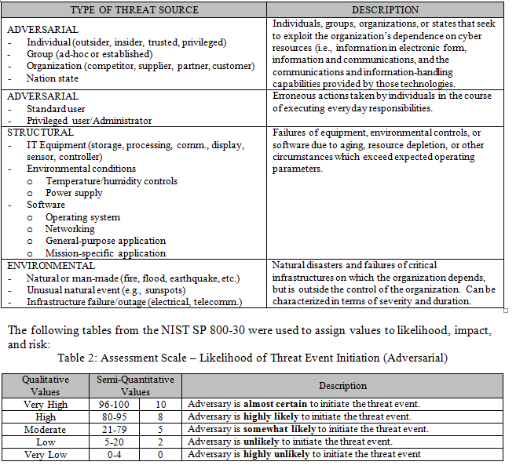
RMF Step 1 – Risk Assessment Report (RAR)

Slide 14
RMF Process Walk Through –
Step 2: Select Security Controls
ISSM Actions:
Select the security control baseline applicable to the IS. The selection is based upon the results of the categorization.
Tailor the controls as needed by supplementing, modifying, or tailoring out controls to effectively manage risk for any unique system conditions.
Develop a strategy for continuous monitoring of security control effectiveness.
Document the security controls selection results in the SSP.
Submit the RAR and initial SSP via OBMS.
ISSP/SCA Actions:
Review the initial SSP and RAR to ensure it meets the necessary security requirements and effectively identifies potential risks to the IS. The ISSP/SCA also reviews the ISSM-recommended deltas from the standard baseline.
Documents concurrence or non-concurrence in the Categorization & Implementation Concurrence Form.
Categorization & Implementation Concurrence Form is returned to ISSM via OBMS.

Slide 15
RMF Process Walk Through –
Step 2: Select Security Controls
ISSM Actions:
If concurrence for both categorization and selection of initial baseline controls is issued, proceed to RMF Step 3.
If non-concurrence is issued, address outstanding issues documented in Categorization & Implementation Concurrence Form. Once issues are addressed, resubmit the RAR and initial SSP via OBMS.
Artifact(s): Initial SSP with identified controls, Continuous Monitoring Strategy, RAR, and Categorization & Implementation Concurrence Form
Reference(s): CNSSI 1253: Security Categorization and Control Selection for National Security Systems and DAAPM (Appendix D)

Slide 16
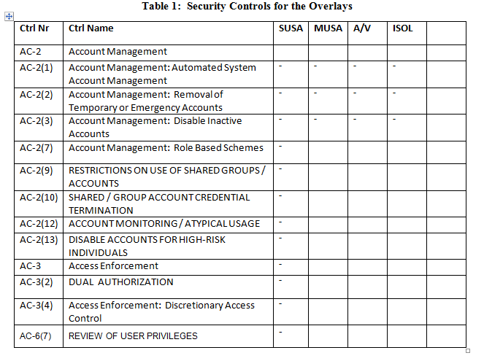
RMF Step 2 – Security Controls - Overlays

Slide 17
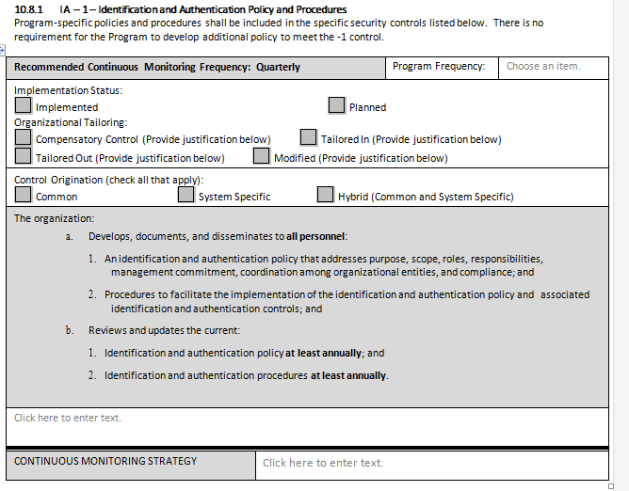
RMF Step 2 – SSP Controls

Slide 18
RMF Process Walk Through –
Step 3: Implement Security Controls
ISSM Actions:
Implement security controls as determined in Step 2.
Revise the SSP in order to document the security control implementation.
Start a Plan of Action and Milestones (if applicable).
Conduct an initial assessment to facilitate early identification of weaknesses and deficiencies.
Document the security control implementation in the SSP.
Artifact(s): Updated SSP with a functional description of security control implementation.
Reference(s): CNSSI 1253: Security Categorization and Control Selection for National Security Systems, NIST SP 800-53: Security and Privacy Controls for Federal Information Systems and Organizations, and DAAPM (Appendix D)

Slide 19
RMF Process Walk Through –
Step 4: Assess Security Controls
ISSM Actions:
Conduct an initial assessment of the effectiveness of the security controls in accordance with the security procedures defined in the SSP.
Utilize the Defense Information System Agency (DISA) vulnerability scanning tools (SCAP Compliance Checker and DISA STIG Viewer) and the DSS Technical Assessment Job Aids to support the initial assessment. If the IS cannot be assessed utilizing the specified scanning tools, please document the justification in the SSP.
Finalize the SSP to reflect the actual state of the security controls, as required, based on the vulnerabilities of the security control assessment, reassessment, and completion of any remediation actions taken.
Submit the final SSP, Certification Statement, RAR, POA&M, and supporting artifacts via OBMS.
Artifact(s): Final SSP, Certification Statement, RAR, POA&M, and SSP Supporting Artifacts Reference(s): DAAPM and NIST SP 800-53A: Assessing Security and Privacy Controls in Federal Information Systems and Organizations: Building Effective Assessment Plans

Slide 20
RMF Process Walk Through –
Step 4: Assess Security Controls
ISSP/SCA Actions:
Receives/Reviews the final SSP, Certification Statement, RAR, POA&M, and SSP Supporting Artifacts via OBMS.
If the SSP is acceptable and the documentation fully addresses all system security controls and security configurations, an on-site validation will be scheduled.
Perform an on-site validation:
  Assess the technical security controls and system configuration utilizing the DISA vulnerability scanning tools (SCAP Compliance Checker/DISA STIG Viewer).
  Document any weaknesses and deficiencies within the Security Assessment Report.
  Identify necessary remediation actions in the POA&M.
The ISSP/SCA schedules a revalidation visit if necessary and makes final updates to the SAR.
Artifact(s): Final SSP, POA&M, and SAR
Reference(s): DAAPM and NIST SP 800-53A: Assessing Security and Privacy Controls in Federal Information Systems and Organizations: Building Effective Assessment Plans

Slide 21
RMF Process Walk Through –
Step 5: Authorize the IS
ISSP/SCA Actions:
Completes Security Authorization Package.
Make risk based recommendation and submits Security Authorization Package to AO.
AO Actions:
Assess the Security Authorization Package and issue an authorization decision. The authorization decision will be an Interim Authorization to Operate (IATO), Authorization to Operate (ATO), or Denial of Authorization to Operate (DATO). The authorization decision will include any terms and conditions of operation as well as the authorization termination date (ATD).
The Authorization Letter will be provided to the ISSM via OBMS.
Artifact(s): Authorization Letter
Reference(s): DAAPM

Slide 22
RMF Process Walk Through –
Step 6: Monitor the IS
ISSM Actions:
Determine the security impact of proposed or actual changes to the IS and its operating environment and inform the ISSP/SCA as necessary.
Assess a selected subset of the security controls, based on the approved continuous monitoring strategy, and inform the ISSP/SCA of the results.
Update SSP documentation and work to satisfy POA&M requirements. Provide regular status reports to the ISSP/SCA per the continuous monitoring strategy.
Conduct any necessary remediation actions based on findings discovered during continuous monitoring.
Ensure IS security documentation is updated and maintained. Review the reported security status of the IS.
As necessary, develop and implement an IS decommissioning strategy.
Artifact(s): Updated POA&M, Updated SSP, Status Reports, Decommissioning Strategy (as necessary), and Continuous Monitoring Strategy.
Reference(s): DAAPM and NIST SP 800-137: Information Security Continuous Monitoring (ISCM) for Federal Information Systems and Organizations

Slide 23
Security Controls and Continuous Monitoring
The RMF process will manage risk more effectively through the introduction of security controls and continuous monitoring of those controls.
Purpose of Security Controls and Continuous Monitoring | Benefits of Security Controls and Continuous Monitoring
Assess security control effectiveness for an IS Document changes to the IS or its environment of operation Conduct security impact analyses of associated changes Report the security status of an IS | Facilitate more efficient enterprise management of cybersecurity Increase security in the system development and acquisition processes Ensure compliance with national standards and reporting requirements
National Industrial Security Program Operating Manual (NISPOM)
NIST SP 800-37: Guide for Applying the Risk Management Framework to Federal Information Systems
NIST SP 800-53: Security and Privacy Controls for Federal Information Systems and Organizations
NIST SP 800-137: Information Security Continuous Monitoring (ISCM) for Federal Information Systems and Organizations
NIST SP 800-53A: Assessing Security and Privacy Controls in Federal Information Systems and Organizations: Building Effective Assessment Plans
Committee on National Security Systems Instruction (CNSSI) 1253: Security Categorization and Control Selection for National Security Systems
Resources to assist in the RMF Process
Many additional resources can be found on the NIST website (www.nist.gov)

Slide 24
Type Authorization
Under RMF, Self-Certification has been replaced with Type Authorization.
Type Authorization means that "like" systems can be authorized under the same authorization package without going through the whole authorization process. This is similar to the self-certification process today. However, multiple Master System Security Plans (MSSPs) cannot be used to define "like" systems. The system must be "like" the system authorized in the MSSP.
The ISSM may add “like” systems to the MSSP AFTER the AO has determined that the ISSM has the requisite knowledge and skills to manage multiple IS under one MSSP. If Type Authorization authority is granted, it will be documented in the Authorization to Operate.
Type Authorized Systems must be acknowledged by the ISSP prior to use.

Slide 25
Proposal Systems
Options are available that will allow Industry to respond to Requests for a Classified Proposal in a timely manner and allow NAO to maintain appropriate oversight.
    Since the majority of Proposal Systems are stand-alone systems with the Categorization of Moderate-Low-Low, the ISSMs can take proactive measures utilizing the DSS Overlays and DISA Scanning Tools to prepare the SSP and configure the IS.
    The Authorizing Official has the authority to issue an Interim Authorization to Operate for a limited period of time with the option to waive the on-site validation. If the AO does not concur with waiving the on-site validation, the on-site may still be required. The AO will make that determination.

Slide 26
Diskless Workstations
A diskless workstation is a system that boots either from a CD or the local network and lacks the ability to store data locally to the machine. These types of systems require authorization using the established baseline security controls, then tailoring those security controls to address the specifics of that system.
The ISSM will submit an SSP package with the proposed tailored security control set for review by the ISSP, as they do with other systems.
The ISSP will evaluate the SSP package to determine if the management, operational, and technical controls identified in the plans are adequate to protect the classified information resident on the IS, with the understanding that several categories of systems can be adequately secured without implementation of complete security control set in the baseline.

Slide 27
Assessment Tools – DISA Scanning Tools
For information systems authorized under RMF, DSS will conduct an assessment of the technical security controls and IS system configuration utilizing the DISA vulnerability scanning tools (SCAP Compliance Checker and DISA STIG Viewer) in accordance with the NISP.
The SCAP Compliance Checker, STIG Viewer, and applicable SCC content must be installed on the IS. If the IS cannot be assessed utilizing the specified scanning tools, please document the justification in the System Security Plan.
The Getting Started with the SCAP Compliance Checker and STIG Viewer Job Aid is available on the DSS website (www.dss.mil/rmf).

Slide 28
Assessment Tools – DISA Scanning Tools
SCAP Compliance Checker
  Automated vulnerability scanning tool that utilizes DISA STIGs/OS specific baselines to analyze and report on the security configuration.
  The tool can be run locally on the host system to be scanned, or scans can be conducted across a network.
PKI enabled – DISA IASE webpage (http://iase.disa.mil/stigs/scap/Pages/index.aspx)
Non-PKI Enabled – MAX.gov homepage (Search for “SCAP”)
  If issues contact MAXSupport@omb.eop.gov or call 202-395-6860.

Slide 29
Assessment Tools – DISA Scanning Tools
STIG Viewer
  Used in conjunction with the SCAP Compliance Checker to view compliance status of the system’s security settings.
  The unclassified DISA STIG Viewer, non-PKI controlled, tool can be downloaded on DISA’s Information Assurance Support Environment (IASE) website: http://iase.disa.mil/stigs/Pages/stig-viewing-guidance.aspx
Operating System Baselines
  Ensure the appropriate OS baseline is downloaded.
  STIG Viewer uses OS baselines to generate checklists used for vulnerability assessments.
  The unclassified, non-PKI controlled, can be downloaded at DISA’s IASE website: http://iase.disa.mil/stigs/os/Pages/index.aspx

Slide 30
RMF Helpful Hints
RMF is a new process for both ISSPs and ISSMs. Success can only be achieved by becoming familiar with the DAAPM and utilizing all available resources. The DAAPM is the ultimate authority.
As with any new process, the first SSP submission will be the most challenging. After the first SSP submission is completed, the process will become more routine.
The DSS Risk Management Framework Information and Resources Web Page provides links to Policy/Guidance, Resources, Training, and Toolkits.
Helpful information can also be accessed at the RMF Knowledge Service Webpage (https://rmfks.osd.mil/login.htm).

Slide 31
DSS RMF Information and Resources Web Page www.dss.mil/rmf
Policy and Guidance
      National Industrial Security Program Operating Manual
      NIST 800-53 Security & privacy Controls for Federal Information Systems and Organizations
      ODAA Process Manual
      JSIG Guidance for Special Access Programs (SAP)
      DSS Assessments and Authorization Process Manual
      Committee on National Security Systems Instruction (CNSSI) 1253 (March 2014)
      DoD 8510.01 Risk Management Framework for DoD Information Technology

Slide 32
DSS RMF Information and Resources Web Page www.dss.mil/rmf
Resources
      Getting Started with Risk Management Framework (October 2016)
      NISPOM to NIST 800-53v4 Security Control Mapping (May 2016)
      Plan of Action and Milestones (POA&M) Job Aid
      Plan of Action and Milestones (POA&M)
      SCAP Compliance Checker & DISA STIG Viewer
      DISA STIG Viewer
      System Security Plan Template (October 2016)
      System Security Plan Template Appendices (August 2016)
      Technical Assessment Guide for Windows 7 Operating Systems
      Technical Assessment Guide for Windows 10 Operating Systems
      Technical Assessment Guide for Windows Server 2012 Operating Systems
      Technical Assessment Guide for RHEL 6
      ISSM-ISSO Appointment Letter Template
      National Industrial Security Program Authorization Office (NAO) Homepage
      Risk Assessment Report Template (September 2016)

Slide 33
DSS RMF Information and Resources Web Page www.dss.mil/rmf
Training
      CDSE
      Introduction to the Risk Management Framework
      Getting Started with the SCAP compliance checker and STIG Viewer
      Applying the Risk Management Framework to Federal Information Systems
      DSS RMF Training Slides
Toolkits
      SCAP Compliance Tools and Products

Slide 34
CDSE Training Courses
RMF Courses
      Introduction to RMF (CS124.16)
      Continuous Monitoring (CS200.16)
      Categorization of the System (CS102.16)
      Selecting Security Controls (CS103.16)
      Implementing Security Controls (CS104.16)
      Assessing Security Controls (CS105.16)
      Authorizing Systems (CS106.16)
      Monitoring Security Controls (CS107.16)

Slide 35
      Questions?
      Contact your local ISSP or visit http://www.dss.mil/rmf/.

