Slide 1
Counterintelligence &
The Insider Threat
Ken Zabella
Intel Analyst Sr Manager

Slide 2
agenda
Understanding the Insider Threat
Insider Threat Trends
Insider Threat Program

Slide 3
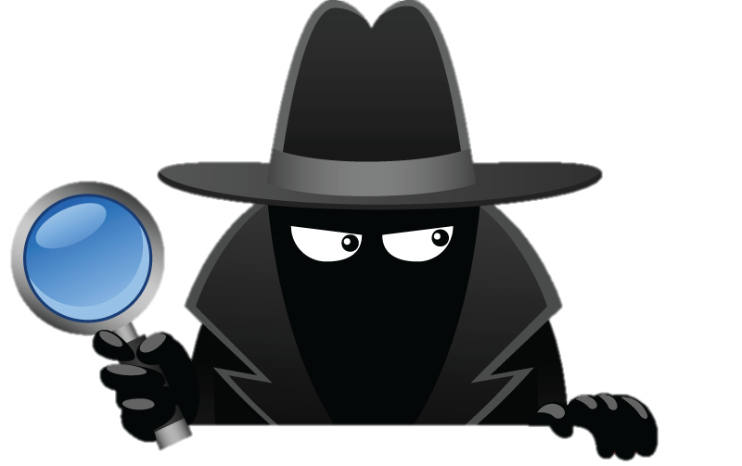
What is counterintelligence?
Simply Stated:
Counterintelligence (CI) is about identifying intelligence threats and developing mitigation strategies to address and neutralize those threats
DETER - DETECT - MITIGATE

Slide 4
2017 Dss trends
METHODS OF CONTACT
The approach used to connect the foreign actor to the targeted individual, information, network, or technology in order for the foreign actor to execute the MO(s)
Telephone
Résumé - Professional
Phishing Operation
Mail
Email
Conference, Conventions, or Trade Shows
Web Form
Social Networking Service
Résumé - Academic
Personal Contact
Foreign Visit
Cyber Operations
How?
Who?
What?
METHODS OF OPERATION
A distinct pattern or method of procedure thought to be characteristic of or habitually followed by an individual or an organization involved in criminal or intelligence activity
Exploitation of Business Activities
Attempted Acquisition of Technology
Exploitation of Experts
Exploitation of Cyber Operations
Exploitation of Relationships
Exploitation of Insider Access
Exploitation of Supply Chain
Exploitation of Security Protocols
RFI/Solicitation
Résumé Submission
Theft
Surveillance
Search/Seizure

Slide 5
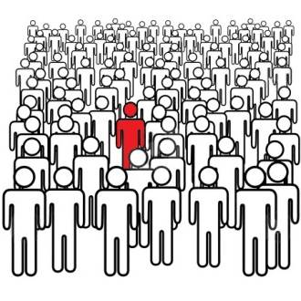
Identifying the insider
It’s not this easy!
The Insider can be easily missed

Slide 6
What is the insider?
INSIDER: Any person with authorized access to any US Government resource, to include personnel facilities, information, equipment, networks, or systems.
INSIDER THREAT: “The threat presented by a person who has, or once had, authorized access to information, facilities, networks, people, or resources; and who wittingly, or unwittingly, commits: acts in contravention of law or policy that resulted in, or might result in, harm through the loss or degradation of government or company information, resources, or capabilities; or destructive acts, to include physical harm to others in the workplace.”
someone with authorized access doing unauthorized things

Slide 7
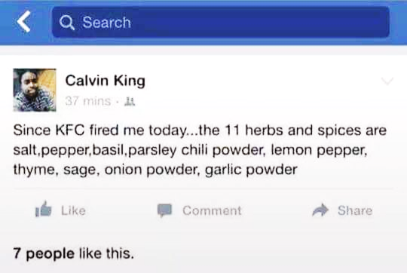
TYPES Of insiders
Unintentional Insiders. Getting a laptop stolen or uploading the wrong file may seem innocuous, but these actions can unintentionally cause massive damage. A recent survey by the International Security Forum found that the vast majority of insider breaches are actually accidental. This is small solace in the aftermath of an incident.
Exploited Insiders. External attackers commonly target high-value employees who have privileged access with spear phishing emails. On average, for every 10 phishing emails sent out, at least one employee will click on a link that infects his machine, giving attackers the foothold they need to execute an attack. Once attackers gain access to an endpoint, they target and steal privileged credentials, exploiting them to escalate access privileges and move laterally through the network until they reach and gain full domain-level access. This gives them full control over sensitive data and IT systems.
External Insiders. More than 60 percent of organizations allow third-party vendors to remotely access their internal networks with the same privileges and access levels as internal employees. Despite this access, these users are not managed by the host organization, but by the contractor, making it incredibly difficult to secure their privileged access to IT resources. Further, contractors are often targeted by external attackers, as in the hack at the Office of Personnel Management where a contractor was hacked and his privileged credentials were used to infiltrate the system.
Malicious Insiders. These are the real bad guys -- malicious, disgruntled employees who knowingly and purposely abuse their internal access to wreak havoc. They typically have the knowledge, access, information and desire needed to bypass existing security solutions to complete their task. Malicious insiders are often the most difficult to detect and the costliest to clean up after.
GCN.com

Slide 8
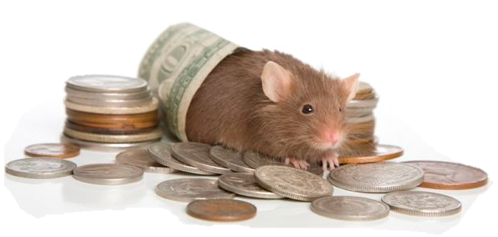
Identifying the insider – Motives
“MICE”
Money
Ideology (includes divided loyalty)
Coercion/Compromise
Ego
The model now also includes:
Disgruntlement
Revenge/Vindictiveness
Alcoholism/Drug Abuse
Ingratiation

Slide 9
Potential insider threat indicators - behaviors
Difficulty controlling emotions
Unusual level of pessimism
Unusual level of sadness
Change in beliefs
Sudden change in work performance
Inappropriate response to stress at work
Inability to cope with stress at work
Responds poorly to criticism
Emotional
Disgruntled
Selfish
Manipulative
Irritable
Threatening
Domineering
Harassment
Argumentative
Poor teamwork
Retaliatory behavior
Superiority complex
Above following rules
Relationship, Personal, Financial
Issues
Marriage problems
Divorce
Stress at home
Inappropriate response to stress at home
Inability to cope with stress at home
Sudden, unexplained affluence
Financial trouble
Irresponsibility
Ego

Slide 10
Potential RISK indicators - activities
Attempts to bypass security controls
Request for clearance or higher level access
Unjustified work pattern
Chronic violation of organization policies
Decline in work performance
Irresponsible social media habits
Unexplained sudden affluence
Outward expression of conflicting loyalties
Unreported foreign contacts / foreign travel
Maintains access to sensitive data after termination notice
Visible disgruntlement towards employer
Use of unauthorized digital external storage devices

Slide 11
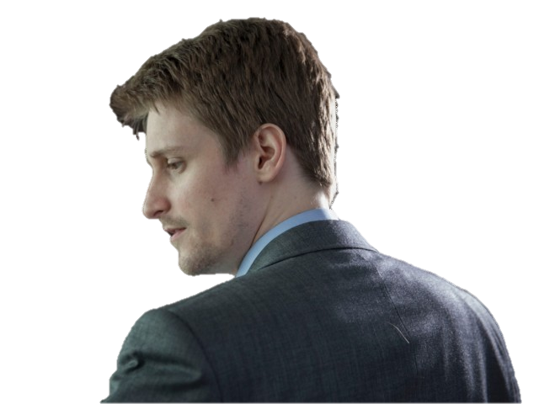
Case study: ???
Disgruntled
Superiority Complex
Background full of falsehoods, exaggerations and omissions
Clearance concerns
Told security investigators he should not be given access to secrets
Incomplete investigation and security violation
Arrogant
Argumentative
Inconsistent and unauthorized work hours
Conflicting loyalties
“the United States caused problems for China but China never caused problems for the United States”
Openly defended previous Army insider
Attempts to bypass security controls … Successfully
EDWARD SNOWDEN

Slide 12
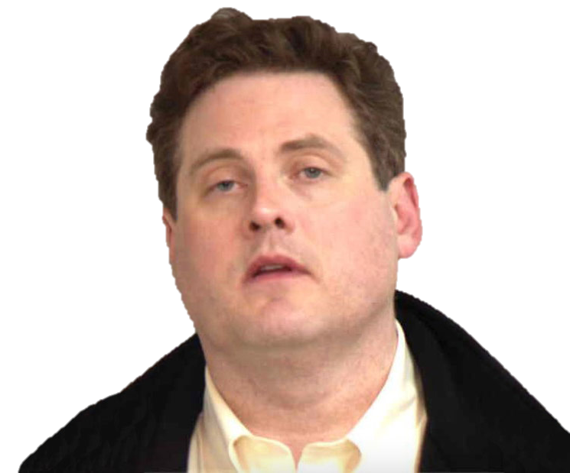
Case study: ???
Drinking problems
Drunk driving arrest
Unpaid tax bills
Two divorces
Computer harassment charge
Posed as police officer during traffic dispute
Drafted a message criticizing the government’s internal security measures
Mental health concerns
Hoarder
HAROLD T MARTIN III

Slide 13
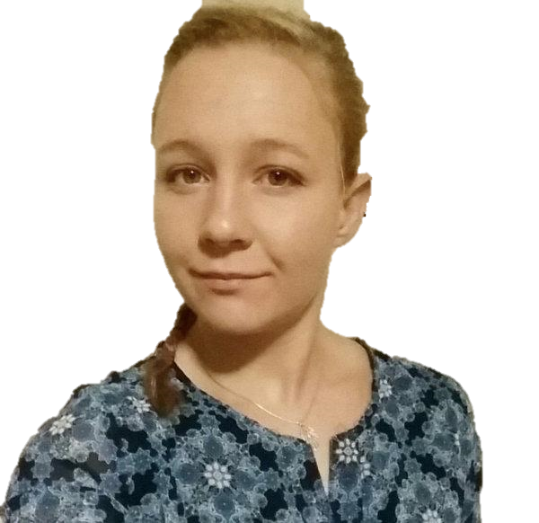
Case study: ???
Wrote on Twitter “the most dangerous entry to this country was the orange fascist we let into the White House”
Facebook described President Trump as “a soulless ginger orangutan”
Expressed support for Taliban leaders and Osama bin Ladin
Stated: “It’s a Christlike vision to have a fundamentalist Islamic State”
Praised Edward Snowden
Retweeted government leaks
Handwrote notes about “burning down the White House, fleeing to Afghanistan and joining the Taliban”
REALITY WINNER

Slide 14
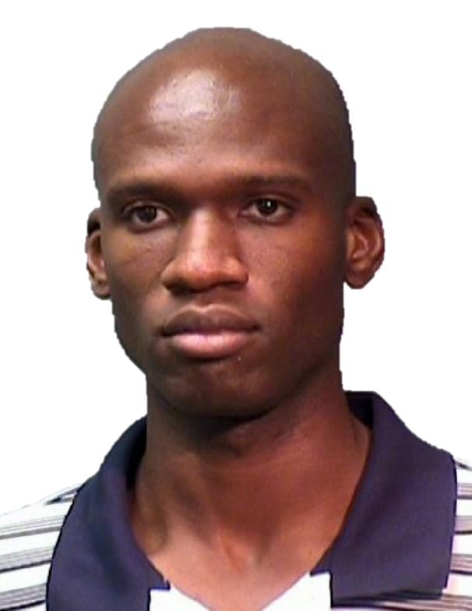
Case study: ???
Anger, anxiety and potential mental heath issues
After receiving clearance, cited at least 8 times for misconduct over 3 years in the Reserve
disorderly conduct, drunkenness and absence without leave, all later dropped
Arrested for shooting the rear tire of a construction vehicle because the worker disrespected him
Fired a bullet into his ceiling and through the apartment above
Arrested on disorderly conduct charge for destroying furnishings in a nightclub
Complained that individuals were using a microwave to send vibrations into his body
Roommate reported frequent drinking and paranoia that people were “coming to get him”
AARON ALEXIS

Slide 15
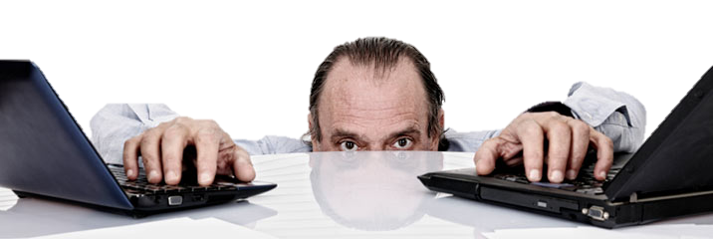
Insider threat trends – when does it happen?
59% of employees leaving a company admit to taking proprietary information with them (FBI)
Out of 800 adjudicated insider threat cases, an overwhelming majority of subjects took the information within the last 30 days of employment (CERT; Carnegie Mellon)
60% of cases were individuals who had worked for the organization for less than 5 years (CPNI)
Majority of acts were carried out by staff (88%), 7% were contractors, and 5% temporary staff (CPNI)

Slide 16
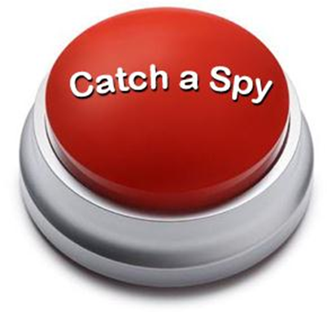
How to catch a spy?
What is the most common way that spies within the U.S. Government and U.S. cleared defense contractors are detected and caught? A: Routine counterintelligence monitoring B: Tip from friend, family, co-worker C: Their own mistakes D: Reporting by U.S. sources within foreign intelligence services
Answer: D – There is no loyalty in the spy business, and intelligence officers who have been recruited as sources by the U.S. Intelligence Community eagerly betray the U.S. persons who have given them information

Slide 17
What are we doing?
LET’S TALK!
Invested in a dedicated CI program
Identification of Critical Assets
Risk Analysis and Mitigation System (RAMS)
Sharkcage
FSO CI Awareness Report
Middle Way Initiative
Off the Grid Program
Overarching Goal
Deter – Detect - Mitigate

Slide 18
Methods of operation
Mitigation Strategy
Criminal Activity
CLEAR / TIP
Training & Awareness
Location-specific Threat Product
Request For Information
Trade / Airshow Support
Training & Awareness
‘Contact Us’ Email Box Reporting
Exploitation Of Relationships
Training & Awareness
Program Management (Joint Ventures) Targeted Training
Surveillance
Training & Awareness
Trade / Airshow Support
Academic Solicitation
LM Fellows Training & Awareness
FLE / IC Engagement
Foreign University IP Tracking
Suspicious Network Activity
Embargoed VPN
Shark Cage
DSC Loaner Laptop Policy
CIRT Reporting To DC3 And DCISE
Foreign Visit
Visit Management System
Training & Awareness
FLE / IC Engagement
ISTART Post-travel Security Survey
Seeking Employment
Cyber Alerts On Letter From Direct Competitors
Talent Acquisition Training
Acquisition Of Technology
Supply Chain / Procurement Training
‘Contact Us’ Email Box Reporting
Support To Mergers & Acquisitions
FLE / IC Engagement
Trade / Airshow Support
Solicitation / Marketing Services
Training & Awareness
Trade / Airshow Support
‘Contact Us’ Email Box Reporting
Search / Seizure
DSC Loaner Laptop Policy
Training & Awareness
Foreign Travel Pre-briefs

Slide 20
Contact information
Ken Zabella
Enterprise Operations
CI & Investigations Senior Manager
407-306-6764
Ken.J.Zabella@lmco.com

