Slide 1
Continuous Monitoring
RMF Step 6 Under NISP RMF

Slide 2
Objectives
Recap the Six Steps in the RMF Process
DSS-provided RMF Guidance and Resources
Overview of an RMF Continuous Monitoring (CONMON) Strategy
Example of CONMON Tracking Document
Overview of the 18 Security Control Families
Review and Discuss Selected Security Controls

Slide 3
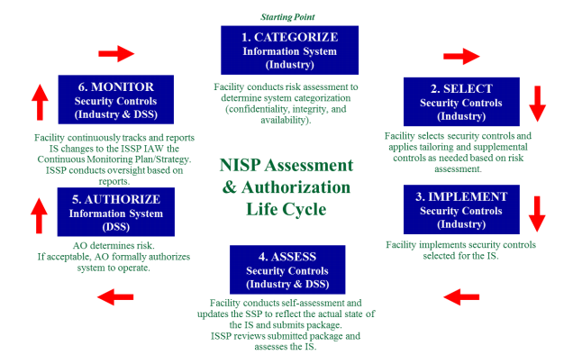
The Six RMF Steps
(from DAAPM v1.3)

Slide 4
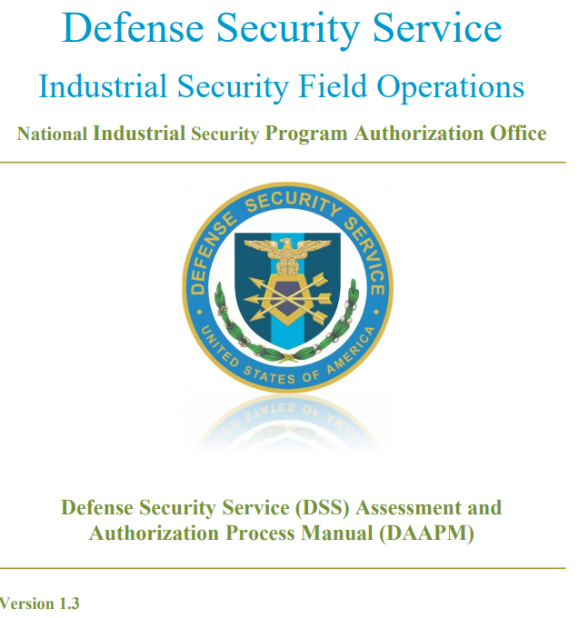
DSS Assessment and Authorization Process Manual (DAAPM) v1.3
Outlines DSS RMF processes and procedures
Defines RMF roles and responsibilities
Identifies minimum training requirements for ISSM/ISSO
Provides configuration management guidance
Establishes the significance of Continuous Monitoring (CONMON) in DAAPM RMF Step 2/Task 4 where it states, in part:
“Ongoing monitoring of the security controls is a critical part of risk management. Effective monitoring includes, but is not limited to, configuration management and control, security impact analyses on proposed changes, assessment of selected security controls, and security status reporting. “

Slide 5
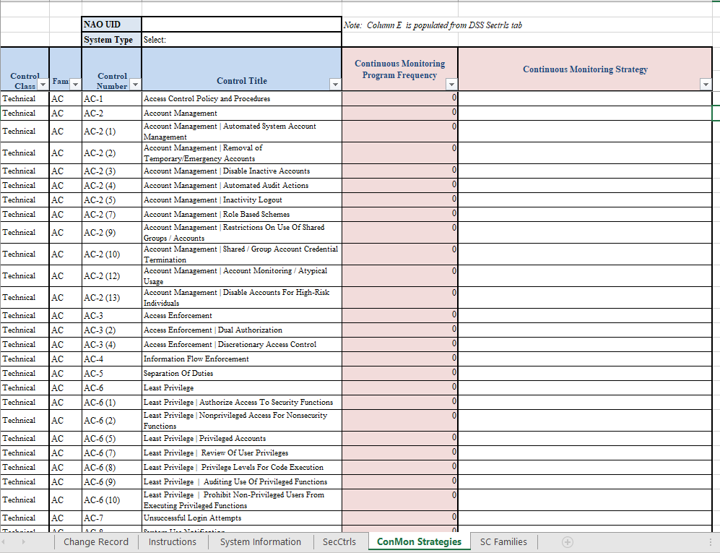
The DSS SSP Overlay System Security Plan (SSP) Excel Version 1.2
Provides a simple six-tab MS Excel workbook format for completing an SSP
The overlay provides pre-selected security controls for SUSA/MUSA/Isolated Networks based on DSS Moderate/Low/Low control selection
Certain controls not selected for a system type are “tailored out” by default and will have a “ – “ under the applicable system type
Tab 5 on the Excel version of the SSP overlay is used to define a CONMON strategy for each assigned control
Based on Moderate/Low/Low
(MLL)

Slide 6
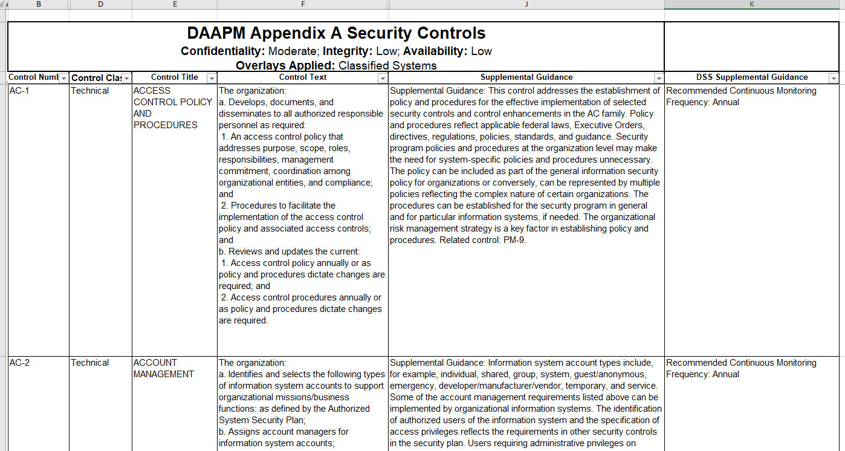
DAAPM Appendix A
Provides the DSS DAAPM selected security controls in a columnar format for easy reference
Shows the DSS recommended continuous monitoring frequency in the left column
Includes supplemental DSS-specific guidance for controls in the left column (for selected controls)
Security Controls v1.2

Slide 7
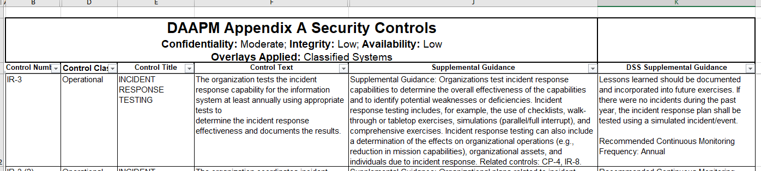
DAAPM Appendix A
DAAPM Appendix A – Sample Control
NIST Guidance is the primary source for these columns
DSS Guidance
Good resource for DSS recommended CONMON frequency
Additional DSS supplemental guidance is not included for some of the controls

Slide 8
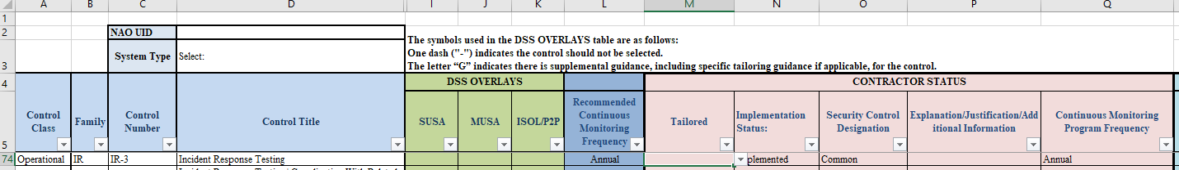
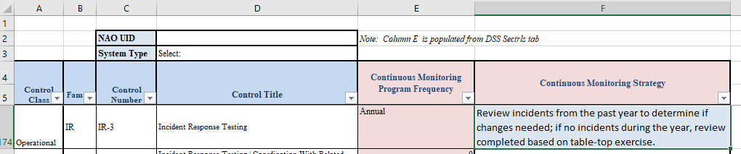
Building a CONMON Strategy in the DSS SSP Overlay
SSP Overlay, TAB 4 “SecCtrls” Column “Q” is Used to Define CONMON Frequency
SSP Overlay, TAB 5 “ConMon Strategies” Column “E” is Populated based on SecCtrls Tab Input
Must describe how your facility completes the required monitoring. Documentation will likely be needed.

Slide 9
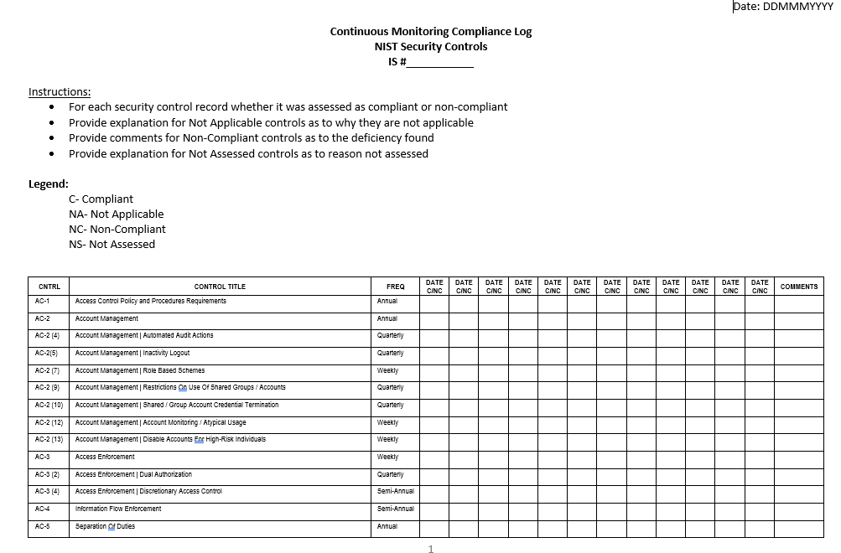
CONMON Tracking
Controls are assigned annual, semi-annual, quarterly, monthly, or weekly CONMON frequency
Tracking mechanism and documentation largely left to the facility/ISSM
Best practice is to coordinate with the assigned ISSP for buy-in when possible
No Defined Form/Format

Slide 10
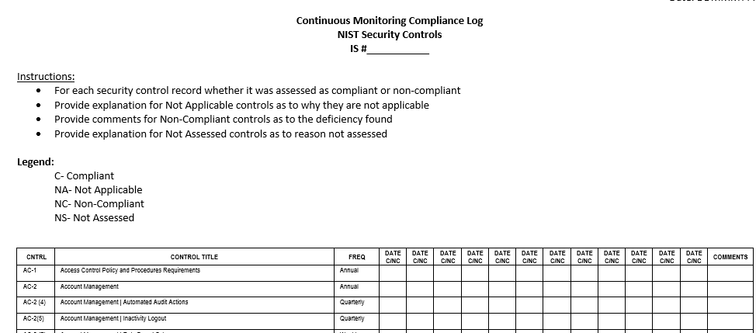
CONMON Tracking
CONMON Tracking Record – Example

Slide 11
Security Control Families
380+ RMF controls are divided into18 groups or families
Many control families relate to policy, training, physical security, etc
(AC) Access Control | (MP) Media Protection
(AT) Awareness and Training | (PE) Physical and Environmental Protection
(AU) Audit and Accountability | (PL) Planning
(CA) Security Assessment and Authorization | (PM) Program Management
(CM) Configuration Management | (PS) Personnel Security
(CP) Contingency Planning | (RA) Risk Assessment
(IA) Identification and Authentication | (SA) System and Services Acquisition
(IR) Incident Response | (SC) System and Communications Protection
(MA) Maintenance | (SI) System and Information Integrity

Slide 12
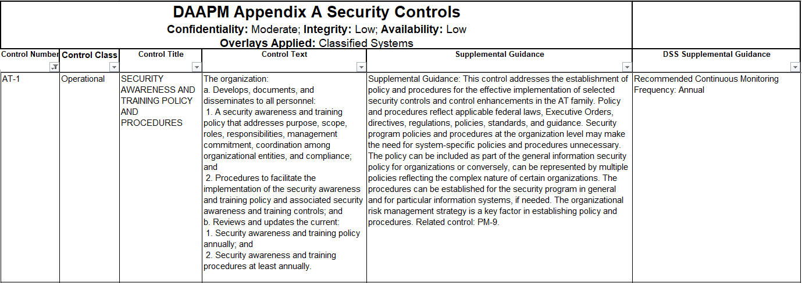
Security Control Families…cont (AT) Awareness and Training
NOTE: This is only a small sampling of controls!!!

Slide 13
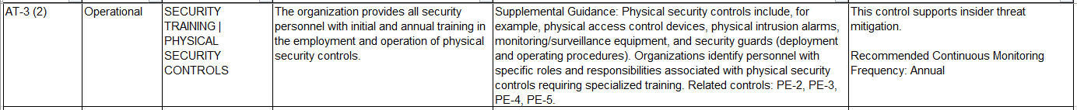
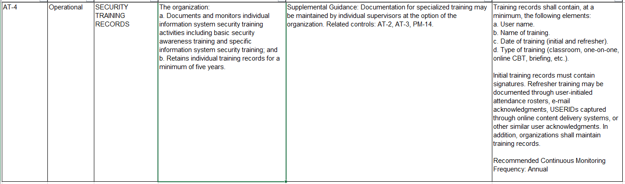




Security Control Families…cont (AT) Awareness and Training

Slide 14
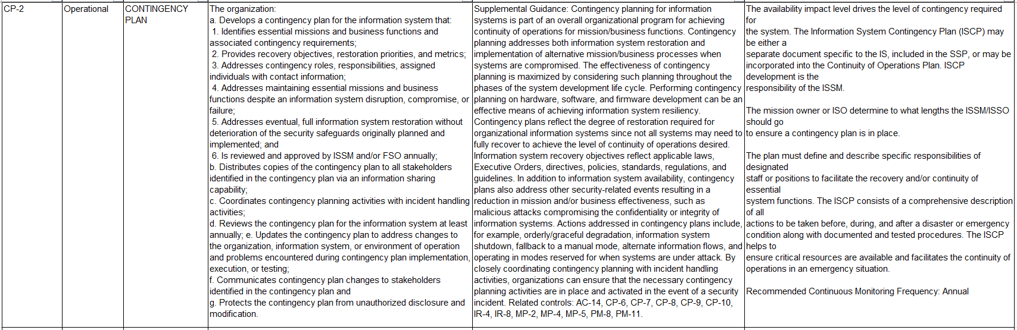




Security Control Families…cont (CP) Contingency Planning
NISPOM, 8-302 c states: Contingency Planning. When contractually required, contractors will establish,
maintain, and effectively implement plans for emergency response, backup operations, and post-disaster
recovery operations for ISs to ensure the availability of critical information and continuity of operations

Slide 15
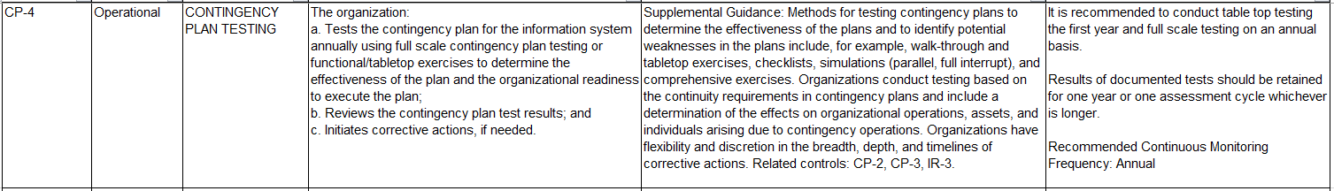
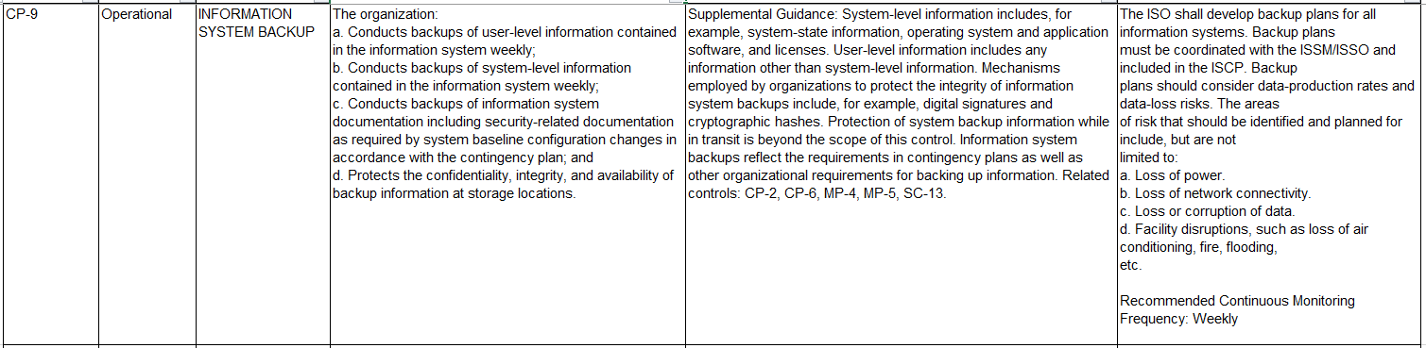











Security Control Families…cont (CP) Contingency Planning

Slide 16
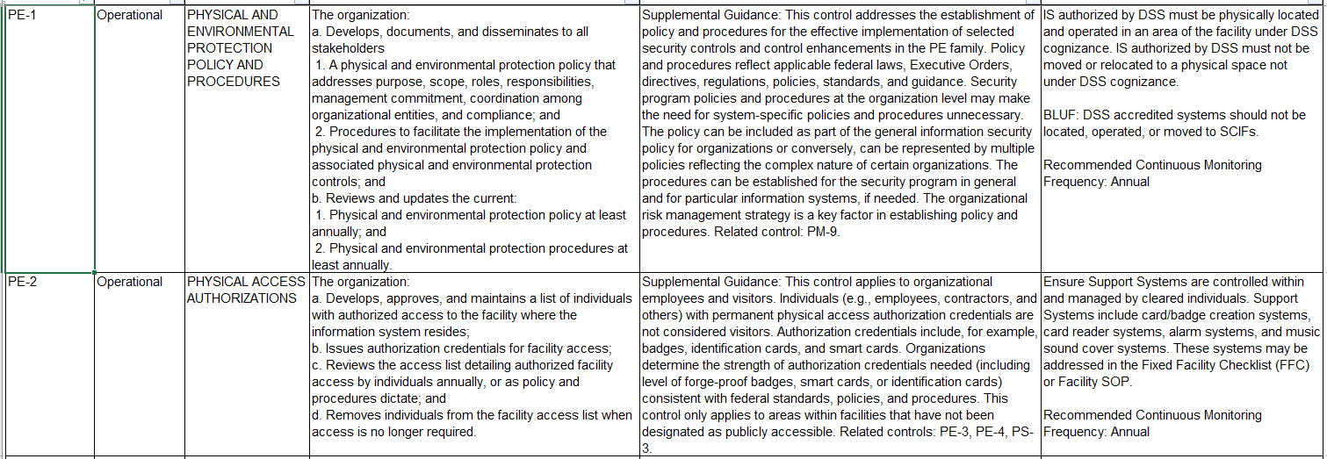







Security Control Families…cont (PE) Physical and Environmental Protection

Slide 17
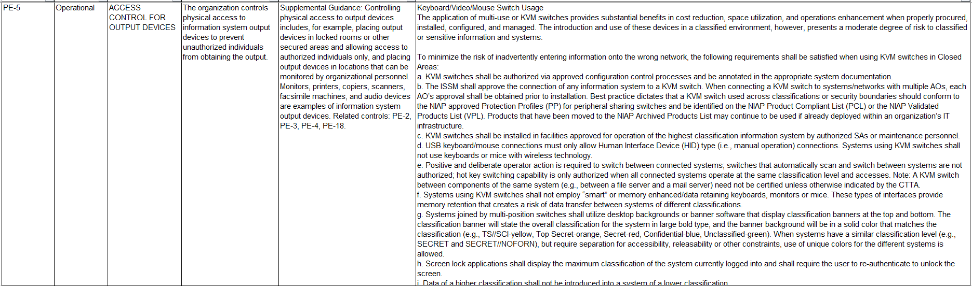
Security Control Families…cont (PE) Physical and Environmental Protection
Best practice dictates that a KVM switch used across classifications or security boundaries should
conform to the NIAPapproved Protection Profile (PP) for peripheral sharing switches…

Slide 18
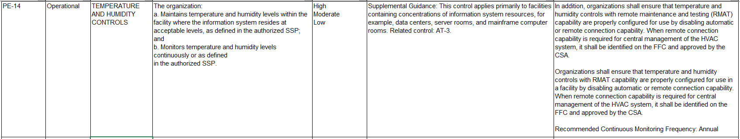
Security Control Families…cont (PE) Physical and Environmental Protection

Slide 19
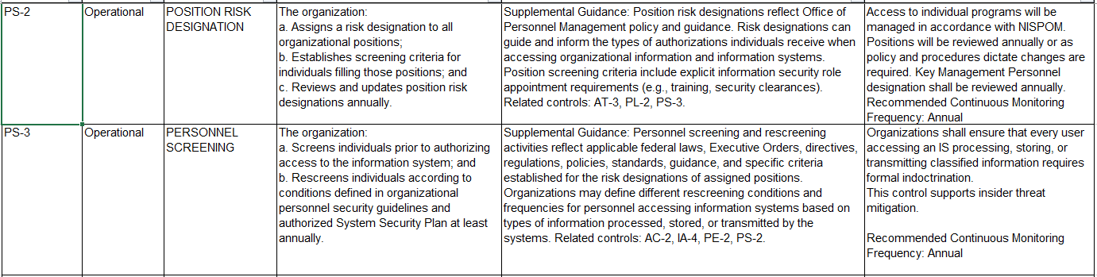













Security Control Families…cont (PS) Personnel Security

Slide 20
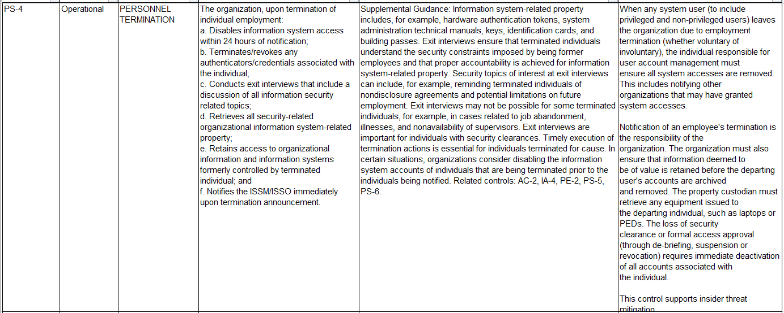





Security Control Families…cont (PS) Personnel Security

Slide 21
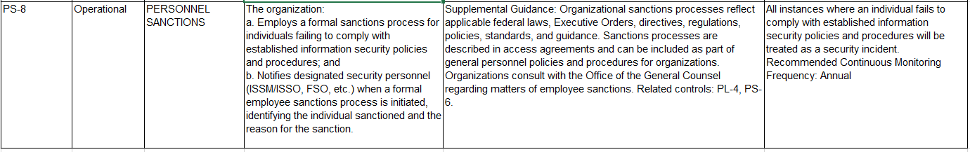












Security Control Families…cont (PS) Personnel Security

Slide 22
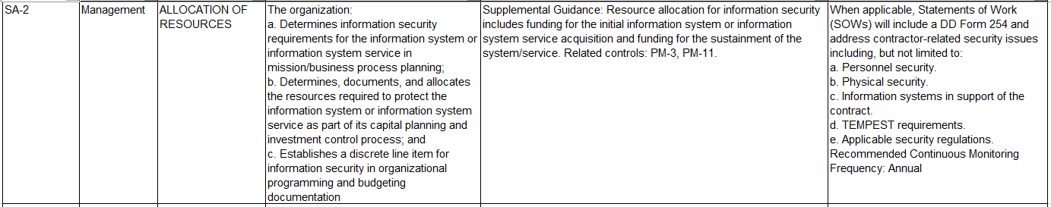









Security Control Families…cont (SA) System and Services Acquisition

Slide 23
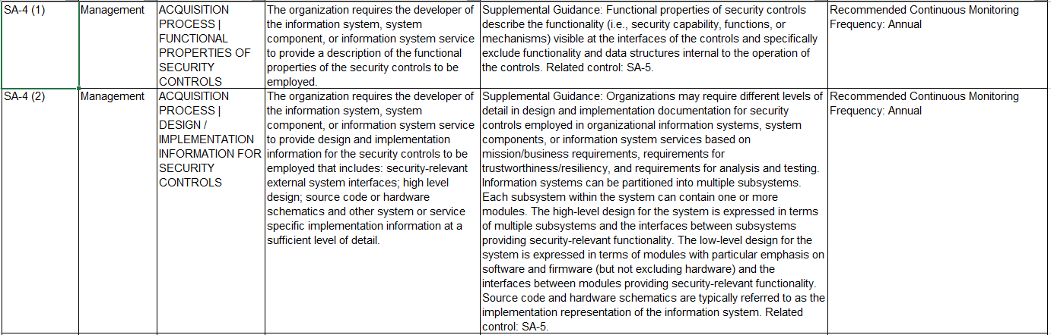







Security Control Families…cont (SA) System and Services Acquisition

Slide 24
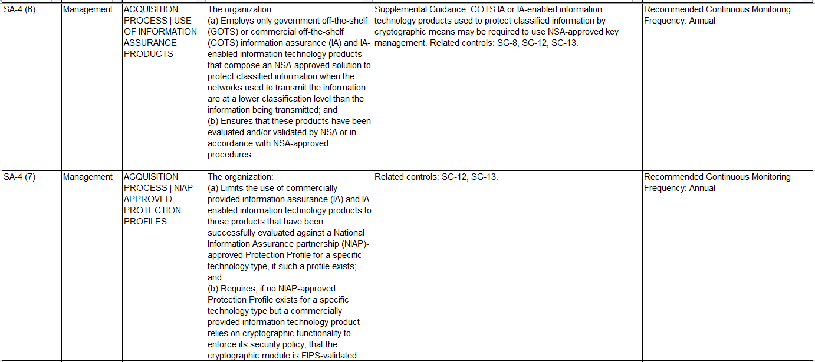







Security Control Families…cont (SA) System and Services Acquisition

Slide 25
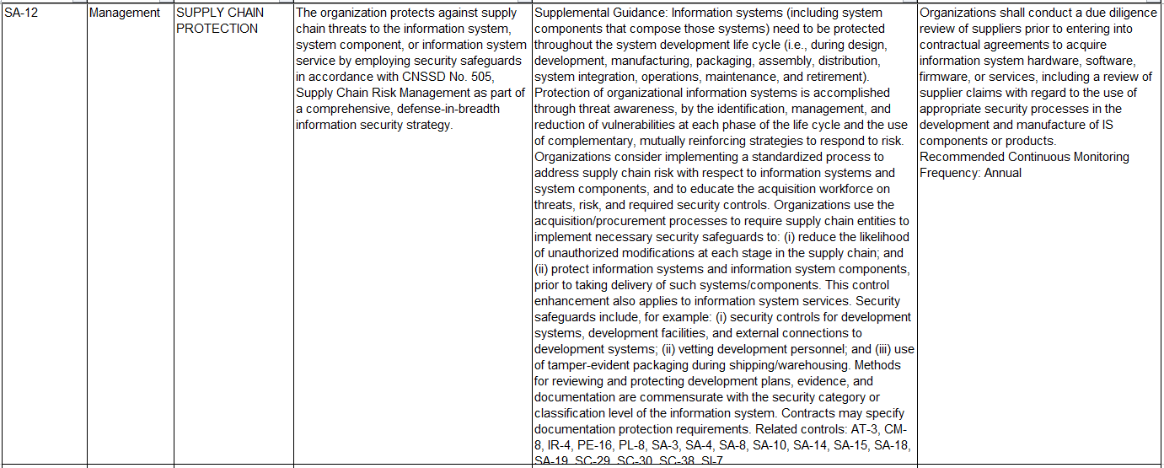









Security Control Families…cont (SA) System and Services Acquisition

