Slide 1
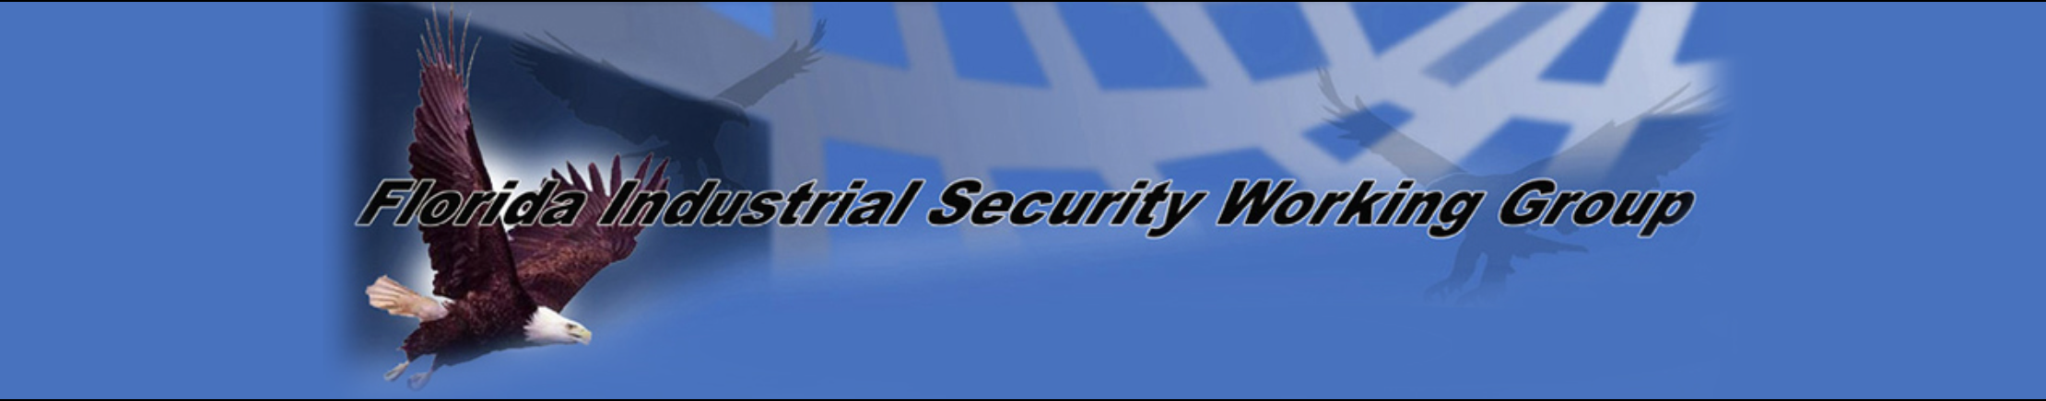

Marking & Protecting
Controlled Unclassified Information
(CUI)
Helen MacDonald
Loyal Source Government Services
9/25/2018

Slide 2

Controlled Unclassified Information (CUI)
Introduction
Identify
Mark
Protect

Slide 3

Introduction
The CUI program standardizes the way the executive branch handles unclassified information that does not meet the criterial required for classification (TS, S, C) but must be protected based on:
Law,
Regulation, or
Government-wide policy
Prior to the implementation of the CUI program, agencies employed ad-hoc marking resulting in inconsistent marking and safeguarding.
An analogy: One department may have been speaking German while another was fluent in French. The purpose of CUI program is to be the Rosetta Stone – to set forth a common language so that we may all understand CUI.
Notes:
Although government agencies have been marking documents and protecting information for decades, not everyone was using the same acronyms or labels to codify information.
Consider this analogy: one department may have been speaking German while another was fluent in French. The purpose of CUI program is to be the Rosetta Stone- to set forth a common language so that we may all about CUI.

Slide 4
Introduction
Final Phase: Full Implementation of the CUI Program FY18-19
Eliminate Old Markings
Assure use of only New Markings
Complete IT Transition
Monitor & Report Implementation
https://csrc.nist.gov/csrc/media/events/ispab-june-2014-meeting/documents/ispab_jun2014_cui_nara_nist.pdf

Slide 5
Identify
CUI Categories List:
https://www.archives.gov/cui/registry/category-list

Slide 6
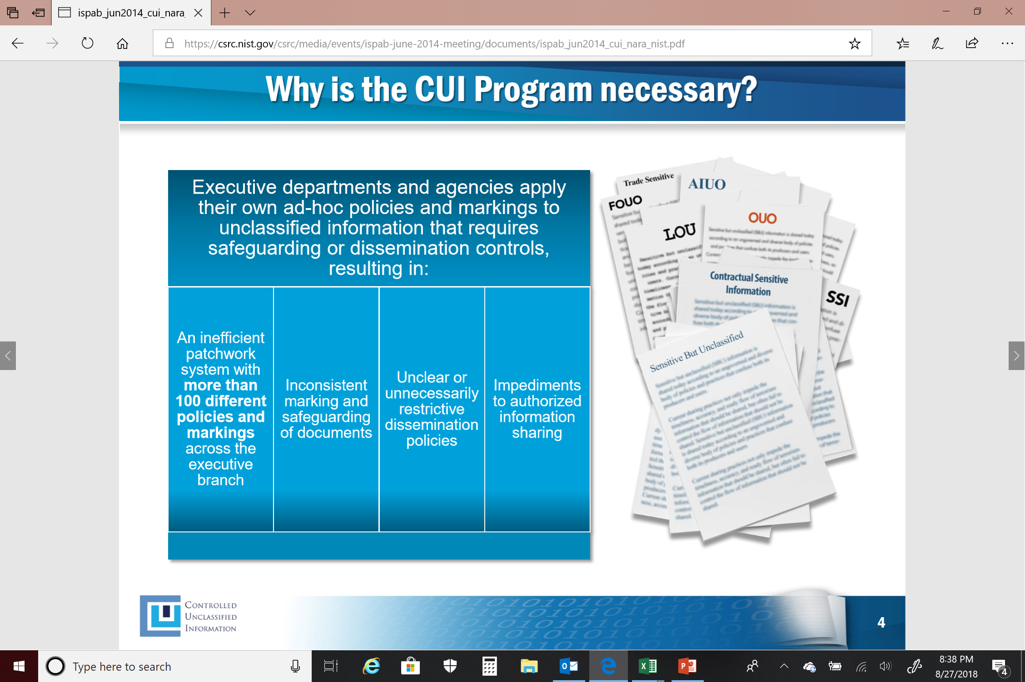
Identify
Old markings will take on the CUI marking (CUI Basic)

Slide 7
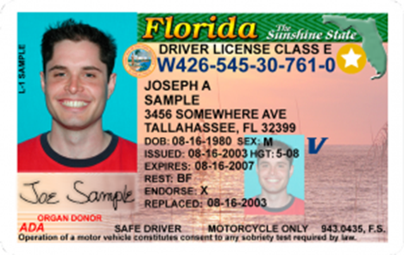
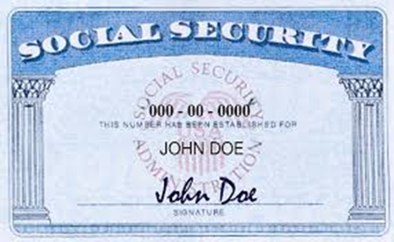
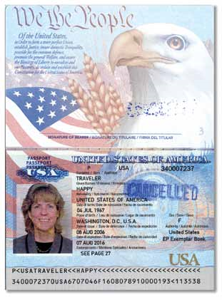
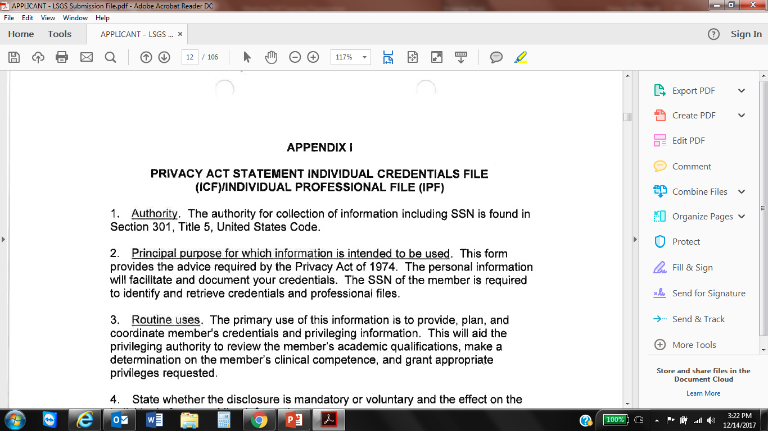
Some examples of CUI
Applicant Photo
Driver’s License
Contract Number
Professional Information Sheet
Applicant Passport or Copy
Education Records or Resume
Credentials Verification Form
Name + Place of Birth
Employment Verification
Surveillance Profile
Social Security Card or SSN + Name
Birth Certificate
Medical History
Professional License
Employee Clearance Level
Permanent Resident Status
Intelligence Financial Records
Export Controlled Data
FOUO
NATO Restricted/Unclassified
NOFORN https://www.archives.gov/cui/registry/limited-dissemination
Proprietary Information* https://www.cdse.edu/documents/cdse/2017-Adjudicative-Guidelines.pdf
Notes:
Proprietary information now also falls under Guideline K of the New Adjudicative Guidelines, meaning that inappropriate use of it will be investigated and prosecuted by the USG.

Slide 8
Marking – CUI Cover Sheet
The company for which I developed this program has decided to always use this CONTROLLED Cover Sheet for physical documents containing CUI on the front and back of each document.
It will also always use this CONTROLLED Cover Sheet for each digital file containing CUI documents on the front of each package.
This presentation does not address CUI Specific.

Slide 9
Marking – CUI Basic Banner Marking
Many U.S. Government forms and templates either containing or requiring CUI do not currently display the mandatory markings.
Consequently, we will use the following until we receive direction or new templates from our government partners.
Additionally, our company will always use these markings on our own data that contains CUI.
This presentation does not address CUI Specific.
Notes:
CUI Specific – Protected information that also requires one or more specific handling standards for that information. It would be marked CONTROLLED //SP-XXX to indicate to the reader that there will be special handling instructions for one or more CUI within the document.

Slide 10
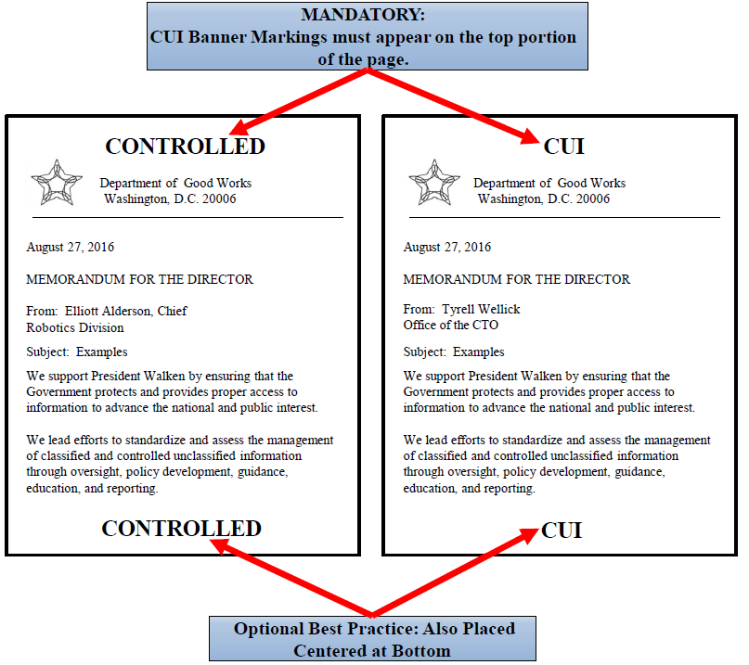

Marking – Header
The primary marking for all CUI here is the CONTROLLED Banner Marking. This is the main marking that will be applied in the Header of each page of any document that contains CUI:
  Mandatory for all documents containing CUI
  Must be inclusive of all CUI within the document
  Marking must be the same on every page
  Must be centered bold capitalized black text stating “CONTROLLED” in the Header of the page. Template can be provided by management
This presentation does not address CUI Specific.
Notes:
CUI Specific – Protected information that also requires one or more specific handling standards for that information. It would be marked CONTROLLED //SP-XXX to indicate to the reader that there will be special handling instructions for one or more CUI within the document.

Slide 11
Marking – Footer
Footer of each Page
This statement must be entered in Footer of each Company document containing CUI: The information herein is Controlled Unclassified Information (CUI) and is protected under the Privacy Act of 1974, as amended. These files may only be accessed by COMPANY NAME and U.S. Government Personnel who possess a valid need-to-know. Unauthorized disclosure or misuse of this information may result in criminal and/or civil penalties
This presentation does not address CUI Specific.

Slide 12
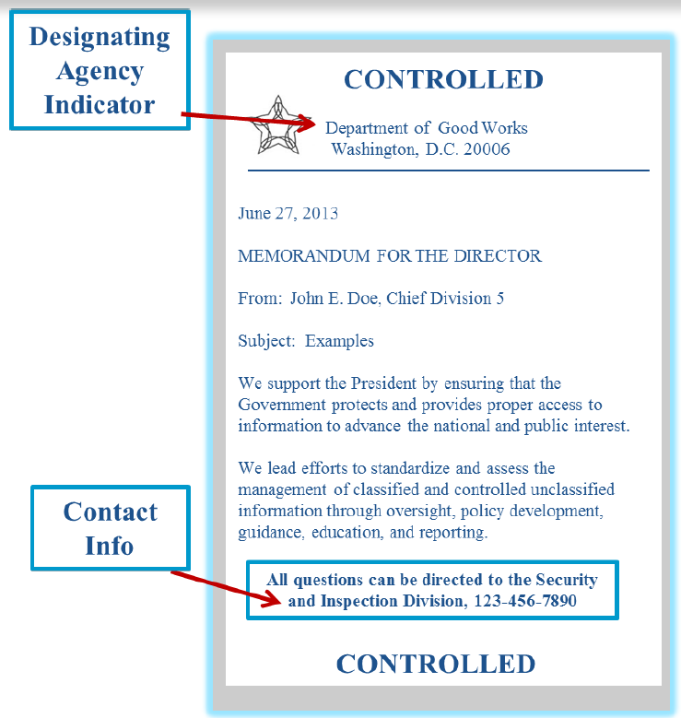

Identification of CUI Designated Agency of Applicable Safeguarding/Dissemination Authority for that CUI
All documents containing CUI must indicate the agency of designation. This may come in several forms, including a letterhead, signature block, or “controlled by” line. However, our government partners may not have provided us the proper templates
That said, my company will take on the responsibility to ALWAYS protect our employees’ and applicants’ sensitive information. So where CUI information exists, until otherwise directed by our government partners, we will utilize our own markings as addressed above
COMPANY NAME
Orlando, FL XXXXX

Slide 13
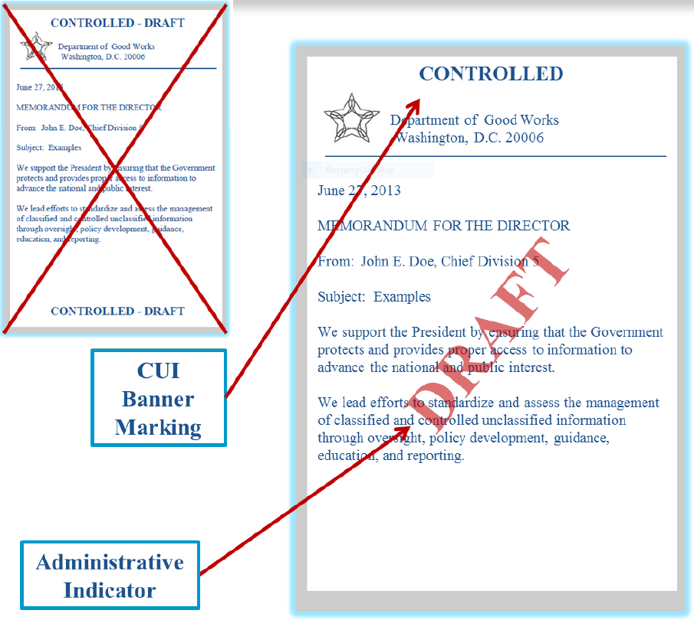
Supplemental Administrative Markings – Very Rare
Draft and In-Process documents must be protected at the level of completed CUI documents
Supplemental Agency Markings can be used to denote non-final status of a document
Cannot be used to control CUI and cannot be commingled into the CUI Banner Marking

Slide 14
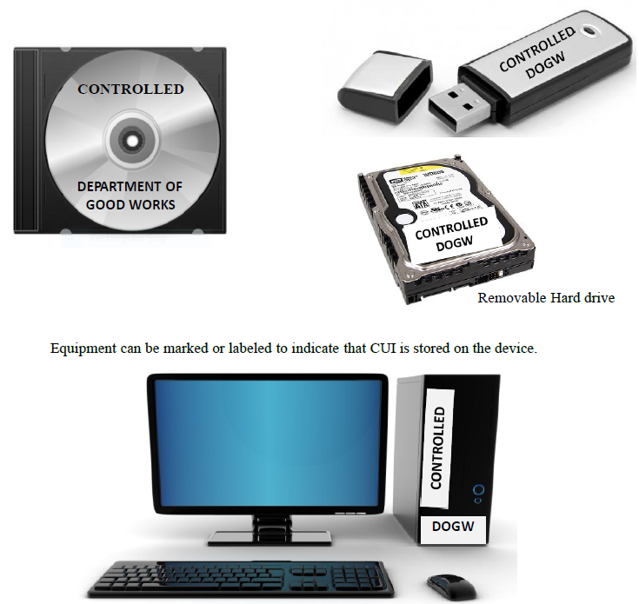
Marking –
Electronic Media Storing or Processing CUI
Media such as USB sticks, hard drives, and CD ROMs must be marked to alert holders to the presence of CUI stored on the device
As space may be limited, at a minimum, mark media with the CUI Control Marking and the designating agency

Slide 15
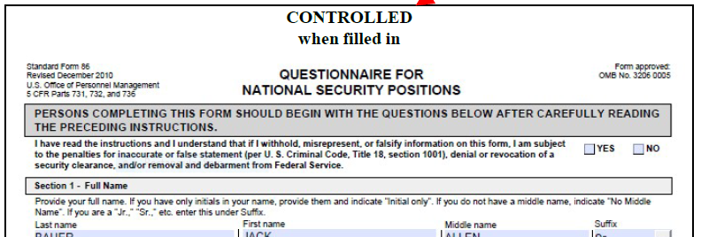
Marking – Forms with CUI
Forms that contain CUI must be marked accordingly when filled in
As forms are updated for the CUI implementation, they should be marked to include a statement that indicates the form is CONTROLLED when filled in

Slide 16
Marking –
Transmittal Documents – FAX
When a transmittal document accompanies the CUI, the transmittal document must indicate that CUI is attached or enclosed
The document must include the following instructions as appropriate:
When enclosure or attachment is removed, this document is Uncontrolled Unclassified Information

Slide 17
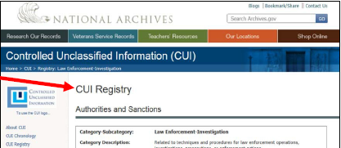
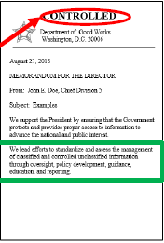
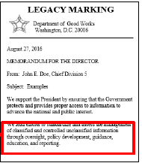
Re-Marking Legacy Information
Legacy information is unclassified information that was marked as restricted from access or otherwise controlled prior to the CUI program (e.g., PII). All Legacy information is not automatically CUI. It must be evaluated.
Identify the information that needs to be reused
Is the information listed in the CUI Registry?
  https://www.archives.gov/cui/registry/category-list
If the information type is listed in the CUI registry…..
…..you must mark the new document as CONTROLLED

Slide 18
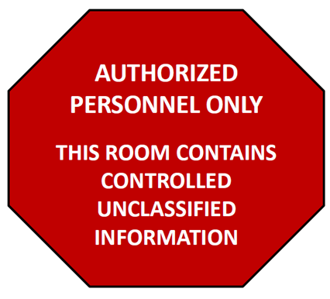
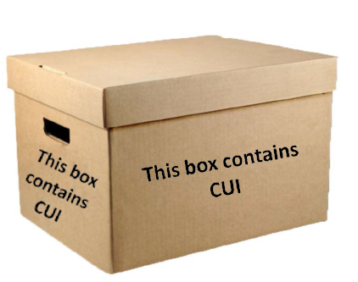
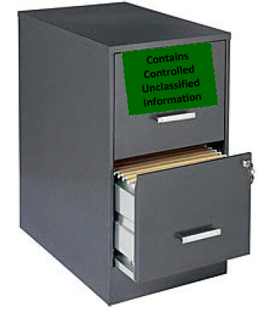
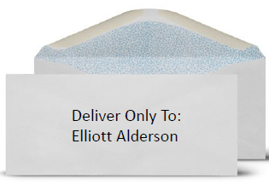
Protect
Room or Area Markings – My company has designated a room with area markings and privacy screens for cubicle computers
Container and Storage Markings
Shipping and Mailing
  Address packages that contain CUI for delivery only to a specific recipient
  Do not put CUI markings on the outside of an envelope or package for mailing/shipping
  Use in-transit automated tracking and accounting tools where possible
  Employees responsible for receiving or sending mail must be individually trained on how to handle CUI and report misuse

Slide 19
Protect –
Transmittal Documents – eMAIL
The principles for marking CUI are the same when sending email containing CUI:
The CONTROLLED banner must appear at the top portion of the email
Include “CUI” in the subject line to indicate that the email contains CUI
When forwarding or responding to email containing CUI, be sure to carry forward all applicable markings to the new email
Our company chose to also continue to encrypt emails containing CUI that was originally called PII

Slide 20
Training
CUI Training Tools

Slide 21
Reference
Information Security Oversight Office
National Archives
cui@nara.gov
Version 1.1 – December 6, 2016
CUI must be handled in accordance with E.O. 13556, “Controlled Unclassified Information” and 32 CFR Part 2002 Supplemental guidance.

Slide 22
Questions?

