Slide 1

NISPOM CHAPTER 3
SECURITY TRAINING AND BRIEFINGS
FISWG PRESENTATION
10 JULY 2013
JOAN NEFF
Facility Security Officer and Administrator
Vision Engineering Solutions, LLC

Slide 2


NISPOM Chapter 3
A tiny chapter with huge responsibilities

Slide 3
Security Training and
Briefing Requirements
NISPOM 1-205 specifies contractors are responsible for advising all cleared employees of their individual responsibility for safeguarding classified information and for providing security training according to NISPOM Chapter 3 by initial briefings, refresher briefings, and debriefings.
NISPOM 3-100 through 3-108 contains all the information necessary to ensure your training program meets the NISPOM Training requirement

Slide 4
Training Goals and Objectives
Awareness of magnitude of foreign and domestic threats
Awareness of security responsibilities and obligations
Awareness of security procedures and practices
Understanding, Motivation and Compliance

Slide 5
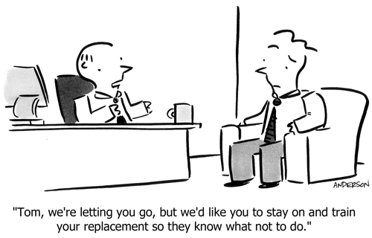
Security Training and Briefings

Slide 6
3-101 Training Materials
To name a few:
DSS offers training information and material on defensive security, threat awareness and other excellent training information
FISWG provides briefing material on its website
Daily newspaper has wealth of articles that can be used for security awareness examples
FBI Newsletters
FSO-generated posters, videos, bulletins

Slide 7
Types of Security Training
Required by NISPOM Chapter 3
FSO TRAINING
GOVERNMENT-PROVIDED BRIEFINGS
TEMPORARY HELP SUPPLIERS
EMPLOYEE TRAINING

Slide 8
3-102 FSO Training
Effective 14 May 2012, under ISL 2012-3, the DSS Center for Development of Security Excellence (CDSE) created new curricula to meet the NISPOM 3-102 requirements for FSO Training
The curricula takes into account the
Facility’s involvement with classified information
Note: Successful completion of any of the previous versions of FSO training by CDSE, the DSS Academy, or DoD Security Institute satisfies the current NISPOM FSO training requirement unless advised otherwise by DSS

Slide 9
3-102 FSO Training
Based on a Facility’s involvement with classified information, CDSE has developed these training curricula:
  FSO Program Management Curriculum for Possessing Facilities
  FSO Orientation Curriculum for Non-Possessing Facilities
Completion within 1 year of appointment

Slide 10
FSO Training Curricula http://www.dss.mil/cdse/catalog/curricula/index.html
Courses:
•FSO Role in the NISP IS021.06
•Introduction to Information Security IF011.06
•ISFD Facility Clearance Verification and Notifications for Industry IS113.06
•DSS e-FCL Submission Site User Guide IS032.16
•Personnel Clearances in the NISP IS142.16
•JPAS/JCAVS Training for Security Professionals PS123.16
•Developing a Security Education & Training Program GS104.06
•Integrating CI and Threat Awareness into your Security Program CI010.16
•Facility Clearances in the NISP IS140.16
•Understanding FOCI IS065.16
•NISP Reporting Requirements IS150.16
•Visits/Meetings in the NISP IS105.16
•NISP Self Inspections IS130.16
•Safeguarding Classified Information in the NISP IS109.16
•Derivative Classification IF103.06
•Marking Classified Information IF105.16
•Transmission and Transportation for Industry IS107.16
FSO Orientation for Non-Possessing Facilities
FSO Program Management for Possessing Facilities

Slide 11
FSO Training Enhancements
Attendance at FISWG Meetings (take advantage of on-line briefings, posters, training material)
Attendance at National Classification Management Society (NCMS) Meetings
DSS On-Line Training
https://www.dss.mil Professional Education

Slide 12
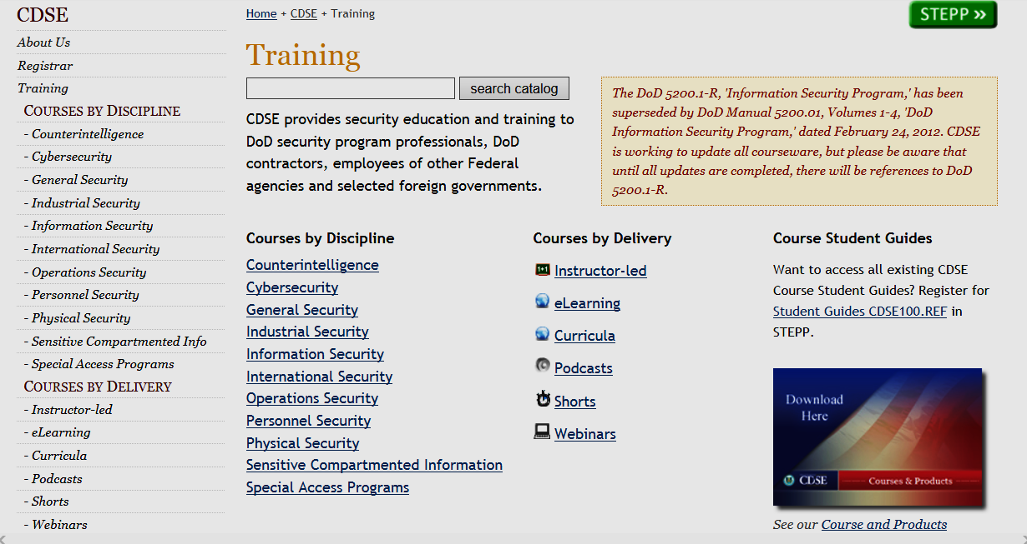

https://www.dss.mil
Professional Education

Slide 13
Types of Security Training
Required by NISPOM Chapter 3
FSO TRAINING
GOVERNMENT-PROVIDED BRIEFINGS
TEMPORARY HELP SUPPLIERS
EMPLOYEE TRAINING

Slide 14

3-103 Government-Provided Briefings
CSA provides initial briefings for special categories to the FSO
  NATO
  COMSEC
  CNWDI
  Other applicable briefings
Employees briefed by FSO or in group by CSA

Slide 15

Types of Security Training
Required by NISPOM Chapter 3
FSO TRAINING
GOVERNMENT-PROVIDED BRIEFINGS
TEMPORARY HELP SUPPLIERS
EMPLOYEE TRAINING

Slide 16
3-104 Temporary Help Suppliers
Requires companies that employ cleared personnel for sole purpose of dispatching them elsewhere (providing a contractual service to another company) to ensure that their cleared personnel receive security briefings and training
Either the Supplier (Temporary Help Employer)or the End User (Using Contractor) may conduct the briefings.

Slide 17
Types of Security Training
Required by NISPOM Chapter 3
FSO TRAINING
GOVERNMENT-PROVIDED BRIEFINGS
TEMPORARY HELP SUPPLIERS
EMPLOYEE TRAINING

Slide 18

Employee Security Training
Classified Information Nondisclosure Agreement (SF-312)
Initial Security Briefing
Refresher Training
Debriefings

Slide 19

3-105 Classified Information Nondisclosure Agreement
The employee’s PSI was to determine his trustworthiness for access to classified information.
He was granted a security clearance
based on the favorable determination of the investigation results.
He must now sign an SF-312 Classified Information Nondisclosure Agreement as a condition of access.
You must give the employee an SF-312 briefing and obtain his signature on the Agreement form

Slide 20
SF-312 Nondisclosure Agreement
Required upon initial PCL prior to being granted access to classified information
A contractual agreement between the United States and the employee who is cleared for access to classified information
Purpose of the SF-312 Briefing is to inform the employee of:
  Special trust placed in him by providing access to classified information
Obligation to protect that information from unauthorized disclosure, unauthorized retention and/or negligent handling
Lifelong commitment and contractual agreement
Serious consequences for noncompliance
Briefing Booklet: http://www.archives.gov.isoo/training/standard-form-312.html

Slide 21
SF-312 Nondisclosure Agreement
FSO must:
  annotate JPAS with date SF-312 (NdA) was signed
  (Select Person>Display Person> Indoctrinate>Date when NdA was signed)
  retain a copy of the SF-312 in employee’s security folder and
  submit a copy of the form to the Personnel Security Management Office for Industry (PSMO-I)

Slide 22

Submitting SF-312 to PSMO-I
Mail:
Personnel Security Management Office for Industry
600 10th Street, Suite 160
Fort Meade, MD 20755-5136
FAX: 301-833-3942 (preferred method)
Attn: SF-312
Include FSO’s name, phone, fax number,
Email address; and Subject’s name and SSN

Slide 23
Employee Security Training
Classified Information Nondisclosure Agreement (SF-312)
Initial Security Briefing
Refresher Training
Debriefings

Slide 24
3-106 Initial Security Briefing
Lecture
Conference Room Setting
One-on-One
Written Briefing
(with signed Briefing Acknowledgement )

Slide 25
Initial Security Briefing
Threat Awareness Briefing
Defensive Security Briefing
Overview of the Security Classification System
Employee reporting obligations and requirements
Security procedures and duties applicable to the employee’s job/required by the contract(s)

Slide 26
Initial Security Briefing
Threat Awareness Briefing
  The threat and the techniques employed by foreign intelligence entities in the attempt to obtain classified information
  Seek up-to-date threat information from local authorities concerning foreign intelligence activities and trends
Defensive Security Briefing
  Necessity of being security aware, recognizing the warning signals, reporting suspicious activities, and knowing what to watch out for in the office, during foreign travel, attendance at technical conferences, etc.

Slide 27
Initial Security Briefing
Overview of the Security Classification System
Three levels of classification (TS, S, C)
Accesses (not a level of classification)
  COMSEC
  CNWDI
  NATO
  FOUO
  Special Access Program (SAP)
  Other

Slide 28


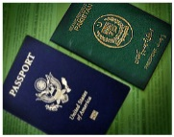



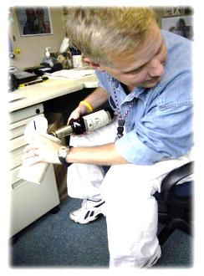


Initial Security Briefing
Employee Reporting Obligations and Requirements
Personal Reports:
Changes to info reported on SF-86 to include name, marital status, citizenship, dual passport; and involvement with the legal system (arrest/conviction)
Foreign Travel and Foreign Contacts:
Dates, locations and purpose of travel outside of the United States
New/ongoing contacts with foreign nationals and suspicious or threatening
contacts/attempts to obtain unauthorized access to classified or proprietary
information
Adverse Information
Factual information that could make an employee vulnerable to exploitative activities, i.e. excessive use of intoxicants, use of illegal/controlled substances, excessive indebtedness or financial difficulties, sudden unexplained displays of affluence, loss or compromise or suspected compromise of classified information, unauthorized attempt by employee to obtain classified or proprietary information

Slide 29
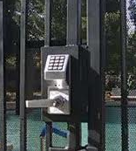
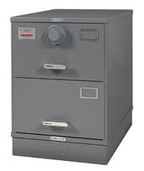

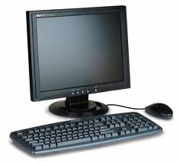

Initial Security Briefing
Security Procedures and Duties Applicable to the Employee’s Job, such as:
Access briefing(s) (NATO, CNWDI, COMSEC,
etc)
Courier
Derivative Classification and Marking
Special Access
IS
Controlled/Closed Area
Gate Closures, Building Access
Escort of Foreign Nationals

Slide 30
Employee Security Training
Classified Information Nondisclosure Agreement (SF-312)
Initial Security Briefing
Refresher Training
Debriefings

Slide 31

Refresher Training
REFRESHER
SECURITY
TRAINING
A chew bar that comes in
bite-sized pieces with
reinforced flavors
A security briefing that gives cleared employees something to chew on that reinforces the initial briefing and provides updates on procedures, regulations and trends

Slide 32
3-107 Refresher Training
NISPOM requirement to provide all cleared employees with some form of security education and training at least annually
Must reinforce information provided during the initial security briefing and keep employees informed of any changes in security regulations
Records must be maintained about the programs offered and employee participation in them

Slide 33
Refresher Training
Can be in form of group briefing, interactive videos, dissemination of instructional materials, etc.
Supplement formal training with newsletters, Emails, security posters
Signed/dated affirmation of training (with documentation retained by FSO)
“Vision 2013 Annual Security Awareness Briefing and Refresher Training” will be made available on FISWG website

Slide 34
Employee Security Training
Classified Information Nondisclosure Agreement (SF-312)
Initial Security Briefing
Refresher Training
Debriefings

Slide 35
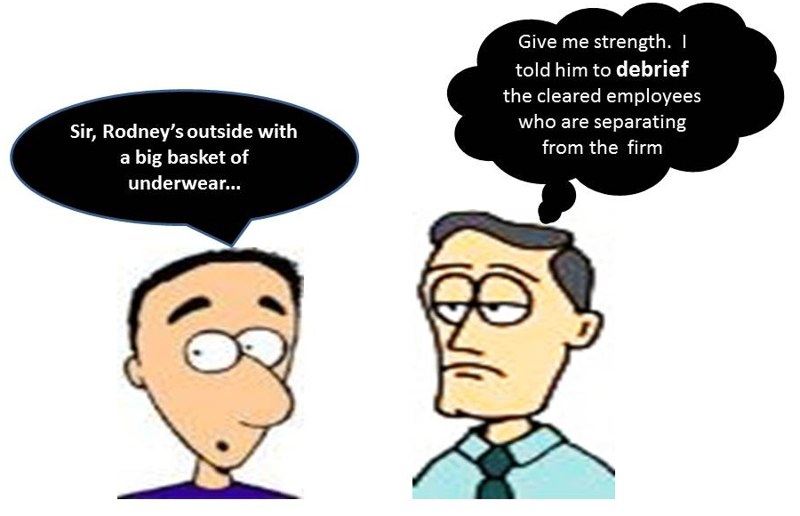

Debriefings

Slide 36
3-108 Debriefings
Reminder of lifetime contractual responsibilities
Required:
At the time of cleared employee’s termination of employment (administrative separation, resignation or retirement)
When Employee’s PCL is terminated/no longer required (terminated, suspended or revoked)
When the Facility Clearance is terminated

Slide 37

Summary of NISPOM Chapter 3
Contractors must provide cleared employees with security training commensurate with their involvement with classified information
Many tools are available for providing security training
Your goal as an FSO is to ensure employees understand their responsibilities and to motivate their compliance

Slide 38
Questions????

