Slide 1
FISWG Conference 10 July 2013
Back to Basics Chapter 2
Helen MacDonald
L-3 Communications

Slide 2
2-100: General Requirements
Determination that company is eligible for access to classified information or award of classified contract at same or lower classification level as FCL granted.
Award may be made prior to FCL.
Must meet eligibility requirements for access to classified information.
No access to classified until the FCL has been granted.

Slide 3
2-104: PCLs Required in Connection with FCL
Senior management official and FSO must always be cleared to level of the FCL.
Some other officials must be granted PCLs or be excluded from classified access (see 2-106 or check with IS Rep).

Slide 4
2-108: MFOs
Home office facility must have FCL at same, or higher, level of any cleared facility within the MFO.
CSA will determine necessity for branch office FCLs.

Slide 5
2-109: Parent/Subsidiary Relationship
When parent/subsidiary relationship exists, each will be processed separately for FCL.
CSA will determine necessity for parent to be cleared (DD-254 is necessary if access is required) or excluded from access to classified information.
When parent or its cleared subsidiaries are co-located, CSA may approve a formal written agreement to use common security services.

Slide 6
2-111: Records Maintenance
CSA will advise and assist company during FCL process. As a minimum, company must:
Execute and maintain original CSA-designated forms (e.g.,441; 441-1; SF-328; 381-R; KMP List).
YOU MUST BE ABLE TO READILY PRODUCE THESE ITEMS AT EACH DSS ASSESSMENT
PHYSICALLY TOUCH THEM DURING CONTRACTOR SELF-REVIEW
Notes:
TREAT CONTRACTOR SELF-REVIEW LIKE A DRESS REHEARSAL!

Slide 7
2-200: General PCL Requirements
CSA Database = JPAS (currently)
Annotate and maintain accuracy of employees’ access records on JPAS.
FSO Designee: Too many back-up personnel don’t access JPAS often enough, and get locked out. New DSS requirements say that a new SAR needs to be submitted, with 3 Pre-Req Courses prior to reissuing JPAS Account Access.
Check Notifications: Contractor will be notified when employee PCL has been denied, suspended, or revoked and contractor shall immediately deny access to classified information.
Contractor may centrally manage eligibility and access records in MFO.
Contractor shall limit requests for PCLs to minimal number necessary for operational efficiency / contractual obligations. PCL requests shall not be made to establish "pools" of cleared employees.

Slide 8
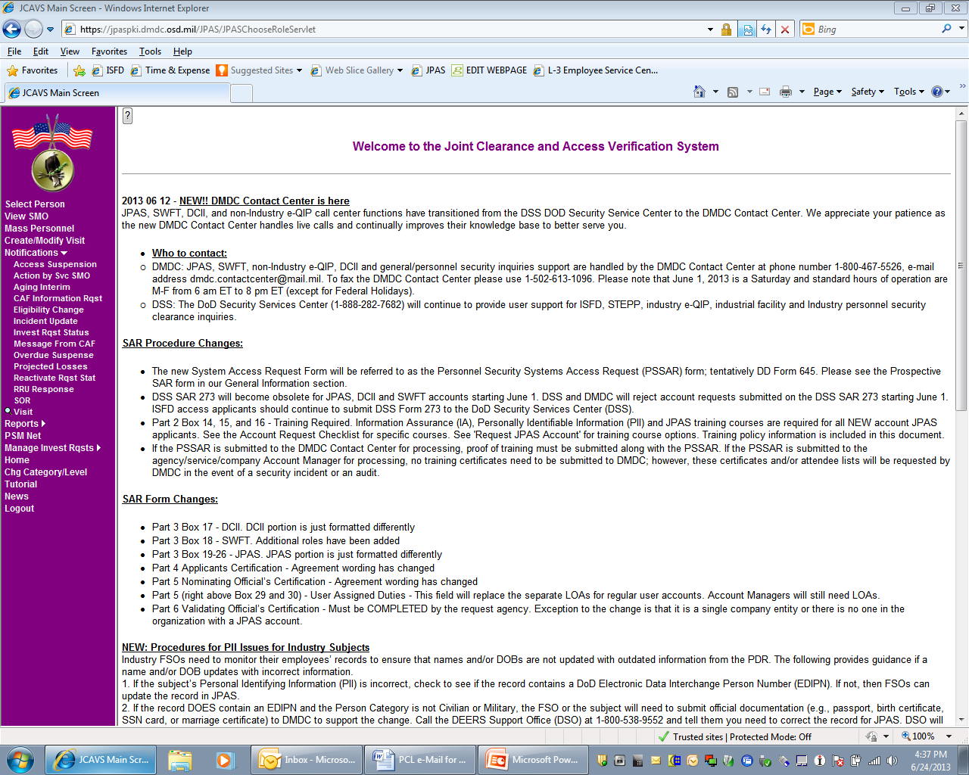
2-200: General PCL Requirements

Slide 9
2-201: Investigative Requirements
Investigations conducted by a Federal agency shall not be duplicated by another when current within 5 years and meet the scope and standards for the level of PCL required. The types of investigations are:
SSBI – required for TOP SECRET, Q, and SCI access. (Electronic SF 86 used).
NACLC – required for SECRET, L, and CONFIDENTIAL PCLs. (Electronic SF 86 used).
Polygraph – used by agencies with policies sanctioning for PCL purposes.
Contractor personnel may be subject to reinvestigation program (usually 5 years for TS; 10 years for S).
Contractor must ensure that employee has the opportunity to complete and submit all Financial Disclosure forms in private.

Slide 10
2-202 a: Procedures for Completing SF 86
SF 86 shall be completed jointly by employee and FSO (or specifically-designated employee) who shall:
Inform employee that SF 86 is subject to review and shall review application solely to determine adequacy and ensure that necessary information has not been omitted.
Provide written notification to employee stating review of the information is for adequacy and completeness, will be used for no other purpose within the company, and is protected by Privacy Act of 1975.
Not share information from the employee’s SF 86 within company AND not use the info for any purpose other than determining adequacy and completeness of the SF 86.
Ensure that applicant’s fingerprints are authentic, legible, and complete to avoid processing delays.

Slide 11
2-202 a (continued): Procedures for Completing SF 86 - Example
As a heads-up, your personnel security clearance is coming up for Periodic Reinvestigation (PR) this year. You will need to complete submission of your PRs within 30 days prior (vs.90 used prior to sequestration) to your individual anniversary date stated below:
JONES, BARBARA submission due before 10 SEPTEMBER 2013
SMITH, RICHARD submission due before 28 OCTOBER 2013
…so please post reminders to start working on your application in your Outlook Calendars. I will also be sending out prompts to you.
You can start gathering your information at any time.
Follow the instructions below, together with those attached.
A link to the SF-86 Questionnaire Reference Guide is provided for your information and ease of use. Under the References tab, you can print out a hard copy of the SF-86 and use it as a Workbook to record information so that you have it ready at hand when you go into eQIP to electronically input your data to the system.
When you have your Workbook ready, you need to let me know via email (and provide me your phone number) so that I may contact you to get some information to “initiate” you into the system.
Please pay close attention to the eQIP Applicant Instructions attached. You can begin at: Getting Started in the instructions; the link to input your data is on Page 2: https://www.e-qip.opm.gov/eqip/eQIP.
You will be going for a Secret NACLC and will need to go back 7 years (unless the instructions specify a different timeline (e.g., “10 years” or “ever”).
You also work for a Federal Contractor, so choose that type of employer when asked.
If you do not know the dates of your last investigation and/or your last clearance date, please contact Security. We can look them up and give them to you.
Once you start entering data, it gives you 30 days. You don’t need to enter everything at once; it will save what you’ve entered and you can just continue from there. You may find that some data that you entered during a prior submission will have been saved by the system.
Also read the attached DNI Security Clearance Guidance reaffirming that the DoD strongly endorses the practice of seeking professional help to address all health-related concerns, whether mental or physical. Seeking professional care of mental health issues should not be automatically perceived to jeopardize an individual’s security clearance.
When you have completed your online application, print out a “Review Copy” and let me know it’s ready for my review
If all is not okay, I will ask you to make the required changes and reprint your application.
If/when all is okay, I will have you print the final copy, which should read “Archival Copy”, together with the Release Forms. Then I ask that you sign the applicable Release Forms and individually scan/email each one individually to me. You may then “submit” your application online, and bring me the hardcopies of your Archival Copy and Signed Releases. I will then send it all to the U.S. Office of Personnel Management (OPM). It’s not necessary for you to provide any attachments online. Just keep hitting to “Next” until it asks you if you want to Submit to Agency. Say YES.
If everything looks okay at the OPM, I will be notified. After that, it’s a waiting game…
Additionally, please note that once your clearance has been granted, per requirements stated in section 3.4, Corporate Policy Statement 305 – Substance Abuse Policy and Control Program, you could be subject to random alcohol / drug screening.
Although L-3 strongly encourages you to report Security concerns directly to your FSO (Facility Security Officer) or DSM (Division Security Manager) to facilitate investigation and/or resolution,
Don’t forget to let me know when you’re ready to start putting the data into the electronic eQIP system. I have to do something at my end before it’ll let you in.
Please don’t hesitate to let me know if you have any questions.
** (to see if anything is missing, or if there are date gaps, etc.).
L-3 Security will hold your record in a locked file cabinet. The file is placed in a sealed, opaque envelope with an official Privacy Act sticker on the outside of the envelope, as well as on your file folder. Security is obligated to hold your SF 86 until you are granted your FINAL Secret clearance. After that, it must be properly returned to you for your retention or destruction.
you may also contact the DoD Hotline number if you are a witness to what you believe to be a violation of ethical standards and/or the law, including but not limited to fraud, waste, or abuse of authority, potential leaks of classified information, or potential acts of terrorism, directly to the Inspector General of the Department of Defense Hotline at 800-424-9098 (e-mail: hotline@dodig.mil).
**About your completed SF-86: Per the National Industrial Security Program Operating Manual (NISPOM) 2.202, L-3 Security is required to review your entire SF 86 for adequacy and completeness; however, your privacy is maintained. The information on your SF 86 may not be used for any other purpose within the company.

Slide 12
2-202 b: Procedures for Completing SF 86
Retain original, signed copy of SF 86 and related signed Releases until clearance process is completed.
Protect this documentation to ensure confidentiality is preserved against access by anyone other than the FSO or designee.
Immediately after FINAL eligibility has been granted or denied, documentation must be destroyed or returned to employee.
Notes:
These are common findings among DSS audits

Slide 13
2-205: Pre-employment Clearance Action
If access to classified information is required by a potential employee immediately upon commencement of employment, Contractor may submit a PCL application to CSA prior to the date of employment provided:
a written commitment (offer letter) for employment has been made by the contractor, and
the candidate has accepted the offer in writing.
The commitment for employment will indicate that employment shall commence within 30 days of the granting of eligibility for a PCL.

Slide 14
2-207/208: Verification of U.S. Citizenship
Contractor shall require each PCL applicant who claims U.S. citizenship to produce valid original evidence:
For individuals born in the US, birth certificate is primary and preferred.
For individual claiming citizenship by naturalization, certificate of naturalization is acceptable.
For citizenship acquired by birth abroad to U.S. citizen parent/s, the following are acceptable evidence:
A Certificate of Citizenship issued by DHS, U.S. Citizenship and Immigration Services (USCIS) or its predecessor organization
Report of Birth Abroad of a Citizen of the USA
A Certificate of Birth
A U.S. Passport, current or expired, is acceptable.
A Record of Military Processing-Armed Forces of the United States (DD Form 1966) is acceptable proof of citizenship, provided it reflects U.S. citizenship.

Slide 15
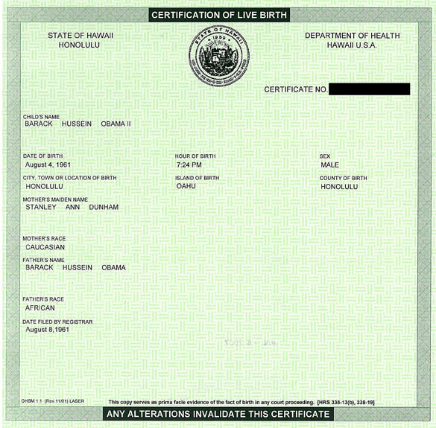
Birth Certificate Example

Slide 16
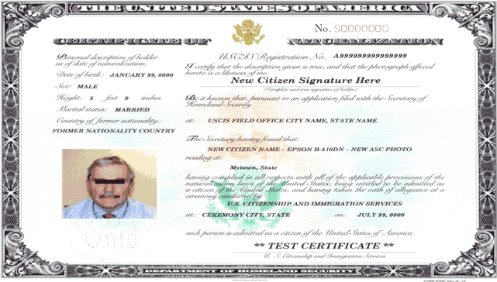
Certificate of Naturalization Example

Slide 17
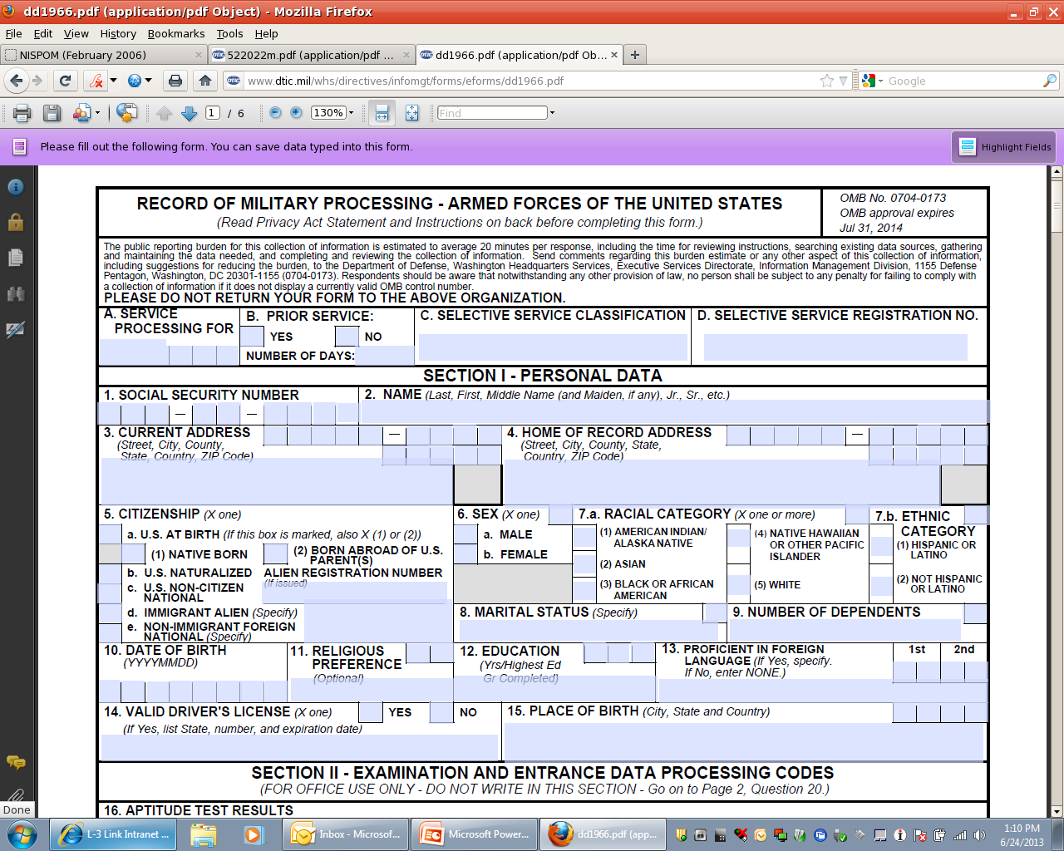
Record of Military Processing Example

Slide 18
2-209: Non-U.S. Citizens
Only U.S. Citizens are (generally) eligible for U.S. Security Clearances
Make every effort not to employ non-U.S. Citizens in duties that may require access to classified information or work in classified areas
ONLY EXCEPTION: LAA

Slide 19
2-211: Interim PCLs
May access classified to same level of Eligibility granted, except for these which need FINAL eligibility:
RD
COMSEC
NATO
SAP or SCI (determined by granting authority)

Slide 20
Questions?

