Slide 1
Adverse Information
Adverse Information:
Negatively reflects on the Integrity or Character of a Cleared employee
Suggests that one’s ability to safeguard classified information may be impaired
Indicates one’s access to classified information clearly may NOT be in the best interest of national security
It is the responsibility of all employees to report to Security any adverse information concerning another cleared employee

Slide 2
Adjudicative Guidelines
There are 13 Adjudicative Guidelines used in determining eligibility to perform sensitive duties as well as evaluating the impact of a potentially derogatory event:
Allegiance to the U.S.
Foreign influence
Foreign preference
Sexual behavior
Personal conduct
Financial considerations
Alcohol consumption
Drug involvement
Psychological conditions
Criminal conduct
Handling protected information
Outside activities
Use of information technology systems

Slide 3
NISPOM 1-300 REPORTING REQUIREMENTS
Impact on the status of the facility clearance (FCL)
Impact on the status of an employee’s personnel security clearance (PCL)
Affect proper safeguarding of classified information
Indicate that classified information has been lost or compromised

Slide 4
NISPOM 1-302a Adverse Information
Report Adverse Information that comes to your attention concerning any of your cleared employees
Reports based on rumor and innuendo should not be made
Adverse Information for terminated employees should be reported

Slide 5
Examples of Adverse Information
Arrest for any serious violation of the law
Use of illegal drugs or misuse of controlled substances
Any pattern of security violations or disregard for security regulations
Excessive indebtedness/recurring financial difficulties
Bizarre or disgraceful conduct
Treatment for mental or emotional disorders

Slide 6
Where and How to Submit Adverse Information Reports
FBI
Reports on espionage, sabotage, terrorism, or subversive activities go to the FBI with a copy to IS Rep
DoDCAF/PSMO-I
Reports on people, including KMPs, go to DoDCAF/PSMO-I usually via the JPAS RRU or Incident Report
DSS IS REP Field Office
Reports on the Facility, including KMPs, go to your DSS IS Rep at the DSS Field Office

Slide 7
Training Personnel is the Key
Brief all cleared personnel on what to report
As an FSO, get out into the workplace and talk to the employees
Inform employees to be vigilant
Keep HR in the loop
Become involved in the company and the community
Know what services are available

Slide 8
Reports of Loss Compromise or Suspected Compromise of Classified Information
Upon initial discovery you must initiate a preliminary inquiry
Get as many facts as possible
Notify the DSS Field Office immediately (via phone or e-mail to your IS REP)
Initial report due by close of business on the following day
Final report is submitted upon completion of your detailed inquiry (normally within 15 days after submission of the initial report)

Slide 9
Do Adverse Information Reports Do Any Good?
Yes, they do
Help identify individuals whose continued access to Classified information requires reassessment
Frequently, Adverse Information Reports do result in reinvestigations and in some cases clearances (eligibilities) are REVOKED

Slide 10
Can Incident Reports Prevent Spies?
Examples of espionage that have occurred in the past clearly indicate where adverse incident reporting might have prevented or decreased the resultant damage
Aldrich Ames, 31-year CIA veteran who spied for Russia
Was an alcoholic with an income of $70K a year
Drove a $40K Jaguar
Paid cash for a half-million dollar home
Wore expensive suits
Wore a Rolex watch
Had monthly credit card bills in excess of $30K

Slide 11
Can Incident Reports Prevent Spies?
Examples of espionage that have occurred in the past clearly indicate where adverse incident reporting might have prevented or decreased the resultant damage
Robert Hanssen , 27-year FBI employee who spied for Russia for 15 years
Motivated by ego gratification
Disgruntled with his job at the FBI
Had school tuition for 4 children
Spent 70K for home remodeling
Spent 80K on a stripper
Involved in illicit and immoral activities

Slide 12
Examples of Adverse Information
Example #1 Individual was discovered illegally downloading movies and has been served with a civil suit
Example #2 Individual was involved in a case of road rage where he actually assaulted another individual (charges have been pressed)
Example #3 Individual has a foreign passport that he refuses to turn in
Example #4 Individual is in the process of a short sale of his house

Slide 13
Ways to Report Adverse Information
Report adverse information through JPAS
Fax adverse information to DoDCAF at 443-661-1140
Defense Security Service
ATTN: PSMO-I
7556 Teague Road, suite 500
Hanover, MD 21076
Phone: 443-661-1320
Ask PSMO-I@dss.mil
Notify local DSS Rep

Slide 14
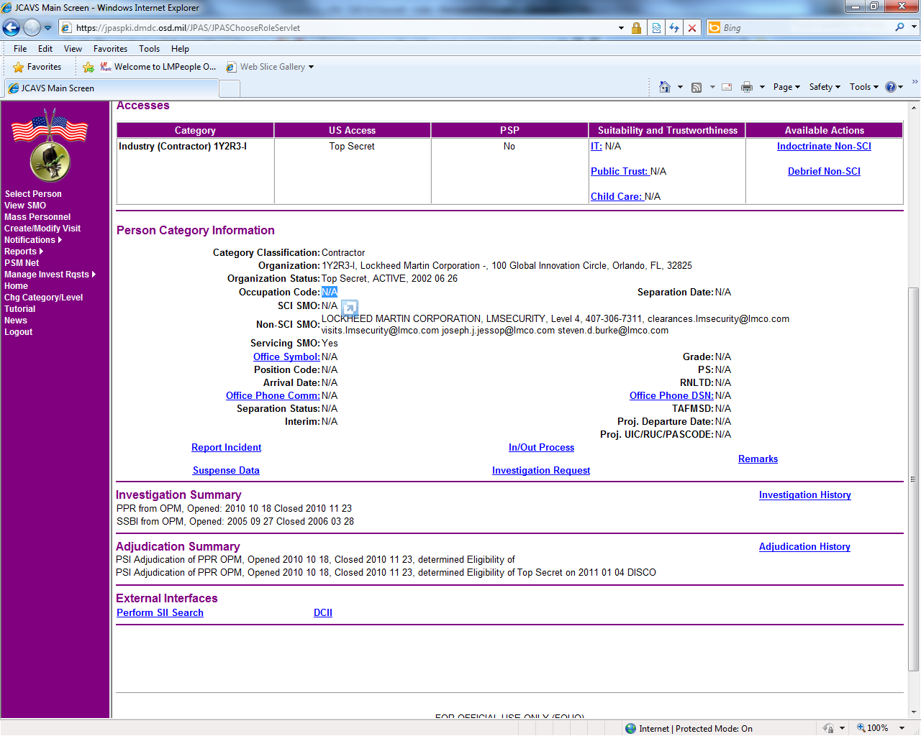
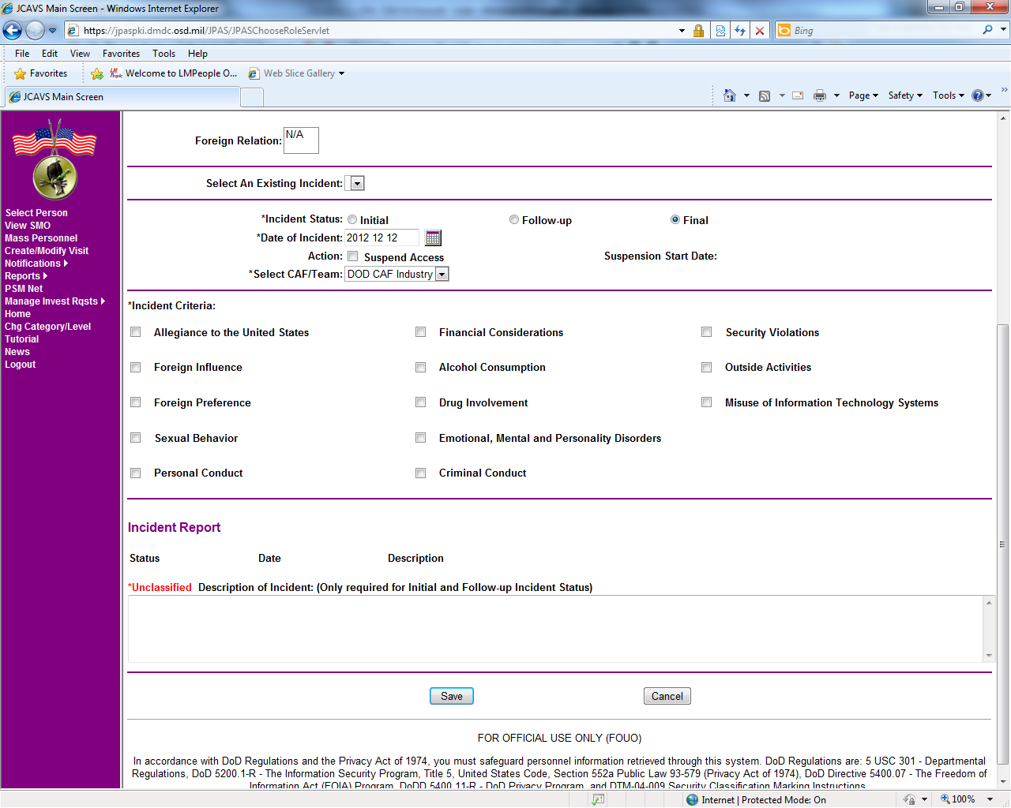
How to Submit an Incident Report via JPAS

Slide 15
BOTTOM LINE
Establish procedures to ensure cleared personnel are aware of their responsibilities for reporting
Know when and how to report adverse information
Keep the appropriate offices advised (IS Rep, DSS, FBI, DoDCAF/PSMO-I)
Do not make reports based on rumors or innuendo
Make sure you talk to your HR department so they will know what to report to you

