Slide 1
FISWG
22 Jan 2020
RMF Appendices
&
Incident Response Plans
Dan Van Aulen & Tom Westermeyer, Lockheed Martin Orlando
407-356-7387

Slide 2
RMF Appendices (Original)
DAAPM 1.2 Appendices (OBMS)
A. System/Network Diagram
B. Facility/System Layout
C. Hardware Baseline
D. Software Baseline
E. DSS Form 147
F. IS Access Authorization and Briefing
G. Upgrade/Downgrade/Sanitization
H. IS Security Seal Log
I. Maintenance Log
J. Assured File Transfer Procedures
K. Contingency Plan
L. Incident Response Plan
M. POA&M
N. Risk Assessment Report (RAR)
O. Mobility System Plan
P. Other items, RALS/254s/SGCs etc.

Slide 3
RMF Appendices (Current) ref page iv - v DAAPM 2.0
DAAPM 2.0 Appendices (eMASS)
A. Security Controls
B. DSS Overlays
C. Risk Assessment Report (RAR)
D. POA&M Template
E. RMF Certification Statement
F. ISSM Appointment Letter
G. Hardware Baseline
H. Software Baseline
I. System/Network Diagram
J. DSS Form 147
K. IS Access Authorization and Briefing
L. Privileged User Briefing
M. Upgrade/Downgrade
N. Security Seal Log
O. Maintenance Log/Change Log
P. AFT Process
Q. Contingency Plan
R. Incident Response Plan
T. Sanitization
U. Mobility System Plan
V. Federal IS Template
W. G-2-C ISA
X. Warning Banner
Y. Acronyms
Z. Definitions
AA. References
Note, Facility/System Layout and DD 254 is not referenced but is still required
Highlighted items are new requirements

Slide 4
RMF Attachments ref page 33 – 34 DAAPM 2.0
In order to provide a complete system security authorization package and facilitate the assessment and authorization process, the following supporting artifacts should be included:
A. Risk Assessment Report (RAR) (App C)
B. POA&M (App D)
C. CONMON Strategy
D. Interconnection (ISA/MOU if applicable)
E. RMF Certification Statement (App E)
F. ISSM/**ISSO Appointment Letter (App F)
G. ISSM Training Records (8570, eMASS, RMF)
H. 254, RFP or framework Agreement
I. Config Management, HW/SW List (App G&H)
J. System/Network Diagram (App I)
K. Facility/System Layout
L. DSS Form 147 (App J)
M. IS Access Authorization and Briefing (App K)
N. Privileged User Briefing (App L)
O. Upgrade/Downgrade (App M)
P. IS Security Seal Log (if applicable) (App N)
Q. Maintenance Log/Change Log (App O)
R. Media Protection AFT Process/DTA (App P)
S. Contingency Plan (if applicable) (App Q)
T. Incident Response Plan (IRP) (App R)
U. Sanitization Procedures (App T)
V. Mobility System Plan (if applicable) (App U)
W. SPP (if applicable)
X. Artifacts (SOPs, policies, etc.) demonstrating proper
control implementation and/or requested by the AO.
Y. Acronyms
Note: The artifacts above are not an all-inclusive list. Templates are provided in the DAAPM Appendices and available for download on the DSS RMF Webpage. (This is a rabbit hole)
**Consider Mobility and Program personnel that perform audits

Slide 5
Definition of an Incident
Event
An event is an occurrence not yet assessed that may affect the performance of an information system and/or network. Examples of events include an unplanned system reboot, a system crash, and packet flooding within a network. Events sometimes provide indication that an incident is occurring or has occurred.
Incident
An incident is an assessed occurrence having potential or actual adverse effects on the information system. A security incident is an incident or series of incidents that violate the security policy. Security incidents include penetration of computer systems, spillages, exploitation of technical or administrative vulnerabilities, and introduction of computer viruses or other forms of malicious code.

Slide 6
Definition of an Incident
Event
An event is an occurrence not yet assessed that may affect the performance of an information system and/or network. Examples of events include an unplanned system reboot, a system crash, and packet flooding within a network. Events sometimes provide indication that an incident is occurring or has occurred.
Incident
An incident is an assessed occurrence having potential or actual adverse effects on the information system. A security incident is an incident or series of incidents that violate the security policy. Security incidents include penetration of computer systems, spillages, exploitation of technical or administrative vulnerabilities, and introduction of computer viruses or other forms of malicious code.

Slide 7
Incidents to Consider
Data Destruction or Corruption
Data Compromise and Data Spills
Malicious Code
Virus Attack
Worm Attack
Trojan Horse Attack
Denial-of-Service (DoS) Attack
System Contamination
Privileged User Misuse
Security Support Structure Configuration Modification
Insider Threat
Illegal or Unauthorized Usage
Improper Usage
Note: This is not an all-inclusive list!!!

Slide 8
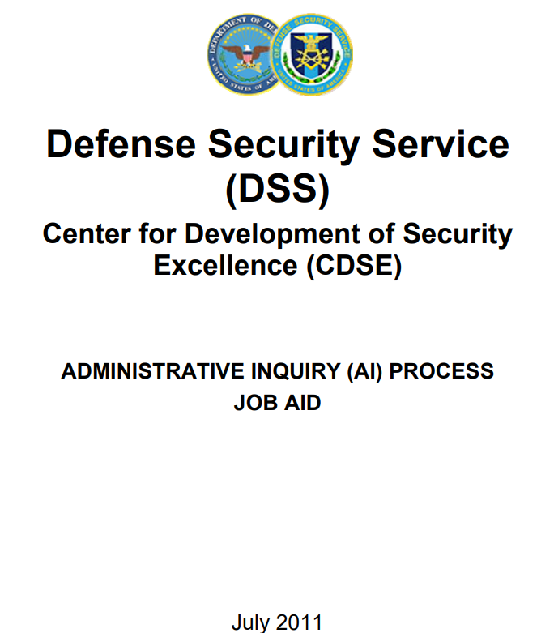
Reporting Requirements

Slide 9
Reporting Requirements
2.3.1 Timeline for Initial Report Submission of the initial report must adhere to the following guidelines:
Top Secret: within 24-hours (1-day)
Secret/Confidential: within 72-hours (3-days)
3.1 Timeline for Final Report Submission of the final report must adhere to the following guidelines:
Top Secret/Secret/Confidential: within 15-days of discovery
However, actual reporting times may vary based on your IS Rep.

Slide 10
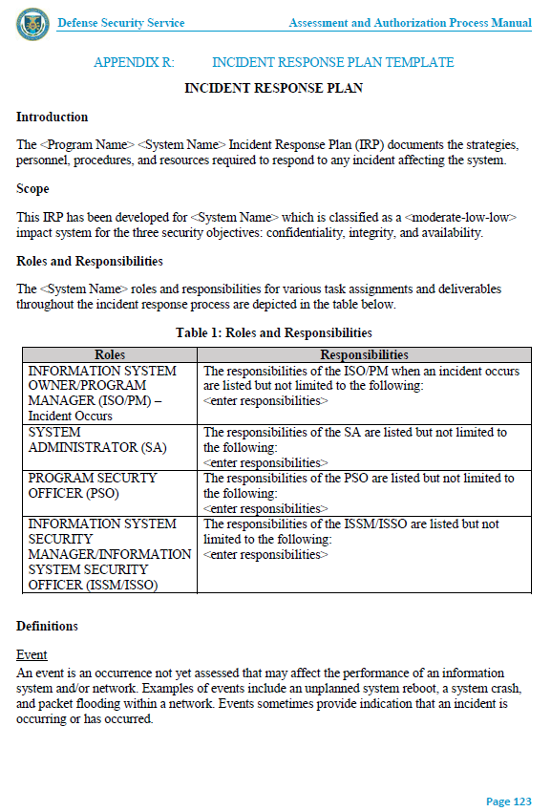

Slide 11
Resources
The following references will assist with the development of an IRP:
· NIST SP 800-88 Rev 1, Guidelines for Media Sanitization
· NIST SP 800-61 Rev 2, Computer Security Incident Handling
· CNSSI No. 1001, National Instruction on Classified Information Spillage
· CNSSP No. 18, National Policy on Classified Information Spillage
· CNSSP No. 26, National Policy on Reducing the Risk of Removable Media for National Security Systems
Note: CNSSP 26 Release Date: 07/24/2013…This document is designated FOUO. To access protected FOUO content in the CNSS Library, you must login with a Federal/DoD Public Key Infrastructure (PKI), Personal Identity Verification (PIV) or Common Access Card (CAC) client certificate correctly installed in your browser and click on the "CAC/PKI/PIV Login" button above.

Slide 12
RMF Attachments (Differences)
DAAPM 1.2 Appendices (OBMS)
A. System/Network Diagram
B. Facility/System Layout
C. Hardware Baseline
D. Software Baseline
E. DSS Form 147
F. IS Access Authorization and Briefing
G. Upgrade/Downgrade/Sanitization
H. IS Security Seal Log
I. Maintenance Log
J. Assured File Transfer Procedures
K. Contingency Plan
L. Incident Response Plan
M. POA&M
N. Risk Assessment Report (RAR)
O. Mobility System Plan
P. Other items, RALS/254s/SGCs etc.
DAAPM 2.0 Appendices (eMASS)
A. Security Controls
B. Facility/System Layout
C. Risk Assessment Report (RAR)
D. POA&M Template
E.RMF Certification Statement
F. ISSM Appointment Letter
G. Hardware Baseline
H. Software Baseline
I. System/Network Diagram
J. DSS Form 147
K. IS Access Authorization and Briefing
L. Privileged User Briefing
M. Upgrade/Downgrade
N. Security Seal Log
O. Maintenance Log/Change Log
P. AFT Process
Q. Contingency Plan
R. Incident Response Plan
T. Sanitization
U. Mobility System Plan
V. Federal IS Template
W. G-2-C ISA
X. Warning Banner
Y. Acronyms
Z. Definitions
AA. References

Slide 13
Questions????

