Slide 1
Counterintelligence Awareness, Reporting, and Partnership Briefing
Larry Hite
This brief has been produced by the Defense Counterintelligence and Security Agency (DCSA) for DoD Contractors and Government Agencies as Part of their security program. Questions and requests to further distribute this publication should be addresses to the DCSA Directorate of Counterintelligence
WARNING: This report may contain information with United States Persons as defined by Executive Order 12333 and Department of Defense Manual 5240.01. Such Information should be handled and protected in accordance with applicable Intelligence Oversight rules by persons and organizations subject to those rules. DCSA collects, retains, and disseminates United States Persons information with all applicable laws, directives, and policies. Should you require minimized USPI, c

Slide 2
Agenda
DCSA Authorities
What is Counterintelligence (CI)?
Industry Reporting
Methods of Contact
Insider Threat
Cyber / Social Networking
Notes:
These are the topics we will be covering…..

Slide 3
Who Are We? – DCSA Authorities
DoDD 5105.42
  Establishes DCSA as a Defense Agency under the authority, direction, and control of the Under Secretary of Defense for Intelligence (USD(I))
  Identifies DCSA as the DoD Cognizant Security Agency for Industrial Security
  Directs DCSA to manage & administer the DoD portion of the National Industrial Security Program (NISP) for the DoD and 24 other U.S. departments/agencies
DoDI 5240.19
  Outlines DCSA’s responsibility to conduct CI activity within the Defense Industrial Base (DIB) in areas of security, threats, suspicious incidents, and countermeasure implementation
Notes:
Has anyone heard of DCSA (formerly DSS), or have worked with us before?
Let me tell you a little about our agency …
Fall under DoD / USDI
Cognizant Security Agency for Industrial Security
National Industrial Security Program (NISP)
Mission = Ensuring a Trusted Workforce and Enabling industry to deliver uncompromised through critical technology protection (CTP), Vetting, CI, and professional education/certification (CDSE)
Vision = Guardians of our Nation’s assets

Slide 4
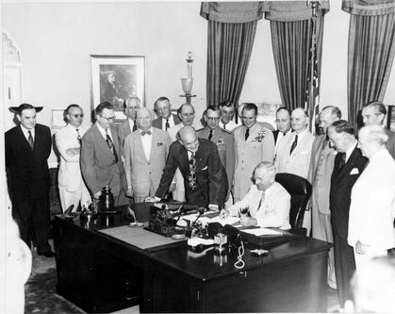
What is Counterintelligence?
Information gathered and activities conducted to protect against:
  Espionage
  Sabotage
  Assassinations
  Other intelligence activities
Conducted by or on behalf of…
  Foreign governments or elements thereof
  Foreign organizations
  Foreign persons
  International terrorist organizations
President Truman signing the
National Security Act of 1947
Notes:
Go through the definition of counterintelligence (CI)
About the picture:
The National Security Act of 1947 was a major restructuring of the United States government's military and intelligence agencies following World War II. The Act merged the Department of War (renamed as the Department of the Army) and the Department of the Navy into the National Military Establishment (NME). The act was amended on August 10, 1949, under the Secretary of Defense. At the same time, the NME was renamed as the Department of Defense. Aside from the military reorganization, the act established the National Security Council, a central place of coordination for national security policy in the executive branch, and the Central Intelligence Agency, the U.S.'s first peacetime intelligence agency.
Promote the national security, established the National Military Establishment (NME)
Established the DoD
Created Intel Agencies
Picutre: https://en.wikipedia.org/wiki/National_Security_Act_of_1947

Slide 5

What Should We Protect?
Any information that would degrade the nation’s advantage if compromised
Protect anything that may:
  Damage national security
  Alter program direction, scope, or duration
  Compromise the program or system capabilities
  Shorten the expected system life
  Deals with Critical Technology in order to counter the impact of loss
It does NOT always involve classified information!
Notes:
Protect anything that would degrade our advantage tactically, operationally, and strategically.
DCSA Mission is to protect the classified, but our advisories don’t always target that first.
Picture: Clipart

Slide 6
Industry Reporting
If You Have to Say “NO,” let DCSA know
  If asked for proprietary information
  If asked for export controlled items
  If asked for classified information
  If asked for dual use technology (military/commercial use)
  If asked for technology outside requestor’s scope of business
  If solicitor is acting as procurement agent for foreign government
  If the request is unusual, etc.
  Any anomalies
Notes:
Sometimes, you may get asked questions where the answer would entail sensitive, proprietary, controlled, or classified answers. You are all trained not to answer those questions, and to re-direct the conversation. However, “If you have to say NO, let DCSA (or your Security Team) know.” Sometimes it is critical to know that they asked and were rebuffed.
The following list is a sample of the information that our adversaries may target

Slide 7
Industry Reporting Requirements
DoD 5220.22-M (NISPOM)
  1-301: Terrorism, Subversion, Espionage, Sabotage; Reports to be submitted to the FBI & CSA
  1-302a: Adverse Information: Report adverse information to CSA
  1-302b: Suspicious Contacts: Report efforts to obtain illegal/unauthorized access to classified information or to compromise a cleared employee
  1-303: Reports of loss, compromise, or suspected compromise: Security Violations
DCSA Industrial Security Letter 2010-02 & 2013-05
Reporting Requirements for Cyber Intrusions
Notes:
Back up slide if you need to reference NISPOM requirements

Slide 8
Contractor Reporting of
Potential Espionage Indicators (PEI)
NISPOM Guidance:
1-302 a. Adverse Information.
  Contractors shall report adverse information coming to their attention concerning any of their cleared employees.
  Reports based on rumor or innuendo should not be made.
  The subsequent termination of employment of an employee does not obviate the requirement to submit this report.
  If the individual is employed on a Federal installation, the contractor shall furnish a copy of the report and its final disposition to the commander or head of the installation.
Becker vs. Philco and Taglia vs. Philco (389 U.S. 979):
The U.S. Court of Appeals for the 4th Circuit decided on February 6, 1967, that a contractor is not liable for defamation of an employee because of reports made to the government under requirements of this manual and its previous versions.
Notes:
Back up slide if you need to reference NISPOM requirements

Slide 9
Targeting U.S. Technology Summary
Most Targeted Technologies
Targeting by Geographic Region 2024
East Asia & the Pacific
Near East
Europe & Eurasia
South & Central Asia
Western Hemisphere
Africa
Unknown
>38%
Electronics
Aeronautic Systems
Command, Control, Communication, & Computers (C4)
Armament & Survivability
Optics
Radars
Software
Space Systems
Marine Systems
Energy Systems
24%
18%
8%
6%
>2%
4%
Top Five Methods of Operation 2024
Resume Submission
25%
RFI/Solicitation
16%
Exploitation of Business Activity
15%
Exploitation of Experts
15%
Exploitation of Cyber
8%
Top Five Methods of Contact 2024
Email
32%
Résumé-Academic
13%
Résumé-Professionals
12%
Web Form
11%
Cyber Operations
8%
Notes:
Quick Overview:
In 2019 (using FY 2018 data) Electronics was the most commonly sought technology category (Do you see technologies that your company works on in this list?)
- 2019 was the first year Optics was in the top five most targeted technology categories
- Foreign entities targeted unmanned or independent systems across all technology categories
East Asia & the Pacific accounted for 40% of industry reporting
The top five most common methods of operation (MO) accounted for 79% of incidents (Exploitation of cyber operations increased by 55% from last year)
Email was overwhelmingly the most common method of contact (MC) in FY18 (2019 Trends) – This includes phishing email operations
** Automation** Red color box pops up -- Now we will talk about Methods of Contact that you may experience in your company…
Reference (Pictures): https://www.dcsa.mil/Portals/91/Documents/CI/FY19_Annual_Targeting_US_Technologies.pdf

Slide 10
Case Study
DOJ Case: Arrest of Ji Chaoqun (2018)
Ji Chaoqun, a Chinese in US on Student visa, was arrested for acting as an agent of the Chinese government and attempting to recruit engineers and scientists in the U.S. with access to sensitive defense technologies.
Role: Ji was tasked by the Jiangsu Province Ministry of State Security (JSSD), a regional arm of China's intelligence agency, to identify ethnic Chinese working in U.S. defense contractors within aerospace and defense industries, including those in Florida.
Operation: Ji provided the JSSD with background reports on eight U.S. citizens, some of whom were defense contractors, as part of his espionage activities.
Arrested in BELGIUM
Notes:
Full report at (https://www.dcsa.mil/Portals/91/Documents/CI/FY19_Annual_Targeting_US_Technologies.pdf)

Slide 11
Target Areas
Overseas Travelers (pre-brief & debrief)
  Employees more vulnerable to foreign collection attempts outside the United States
Hosting Foreign Visits
  Primary contact with visiting foreigners; arranging the visit; prime elicitation target
Business Development Personnel
  Virtue of duties make them first-contact for business proposals
Sales / International Sales
  Initial contact; continued contact; website / web-form requests; low cost, high gain targeting
Human Resource Personnel
  Employment often sought to get close to classified programs; resumes
Abouzar Rahmati, naturalized citizen who worked for the FAA. Attended Iranian Universities for BS and MS and a US University for another MS. Arrested 2023.
Notes:
This slide and the next, list some areas our adversaries target to collect information and technology. Do you work in one of these areas? If I asked everyone to raise their hand if they work in one of these areas, I bet we’d see almost all the hands go up.
Yes, we are all targets.
See also DCSA Counterintelligence Awareness Handout 2019 (https://www.dcsa.mil/Portals/91/Documents/CI/DCSACounterintelligenceAwareness2019.pdf)

Slide 12

Target Areas (Cont.)
Gate Keepers (Admin Assistants/Receptionists)
  Familiarity with inner workings make for ideal foreign targeting
Technology (IT) Personnel
  Best positioned to discern cyber attacks (from inside or outside)
Published researchers, scientists, engineers, etc.
  Specifically targeted for exploitation by hostile services
Public Affairs Personnel
  Typically knowledgeable of foreign visitors or requests for info
Notes:
Continued
Picture: Clipart

Slide 13
Identifying Suspicious Contacts
  Emails
  Phone Calls / Fax / Web-requests
  Elicitation
  Foreign Visits
  Foreign Travel
  Conferences / Symposiums / Trade Shows
Notes:
As mentioned when we went over the Yearly Report (TRENDS no longer exists), we will now talk about some of the common “Methods of Contact” adversaries use to target cleared industry.

Slide 14
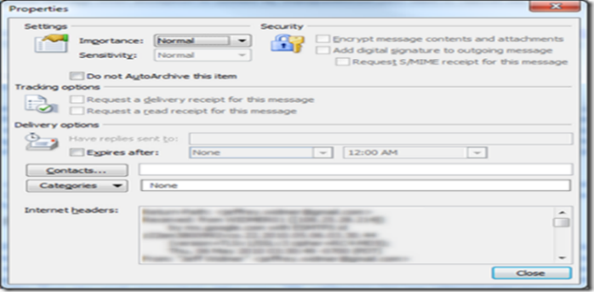
Emails/RFIs
Possible Indicators
  Email/Internet addresses from a
  foreign country
  Recipient uses only a personal address and
  will not provide a business or government email address
  It is unknown how they got your email address
  Technology requested is classified, export-controlled, or dual-use
  Requester is a student, consultant, or employee of a foreign government
  Requester will not divulge end-user
  Recipient is told not to worry about security concerns
Expand header/footer information:
(Outlook) Open email>>File>>Properties>>Copy Headers
Notes:
RFI = Requests for Information
Go over email solicitations, and why this is the #1 Method of Contact for overt collection.
Go over email indicators
Header/Footer information can be useful
Quick Check: Is this email from inside or outside your organization. If outside your company, could it be a spoofed / spear-phishing email? (We will cover these more in the Cyber section later on in the briefing)
Picture: https://weblogs.asp.net/jeffwids/how-to-view-outlook-2010-internet-headers-for-an-email

Slide 15
GMAIL
• Log in to your Gmail account.
• Open the message you want to view headers for.
• Click the Down arrow next to the Reply button, located at the top right of the message pane.
• Select Show Original.
HOTMAIL
• Log in to your Hotmail account.
• Select Inbox from the left-side menu.
• Right-click the message you want to view headers for and select View Message Source.
YAHOO
• Log in to your Yahoo mail account.
• Select the message you want to view headers for.
• Click the Actions dropdown and select View Full Header.
OUTLOOK
• Open Outlook.
• Open a message.
• On the Message tab, located in the Options group, click the Dialog Box Launcher icon.
• In the Message Options dialog box, the headers will appear in the Internet Headers box.
For older versions of Outlook:
• Open Outlook.
• Open the message you want to view headers for.
• Click the View menu and select Options.
OUTLOOK EXPRESS
• Open Outlook Express.
• From your Inbox, find the message you want to view headers for.
• Right-click the message and select Properties.
• Open the Details tab in the Dialogue Box.

Slide 16
Website Contact Us Form
Possible Indicators
  Contact information is from a foreign country
  Technology requested is classified, export-controlled, or dual-use
  Claims to be a student, consultant, employee of a foreign government
  Requester will not divulge end-user
  Assures the sales team that export licenses are not required
  Employee is told not to worry about security concerns
  Web-form, or “Contact Us” form, easy way to make contact
Notes:
Go over website-based solicitations
Low cost / High Gain
Adversaries can be anyone on the web, and simply ask for information, or if you will sell them x, y, z…
“If you have to say NO, let DCSA know.” …. Meaning, if your BD/Sales team identifies anomalies, and won’t continue the sale; let Security/DCSA know that someone TRIED to suspiciously request your technology. Sometimes, knowing that they asked (even if you intend to “no-bid” the situation) is important
“Indicators of Suspicious Purchase Requests:”
• End user is a warehouse or company that organizes shipments for others
• No end-user certificate
• Vagueness of order – quantity, delivery, destination, or identity of customer
• Multiple sales representatives
• Unusual quantity
• Requested modifications of technology
• Rushed delivery date
• No return address
• End user address is in a third country
• Address is an obscure PO Box or residence
• Multiple businesses using the same address
• Buyer requests all products be shipped directly to him/her
~~ CI Booklet, page 3, Counterintelligence Awareness

Slide 17
Elicitation
Elicitation (or social engineering) is the subtle extraction of information during an apparently normal and innocent conversation
Conducted by a skilled intelligence collector can appear to be a social or professional conversation and can occur anywhere (restaurant, conference, or one’s home)
Foreign Intelligence Entities are very patient and skilled
Don’t answer questions outside your scope
(Stay in your lane)
Answer a question with a question
(Why are you asking me this?)
Notes:
Go over elicitation
If you get that feeling that someone is asking too many personal or business-related questions, let Security/DCSA know
“Foreign intelligence officers are trained in elicitation tactics; their job is to obtain protected information. Non-traditional collectors, such as business and academic contacts, will leverage existing relationships to obtain restricted information outside the scope of the relationship. Because of this, not all elicitation attempts are obvious to the target.” ~~ CI Booklet, page 18, Personal Contact
“If you believe someone is attempting to elicit information from you, you can”:
• Change the topic
• Refer them to public websites
• Deflect the question
• Provide a vague answer
• Explain that you don’t know
~~ CI Booklet, page 19, Personal Contact

Slide 18
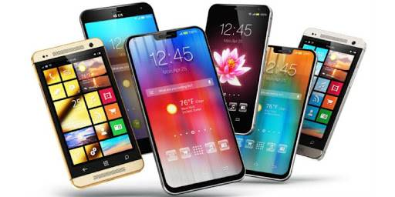
Foreign Visits
Possible Indicators
  Peppering & questions outside the scope of the approved visit
  Wandering or distraught visitor who acts offended when confronted
  Divide and conquer technique to separate from group
  Switch visitors: Last minute additions or changes to the visit
  Bait and switch: Changing the scope of the visit at the last minute
  Prohibited Electronics: Bringing phones / cameras / video into areas where none are allowed
  Visitors who conceal their foreign government ties
Know your Technology Control Plan (TCP)
Consider a visitor cell phone policy
Name checks prior to the visit
Business Cards
Notes:
Go over Foreign Visit suspicious indicators
Examples
• Violation of Security Protocols
• Peppering
• Wandering Visitor
• Divide and Conquer
• Switch Visitors
• Bait and Switch
• Distraught Visitor
• Use of Prohibited Electronics
~~ See also Foreign Visits Handout 2019 (https://www.dcsa.mil/Portals/91/Documents/CI/DCSAForeignVisits2019.pdf)
Picutre: https://www.bestfunquiz.com/q/how-to-choose-a-smartphone-quiz

Slide 19
Foreign Travel
Possible Indicators
  Hotel room seems as if it was searched
  Theft
  The appearance of being followed
Countermeasures
  Leave unnecessary devices at work / home
  Use a travel laptop or removable hard-drive
  Computer scans before leave / upon return
  Don’t publicize travel plans (social media)
  Pre / Post travel security briefings
Jul 2025 UTS Highlights:
-Spain gives Huawei Wiretap Contracts, Sparking Concerns Over Potential Chinese Government Access Due To Huawei’s Links to Beijing
Recent Interview:
- Cell Phone Connected To Local Towers and Downloaded Emails To Servers, Discovered While Reviewing Bill
Do you need to take your laptop?
Computer scans before leave / upon return
Business Cards
Notes:
Go over Foreign Travel suspicious indicators (May have to Insert the video again)
In Transit:
• Questioning from airport security
• Luggage searches
• Being separated from your computers and personal electronic devices
At Destination:
• Hotel surveillance (room, lobby)
• Hotel room intrusion or searches
• Hotel safes are not “safe.”
• Theft
• Eaves-dropping
• Event surveillance (CCT, Expos)
• Unauthorized installation of malicious software on computers or personal devices
Video, (1 min clip): of what it looks like to have a hotel room searched by those who “work” at the hotel
Can also show DNI “Know the Risk, Raise your Shield” Travel Awareness video (or parts of it; it’s 7 mins log) (https://www.dni.gov/index.php/ncsc-how-we-work/ncsc-know-the-risk-raise-your-shield/ncsc-awareness-materials)
(YouTube: https://youtu.be/6ZXYEdWPBYA)
~~ CI Booklet, page 24-25, Foreign Travel Vulnerability

Slide 20
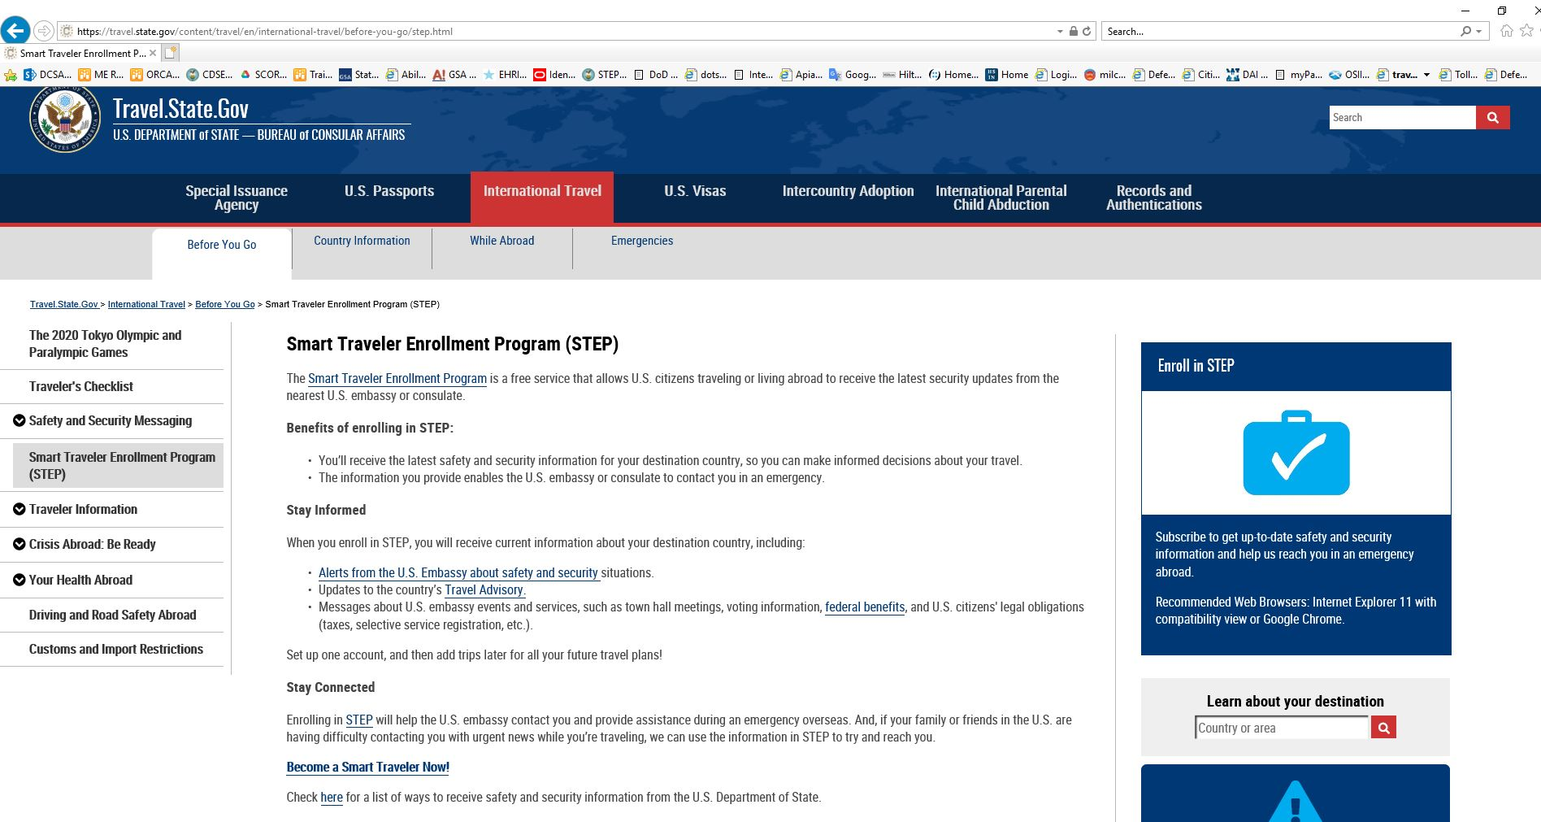
Foreign Travel (Cont.)
Notes:
Smart Traveler Enrollment Program (https://travel.state.gov). Full URL /Picture: (https://travel.state.gov/content/travel/en/international-travel/before-you-go/step.html)
What is STEP?
Benefits of Enrolling in STEP The Smart Traveler Enrollment Program (STEP) is a free service to allow U.S. citizens and nationals traveling abroad to enroll their trip with the nearest U.S. Embassy or Consulate
Before you go:
• Inform others of your itinerary
• Know the local laws and customs
• Register your travel with the Department of State
• Check health and immunization information with Center for Disease Control and World Health Organization
• Establish a point of contact for your family
• Keep all medications in their original container
• Make copies of your passport and other important documents
Contact your local security official for a Foreign Travel Debriefing upon return from your trip
• Report any suspicious activity or contact to your local security official

Slide 21
Conferences, Conventions, Trade Shows
Clue = All Expenses Paid
Possible Indicators
  Unsolicited invitation to overseas conference or symposium
  Being approached by individuals who are overly knowledgeable of you and your work
  Approved guests bringing uninvited participants to the event (known as “shoe horning”)
  Foreigners attempting to access events that are closed to foreigners (feigning ignorance)
  Suspicious behavior at the CCT (photographs, following an employee, invitations to events, etc.)
Suspicious contact after you return from your trip (Saying, “I met you at the trade show”)
Business cards
Notes:
Go over CCT suspicious indicators: Before the trip, during the trip, after you return from your trip
~~See also CCT Handout 2019 (https://www.dcsa.mil/Portals/91/Documents/CI/DCSAConferences2019.pdf)
Can also show DNI “Know the Risk, Raise your Shield” Human Targeting at CCTs video (5:11 mins long) (https://www.dni.gov/index.php/ncsc-how-we-work/ncsc-know-the-risk-raise-your-shield/ncsc-awareness-materials)
(YouTube: https://youtu.be/XpqOEniQK9U)

Slide 22
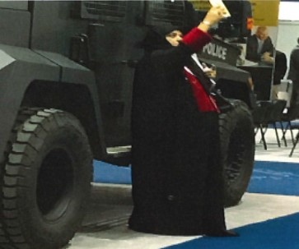
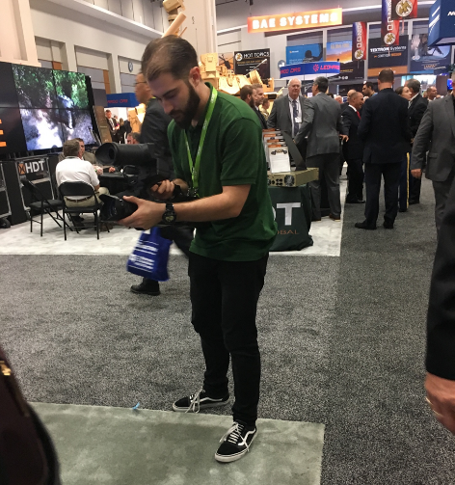
Conferences, Conventions, Trade Shows
Suspicious Behaviors
Aggressively inspecting displays or refusing to leave
Questionable badge credentials / hiding them
Using hand to measure
Asking detailed questions, where answers could reveal controlled information
Creative photography “selfies”
Social Networking
Business cards
Multiple cell phones or cameras
Claiming to be journalists
Swarm tactics
Notes:
Here are some suspicious behaviors industry has reported at CCTs.
The four pictures will display first.

Slide 23

Exploitation of Relationships
Joint ventures and joint research may provide opportunities for elicitation and access to employees / networks
Joint efforts place foreign personnel in close proximity to cleared employees and technology
Adversaries seek to build rapport and prey
on eagerness to develop or expand
commercial relationships
Front companies posing as legitimate
businesses
Be wary of providing information beyond the scope of the meeting or business activity
Notes:
Foreign entities exploit legitimate activities with defense-oriented companies to obtain access to otherwise denied information, programs, technology, or associated U.S. personnel.
This method of operation relies on the appearance of legitimacy provided by the established commercial or business activity.
Conversely, U.S. company personnel, cleared or not, seeking to build positive relationships and gain future business with foreign partners, may unwittingly provide information beyond the scope of the business activity for which the relationship exists.
~~ See also DCSA Exploitation of Business Activities 2019 Handout (https://www.dcsa.mil/Portals/91/Documents/CI/DCSAExploitationofBusinessActivities2019.pdf)
Picture: DCSA Handout

Slide 24





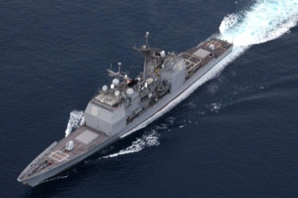
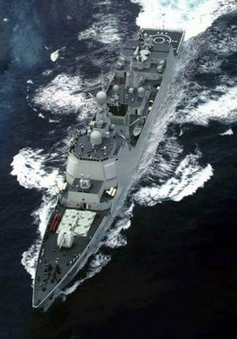

Insider Threat
Most damaging espionage cases were carried out by insiders
(USPER1) Chi Mak
Secret clearance
L3 Power Paragon
Naval QED propulsion technology
VA class submarine
Aegis battleship
China
24 yrs prison / $50,000
(USPER2) Greg Bergersen
Secret clearance
Pentagon contractor
Taiwan's air defense system
US plans in Taiwan
China
57 months / 16 yrs prison
U.S. Aegis
battleship
Chinese
Luyang II
Notes:
The most potentially damaging scenario to sensitive DoD equity involves a trusted insider threat.
Definition: The likelihood, risk, or potential that an insider will use his or her authorized access, wittingly or unwittingly, to do harm to the national security of the United States. Insider threats may include harm to contractor or program information, to the extent that the information impacts the contractor or agency’s obligations to protect classified national security information.
MICE-R acronym for potential motivations. ** Automations will pop up each of the 5 motivations **: Money, Ideology, Compromise (Blackmail), Ego, Revenge
Have the audience identify the possible motivations in the following case studies
Two case studies:
(USPER1) Chi Mak: (USPER) Chi Mak worked on more than 200 U.S. Defense and military contracts over a 20-year span. Sent to US in 1978 to gain employment. In 2008, (USPER1) Mak was eventually convicted for acting as an unregistered foreign agent of China and sentenced to 24 and 1/2 years in prison for conspiring to export technology related to Navy ships. Gave up information on the Navy’s Quiet Electric Drive (QED) Propulsion System. Removed computer disks from work and emailed photographs to his home computer. Motivation: Ideology. He was placed in the US for 24 years to assess US defense and commercial industries.
(USPER2) Greg Bergersen (**Watch 60 minutes clip. Click on dark shadow box. 1 min clip) YouTube: (https://youtu.be/cAz0Pt3NUWM)
Former Policy Analyst for Defense Security Cooperation Agency (DSCA). Worked at Pentagon as a contractor. Gave up Taiwan’s air defense system plans to who he thought was a Taiwan government official. In fact, the FIE was Chinese. Sold classified defense information to the People’s Republic of China .Pled guilty to conspiracy to disclose national defense information. FBI recorded several meetings between (USPER2) Bergersen and Tai Shen Kuo (naturalized citizen and Chinese agent). Sentenced to 57 months in prison. Kuo sentenced to 16 years. Motivation: Money and Ideology. Received several thousand dollars and trip to Las Vegas. He felt that Taiwanese government should know Pentagon’s plans for a C4ISR air defense system and US five year plan for arms sales to Taiwan.
Other Potential Espionage Indicators (PEIs):
• Security violations
• Fail to report overseas travel / contact with foreign nationals
• Seeking job or clearance outside current job or abilities
• Asking questions where the answer would be controlled or classified information (If you have to say, “No;” let DCSA know)
• Seeking access to restricted areas
• Working odd hours
• Behavioral indicators such as (Depression, Personal life issues, Abuse of alcohol or drugs, Gambling, Finance trouble, Disciplinary issues) Note: Behaviors may also be indicative of potential workplace violence
~~ For more examples, See CDSE Case Studies: (https://www.cdse.edu/resources/case-studies/insider-threat.html)
~~ See also Exploitation of Insider Access 2019 Handout (https://www.dcsa.mil/Portals/91/Documents/CI/DCSAExploitationofInsiderAccess2019.pdf)
Aegis picture: https://en.wikipedia.org/wiki/Aegis_Combat_System
Luyang II picture: https://en.wikipedia.org/wiki/Type_052C_destroyer
Mice picture: https://www.chapters.indigo.ca/en-ca/books/goldwhiskers/9781442467057-item.html

Slide 25
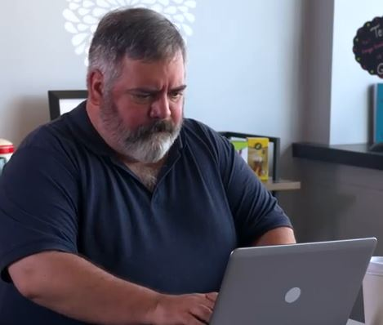

Cyber: Phishing
Socially-engineered email aka “phishing” or “spear-phishing” is the most common method our adversaries use to get inside computer networks
A socially-engineered email is:
  An email with maliciously-crafted attachments or links to a malicious website
  High level of targeting sophistication (spear-phishing)
  May appear to come from an associate, client, or acquaintance
  May be contextually relevant to your job
Spearphishing
Do not open attachments (or clink on links) from someone you do not know
Notes:
Earlier when we talked about RFIs, recommend you check if an email is from inside or outside your organization. If outside your company, could it be a spearphishing or spoofed email?
Explain what is phishing
Don’t open ATTACHMENTS or click on LINKS from an unknown source
Optional: Can click on the two pictures for links to 2 videos from DNI, “Know the Risk Raise Your Shield”. Can also play from:
(https://www.dni.gov/index.php/ncsc-how-we-work/ncsc-know-the-risk-raise-your-shield/ncsc-awareness-materials) Scroll down the page to a series of videos.
(They are also on YouTube: https://youtu.be/X5P-VYxPNrk and https://youtu.be/33R-W8foNlo)
“Don’t be this guy” – short clip of clicking on phishing email and losing $$ (30 sec)
“Spearphishing” – click on the brow box and not the word. Video explaining spear phishing. (2:46 mins long)

Slide 26
Cyber / Social Networking
Cyber
Social Networking
Malicious links or attachments
Spearphishing
Spoofed emails
Un-patched or zero-day vulnerabilities
Compromised media (USB drives)
Credential harvesting
Easily broken passwords
Attempted and successful intrusions
Access Controls & User Account Audits
Review BYOD policies
Great tool, but…
False identities, personas
Vulnerable to spearphishing, spoofing, hacking
Tremendous volume of users presents targets of opportunity
Can be used for reconnaissance and elicitation
Remember NEED-TO-KNOW. Only post what is needed
Adjust your security settings
Not everyone is a friend!
Do not open attachments (or clink on links) from someone you do not know
Notes:
Cyber and Social Networking Considerations
Note: BYOD = Bring Your Own Device to work policies
**Show social networking funny video. Click on red box. A humorous, fake clip from Onion news. How users on social media sites can post so much information on themselves. (3:20 mins long)
(YouTube: https://youtu.be/eiPaTy2iJTM)
See also DCSA Cyber Threats 2019 Handout (https://www.dcsa.mil/Portals/91/Documents/CI/DCSACyberThreats2019.pdf)
• Remember that everyone is a potential target
• Use complex passwords, change them regularly, and don’t reuse
• Be wary when connecting with unknown individuals on social networking sites
• Spear-phishing can happen on any account, including personal email accounts
• Do not open emails, attachments, or click links from unfamiliar sources, even if they look official

Slide 27
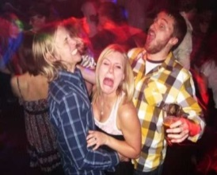
Social Networking Tips
  NEED-TO-KNOW. Only post information that you are comfortable with others knowing
  No detailed biographic information
  Do not list your home address or personal phone number (A phone number can be used to perform a reverse look-up and find your home address)
  Adjust security settings, lock down pictures and personal information
  Do not divulge sensitive company information. Limit project-specific descriptions
  Remember! Not everyone is your friend. Do not blindly accept every business associate, referral, or friend invitation
Never divulge your clearance level or that you work on classified projects
Notes:
Some tips.
Funny picture to say, “Remember: What goes on the Internet, stays on the internet.” Be mindful of what you post.
Picture: https://www.dumpaday.com/funny-pictures/funny-nightclub-pictures-20-pics/

Slide 28
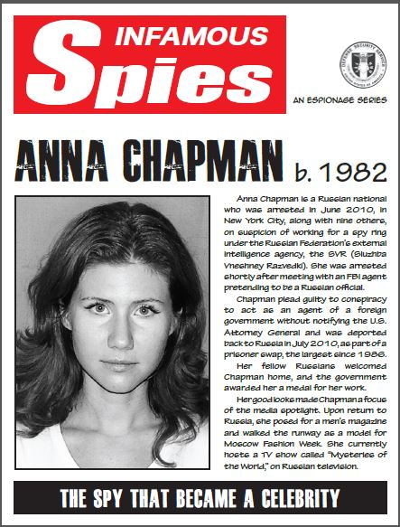
Social Networking: Case Study
Anna Chapman (Anna Vasilyevna Kushchenko)
is the daughter of a Russian Intelligence General
Anna was a deep cover Russian intelligence
officer targeting U.S. policy, economics, and
personnel who had access
Anna used a popular social networking site to socially
engineer her targets and later used Steganography to
hide (encrypt) her emails back to Russia
June 28th, 2010, she was arrested with ten other Russians on charges of conspiring to act as an unregistered agent of a foreign government
After her arrest, hundreds of (USPER3) Facebook friends quickly dropped her
July 8, 2010, she pled guilty and was returned to Russia for four U.S. sources
October 2010, she received highest honors from the Kremlin for her work as an undercover Russian agent
Notes:
Extra case study if needed
Picture: CDSE

Slide 29
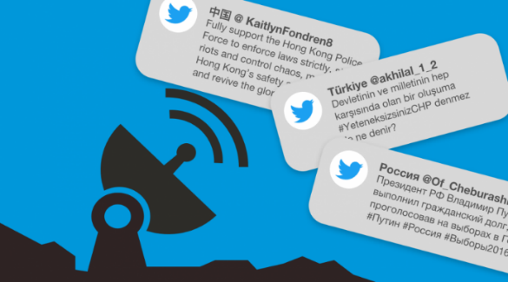
What is “Malign Foreign Influence?”
Combating foreign influence in an interconnected world, combined with the anonymity of the Internet
Adversaries use tools like the Internet to spread disinformation, discord, and undermine confidence in U.S. democratic institutions and values
  Fake social media personas (i.e. (USPER4) Twitter example)
  Fake news
  Divisive messages, disinformation
  Often combined with cyber, covert operations, state funded media, third parties, paid social media users or “trolls”
Targeting
  Election infrastructure (registration databases,
  voting machines)
  Political organizations and Public officials
  Public opinion to sow division
Foreign influence operations will evolve as technology evolves
Use a critical eye when reading social media, check sources whenever possible
Notes:
This final slide is something to consider when talking about social media. I’m not showing it to dive into politics or what is and what is not “fake news,” but to underscore how our foreign adversaries can manipulate social media to their advantage. Bottom line up front: this is an old tactic, deployed in a new way, so much so that in the Fall of 2017, Director of the FBI established the Foreign Influence Task Force (FITF) to identify and counteract foreign influence operations in the US.
Malign foreign influence operations aimed at the U.S. are not new (covertly funding newspapers for example), but the Internet allow for these efforts to spread rapidly and globally (for example false US personas on Internet sites spreading divisive messages). (https://www.justice.gov/opa/speech/deputy-assistant-attorney-general-adam-s-hickey-testifies-house-judiciary-committee, 22 Oct 2019)
Foreign influence operations are not a new problem. But the interconnectedness of the modern world, combined with the anonymity of the Internet, have changed the nature of the threat and how the FBI and its partners must address it. The goal of these foreign influence operations directed against the United States is to spread disinformation, sow discord, and, ultimately, undermine confidence in our democratic institutions and values.
(https://www.fbi.gov/investigate/counterintelligence/foreign-influence)\
See the examples
Example: 2016 Presidential Election and 2018 Midterm Elections: January 2017 report by the Office of the Director of National Intelligence (ODNI) addressing Russian interference in the 2016 U.S. presidential election, Russia has had a “longstanding desire to undermine the U.S.-led liberal democratic order,” and that nation’s recent election-focused “activities demonstrated a significant escalation in directness, level of activity, and scope of effort compared to previous operations.” Russia’s malign foreign influence campaign, according to ODNI, “followed a Russian messaging strategy that blends covert intelligence operations—such as cyber activity—with overt efforts by Russian Government agencies, state funded media, third-party intermediaries, and paid social media users or ‘trolls.’ (https://www.justice.gov/opa/speech/deputy-assistant-attorney-general-adam-s-hickey-testifies-house-judiciary-committee, 22 Oct 2019)
Non Political example: In October 2018, seven Russian officers in the GRU were indicted on computer hacking and other charges related to a Russian malign influence effort designed to undermine, retaliate against, and otherwise delegitimize the efforts of international anti-doping organizations and officials who had publicly exposed a Russian state-sponsored athlete doping program and to damage the reputations of athletes around the world (https://www.justice.gov/opa/speech/deputy-assistant-attorney-general-adam-s-hickey-testifies-house-judiciary-committee, 22 Oct 2019)
(USPER4) Twitter / Fake Persona Examples: As of 12 June 2020: (USPER4) Twitter has identified online propaganda networks run by Russia, China, and Turkey and shut down over 170,000 accounts that were essentially false personas run through bots and related methodologies (23,750 China accounts that tweeted that tweeted 348,608 times [ They also had 200,000 accounts suspended in August 2019], 1,152 Russian accounts that tweeted 3,434,792 times, 7,340 Iranian accounts that tweeted 36,948,524 times.) Tweets focused on the Hong Kong protests; COVID-19; exiled Chinese billionaire Guo Wengui; and Taiwan (a smaller but still significant set).
- Narratives around COVID-19 primarily praise China’s response to the virus, and occasionally contrast China’s response against that of the U.S. government or Taiwan’s response, or use the presence of the virus as a means to attack Hong Kong activists. The English-language content included pointed reiterations of the claim that China - not Taiwan - had a superior response to containing coronavirus.
- Similar to (USPER4) Twitter’s August 2019 PRC-attributed takedown, the accounts used in this operation were not well developed personas: most accounts had fewer than 10 followers and no bios. Batches of accounts were created on the same day with similar naming conventions or bio patterns.
- Tweets about Hong Kong and Guo clustered around significant events, and focused on countering pro-democracy narratives in Hong Kong and denouncing Guo’s business contract with former White House chief strategist Steve Bannon.(https://blog.twitter.com/en_us/topics/company/2020/information-operations-june-2020.html) (https://cyber.fsi.stanford.edu/io/news/june-2020-twitter-takedown)
*Animation: Conclusion will pop-up at the end. See also conclusion in the report https://www.justice.gov/opa/speech/deputy-assistant-attorney-general-adam-s-hickey-testifies-house-judiciary-committee
Picture from: https://cyber.fsi.stanford.edu/io/news/june-2020-twitter-takedown

Slide 30
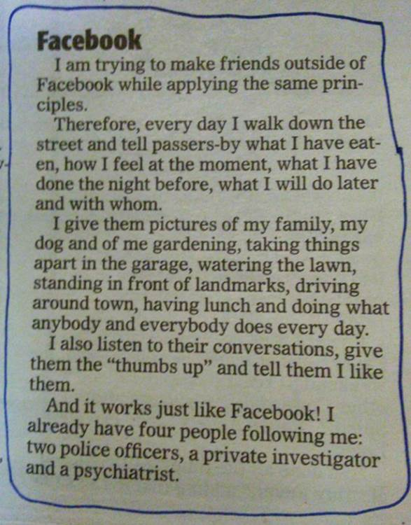
Social Media
Notes:
I like to end with some humor at the end of this presentation. ☺
Picture: Twitter screen shot, https://twitter.com/

Slide 31
4 Things to Remember
If you think something is an anomaly, report it (If you say no, let DCSA know!)
Identifying & reporting vulnerabilities helps protect your product, your company, and DoD technology
Insider Threat is the most damaging
Do not open attachments (or click on links) from someone you do not know

Slide 32
Questions?
Larry Hite
200 E Palm Valley Drive
Oviedo Fl 32780
larry.f.hite.civ@mail.mil
Office: 407 542 – 6950
Mobile: 571 656 - 7897
Doug Hartwell
Tampa Fl
Douglas.e.Hartwell.civ@mail.mil
Office: 813 280 - 8861
Mobile: 813 442-2935
This brief has been produced by the Defense Counterintelligence and Security Agency (DCSA) for DoD Contractors and Government Agencies as Part of their security program. Questions and requests to further distribute this publication should be addresses to the DCSA Directorate of Counterintelligence
Notes:
Questions? (Fill in your contact information)

