Slide 1
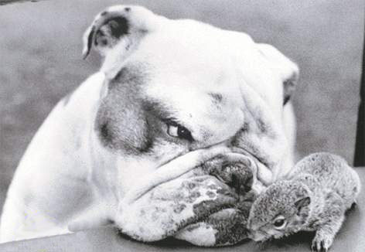
ALWAYS CHALLENGE SUSPICIOUS VISITORS AND ACTIONS

