Slide 1
Cybersecurity and the Department of Justice
Vincent A. Citro,
Assistant United States Attorney
July 9-10, 2014
Unclassified – For Public Use
Notes:
Thank you for inviting me here today. My name is Vince Citro, and I am an AUSA in the Middle District of Florida.

Slide 2
“We know foreign countries and companies swipe our corporate secrets. Now our enemies are also seeking the ability to sabotage our power grid, our financial institutions, our air traffic control systems.”
President Barack Obama, State of the Union (Feb. 12, 2013)
“Increasingly, U.S. businesses are speaking out about their serious concerns about sophisticated, targeted theft of confidential business information and proprietary technologies through cyber intrusions emanating from China on an unprecedented scale.”
National Security Adviser Thomas E. Donilon (Mar .11, 2013)
“We are also clear-eyed about the challenges in cyber. The United States has expressed our concerns about the growing threat of cyber intrusions, some of which appear to be tied to the Chinese government and military.”
Secretary of Defense Chuck Hagel (June 1, 2013)
Ambition to penetrate industrial control systems (SCADA) or otherwise to damage or destroy data or systems.
Saudi Aramco, RasGas, South Korea
DDOS attacks against the financial sector
Terrorists and other extremists deface websites, harass, recruit, and fundraise.
Syrian Electronic Army
Tunisian Cyber Army
Notes:
Cybersecurity is a top priority for the U.S. Government generally and the Department of Justice in particular. Securing the nation’s networks and information from exploitation and damage, though, requires improved information sharing and enhanced coordination between the private and public sectors. To that end, we are meeting with companies like yours to discuss the cybersecurity threats they face and what the Department can do to help.

Slide 3
New York Times
Accuses China of Hacking
Gov’t Warns of More Attacks
President Issues
Cybersecurity Order
More Companies Report Cyber Attacks
Credit Cards Stolen
ECONOMIC ESPIONAGE
Banks Continue
to Suffer Attacks
Notes:
Cybersecurity is in the news almost every day. Although I cannot comment directly on any ongoing investigations or reports you may have seen in the news, I want to assure you the Department of Justice and other federal agencies are involved in many investigations across the country.

Slide 4
Today’s Cyber Threats
Malicious activity by hacktivists
Financial crimes and other frauds
Website defacements
Theft of confidential business information and proprietary technology
Denial of service (DDOS) attacks
Destruction of information and systems
Notes:
Cyber threats are as varied as the actors who carry them out. A growing number of sophisticated state and non-state actors have both the desire and the capability to steal sensitive data, trade secrets, and intellectual property for military or competitive advantage. Others seek to cause damage by erasing data or rendering systems inoperable. While most of the state-sponsored intrusions we are aware of remain classified, the onslaught of network intrusions believed to be state-sponsored is widely reported in the media. All of these categories of activity are crimes that the Department of Justice will investigate and prosecute, regardless of threat actor.
[On Click]: These (highlighted) forms of malicious cyber activity concern us most from a national security perspective. At the Department, we consider these crimes to be national security threats when conducted by nation-state actors and terrorists. And even when perpetrated by others, they may implicate national security equities as a result of scope, target, or sensitivities, and we must treat them accordingly. We must bring all of the government’s tools to the table to address them.

Slide 5
What the USG is Doing
E.O. 13636, Improving Critical Infrastructure Cybersecurity (2013), http://wh.gov/dbX5
Share information about cyber threats, including with the private sector
Expand cyber security services for critical infrastructure beyond the U.S. defense industrial base
Directs the National Institute of Standards and Technology to establish standards to improve cyber security
Notes:
Cybersecurity is a national priority. Because our country faces threats from a variety of cyber threats, including attacks that could disrupt our critical infrastructure, and in the absence of comprehensive legislation, the President issued an Executive Order directing federal agencies to use their existing authorities and increase cooperation with the private sector to provide better protection for the systems that are critical to our national and economic security.
The Executive Order clears the way for more efficient sharing of cyber threat information with the private sector.
It also directs the expansion of the Enhanced Cybersecurity Services (ECS) program, administered by other agencies, to provide near real-time sharing of information on cyber threats with critical infrastructure companies.
And it directs the National Institute of Standards and Technology to develop of a framework of cybersecurity practices to reduce cyber risks to critical infrastructure. NIST is working collaboratively with industry to develop the framework, relying on existing international standards, practices, and procedures that have proven to be effective. To enable technical innovation, the Cybersecurity Framework will provide guidance that is technology neutral and that enables critical infrastructure sectors to benefit from a competitive market for products and services

Slide 6
National Security Cyber Specialist Network
NSCS
USAOs
Local relationships and experience
National Security Division Intelligence
Information
Criminal Division
Computer Crimes Expertise
Notes:
The Department of Justice is adapting to address the threat as well. The Department has recently focused its efforts to better equip itself to combat cyber threats to the national security – namely, intrusion activity conducted by or on behalf of terrorists and nation states. This is a growing problem, and one that requires close coordination between the government and the victims of this activity. Within DOJ, we have prosecutors from around the country and at headquarters with extensive expertise in both computer crimes and national security crimes who are working together to combat these types of intrusions by drawing on their respective areas of expertise.
I am one of those AUSAs. Here in the district of ______, we are working closely with Main Justice, other U.S. Attorney’s Offices, the FBI, and other investigative to ensure that we can detect nationwide patterns and threats.

Slide 7
to combat cyber attacks,
we need to work
together
Notes:
But the government cannot help protect you from national security cyber threats if it does not know about them. The private sector is often our first line of defense – our early warning system – for understanding and defending against new and emerging threats.
We know that the decision whether to report a particular intrusion can be a difficult one. You may doubt an event’s significance or have concerns about disclosing information that may affect your reputation or compromise sensitive or proprietary interests.

Slide 8
no intrusion is
to report
too small
Notes:
Regarding significance – no intrusion is too small to report. What may appear to be an isolated and minor intrusion into one company’s network may turn out to be evidence that can be used to better understand a persistent threat on another’s. When state actors compromise your systems, it may be part of a much larger event, with national implications. We may know who the perpetrator is and have useful information about how best to mitigate and respond to the attack. Only with complete information can our law enforcement and intelligence communities connect the necessary dots to understand and disrupt the threat.
More often than not, the information you provide will, by itself, help law enforcement and others better protect U.S. computer networks. Gathering the information that can help the U.S. Government protect your company, other companies, and other U.S. interests is our first priority.

Slide 9
we will work to minimize
CRIME SCENE DO NOT CROSS CRIME SCENE DO NOT CROSS CRIME SCENE DO
CRIME SCENE DO NOT CROSS CRIME SCENE DO NOT
CRIME SCENE DO NOT CROSS CRIME SCENE DO
CRIME SCENE DO NOT CROSS CRIME SCENE DO NOT CROSS CRIME SCENE DO
CRIME SCENE DO NOT CROSS CRIME SCENE DO NOT CROSS CRIME SCENE DO
time and resources
required to report intrusions
Notes:
Investigative agencies are committed to minimizing the time and resources required to report intrusions. We also want to emphasize that if you contact us to report an intrusion, you can be confident that we will treat the matter with the highest discretion. We may also ask you to use discretion as well, so as not to reveal the investigation to the intruders on your network.

Slide 10
in return, we will
share information
U.S.
Government
Private
Sector
when we can
Notes:
To the extent the Government can share information about the threat with you, we will. Of course, you should be aware that we may not always be able to provide immediate feedback – either because of operational reasons or because classified information is implicated. Rest assured, however, that even if you do not hear back immediately, it does not mean that the information was not important or appreciated. We will always be available to discuss these issues with you, so please don’t hesitate to reach out.

Slide 11
disclosing an intrusion
to customers
or the public
Intrusion
Investigation
Notification of Customers
may affect an
ongoing investigation
Notes:
We also understand that you may have obligations to disclose information about intrusions to your customers or the public. 46 states have data breach notification requirements, and the SEC has also issued guidance on disclosures.
However, whether and how you disclose an intrusion to your customers or the public can affect any ongoing investigation. Data breach notification laws typically make allowances to delay notification when requested by law enforcement agencies in furtherance of an investigation. We will work with you to help you determine when and how to disclose information about intrusions.

Slide 12
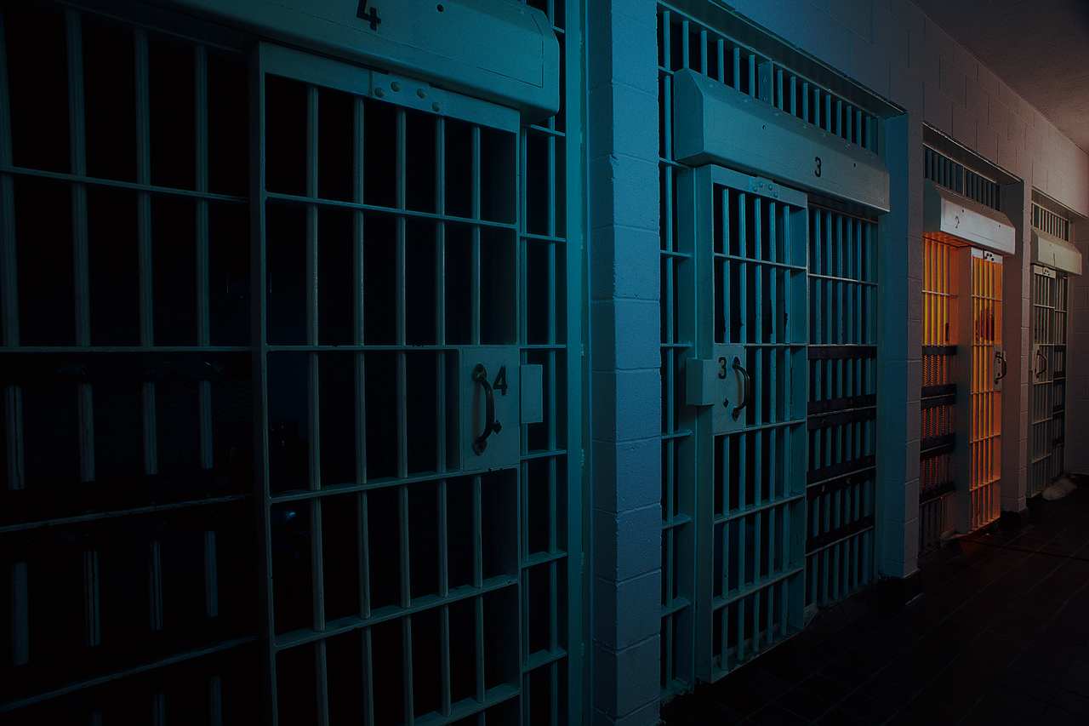
criminal prosecution
is a
powerful,
long-term
tool
for combating intrusions
Notes:
Sharing information about any hacking experiences you have will not always result in a prosecution, but in certain instances, it may also be possible to charge and prosecute the hackers responsible for the intrusion into your company. Criminal prosecution can be a powerful, long-term tool toward combating intrusions.
Should that become possible, this Office will work closely with you to protect your company’s equities to the best of our abilities. In general, prosecutors have discretion in deciding whether and when to bring charges. In exercising that discretion, we absolutely consider whether the company that has been hacked wants to pursue charges and the effect of such charges on the company.

Slide 13
What You Can Do Today
Prepare for the worst—hope for the best
Organize a crisis-response team within the company
Participate in information sharing organizations, like InfraGard or the Electronic Crimes Task Forces
Use modern network defense best practices
Notes:
It’s important that you take steps today to protect yourself. Have a cybersecurity plan—and test it. Have contingencies if your plans fail. And, importantly, make sure your senior management, including your general counsel, understands the risk and business impact that various cyber events would have on your company. This isn’t just an IT issue—this is an issue for your whole company.
Companies facing a significant data breach often face a number of novel and consequential decisions. Organizing a team of senior managers in advance to anticipate and then later make those decisions can make it easier for the company to interact with USG agencies, the public, and other constituents in the immediate aftermath of an incident. A crisis response team might consist of a company’s CEO, CISO or other Corporate Security professional, and representatives of its Information Technology, Public Affairs, and General Counsel’s offices.
Although some of the information sharing programs mandated by the EO are still in development, the government already has information sharing programs in place. Through the FBI’s InfraGard program, individuals in law enforcement, government, the private sector, and academia meet to talk about how to protect our critical infrastructure. InfraGard has more than 85 chapters across the country, with more than 47,000 members. Additionally, the U.S. Secret Service’s Electronic Crimes Task Forces bring together federal, state and local law enforcement, and prosecutors, private industry and academia to work together to prevent, detect, mitigate and investigate attacks on the nation's financial and critical infrastructures. [Consider providing local contact information for those groups.]

Slide 14
Cyber Incident Preparation
Know your legal agreements with users and partner companies
Make sure your IT staff and managing partners are talking regularly
Segment your networks (e.g., finance vs. HR/payroll vs. operations)
Segment your authentication (e.g., two-factor authentication)
Carefully consider the tradeoff between security and productivity
Remember: Any network link is a potential intrusion vector
Have at least 2 to 3 IT staff members trained in cyber incident response
Contact law enforcement as soon as an intrusion is identified
Notes:
FBI has advised businesses on steps they can take long before an incident to safeguard their networks and to be prepared in the event of an intrusion.

Slide 15
Cyber Incident Response
Point of contact for legal, technical (IT), and project management
Copies of banners/ computer use agreements
Employee handbook, other corporate policies
Network topography maps
Internal and external IP address and host lists
List of network devices (switches, routers, other devices)
Incident logs (e.g., security, host, IDS/IPS, web, database, network)
Archived network traffic
Forensic images of compromised hosts (live memory captures)
Physical access logs (video cameras, key cards, TFA devices)
Notes:
FBI has also advised, in its outreach to the private sector, that it is likely to request the following list of things in the immediate aftermath of an incident and during the initial phases of an investigation.

Slide 16
Questions?
Vincent.Citro@usdoj.gov
(407) 648-7555
Notes:
If your company is the victim of a cyber intrusion, please contact your local Federal law enforcement office. Your information could help protect U.S. national security interests.
I’m sure you have many questions for me, and I have some for you too…

