Slide 1
OPSEC
Awareness Briefing
Man-In-The-Middle Attacks
(MITM)

Slide 2
What is a Man-In-The-Middle (MITM) Attack?
An MITM attack refers to a broad range of active eavesdropping techniques in which an attacker attempts to intercept, read, or alter information moving between two or more computers.
These attacks allow a 3rd party to interject themselves between separate systems and act as an electronic go-between, anonymously observing data while passing information back and forth between the other systems.
This form of information gathering/altering is also sometimes referred to as a Bucket Brigade or Janus attack.

Slide 3
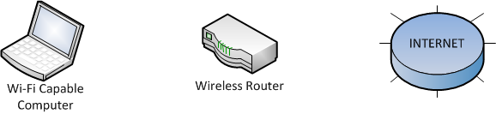
How MITM Attacks Work
There are several methods for employing an MITM attack. However, they all rely on the ability to fool a system into believing that it is communicating securely.
During normal operations a Wi-Fi capable computer authenticates with a wireless router which allows it to connect to a network, intranet or internet.

Slide 4
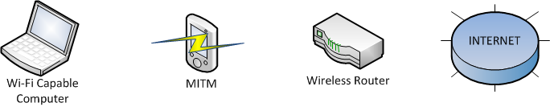
How MITM Attacks Work
During an MITM attack the 3rd party steps in between the targeted computer and a router when the computer first attempts to initiate a connection. The MITM then intercepts communications between the computers. In this position the MITM acts as a proxy; reading, altering, and inserting data in the communications stream. This allows the MITM to capture transmitted files, public keys, cookies, and passwords passed between the systems.

Slide 5
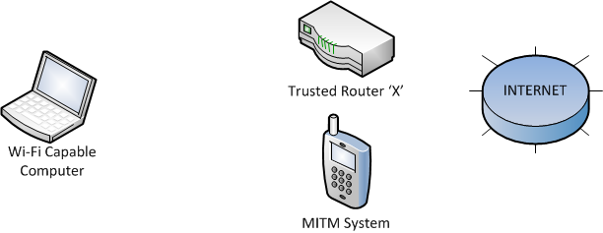
How MITM Attacks Work
Some systems may actively imitate a trusted network by setting up a Wi-Fi connection with a generic name or creating a separate ad hoc system. It is also possible for hardware to imitate the response from a trusted router and then route all data through its own connection to the internet. This form of MITM is sometimes referred to as a ‘honeypot’.

Slide 6
How MITM Attacks Work
MITM attacks can occur if –
An attacker is in control of a router along the normal point of traffic communications.
An attacker is located on the same broadcast domain as the target.
An attacker is located on the same broadcast domain as any of the routing devices used by the target.
Areas of high risk include any location in which your computer system utilizes Wi-Fi signals for access, such as airports, hotels, restaurants, and even homes.

Slide 7

MITM Attacks
While most MITM attacks require advanced computer skills and training, there has been an increase in the accessibility of easy to use technology which allows for rapid deployment and set-up within a wide range of areas.
Several devices that perform MITM type attacks are readily available through the internet. One organization, hakshop (hakshop.myshopify.com), offers the WiFi Pineapple. This 4th generation testing platform retails for under $100 dollars and is marketed as a “Stealth Access Point for MITM attacks” which is “focused on ease-of-use” and makes “launching MITM attacks as simple as setting up your typical home wireless router.”
hakshop’s Pineapple

Slide 8
Vulnerabilities Created by MITM Attacks
MITM attacks have the potential to compromise communications and risk the inadvertent disclosure of sensitive information.
A significant issue with this form of attack is that any loss of information may be completely undetectable as the data is read while transferring between systems.
Resources to conduct MITM attacks are progressively more reliable and easier to employ, leading to a larger potential user base.
There is an increased number of public venues which provide free Wi-Fi. It is relatively simple for personnel in these areas to employ MITM attacks, especially in areas where the Wi-Fi router lacks password protection.

Slide 9
Countermeasures to Prevent MITM Attacks
⇒Use hardwired, or non Wi-Fi, connections whenever possible. Utilize ethernet cables or direct tethering to avoid potential Wi-Fi vulnerabilities. During hotel stays, use the ethernet cables available in most rooms instead of Wi-Fi.
⇒Don’t connect to public Wi-Fi systems. If you do connect, limit the type of information which you transmit. Avoid logging on to any websites or accounts which require a password. If you do use a password, change it when you are once again on a hardwired connection.
⇒Utilize Virtual Private Network (VPN) connections or sites which operate through Hypertext Transfer Protocol Secure (HTTPS) to increase security. Please remember that VPN and HTTPS may not be sufficient to secure your information.

Slide 10
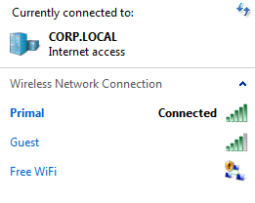

Countermeasures to Prevent MITM Attacks
⇒Turn off “Auto Connect” for your wireless devices. This will require you to enter your password each time you attempt to connect to known Wi-Fi systems.
⇒Examine the source of the Wi-Fi signals before attempting to connect. Ad Hoc networks typically show up differently and could represent a 3rd party attempting to hijack your connection.
This symbol represents an ‘ad hoc’
connection. Do not connect to this
wireless source.

Slide 11

Remember – You Get What You Pay For
Wi Fi
Or…
Mi Tm
Is now really the time to send that confidential document?

Slide 12
References and Suggested Reading
An Example of a Man-in-the-middle Attack Against Server Authenticated SSL-sessions by Mattias Erikson, Simovits Consulting (PDF),
http://www8.cs.umu.se/education/examina/Rapporter/MattiasEriksson.pdf
Man in The Middle Attack – Explained by Michael Cotes, 3 March 2010, http://michael-coates.blogspot.com/2010/03/man-in-middle-attack-explained.html

Slide 13
Additional Questions?
Please contact your Facility Security Officer if you have any questions regarding this training.
For additional technical issues it is highly recommended that you discuss potential safeguards with your IT Department.

