Slide 1
Defense Security Service
UNCLASSIFIED//FOUO
Defense Security Service
Cybersecurity Operations Division
Counterintelligence
UNCLASSIFIED//FOUO

Slide 2
Defense Security Service
UNCLASSIFIED
DSS Mission
DSS Supports national security and the warfighter, secures the nation’s technological base, and oversees the protection of U.S. and foreign classified information in the hands of Industry
Capability
(U) 11 personnel conducting analysis, liaison, field support, strategic development and program management
(U) Wide range of skill sets – CI, CT, LE, Cyber, Security, Intel, IA, CNO and more
(U) Direct access to cleared industry across 25 DSS field offices nationwide
(U) Large roles at U.S. Cyber Command, National Security Agency, National Cyber Investigative Joint Task Force and the Department of Homeland Security
CI Mission
DSS CI identifies unlawful penetrators of cleared U.S. defense industry and articulates the threat for industry and government leaders
Scope
10K+ firms; 13K+ facilities; 1.2m personnel
1 CI professional / 261 facilities
10.5% of facilities report
UNCLASSIFIED

Slide 3
Defense Security Service
UNCLASSIFIED
Challenges
(U) Secure sharing of threat information with industry partners
(U) Identifying and reporting suspicious network activity
(U) Limited resources to execute for an quickly expanding mission area
Significant Achievements and Notable Events
(U) Since September, 2009 – Assessed over 3,000 cyber-related suspicious contact reports from Industry and the Intelligence Community; facilitating action on over 170 federal investigations/operations
(U) Developed four benchmark product lines for Industry and the Intelligence Community to include the 3rd edition of the DSS Cyber Trends
(U) Briefed at 24 venues and over 1,000 personnel in FY12 on the cyber threat
(U) In FY12, delivered over 350 threat notifications to industry, detailing adversary activity occurring on their networks.
UNCLASSIFIED

Slide 4
SCR Assessment Life Cycle
UNCLASSIFIED
Suspicious Contact Report
(U) Fundamental building block of industry intelligence analysis
(U) Highlights various methods of contact and approach
(U) Provides vital insight to military programs and key facility programs
Threat
Collect
Report
Analyze
Refer
Exploit
Educate
SCR
Assessment
Life Cycle
UNCLASSIFIED

Slide 5
Evaluating Suspicious Contacts
UNCLASSIFIED
Method of Operation
Attempted Acquisition of Technology
Conferences, Conventions, Trade Shows
Criminal
Exploitation of Relationships
Seeking Employment
Solicitation or Marketing Services
Student Requests – Academic Solicitation
Suspicious Network Activity
Collector Affiliation
Commercial, Government, Government Associated, Individual
Technologies and Programs Targeted
Military Critical Technology List
UNCLASSIFIED

Slide 6
UNCLASSIFIED//FOUO
Way Ahead
(U) Continue to grow and expand DSS’s cyber capability
(U) Increase Opportunities for sharing of timely threat information and actionable data
(U) Continue to build partnerships throughout cleared industry, intelligence and federal government communities
UNCLASSIFIED//FOUO

Slide 7
BREAK

Slide 8
Defense Security Service
UNCLASSIFIED//FOUO
(U) Cyber Threats to the Defense
Industrial Base
UNCLASSIFIED//FOUO
Notes:
UNCLASSIFIED//FOUO
Good Afternoon.
My name is ….
Today I will be providing you with a briefing on Cyber Threats to the Defense Industrial Base. The overall classification of this brief is Unclassified//For Official Use Only
UNCLASSIFIED//FOUO

Slide 9
(U) Agenda
UNCLASSIFIED
(U) Fiscal Year 2012 Industry Cyber Reporting
(U) Threat Overview
(U) Where We Are Vulnerable
(U) Methods of Operation
(U) A New Approach to Threat Modeling
(U) Reporting
(U) Getting Ahead
UNCLASSIFIED
Notes:
UNCLASSIFIED//FOUO
(U) These are the topics we will be covering.
UNCLASSIFIED//FOUO

Slide 10
(U) FY12 Industry Cyber Reporting
UNCLASSIFIED//FOUO
(U//FOUO) 1,678 suspicious contact reports (SCR) categorized as cyber incidents (+102% from FY11)
(U//FOUO) 1,322 of these were assessed as having a counterintelligence (CI) nexus or were of some positive intelligence (PI) value (+186% increase from FY11)
(U//FOUO) 263 were categorized as successful intrusions (+78% increase from FY11)
(U//FOUO) 82 SCRs resulted in an official investigation or operation by an action agency (+37% increase from FY11)
UNCLASSIFIED//FOUO
Notes:
UNCLASSIFIED//FOUO
For FY12:
(U//FOUO) 1,678 suspicious contact reports (SCRs) categorized as cyber incidents were reported
(U//FOUO) 102% increase from FY11, in which 785 SCRs were reported
(U//FOUO) The increase is due to some Cleared Contractor reported directly to DSS HQ (some of which are DIB Framework Members) and also due to DSS having more resources in the field, to collect more reports from the Defense Industry. As well as an increased focus on cyber education and cyber threat awareness.
(U//FOUO) 1,322 SCRs were assessed as having a counterintelligence (CI) nexus or were of Positive Intelligence Value
(U//FOUO) 186% increase from FY11, in which 463 SCRs were reported
(U//FOUO) These reports are of CI or PI value, some of which were noted as successful intrusions.
(U//FOUO) 263 were categorized as successful intrusion - 78% increase from FY11
(U//FOUO) (U) An intrusion is determined successful when the methods used to exploit an information system work as intended, compromising at least one computer but potentially entire networks.
(U//FOUO) An intrusion as most of you know, can mean unauthorized access to a computer or an entire network, or simply that a user clicked on a malicious link or attachment, dropping malicious files on a user’s computer, possibly even a backdoor, allowing the Intruder full access to a user’s computer.
(U//FOUO) 82 SCRs resulted in an official investigation or operation by an action agency (37% increase from FY11)
(U//FOUO) Source: Statistics derived solely from Industry reporting to DSS.
UNCLASSIFIED//FOUO

Slide 11
(U) FY12 Technologies Targeted by Cyber
UNCLASSIFIED//FOUO
UNCLASSIFIED//FOUO
Notes:
UNCLASSIFIED//FOUO
(U//FOUO) These numbers account for only the cyber-related incidents where DSS assesses the incident to have counterintelligence or positive intelligence value.
(U//FOUO) Aeronautics and Information Systems were the majority of targeted technology, accounting for 8% each.
(U//FOUO) However, in 64% of cases, a specific targeted technology wasn’t able to be assessed.
(U//FOUO) Some facilities produce more than one technology, therefore this could be the reason why the Targeted Technology was deemed Unknown.
(U//FOUO) In some instances if a network was compromised & if DSS was provided with more information on the type of information exfiltrated (if any), then we can determine the Targeted Technology.
(U) Source: This information is based solely on Industry reporting to DSS. This does not necessarily reflect adversary data exfiltration activity within the Intelligence Community.
UNCLASSIFIED//FOUO

Slide 12
(U) FY12 Cyber Incident by Category
UNCLASSIFIED//FOUO
UNCLASSIFIED//FOUO
Notes:
UNCLASSIFIED//FOUO
(U//FOUO) For FY12, these numbers account for only the cyber-related incidents were DSS assesses the incident to have counterintelligence or positive intelligence value
(U//FOUO) The majority of cyber-related SCRS, 66%, were categorized as an unsuccessful intrusion attempt
(U//FOUO) Most commonly this includes spear phishing attempts in which the user did not click on the malicious link or open the malicious attachment.
(U//FOUO) In some cases the cleared contractor’s facility’s email filtering systems stripped off the malicious attachment
(U//FOUO) 13% of SCRs were categorized as a root level intrusion
(U//FOUO) These cases in which unauthorized access to a complete network was obtained
(U//FOUO) Intrusion vectors can vary widely but some of the more common are the installation of malicious code through socially engineered emails (clicking a link or malicious attachment), exploiting website vulnerabilities, and exploiting poor security practices such as weak administrator or user passwords.
UNCLASSIFIED//FOUO

Slide 13
(U) Threat Overview
UNCLASSIFIED
(U) A variety of adversaries have demonstrated the capability and intent to do harm to Department of Defense (DoD) systems and networks
Threat = Capability + Intent
UNCLASSIFIED
Notes:
UNCLASSIFIED//FOUO
(U//FOUO) The adversary must have both the capability and the intent to post a threat. If one or the other is not present, there is no threat.
(U//FOUO) Capabilities can include specific equipment, knowledge, and financing to effectively deploy malware onto a target system
(U//FOUO) Intent could be to steal information for either personal, economic, political, or military gain
(U//FOUO) Identifying what the adversary already knows helps you prioritize your information and allows you to determine the collection method(s) the adversary is using against you. Also, keep in mind that the adversary may go to several different sources to collect the information he needs. Once you have assessed the adversary's intent and capability, you can assess his potential threat to you.
UNCLASSIFIED//FOUO

Slide 14
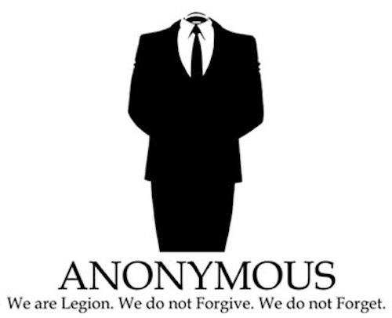
(U) Cyber Threats
UNCLASSIFIED
(U) Nation states (foreign governments)
(U) Terrorist groups/extremists/sympathizers
(U) Insiders
(U) Recruited
(U) Disgruntled Employee
(U) Hackers/criminals
(U) Organized/individuals
UNCLASSIFIED
Notes:
UNCLASSIFIED//FOUO
(U//FOUO) Cyber threats can come in many forms…
It can be a savvy computer user who down the street, members of terrorist organizations, or sophisticated and well-resourced computer network operations programs of nation states / foreign governments
(U//FOUO) Hackers or criminals may collect specific pieces of information about a target and leverage that information against the target to compromise their networks and resources. They may distribute unwanted spam mail, perform denial of service attacks against a remote target, thus making money off your computers bandwidth and processing power. Some want to conduct online banking fraud against you, such as the Zeus botnet. Others, such as the group anonymous just want the challenge of bringing down the network, which have been successful planned attacks against government agencies and CDCs, and post sensitive information to the public (such as usernames, passwords, information on proposals, and information that CDCs may have on government agencies that is sensitive information)
(U//FOUO) Often overlooked are cyber threats from “insiders”. An insider threat is an individual who has direct access to computer systems or networks and uses that access to cause harm. The damage caused by an insider threat can take many forms, including the introduction of computer viruses/worms, the corruption or deletion of data, theft of sensitive, proprietary or potentially classified data, identity theft, etc. Insiders are one of the most difficult threats to protect your computer or network from.
UNCLASSIFIED//FOUO

Slide 15
(U) Where We Are Vulnerable
UNCLASSIFIED
(U) Bottom Line Up-Front: Everywhere
(U) Application vulnerabilities (e.g., Internet Explorer, Adobe)
(U) Operating systems
(U) Web-based applications (e.g., JavaScript, Flash)
(U) Removable media
(U) Network-enabled devices
(U) The end user
UNCLASSIFIED
Notes:
UNCLASSIFIED//FOUO
(U) Applications, Operating systems and web-based applications, present tremendous challenges for network security professionals. An actor can exploit a flaw in the software code, unknown to the administrator or even to the software developer, to install malicious software and exploit system resources and information without the user knowing.
Hackers develop exploits which can exploit the vulnerability and provide the hacker access to the computer. Most exploits require user-interaction, so hackers are counting on users to select a malicious email link or open a malicious email attachment.
(U) Removable media (i.e. thumb drives, USB devices, CDs, etc) can pose a security risk. Malicious code can reside on the media and can easily (and unknowingly) be transferred to multiple networks and domains.
Users should exercise extreme caution when receiving media from outside or untrusted sources. (i.e. conferences, trade shows, etc.)
Removable media should ALWAYS be scanned for viruses before use and before being placed on a trusted network.
Malicious actors are known to even place thumb drives with malware on them in parking lots near target facilities, hoping that DoD or Cleared Contractor workers will plug them into their networks.
(U) Vulnerabilities also exist in network enabled devices found on the computer or network. Vulnerabilities in the applications for these devices exist in everything from the desktop computer and printers, to the routers and peripherals that make up the network infrastructure. These vulnerabilities could allow an unauthorized user access to a computer or entire network.
Hackers have begun to focus developing malware for smart-phones.
(U) The end user is the greatest vulnerability. The only “patch” for the end user is user education and awareness.
The high success rate of socially engineered emails is directly attributed to the adversary taking advantage of the user’s lack of awareness
Examples of user error could be are clicking on links or attachments in suspicious emails resulting in the download of malicious files or system administrators or power users not following or not understanding proper procedures for their network equipment resulting in a network vulnerability.
UNCLASSIFIED//FOUO

Slide 16
(U) Methods of Operation
UNCLASSIFIED
(U) Open source research
(U) Passive collection
(U) Vulnerabilities and exploits
(U) Socially engineered email attacks
(U) 0-Day (Zero Day) application vulnerabilities
(U) Credentials
(U) Exploitation of trusted relationships (IT)
(U) Poor security practices/configurations
(U) Lack of end user education
UNCLASSIFIED
Notes:
UNCLASSIFIED//FOUO
(U) Actors will often first conduct as much open source research as possible on their target, gaining as much information as they can that will assist in making their exploitation attempt successful.
A large amount of personal information about individuals is readily available through the use of Google and other Internet search Engines (Such as Spokeo, PiPl)
(U) Facebook is not the only source of information for adversaries
(U) Public records (school, tax records, utilities)
(U) Blogs (personal, friends)
(U) Online newspapers (banns, obituaries, editorials)
(U) Combining information from multiple sources creates a very detailed picture
(U) Socially engineered email attacks remain the number one way the adversary is exploiting the networks of defense industry.
Email gives the adversary a direct line of communication to their target – stopped by only well configured network defenses and the recipient’s user education.
The “don’t take candy from strangers” rule applies to the email. It’s not always easy to spot a socially-engineered email. Be aware that not all of them contain errors and/or typos and many of them are contextually relevant to the victim’s job.
(U) 0-day vulnerabilities are flaws in the source code that the software developers did not catch, leaving the computer vulnerable and able to be exploited.
(U) According to a news article in the Register, hackers exploit security vulnerabilities in software for 10 months on average before they are launched and before vendors are aware of the vulnerabilities and typically last 312 on average.
(U) The only way to stop a 0-day from infecting a computer is to have a patch written to fix the source code flaw. Usually a patch is written within a couple of weeks of the 0-day software’s release, highlighting the importance that software patches are up to date so computer networks are protected from the latest threats.
(U) Valid user credentials (username and password, PKI credentials, security tokens, etc) are also rapidly becoming a preferred method of operation used by the adversary.
The use of a valid credential allows the adversary to appear as a legitimate user, increasing their opportunities for a successful exploit
(U) Using weak or default passwords is an easy way for someone to compromise a computer system.
When receiving a new piece of equipment ensure the default passwords are reset to a strong password of your choosing.
A strong password should consist of uppercase letters, lowercase letters, numbers, special characters, and is approximately 9-15 characters long.
UNCLASSIFIED//FOUO

Slide 17
Threat Modeling
UNCLASSIFIED
(U) The model for handling threats MUST change
“Conventional incident response methods fail to mitigate the risk posed by APTs because they make two flawed assumptions: response should happen after the point of compromise, and the compromise was the result of a fixable flaw”
(U) Intelligence-driven computer network defense is a necessity
(U) Address the threat component of risk, incorporating adversary analysis, their capabilities, objectives, doctrine and limitations
UNCLASSIFIED
Notes:
Source: Intelligence-Driven Computer Network Defense Informed by Analysis of Adversary Campaigns and Intrusion Kill Chains. Eric M. Hutchins, Michael J. Cloppert, Rohan M. Amin, Ph.D. (Lockheed Martin Corporation)

Slide 18
Threat Modeling
UNCLASSIFIED
(U) Intrusions must be studied from the adversary’s perspective – analyzing the “kill chain” to inform actionable security intelligence
(U) An adversary must progress successfully through each stage of the chain before it can achieve its desired objective
(U) Just one mitigation disrupts the chain and the adversary
Recon
Weapon
Delivery
Exploit
Install
Command and Control
Actions on Objectives
UNCLASSIFIED
Notes:
Source: Intelligence-Driven Computer Network Defense Informed by Analysis of Adversary Campaigns and Intrusion Kill Chains. Eric M. Hutchins, Michael J. Cloppert, Rohan M. Amin, Ph.D. (Lockheed Martin Corporation)

Slide 19
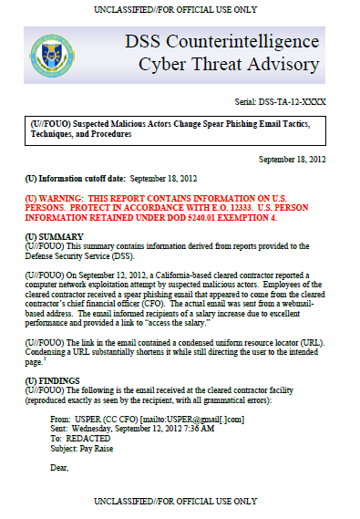
Threat Modeling
UNCLASSIFIED//FOUO
(U) Moving detection and mitigation to earlier phases of the kill chain is essential in defending today’s networks
Recon
Weapon
Delivery
Exploit
Install
Command and Control
Actions on Objectives
UNCLASSIFIED//FOUO

Slide 20
(U) Emerging Threats
UNCLASSIFIED
(U) Mobile devices
(U) iOS
(U) Android
(U) Blackberry
(U) Social Networking Sites
(U) Facebook
(U) Linked In
(U) Cloud Computing
(U) Offers great potential for cost reduction through optimized and efficient computing
(U) Poor or inadequate implementations of cloud computing security and policy can provide actors with opportunities for exploitation.
UNCLASSIFIED
Notes:
UNCLASSIFIED//FOUO
(U) The use of smart phones and smart phone technology will continue to increase. Government agencies and corporations will likely incorporate smart phones into daily operations
Blackberries, Android, and Iphone devices are all used to manage multiple tasks, such as conducting work activities (phone calls, viewing documents, email), paying bills, accessing bank accounts and accessing Social Networking Sites
Adversaries have been known to conduct attacks and turn these devices into their own resources
(U) Social Networking Sites and their capabilities to share more information will continue to grow
Adversaries have been known to crease false personas to connect to individuals. Once they have established a trust, the adversary can then exploit that relationship
Social Networking Sites can contain cookie exploits, XSS vulnerabilities, Malware in applications stealing login credentials
Information on SSN can be used for criminal and intelligence purposes
(U) Cloud Computing:
Pros of Cloud Computing Include:
Cloud Computing enables rapid, on-demand, and convenient virtual network access to shared resources, software, and information
Main reasons for cloud computing are to reduce costs, provide quick and efficient access to information and applications, and simplify information technology infrastructure and managements
Cons of Cloud Computing Include:
Eavesdropping on activities and transactions
Manipulating data
Accessing secure data and storing malicious files for retransmission
UNCLASSIFIED//FOUO

Slide 21
(U) Reporting
UNCLASSIFIED
(U) DoD 5220.22-M (NISPOM) Section 3. Ch. 1-302b
(U) Industrial Security Letter 2010-02 (Feb 22, 2010)
(U) DoDD 5240.06, May 17, 2011, Encl. 4, Table 1 & 3
(U) Actual or attempted unauthorized access into automated information systems or networks
(U) Password cracking, key logging, encryption, hacking activities, and account masquerading
(U) Use of account credentials by unauthorized parties
(U) Data exfiltrated to unauthorized domains
(U) Social engineering, electronic elicitation, email spoofing or spear phishing
UNCLASSIFIED
Notes:
UNCLASSIFIED//FOUO
(U) This information reinforces the existing requirements for industry to report cyber-related suspicious contact reports, as well as some examples taken from DoDD 5240.16 as to what these incidents may consist of.
UNCLASSIFIED//FOUO

Slide 22
Why Your Reporting Matters
UNCLASSIFIED//FOUO
(U//FOUO) Reporting establishes and/or confirms Foreign Intelligence Entities activities throughout Industry
(U//FOUO) Provides leads for investigations and operations
(U//FOUO) Provides high quality information to the Intelligence Community
(U//FOUO) Provides valuable information that aides the Intelligence Community in articulating the threat to the highest levels of the U.S. Government
(U//FOUO) Stolen unclassified DoD/U.S. Government data aids the adversary: strategically, operationally, tactically, diplomatically, economically, research and development, etc., etc…
UNCLASSIFIED//FOUO
Notes:
(U) The impact to the DIB is huge.
The loss of our technology to foreign adversaries seriously degrades the US operationally, politically, and economically.
Operationally, it costs on the battlefield as our adversaries continue to close the technological gap.
Helps our adversaries R&D programs, and helps countries like China develop new technologies, perhaps even a stealth fighter.

Slide 23
Getting Ahead
UNCLASSIFIED
(U) Your DSS Community - ISR, ISSP, FCIS
(U) Community Partnerships
(U) Analytical Products
(U) SCR Responses, Cyber Activity Bulletin, Cyber Threat Advisories, Cyber Special Assessments, Crimson Shield, Scarlet Sentinel, Annual Cyber Trends
(U) Homeland Security Information Network (HSIN)
(U) DSS Cyber Security web-based training
http://www.dss.mil/cdse/catalog/counterintelligence.html
http://cdsetrain.dtic.mil/cybersecurity
UNCLASSIFIED
Notes:
(UNCLASSIFIED)
(U) The following information highlights some of the efforts DSS is taking to help not only educate defense industry on the cyber threat, but also the roles we play within the larger government cyber community:
(U) The Department of Homeland’s Security Information Network (HSIN)
A collaborative portal hosted by DHS where many of the unclassified analytical products are posted
(U) Cyber security web-based training that DSS created and offers to the community
(UNCLASSIFIED)

Slide 24
BREAK

Slide 25
Defense Security Service
UNCLASSIFIED//FOUO
(U) Spear Phishing and
Malware Submissions
UNCLASSIFIED//FOUO
Notes:
UNCLASSIFIED//FOUO
Good Afternoon.
My name is ….
Today I will be providing you with a briefing on Cyber Threats to the Defense Industrial Base. The overall classification of this brief is Unclassified//For Official Use Only
UNCLASSIFIED//FOUO

Slide 26
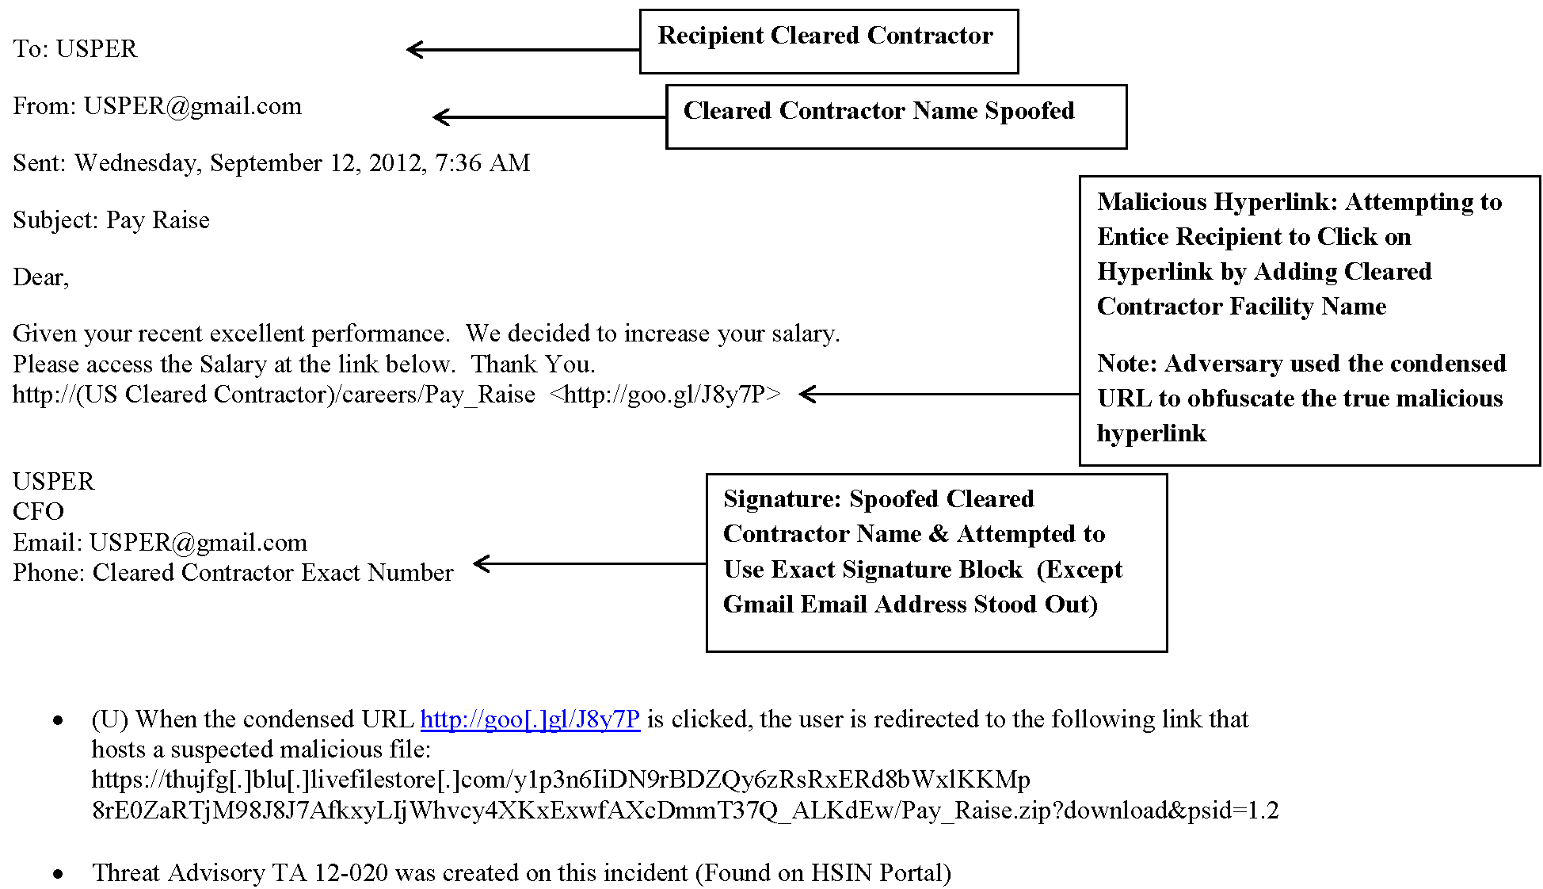
(U) Spear Phishing Sample #1
UNCLASSIFIED
UNCLASSIFIED
Notes:
UNCLASSIFIED//FOUO
Spear Phishing Example
UNCLASSIFIED//FOUO

Slide 27
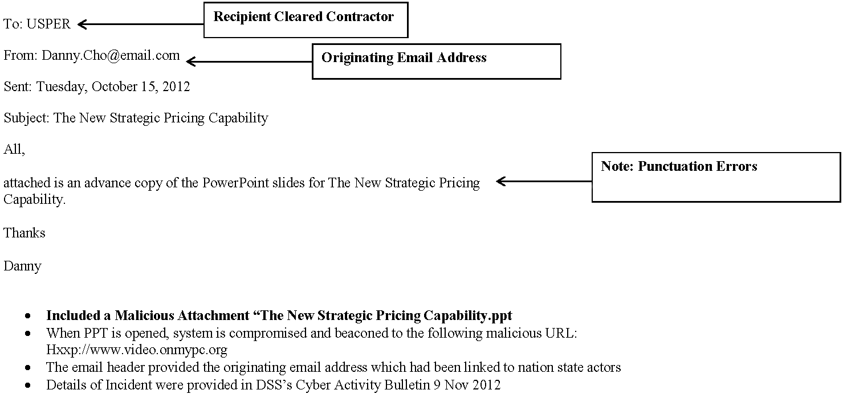
(U) Spear Phishing Sample #2
UNCLASSIFIED
UNCLASSIFIED
Notes:
UNCLASSIFIED//FOUO
Spear Phishing Example
UNCLASSIFIED//FOUO

Slide 28
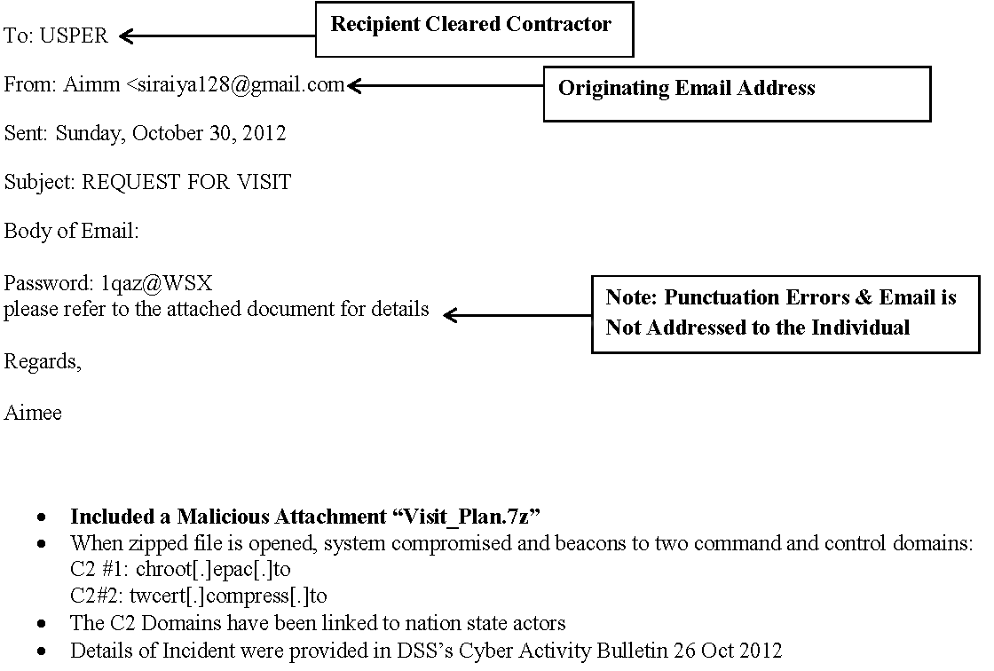
(U) Spear Phishing Sample #3
UNCLASSIFIED
UNCLASSIFIED
Notes:
UNCLASSIFIED//FOUO
Spear Phishing Example
UNCLASSIFIED//FOUO

Slide 29
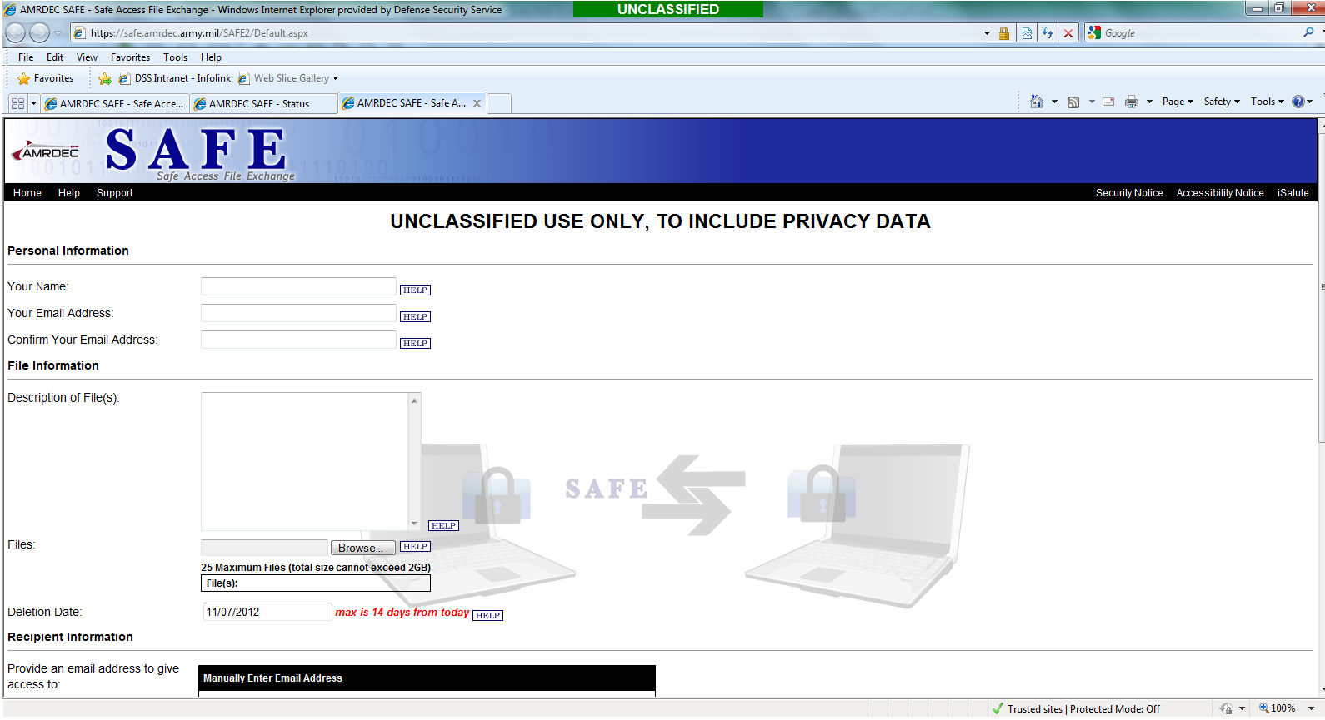
(U) Malware Submission Website - AMRDEC
UNCLASSIFIED//FOUO
UNCLASSIFIED//FOUO
Notes:
UNCLASSIFIED//FOUO
In order to prevent inadvertent compromises of the Department of Defense network, confirmed or
suspected malicious files must be handled in a manner that minimizes the risk of damage to the network.
As such, DSS is now utilizing a trusted, secure file transfer service to receive all suspect files for analysis.
1. To submit files for malware analysis, you will go to https://safe.amrdec.army.mil/SAFE2/Default.aspx
Personal Information
Enter Your Name (Person actually submitting the sample)
Enter Your Email Address (Person actually submitting the sample)
Confirm Your Email Address (Person actually submitting the sample)
1. File Information
Description of File(s): Enter the file name and the DSS local tracking number associated with it. If no DSS local tracking number is available, provide as much identifying information as possible (e.g. Facility/Company name submitting the file, CAGE code, DSS POC information (such as responsible IS Rep, FCIS, ISSP), etc.
2. Click “Browse…” to select and upload your file. Please note: As an additional security measure, this system is designed to strip out any malicious files uploaded to it. In order to prevent this and successfully upload your file, it must be placed in a password protected zipped file. The default password for the zipped file is “infected.”
3. Deletion Date: Leave this as the default date.
UNCLASSIFIED//FOUO

Slide 30
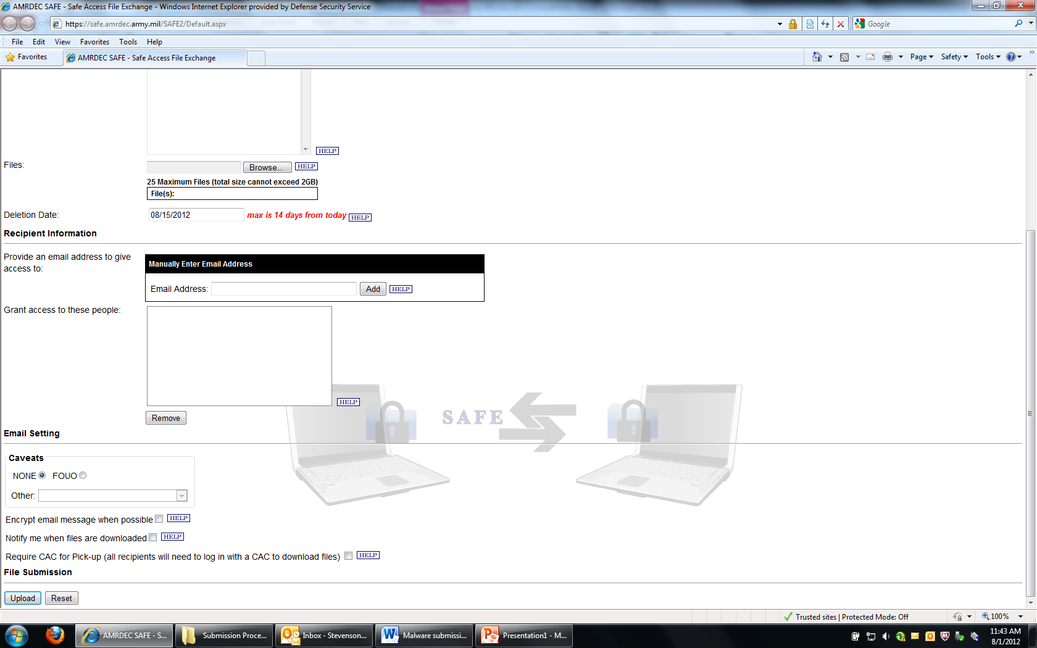
(U) Malware Submission Website- AMRDEC
UNCLASSIFIED//FOUO
UNCLASSIFIED//FOUO
Notes:
UNCLASSIFIED//FOUO
*** Continued from Slide 16
Recipient Information
Provide an email address to give access to: Enter dsscyberci@dss.mil in this box and click “Add”. This will add it to the block below titled “Grant access to these people.”
Email Setting
Caveats. Please mark “FOUO”
Check “Encrypt email message when possible”
Choose whether or not you want to be notified when files are downloaded.
Do NOT check “Require CAC for Pick-up”, otherwise here at DSS HQ, we can not retrieve the file
File Submission
If finished, click “Upload”
UNCLASSIFIED//FOUO

Slide 31
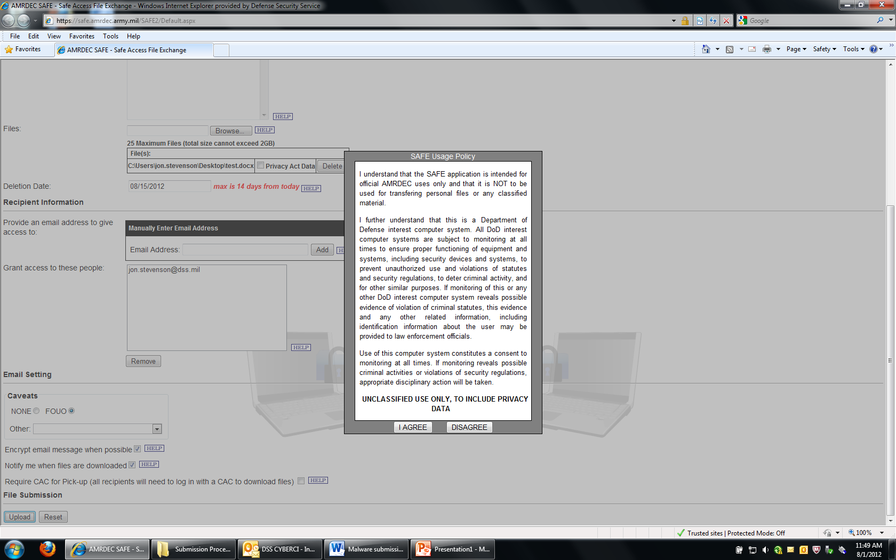
(U) AMRDEC Safe Usage Policy Agreement
UNCLASSIFIED//FOUO
UNCLASSIFIED//FOUO
Notes:
UNCLASSIFIED//FOUO
You will then see a “SAFE Usage Policy Window”. Click “I AGREE”.
UNCLASSIFIED//FOUO

Slide 32
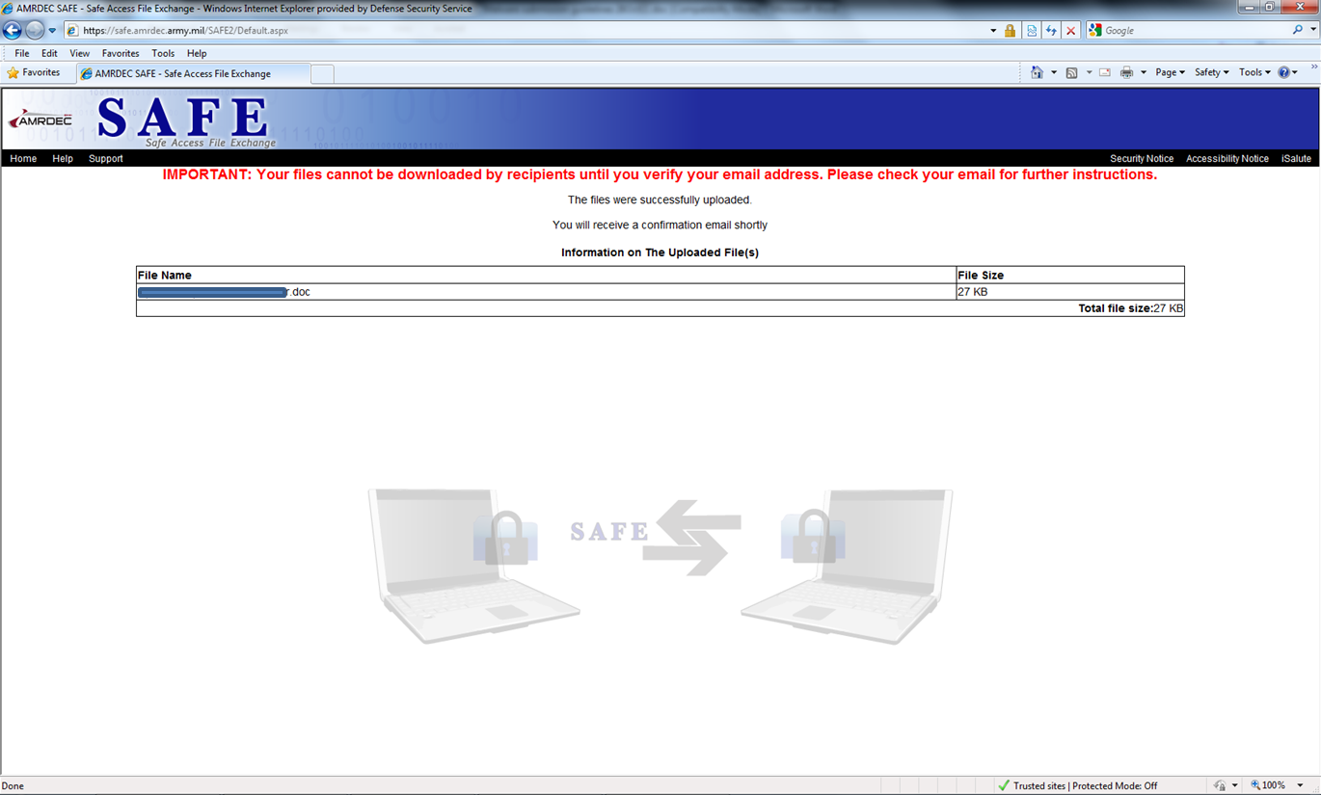
(U) Verify Email Address
UNCLASSIFIED//FOUO
UNCLASSIFIED//FOUO
Notes:
UNCLASSIFIED//FOUO
You should then see a verification message that your file has been uploaded successfully BUT that you must verify your email address, otherwise your file WILL NOT be submitted.
UNCLASSIFIED//FOUO

Slide 33
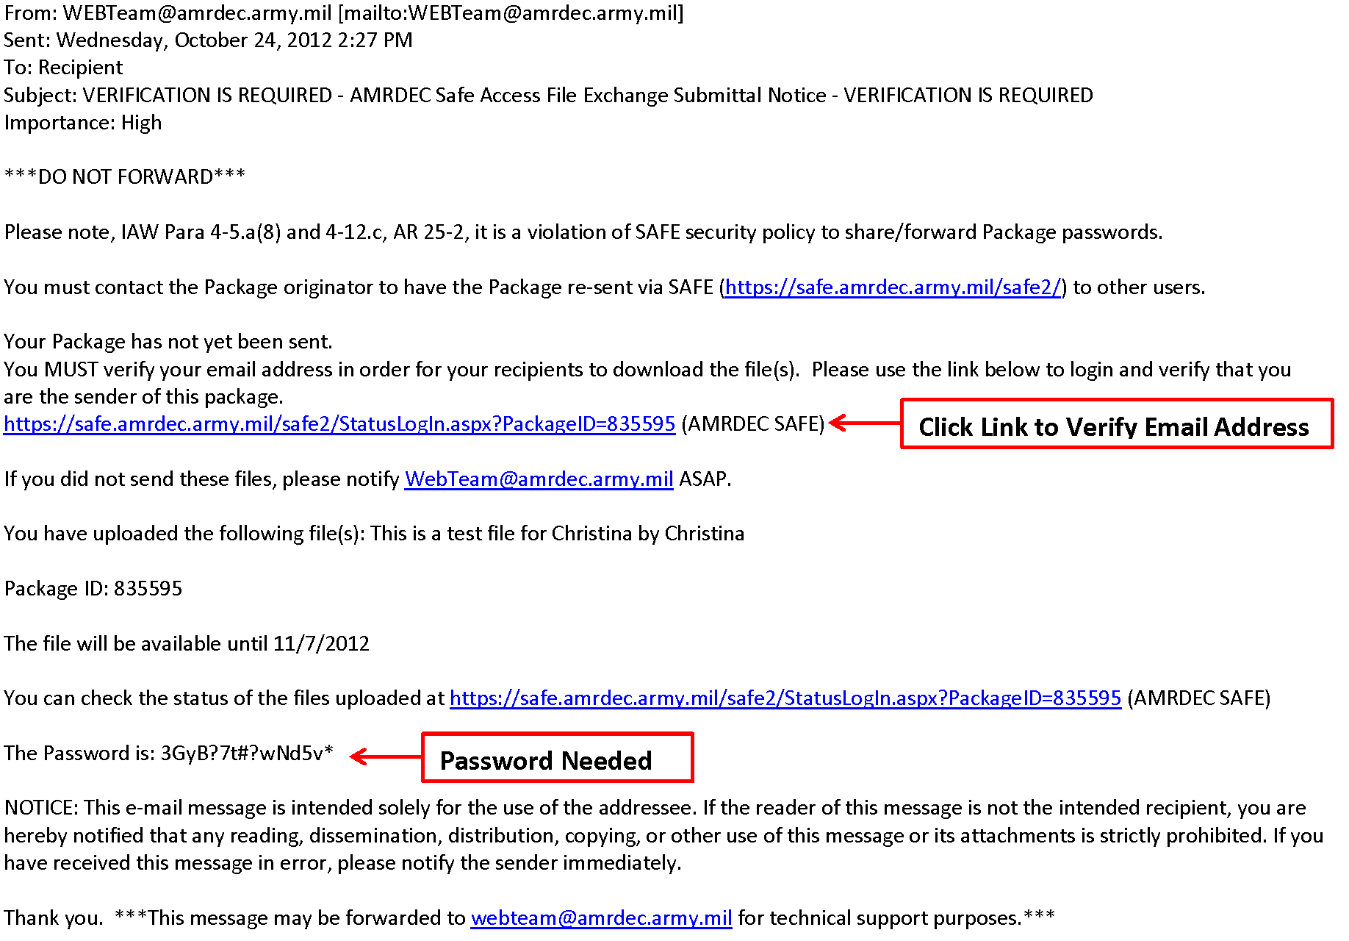
(U) Malware – Link to Verify Email Address
UNCLASSIFIED//FOUO
UNCLASSIFIED//FOUO
Notes:
UNCLASSIFIED//FOUO
Once uploaded, you will receive a verification email. You must click on the link in the email, enter the password provided and then click “Verify” to submit your file. If this step is not completed, then your file WILL NOT be submitted.
UNCLASSIFIED//FOUO

Slide 34
(U) Malware – Verify Email to Submit File
UNCLASSIFIED//FOUO
1
2
3
UNCLASSIFIED//FOUO
Notes:
UNCLASSIFIED//FOUO
Once uploaded, you will receive a verification email. Your file has not yet been submitted. You must click on the link in the email, enter the password provided and then click “Verify” to submit your file.
UNCLASSIFIED//FOUO

Slide 35
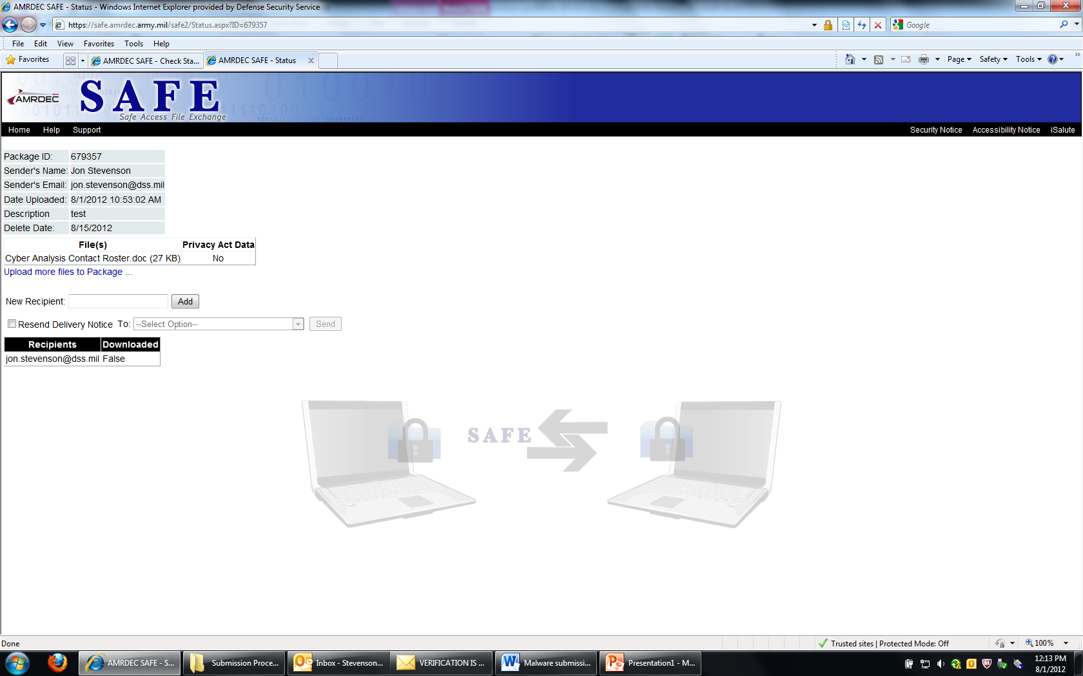
(U) Malware – Submission Confirmation
UNCLASSIFIED//FOUO
UNCLASSIFIED//FOUO
Notes:
UNCLASSIFIED//FOUO
Once uploaded, you will receive a verification email. Your file has not yet been submitted. You must click on the link in the email, enter the password provided and then click “Verify” to submit your file.
UNCLASSIFIED//FOUO

Slide 36
UNCLASSIFIED//FOUO
Questions?
Jon Stevenson
jon.stevenson@dss.mil
UNCLASSIFIED//FOUO

