Slide 1
"Partnering for Compliance™" East Coast 2014 will be on March 5-7 at the Holiday Inn Orlando International Airport

Slide 2
GOVERNMENT DEPARTMENTS & TRADE SPEAKERS PARTICIPATING:
Department of State (Terry Davis – DTCL & Glenn Smith – DTCC)
Department of Commerce (Gene Christiansen – Licensing & Jonathan Barnes – OEE)
Department of Defence (Kenneth Oukrop – DTSA)
Treasury Department(Jeremy Sasseur – OFAC)
Census Bureau (Joe Cortez)
Department of Homeland Security (CBP – Russ Morgan & Joe Mitchell, and ICE – Jacqueline Metzger & Jose Pagan)
Baker & McKenzie (Bart McMillan & Jonathan Poling)
Braumiller Law Group, PLLC (Adrienne Braumiller & Bruce Leeds) – Imports, and U.S. Trade.

Slide 3
Important reasons why certain exports are controlled by the U.S. government, including
(1) national security; (2) foreign policy; (3) proliferation of weapons of mass destruction; (4) antiterrorism; and (5) protecting our valuable intellectual property and, thus, our livelihood.

Slide 4
The following abbreviations are often used:
RE = rare earth
REM = rare-earth metals
REE = rare-earth elements
REO = rare-earth oxides
REY = rare-earth elements and yttrium
LREE = light rare earth elements (Sc, La, Ce, Pr, Nd, Pm, Sm, Eu, and Gd; also known as the cerium group)
HREE = heavy rare earth elements (Y, Tb, Dy, Ho, Er, Tm, Yb, and Lu; also known as the yttrium group)

Slide 5
Rare Earths Expected to be in Short Supply in the next 15 years
*Neodymium, Europium, Terbium, Dysprosium, Yttrium

Slide 6
Concentrations of Rare Earth Elements
Source: Jared L. Romero and Samuel A. McCord
SANDIA REPORT, 2012

Slide 7
REEs share many similar properties, which is why they occur together in geological deposits.
The 17 REEs are found in all REE deposits but their distribution and concentrations vary.
They are referred to as ‘rare’ because it is not common to find them in commercially viable concentrations.
Vital for the Earth’s fastest growing areas: Clean Energy & High Technology (incl. Defense)

Slide 8
REEs Play a Key Role in the Green Energy Sector
Electric and hybrid cars can contain 20 - 25 pounds of rare earths, which is double that found in a standard gasoline vehicle.
The battery itself is made from several pounds of rare earth compounds. REEs are also used in regenerative braking systems and electric traction motors. The motors consist of powerful magnets made from neodymium and dysprosium.

Slide 9
A table listing the seventeen rare earth elements, their atomic number and symbol, the etymology of their names, and their main usages (see also Applications of lanthanides) is provided here. Some of the rare earth elements are named after the scientists who discovered or elucidated their elemental properties, and some after their geographical discovery.
Z | Symbol | Name | Etymology | Selected applications
21 | SC | Scandium | from Latin Scandia (Scandinavia). | Light aluminium-scandium alloys for aerospace components, additive in metal-halide lamps and mercury-vapor lamps, radioactive tracing agent in oil refineries
39 | Y | Yttrium | after the village of Ytterby, Sweden, where the first rare earth ore was discovered. | Yttrium aluminium garnet (YAG) laser, yttrium vanadate (YVO₄) as host for europium in TV red phosphor, YBCO high-temperature superconductors, yttria-stabilized zirconia (YSZ), yttrium iron garnet (YIG) microwave filters,energy-efficient light bulbs,^{[5]} spark plugs, gas mantles, additive to steel
57 | LA | Lanthanum | "lanthanein", meaningto be hidden. | High refractive index and alkali-resistant glass, flint, hydrogen storage, battery-electrodes, camera lenses, fluid catalytic cracking catalyst for oil refineries
58 | CE | Cerium | Ceres, named after the Roman goddess of agriculture. | Chemical oxidizing agent, polishing powder, yellow colors in glass and ceramics, catalyst for self-cleaning ovens, fluid catalytic cracking catalyst for oil refineries,ferrocerium flints for lighters
58 | PR | Praseodymium | "prasios", meaningleek-green, and "didymos", meaningtwin. | Rare-earth magnets, lasers, core material for carbon arc lighting, colorant inglasses and enamels, additive in didymium glass used in welding goggles, ferrocerium firesteel (flint) products.
60 | ND | Neodymium | from the Greek "neos", meaning new, and "didymos", meaning twin. | Rare-earth magnets, lasers, violet colors in glass and ceramics, didymium glass,ceramic capacitors

Slide 10
Z | Symbol | Name | Etymology | Selected applications
61 | PM | Promethium | after the TitanPrometheus, who brought fire to mortals. | Nuclear batteries
62 | SM | Samarium | after mine official,Vasili Samarsky-Bykhovets. | Rare-earth magnets, lasers, neutron capture, masers
63 | EU | Europium | after the continent of Europe. | Red and blue phosphors, lasers, mercury-vapor lamps, fluorescent lamps, NMR relaxation agent
64 | GD | Gadolinium | after Johan Gadolin (1760–1852), to honor his investigation of rare earths. | Rare-earth magnets, high refractive index glass or garnets, lasers, X-ray tubes,computer memories, neutron capture, MRI contrast agent, NMR relaxation agent, magnetostrictive alloys such as Galfenol, steel additive
65 | TB | Terbium | after the village of Ytterby, Sweden. | Green phosphors, lasers, fluorescent lamps, magnetostrictive alloys such as Terfenol-D
66 | DY | Dysprosium | from the Greek "dysprositos", meaning hard to get. | Rare-earth magnets, lasers, magnetostrictive alloys such as Terfenol-D
67 | HO | Holmium | Latin, "Holmia"), native city of one of its discoverers. | Lasers, wavelength calibration standards for optical spectrophotometers, magnets
68 | ER | Erbium | after the village of Ytterby, Sweden. | Infrared lasers, vanadium steel, fiber-optic technology
69 | TM | Thulium | after the mythological northern land of Thule. | Portable X-ray machines, metal-halide lamps, lasers
70 | YB | Ytterbium | after the village of Ytterby, Sweden. | Infrared lasers, chemical reducing agent, decoy flares, stainless steel, stress gauges, nuclear medicine
71 | LU | Lutetium | after Lutetia, the city which later became Paris. | Positron emission tomography – PET scan detectors, high refractive index glass,lutetium tantalate hosts for phosphors

Slide 11
Most Rare REE:
Only the highly unstable and radioactive promethium "rare earth" is quite scarce. The rare earth elements are often found together.
Date of Discovery: 1945 Discoverer: J.A. Marinsky Name Origin: From the god Prometheus (who stole fire of the sky and gave it to man) Obtained From: fission products of uranium, thorium, plutonium (originally was called “clintonium” after the lab in which it was discovered)
Some practical applications exist only for chemical compounds of promethium-147, which are used in luminous paint, atomic batteries and thickness measurement devices – among other uses. Since natural promethium is exceedingly scarce, the element is typically synthesized by bombarding uranium-235 (enriched uranium) with thermal neutrons to produce promethium-147. There are known scattered deposits of promethium in Eastern China (POC) and North Korea (DPRK)

Slide 12
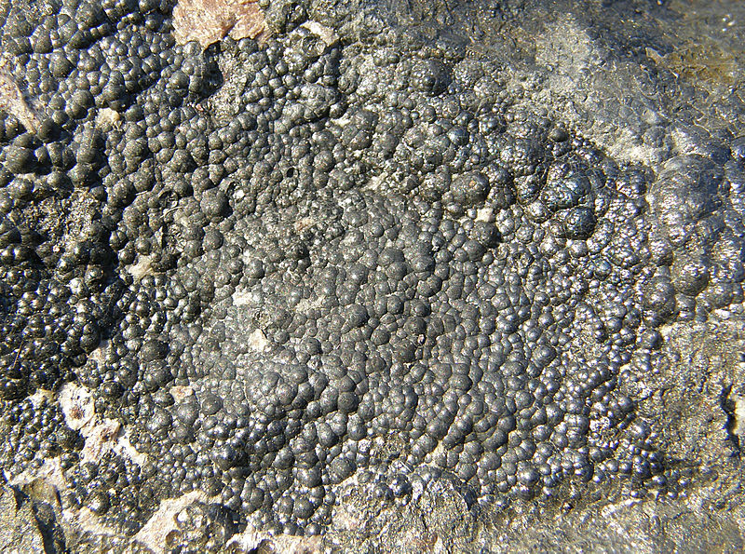
Pitchblende, a uranium ore and the host for most of Earth's promethium

Slide 13
Definition – Merriam-Webster dictionary
1. A soft black lustrous form of carbon that conducts electricity and is used in lead pencils and electrolytic anodes, as a lubricant, and as a moderator in nuclear reactors
2. A composite material in which carbon fibers are the reinforcing material

Slide 14
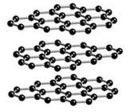
Graphite
(The mineral graphite /ˈɡræfaɪt/ is an allotrope of carbon. It was named by Abraham Gottlob Werner in 1789 from the Ancient Greek γράφω (graphō), "to draw/write", for its use in pencils, where it is commonly called lead (not to be confused with the metallic element lead).

Slide 15
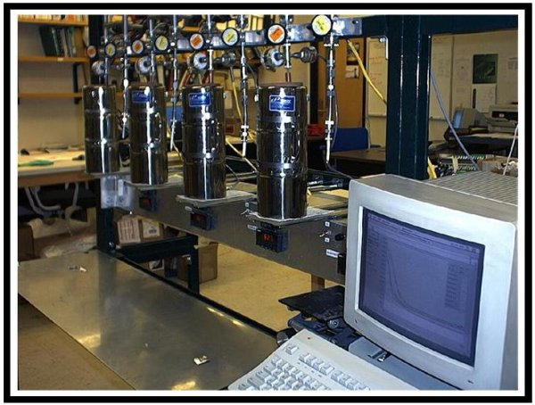
The system used to change the carbon dioxide sample to graphite. An automated system is used to measure the pressure–ensuring that the reaction goes to completion (in other words, that all carbon dioxide is reacted to create graphite).
(The mineral graphite /ˈɡræfaɪt/ is an allotrope of carbon. It was named by Abraham Gottlob Werner in 1789 from the Ancient Greek γράφω (graphō), "to draw/write", for its use in pencils, where it is commonly called lead (not to be confused with the metallic element lead).

Slide 16
Accelerator Mass Spectrometer for ¹⁴C. The target wheel, shown above, holds the small aluminum targets of graphite (and iron). The targets are analyzed with an accelerator mass spectrometer.
Earth System Research Laboratory National Oceanic & Atmospheric Administration (NOAA)
Global Monitoring Division
(It’s not a home distillery)

Slide 17
According to a statement released by Chinese Vice Commerce Minister Chen Jian, the government is willing to “support big Chinese companies who are willing to invest in North Korea to broaden the economic and trade cooperation with North Korea, to push the two sides to upgrade two-way trade and investment structures and study the feasibility of cooperation on big projects.”

Slide 18
While the actual potential of North Korea’s REE reserves is still unknown, speculators argue that it is likely to be aimed at North Korea’s mineral sector, which some estimate is worth more than $6 trillion — including a large number of rare earth metals. China does not currently adhere to the US and United Nations sanctions that restrict North Korea’s trade.

Slide 19
Korea Resources (South Korea’s largest commodities developer)
In July 2012,investors learned that in 2011 South Korea’s state-owned commodities developer held talks in North Korea about a possible North-South project aimed at developing REE deposits.

Slide 22
US was the largest producer of REEs until the 2000’s

Slide 23
Main producers of REEs:
1st Tier producer: China: 96% according to USGS in 2010;
2nd Tier Producers: US (has approximately 15% of known deposits); Australia and Canada.
Thus, China is by far the largest producer with the largest known deposits in the world.

Slide 24
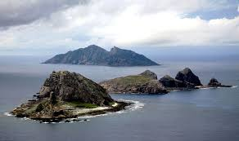
External political tensions – global tensions converging on scarce resources
E.G. China’s current political/defense “disagreement” with Japan over Senkaku Islands – banning export of REEs to Japan ….. and others
Japanese hybrid car manufacture suffering

Slide 25
Japan’s Minister of Economy was quoted recently saying
“China needs to understand that no country can prosper by dominating its resources...It’s only natural that China would want to use its resources strategically, but it needs to understand that the basic principle in trade is that you can only prosper if your partner is prosperous.”

Slide 26
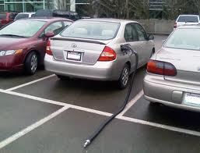
Surprising Japan’s Toyota Motor Corporation has a 250-year strategic plan, Japan had no plan for the secure acquisition of REEs until recently

Slide 27
Deposits in remote areas of Greenland – expected to be very large. Will China muscle in on that market??

Slide 28
Potential to hide environmental problems, e.g. water pollution

Slide 29
Dependent Bargaining
Accept the constraints of dependency and Transnational Enterprises (TNE) participation in energy contracts as givens but employ their political and technical abilities to obtain the best deal they perceive is available to the country.”

Slide 30
GM & Hitachi formed a REE exploration company called Magnequench in 1986
DoD has its own report on the availability of REEs which is classified.

Slide 31
The supply chain, and its protection, is of paramount importance to the US.
Government Departments, research institutes, private enterprise, and our allies will substantially depend on the US to ensure a reliable, secure and safe supply chain for their access to REEs.

Slide 32
Vulnerabilities in the Supply Chain

Slide 33
New and Emerging Technologies

Slide 34
Emerging economies – e.g. Ethiopia with its reliance of Wind Turbines & Solar for energy supplies
http://www.bbc.co.uk/news/world-africa-25153255
Africa is world’s 2nd largest continent with 54 independent countries from Algeria to Zimbabwe, and several protectorates (e.g. Canary Islands). Largest country is Sudan, smallest country is Seychelles

Slide 35
Why are we talking about Africa in the context of REEs?
Africa is the fastest growing continent in economic development terms with a growing population that is utilizing technology in its development at a phenomenal rate. Thus, its expanding need for consistent and secure access to REEs will, in all probability, be very dependent on China for its supply. What will China demand in return? The sky is the limit.
Vulture Alley in Outer Mongolia – China’s Vulture Alley in Africa

Slide 36
StartUpBus Africa Tour 2013:
http://www.bbc.co.uk/news/business-25095999
Rwanda Buses used to teach IT skills:
http://www.bbc.co.uk/news/business-24574998
Rwanda IT Revolution
http://www.bbc.co.uk/news/business-24571624 (1 laptop per child - targets knowledge economy)

Slide 37
What other countries are doing?
Germany, for example, is building “strategic partnerships” with Mongolia, Namibia, Nigeria, Kazakhstan, South Africa, Chile, and
Peru to try to source rare earths.
Africa is being sources for REEs – many countries from South Africa to Sierra Leone are collaborating with other countries, especially China to exploit deposits

Slide 38
Environmental problems with mining – uranium in water supplies in China
Internal political tensions – community unrest etc.

Slide 39
China nationalized the mining of REEs, thus has complete government control over the deposits, mining, shipping and quantities etc. It has restricted the export of REEs in 2010 and in 2012 held the export quantity steady. On the other hand the US and other producers are depending on private enterprise to mine REEs. The largest deposit in the US is in Mountain Pass, CA – which ceased production in 2002.

Slide 40
Sites that you can visit to learn more
Sandia Report July 2012:
http://prod.sandia.gov/techlib/access-control.cgi/2012/126316.pdf
DoE Report December 2011:
http://energy.gov/sites/prod/files/DOE_CMS2011_FINAL_Full.pdf
Rare Earth Investing news (North Korea):
http://rareearthinvestingnews.com/7722-north-korea-rare-earth-powerhouse-china-reserves-supply-market.html
Lt Col, Eugene V. Becker’s Masters’ Thesis USAF
http://www.dtic.mil/dtic/tr/fulltext/u2/a545604.pdf

Slide 41
More sites that you can visit to learn more
Rare Earth Elements 101
http://www.iamgold.com/files/REE101.pdf
U.S. Geological Survey:
http://www.usgs.gov/newsroom/article.asp?ID=2642&from=rss_home#.Upt_gHDIaQA
U.S. Geological Service:
http://gallery.usgs.gov/audio/corecast/ep137/20101117_137_REE_Report.mp3
Rare Earths Statistics & Information:
http://minerals.usgs.gov/minerals/pubs/commodity/rare_earths/
A Summary of Domestic Deposits and a Global Perspective:
http://pubs.usgs.gov/sir/2010/5220/
JOINT ADVANCED WARFIGHTING SCHOOL Thesis:
http://www.dtic.mil/dtic/tr/fulltext/u2/a545604.pdf

Slide 42
"Partnering for Compliance™"
Phone Number:
(321) 952-2978
Email:
Ailish@PartneringForCompliance.org
Website:
http://www.PartneringForComplianc e.org/

Slide 44
Questions?

