Slide 1
Developing Standard
Practice and Procedures
Will McEllen, SAPPC, ISP
Armiger, LLC.
Industrial Security Consulting and Support

Slide 2
Today’s Topics
Current requirements for Standard Practice Procedures at all Cleared Facilities
Sample SPP for meeting minimum requirements set forth in ISL 2021-02
Creating Your Own SPP – From Templates to Starting Fresh

Slide 3
Current Requirements
32 CFR 117.7(e) requires that contractors prepare written procedures when the CSA determines them to be necessary to reasonably exclude the possibility of loss or compromise of classified information, and in accordance with additional Cognizant Security Agency-provided guidance, as applicable.
ISL 2021-02 has identified that the Cognizant Security Agency (DCSA) requires contractors to have a written plan/standard practice procedures (SPP) in place for implementation of SEAD-3 reporting requirements. This written plan/SPP must be available for review during scheduled assessments. DCSA started incorporating the assessment of compliance with SEAD-3 reporting requirements on March 1, 2022.

Slide 4
Current Requirements
ISL 2021-02 requires that the contractor's SPP will, at a minimum, establish the necessary processes and procedures to inform their cleared contractor personnel on reporting requirements related to SEAD-3 and the requirements for adverse information reporting as directed by the NISPOM rule at section 117.8(c)(1).
The SPP will also include processes and procedures that address:
How the contractor receives, processes, and manages the required reports from covered individuals as identified in this ISL.
How these processes and procedures are to be implemented within the cleared contractor facility.
How a covered individual will alert the cleared contractor (FSO or assigned designee) of the reportable actions concerning other covered individuals. (SEAD-3, F.3.)
Unofficial Foreign Travel reporting should also be added to the SPP. The DoD has amended 32 CFR Part 117, to extend the compliance date solely for reporting and pre-approval of unofficial foreign travel as prescribed in SEAD-3. The reporting of the foreign travel component of SEAD-3 will begin August 24, 2022.

Slide 5
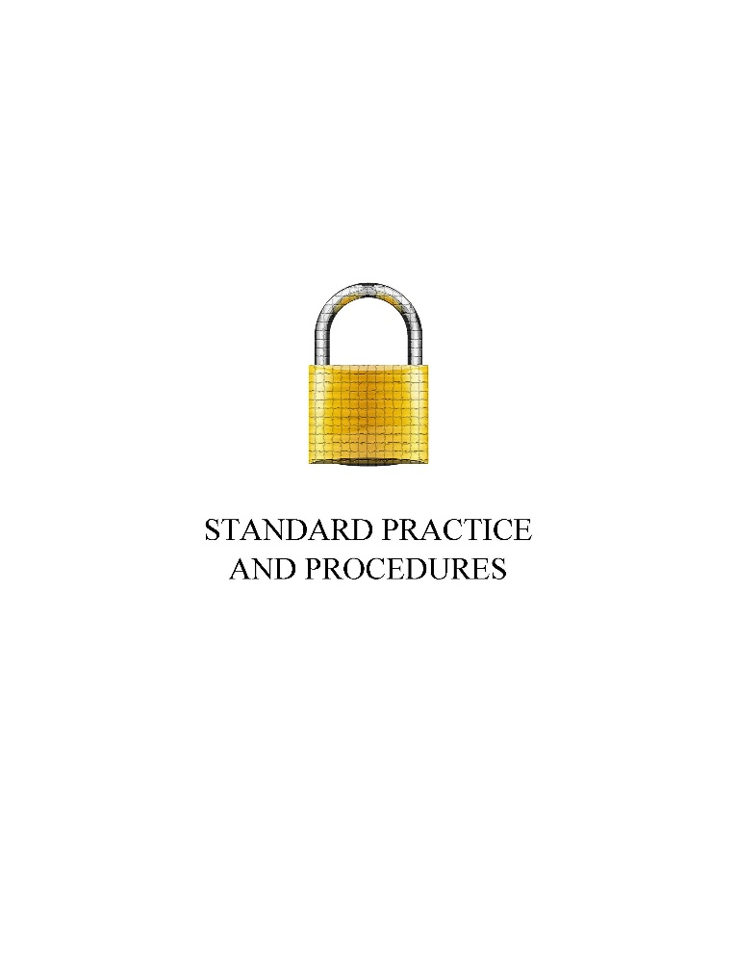
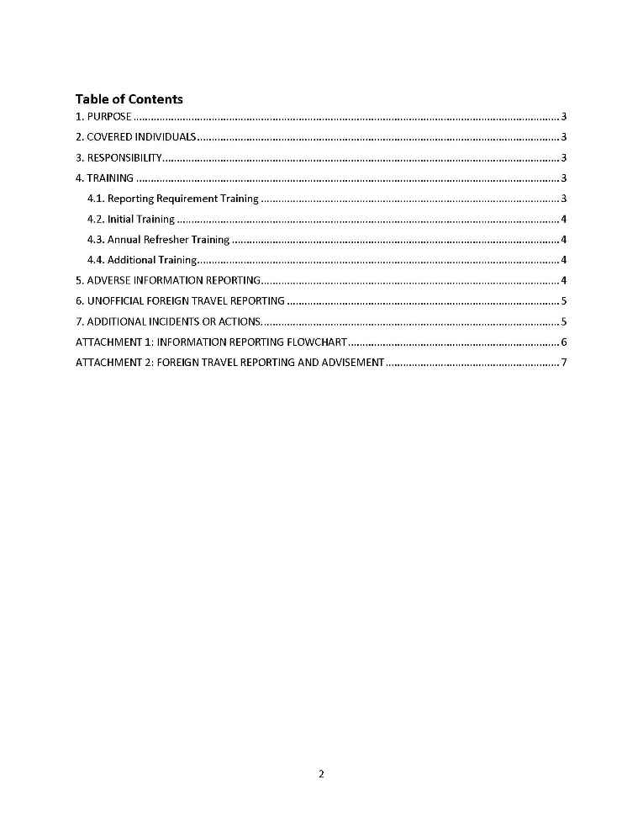
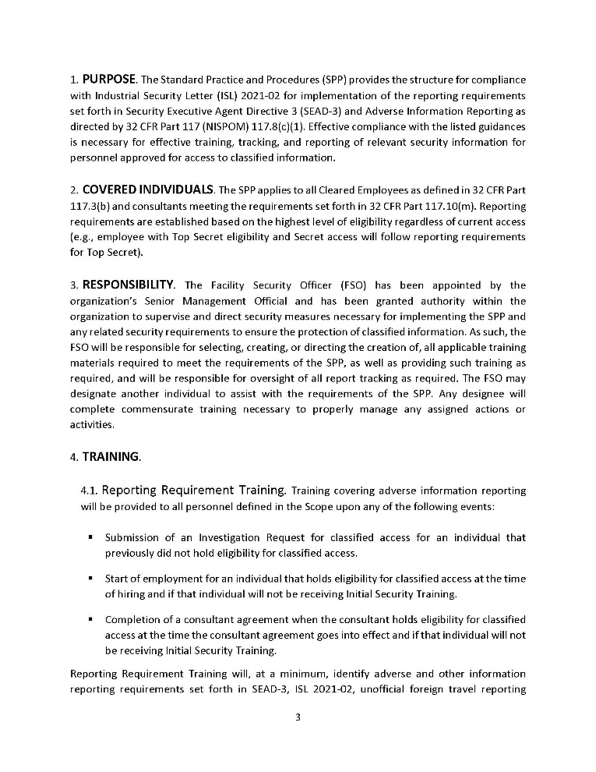
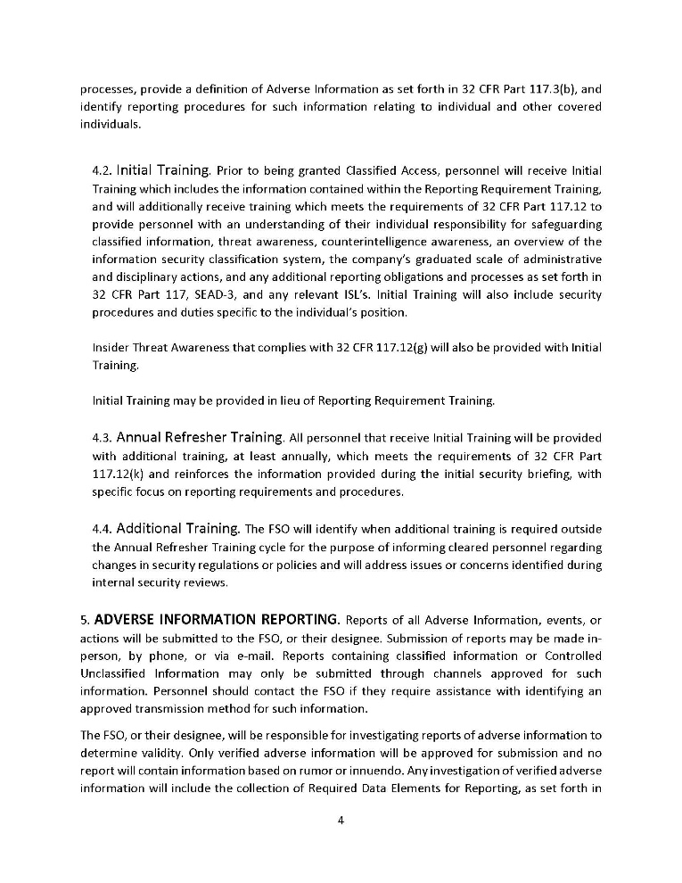
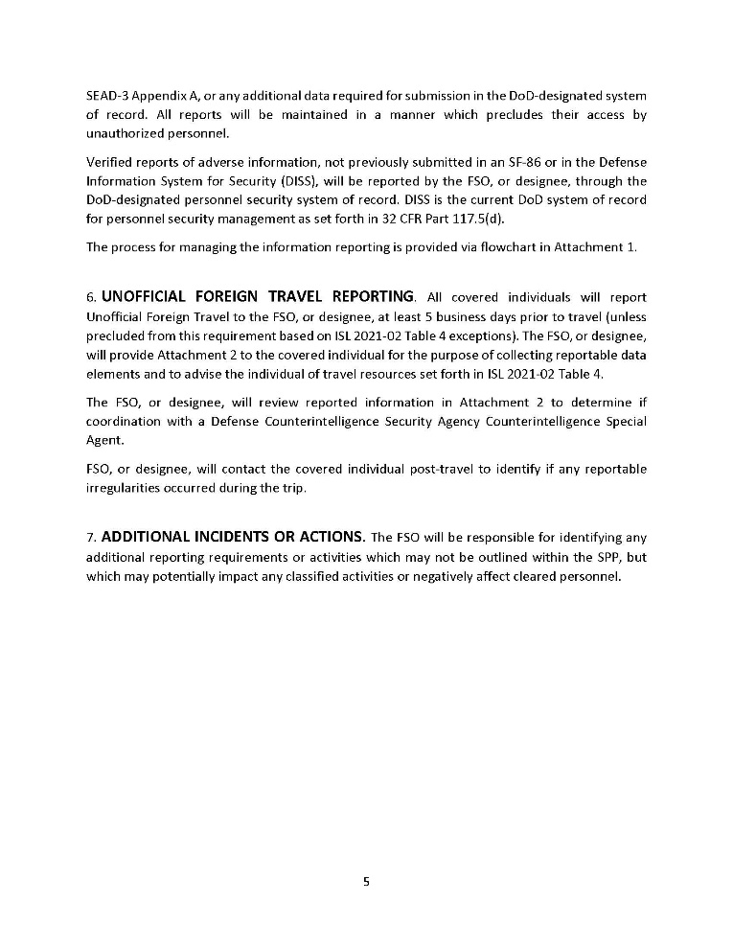
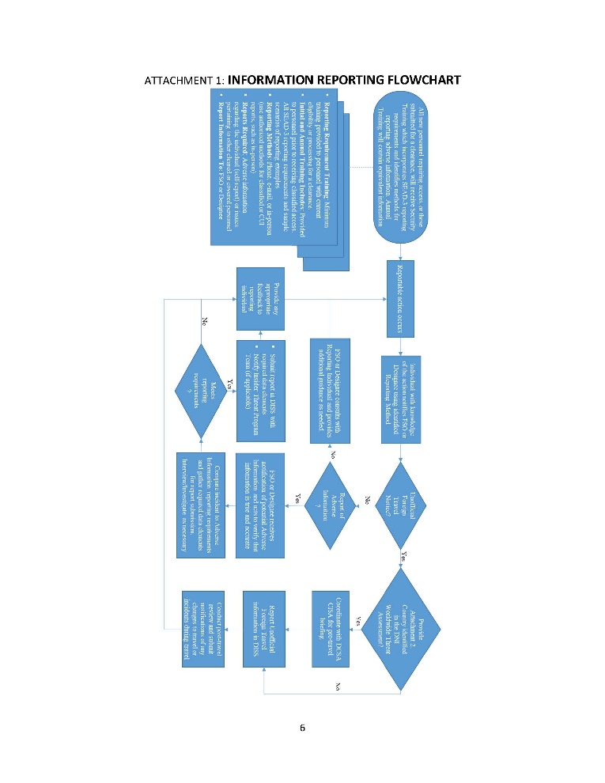
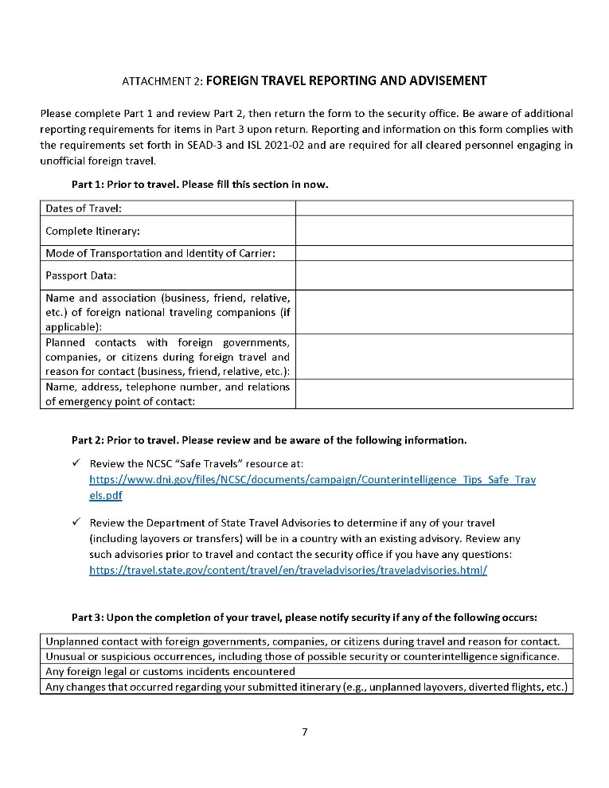
Sample SPP - Contents
1. Purpose
2. Covered Individuals
3. Responsibility
4. Training
4.1. Reporting Requirement Training
4.2. Initial Training
4.3. Annual Refresher Training
4.4. Additional Training
5. Adverse Information Reporting
6. Unofficial Foreign Travel Reporting
7. Additional Incidents or Actions
Attachment 1: Information Reporting Flowchart
Attachment 2: Foreign Travel Reporting and Advisement

Slide 6
Sample SPP – Purpose, Covered Individuals, and Responsibility
1. PURPOSE. The Standard Practice and Procedures (SPP) provides the structure for compliance with Industrial Security Letter (ISL) 2021-02 for implementation of the reporting requirements set forth in Security Executive Agent Directive 3 (SEAD-3) and Adverse Information Reporting as directed by 32 CFR Part 117 (NISPOM) 117.8(c)(1). Effective compliance with the listed guidances is necessary for effective training, tracking, and reporting of relevant security information for personnel approved for access to classified information.
2. COVERED INDIVIDUALS. The SPP applies to all Cleared Employees as defined in 32 CFR Part 117.3(b) and consultants meeting the requirements set forth in 32 CFR Part 117.10(m). Reporting requirements are established based on the highest level of eligibility regardless of current access (e.g., employee with Top Secret eligibility and Secret access will follow reporting requirements for Top Secret).
3. RESPONSIBILITY. The Facility Security Officer (FSO) has been appointed by the organization’s Senior Management Official and has been granted authority within the organization to supervise and direct security measures necessary for implementing the SPP and any related security requirements to ensure the protection of classified information. As such, the FSO will be responsible for selecting, creating, or directing the creation of, all applicable training materials required to meet the requirements of the SPP, as well as providing such training as required, and will be responsible for oversight of all report tracking as required. The FSO may designate another individual to assist with the requirements of the SPP. Any designee will complete commensurate training necessary to properly manage any assigned actions or activities.

Slide 7
Sample SPP
4.1. Reporting Requirement Training. Training covering adverse information reporting will be provided to all personnel defined in the Scope upon any of the following events:
Submission of an Investigation Request for classified access for an individual that previously did not hold eligibility for classified access.
Start of employment for an individual that holds eligibility for classified access at the time of hiring and if that individual will not be receiving Initial Security Training.
Completion of a consultant agreement when the consultant holds eligibility for classified access at the time the consultant agreement goes into effect and if that individual will not be receiving Initial Security Training.
Reporting Requirement Training will, at a minimum, identify adverse and other information reporting requirements set forth in SEAD-3, ISL 2021-02, unofficial foreign travel reporting processes, provide a definition of Adverse Information as set forth in 32 CFR Part 117.3(b), and identify reporting procedures for such information relating to individual and other covered individuals.
REMINDER: “Covered Individuals” refers to those contractor personnel who have been granted eligibility for access to classified information through the NISP or are in the process of a determination for eligibility for access to classified information through the NISP. Individuals may be subject to reporting requirements even before they are approved for classified access.

Slide 8
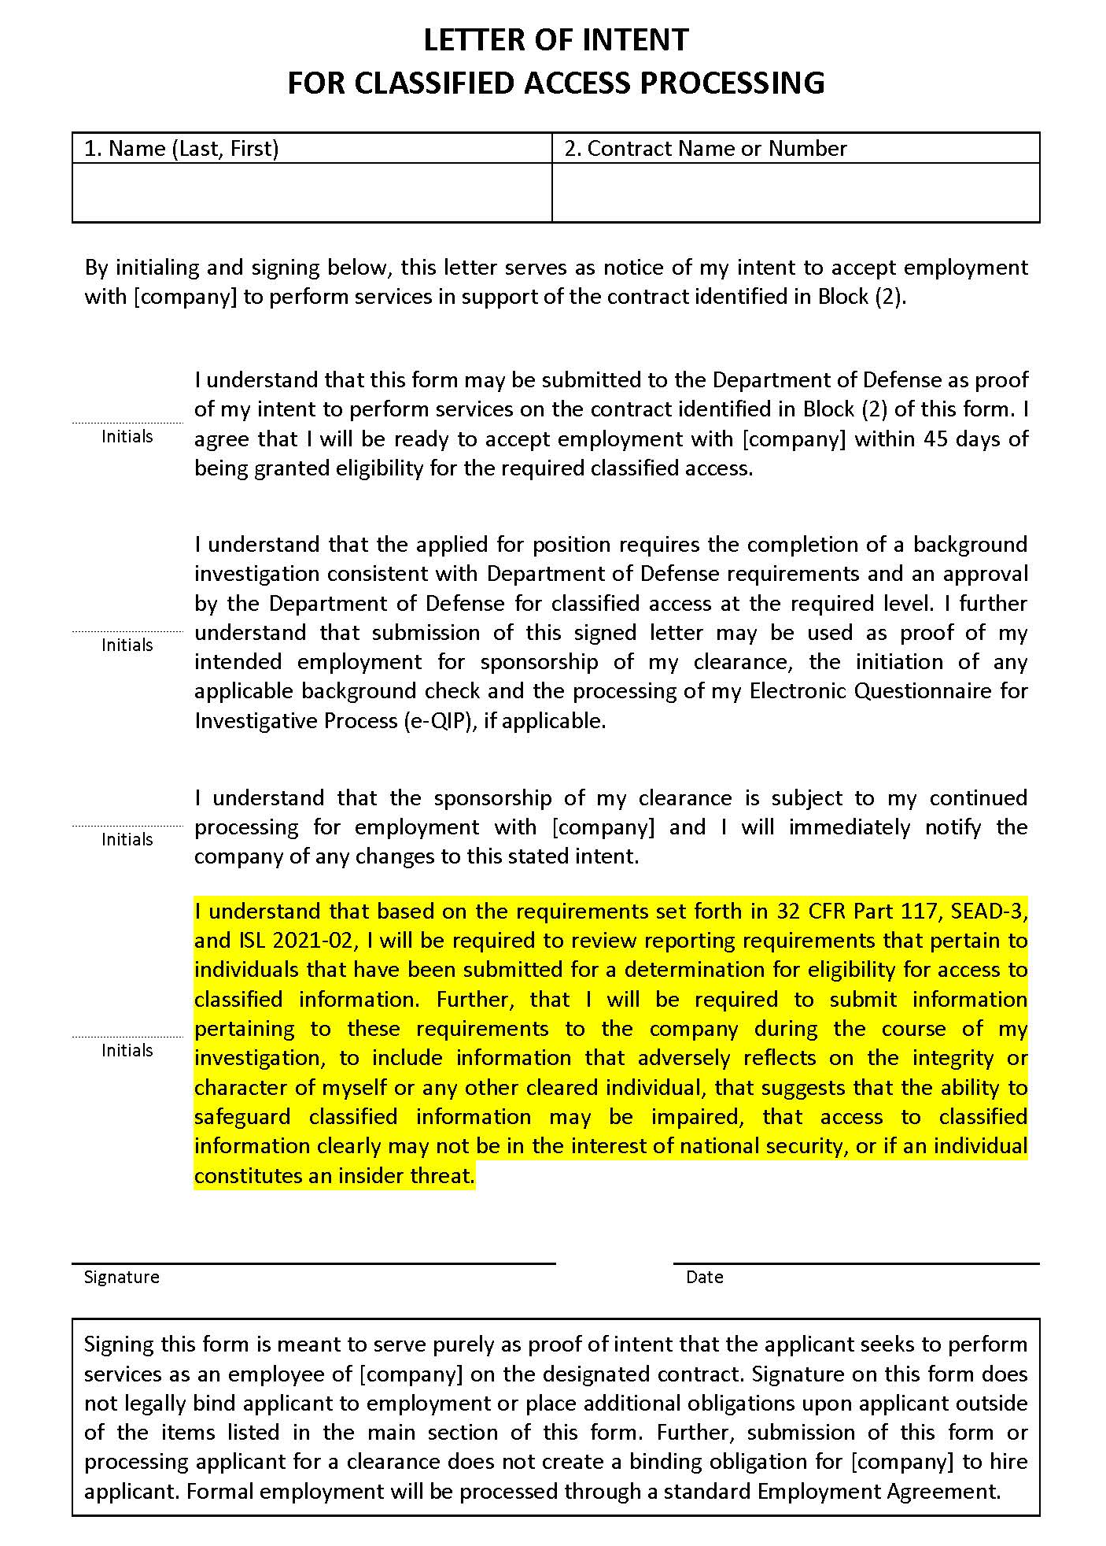
Sample SPP
Quick thought…. You may have to consider reporting requirements for individuals that aren’t actively employed by your company.
32 CFR 117.10(f) still allows for processing personnel for investigations prior to the start of their employment. However, the fact that they are not an employee doesn’t alleviate you from ensuring that the individual is fulfilling their reporting requirements while their investigation is processing.
Recommendation: add wording to any pre-employment Letter of Intent to ensure individuals understand this additional requirement.
?
?
?

Slide 9
Sample SPP
4.2. Initial Training. Prior to being granted Classified Access, personnel will receive Initial Training which includes the information contained within the Reporting Requirement Training, and will additionally receive training which meets the requirements of 32 CFR Part 117.12 to provide personnel with an understanding of their individual responsibility for safeguarding classified information, threat awareness, counterintelligence awareness, an overview of the information security classification system, the company’s graduated scale of administrative and disciplinary actions, and any additional reporting obligations and processes as set forth in 32 CFR Part 117, SEAD-3, and any relevant ISL’s. Initial Training will also include security procedures and duties specific to the individual’s position.
Insider Threat Awareness that complies with 32 CFR 117.12(g) will also be provided with Initial Training.
Initial Training may be provided in lieu of Reporting Requirement Training.

Slide 10
Sample SPP
4.3. Annual Refresher Training. All personnel that receive Initial Training will be provided with additional training, at least annually, which meets the requirements of 32 CFR Part 117.12(k) and reinforces the information provided during the initial security briefing, with specific focus on reporting requirements and procedures.
4.4. Additional Training. The FSO will identify when additional training is required outside the Annual Refresher Training cycle for the purpose of informing cleared personnel regarding changes in security regulations or policies and will address issues or concerns identified during internal security reviews.

Slide 11
Sample SPP
5. ADVERSE INFORMATION REPORTING. Reports of all Adverse Information, events, or actions will be submitted to the FSO, or their designee. Submission of reports may be made in-person, by phone, or via e-mail. Reports containing classified information or Controlled Unclassified Information may only be submitted through channels approved for such information. Personnel should contact the FSO if they require assistance with identifying an approved transmission method for such information.
The FSO, or their designee, will be responsible for investigating reports of adverse information to determine validity. Only verified adverse information will be approved for submission and no report will contain information based on rumor or innuendo. Any investigation of verified adverse information will include the collection of Required Data Elements for Reporting, as set forth in SEAD-3 Appendix A, or any additional data required for submission in the DoD-designated system of record. All reports will be maintained in a manner which precludes their access by unauthorized personnel.
Verified reports of adverse information, not previously submitted in an SF-86 or in the Defense Information System for Security (DISS), will be reported by the FSO, or designee, through the DoD-designated personnel security system of record. DISS is the current DoD system of record for personnel security management as set forth in 32 CFR Part 117.5(d).
The process for managing the information reporting is provided via flowchart in Attachment 1.

Slide 12
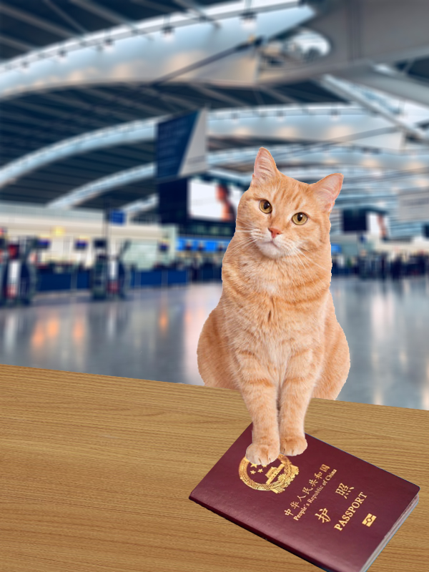
Sample SPP
6. UNOFFICIAL FOREIGN TRAVEL REPORTING. All covered individuals will report Unofficial Foreign Travel to the FSO, or designee, at least 5 business days prior to travel (unless precluded from this requirement based on ISL 2021-02 Table 4 exceptions). The FSO, or designee, will provide Attachment 2 to the covered individual for the purpose of collecting reportable data elements and to advise the individual of travel resources set forth in ISL 2021-02 Table 4.
The FSO, or designee, will review reported information in Attachment 2 to determine if coordination with a Defense Counterintelligence Security Agency Counterintelligence Special Agent.
FSO, or designee, will contact the covered individual post-travel to identify if any reportable irregularities occurred during the trip.

Slide 13
Sample SPP
7. ADDITIONAL INCIDENTS OR ACTIONS. The FSO will be responsible for identifying any additional reporting requirements or activities which may not be outlined within the SPP, but which may potentially impact any classified activities or negatively affect cleared personnel.

Slide 14
Sample SPP - Information Reporting Flowchart
Provide Attachment 2. Country identified in the DNI Worldwide Threat Assessment?
All new personnel requiring access, or those submitted for a clearance, will receive Security Training which incorporates SEAD-3 reporting requirements and identifies methods for reporting adverse information. Annual Training will contain equivalent information
Unofficial Foreign Travel Notice?
Reportable action occurs
Individual with knowledge of the action notifies FSO or Designee using identified Reporting Method
Yes
No
Yes
FSO or Designee consults with Reporting Individual and provides additional guidance as needed.
Report of Adverse Information?
Coordinate with DCSA CISA for pre-travel briefing.
No
No
Reporting Requirement Training: Minimum training provided to personnel with current eligibility or processing for a clearance.
Initial and Annual Training Includes: Provided to personnel prior to receiving classified access. All SEAD-3 reporting requirements and sample scenarios of reporting examples
Reporting Methods: Phone, e-mail, or in-person (use authorized methods for classified or CUI reports, such as in-person)
Reports Required: Adverse information regarding the individual (self-report) or issues pertaining to other cleared or covered personnel
Report Information To: FSO or Designee
Yes
Provide any appropriate feedback to reporting individual
Submit report in DISS with required data elements
Notify Insider Threat Program Team (if applicable)
FSO or Designee receives notification of potential Adverse Information and acts to verify that information is true and accurate
Report Unofficial Foreign Travel information in DISS
Yes
Meets reporting requirements?
Compare incident to Adverse Information reporting requirements and gather required data elements for report submission. Interview/Investigate as necessary
Conduct post-travel review and submit notifications of any changes to travel or incidents during travel
No

Slide 15
Sample SPP - Information Reporting Flowchart
Provide Attachment 2. Country identified in the DNI Worldwide Threat Assessment?
All new personnel requiring access, or those submitted for a clearance, will receive Security Training which incorporates SEAD-3 reporting requirements and identifies methods for reporting adverse information. Annual Training will contain equivalent information
Unofficial Foreign Travel Notice?
Reportable action occurs
Individual with knowledge of the action notifies FSO or Designee using identified Reporting Method
Yes
No
Yes
FSO or Designee consults with Reporting Individual and provides additional guidance as needed.
Report of Adverse Information?
Coordinate with DCSA CISA for pre-travel briefing.
No
No
Reporting Requirement Training: Minimum training provided to personnel with current eligibility or processing for a clearance.
Initial and Annual Training Includes: Provided to personnel prior to receiving classified access. All SEAD-3 reporting requirements and sample scenarios of reporting examples
Reporting Methods: Phone, e-mail, or in-person (use authorized methods for classified or CUI reports, such as in-person)
Reports Required: Adverse information regarding the individual (self-report) or issues pertaining to other cleared or covered personnel
Report Information To: FSO or Designee
Yes
Provide any appropriate feedback to reporting individual
Submit report in DISS with required data elements
Notify Insider Threat Program Team (if applicable)
FSO or Designee receives notification of potential Adverse Information and acts to verify that information is true and accurate
Report Unofficial Foreign Travel information in DISS
Yes
Meets reporting requirements?
Compare incident to Adverse Information reporting requirements and gather required data elements for report submission. Interview/Investigate as necessary
Conduct post-travel review and submit notifications of any changes to travel or incidents during travel
No

Slide 16
Sample SPP - Information Reporting Flowchart
Provide Attachment 2. Country identified in the DNI Worldwide Threat Assessment?
All new personnel requiring access, or those submitted for a clearance, will receive Security Training which incorporates SEAD-3 reporting requirements and identifies methods for reporting adverse information. Annual Training will contain equivalent information
Unofficial Foreign Travel Notice?
Reportable action occurs
Individual with knowledge of the action notifies FSO or Designee using identified Reporting Method
Yes
No
Yes
FSO or Designee consults with Reporting Individual and provides additional guidance as needed.
Report of Adverse Information?
Coordinate with DCSA CISA for pre-travel briefing.
No
No
Reporting Requirement Training: Minimum training provided to personnel with current eligibility or processing for a clearance.
Initial and Annual Training Includes: Provided to personnel prior to receiving classified access. All SEAD-3 reporting requirements and sample scenarios of reporting examples
Reporting Methods: Phone, e-mail, or in-person (use authorized methods for classified or CUI reports, such as in-person)
Reports Required: Adverse information regarding the individual (self-report) or issues pertaining to other cleared or covered personnel
Report Information To: FSO or Designee
Yes
Provide any appropriate feedback to reporting individual
Submit report in DISS with required data elements
Notify Insider Threat Program Team (if applicable)
FSO or Designee receives notification of potential Adverse Information and acts to verify that information is true and accurate
Report Unofficial Foreign Travel information in DISS
Yes
Meets reporting requirements?
Compare incident to Adverse Information reporting requirements and gather required data elements for report submission. Interview/Investigate as necessary
Conduct post-travel review and submit notifications of any changes to travel or incidents during travel
No

Slide 17
Sample SPP - Information Reporting Flowchart
Provide Attachment 2. Country identified in the DNI Worldwide Threat Assessment?
All new personnel requiring access, or those submitted for a clearance, will receive Security Training which incorporates SEAD-3 reporting requirements and identifies methods for reporting adverse information. Annual Training will contain equivalent information
Unofficial Foreign Travel Notice?
Reportable action occurs
Individual with knowledge of the action notifies FSO or Designee using identified Reporting Method
Yes
No
Yes
FSO or Designee consults with Reporting Individual and provides additional guidance as needed.
Report of Adverse Information?
Coordinate with DCSA CISA for pre-travel briefing.
No
No
Reporting Requirement Training: Minimum training provided to personnel with current eligibility or processing for a clearance.
Initial and Annual Training Includes: Provided to personnel prior to receiving classified access. All SEAD-3 reporting requirements and sample scenarios of reporting examples
Reporting Methods: Phone, e-mail, or in-person (use authorized methods for classified or CUI reports, such as in-person)
Reports Required: Adverse information regarding the individual (self-report) or issues pertaining to other cleared or covered personnel
Report Information To: FSO or Designee
Yes
Provide any appropriate feedback to reporting individual
Submit report in DISS with required data elements
Notify Insider Threat Program Team (if applicable)
FSO or Designee receives notification of potential Adverse Information and acts to verify that information is true and accurate
Report Unofficial Foreign Travel information in DISS
Yes
Meets reporting requirements?
Compare incident to Adverse Information reporting requirements and gather required data elements for report submission. Interview/Investigate as necessary
Conduct post-travel review and submit notifications of any changes to travel or incidents during travel
No

Slide 18
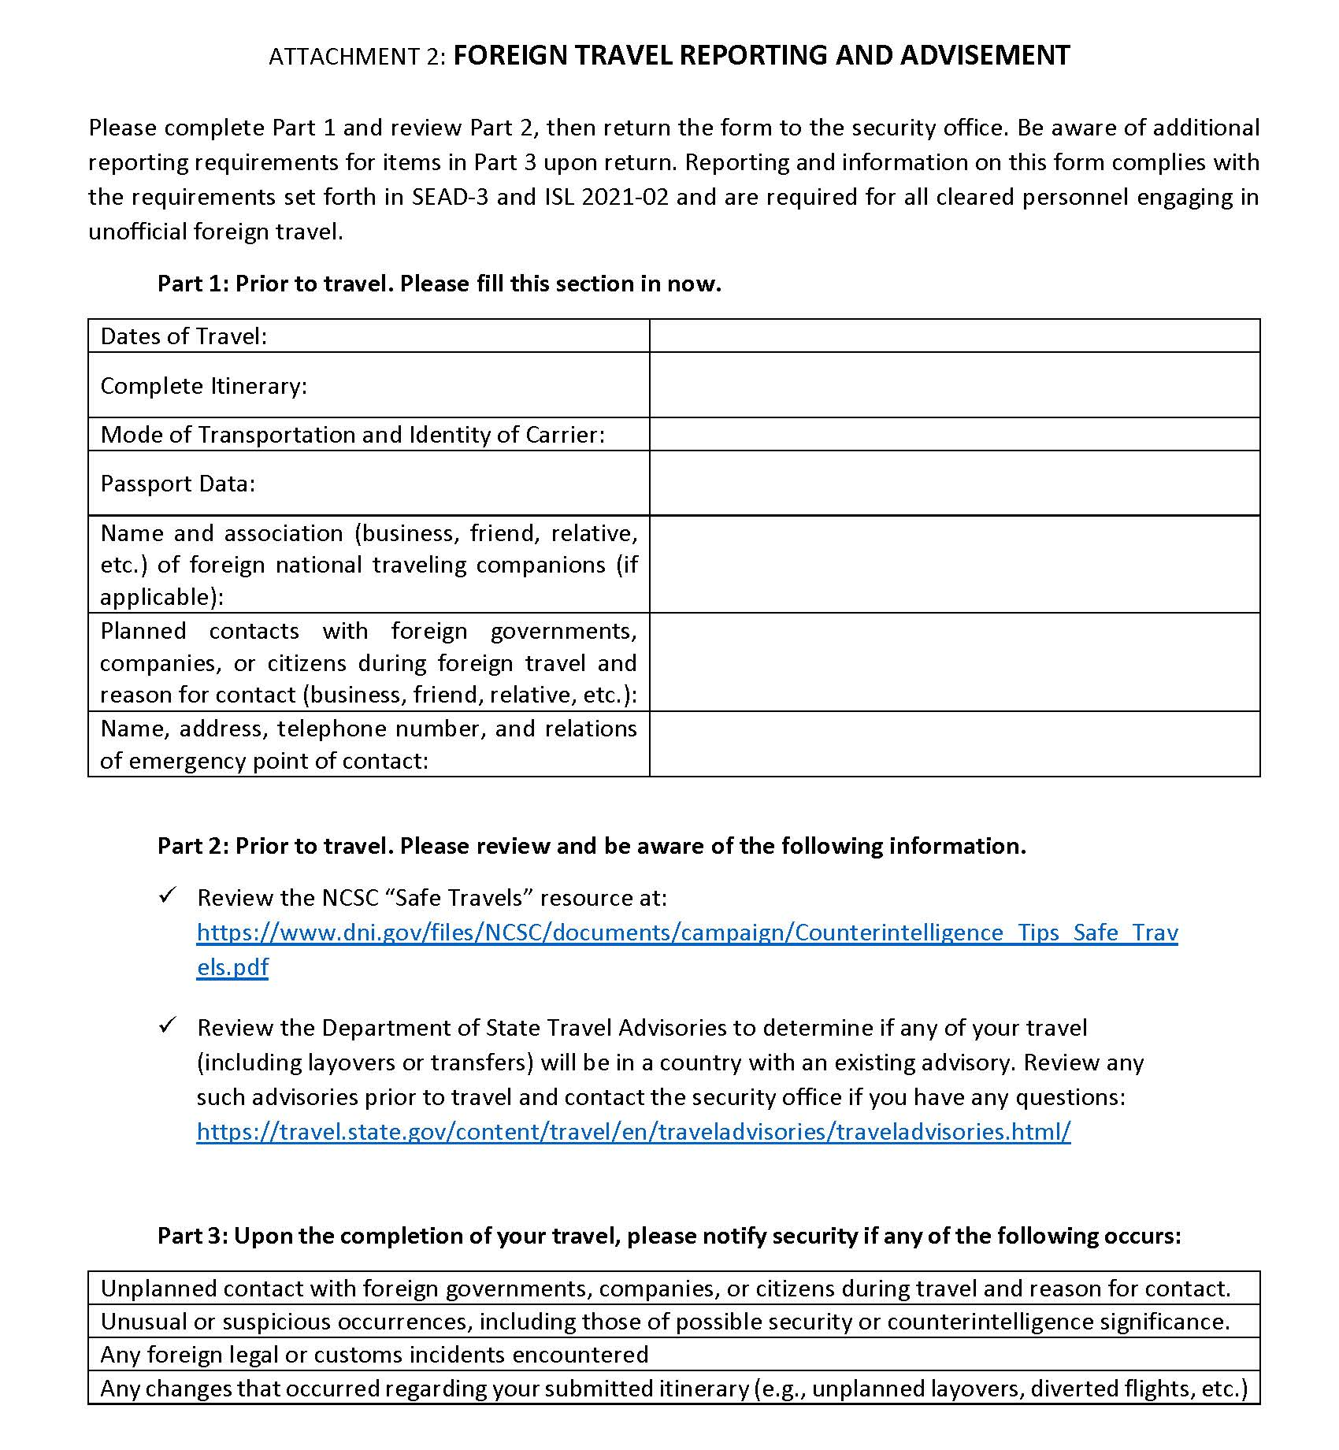
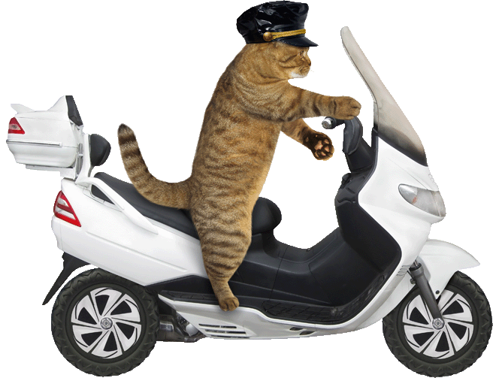
Sample SPP – Foreign Travel Reporting and Advisement

Slide 19
Creating Your Own SPP - Considerations
Start by identifying any restrictions.
Do you have internal company guidelines requiring specific formats?
Do you need to meet certain requirements, such as ISO 9001?
Do you need to include other security aspects, such as cybersecurity?
Are there other agency requirements?… DoE may require a more robust SPP even if DCSA does not.
How often do things change?
Will other individuals have control over specific sections of the Procedures that need to be separated or referenced?
Do the procedures cover a location with a shared services agreement?
Determine Scope:
FCL Level?
Possessing Facility?
Closed Areas?
Do you need to have sections covering CUI, OPSEC, or any other policies?
Any requirements from your DCSA Industrial Security Rep?

Slide 20
Creating Your Own SPP - Resources
32 CFR Part 117
https://www.ecfr.gov/current/title-32/subtitle-A/chapter-I/subchapter-D/part-117
Security Executive Agent Directive 3 (SEAD-3)
https://www.dni.gov/files/NCSC/documents/Regulations/SEAD-3-Reporting-U.pdf
Industrial Security Letter (ISL) 2021-02
https://www.dcsa.mil/Portals/91/Documents/CTP/tools/ISL2021-02_SEAD-3.pdf
DCSA Security Incident Job Aid
https://www.cdse.edu/Portals/124/Documents/jobaids/industrial/security-incident-job-aid.pdf
DCSA Self-Inspection Handbook
https://www.dcsa.mil/Portals/91/Documents/CTP/nispom/self_inspect_handbook_nisp.pdf
All active DD-254s – will identify potential add-ons such as NATO, COMSEC, or other specific requirements
DCSA Security Review and Rating Resources (Criteria, Roadmap, and References)
https://www.dcsa.mil/mc/isd/srrp/

Slide 21
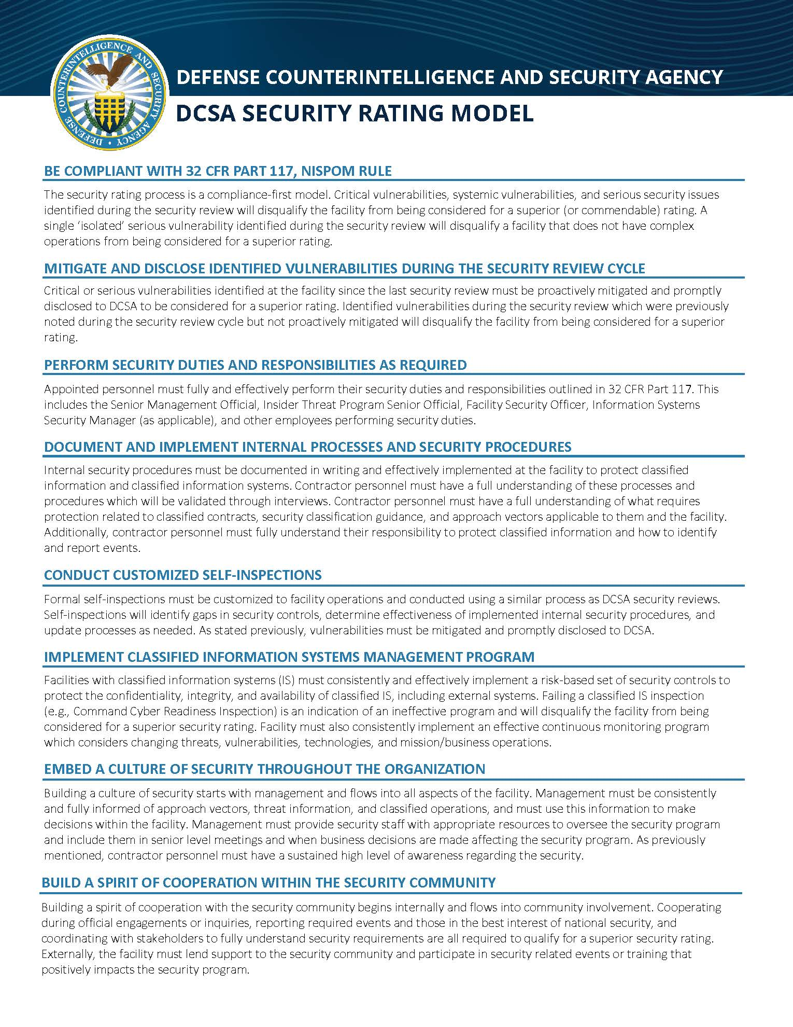
Creating Your Own SPP
Be Compliant with 32 CFR Part 117, NISPOM Rule
Mitigate and disclose identified vulnerabilities during the security review cycle
Perform security duties and responsibilities as required
Document and implement internal processes and security procedures
Conduct customized self-inspections
Implement classified information systems management program
Embed a culture of security throughout the organization
Build a spirit of cooperation within the security community

Slide 22
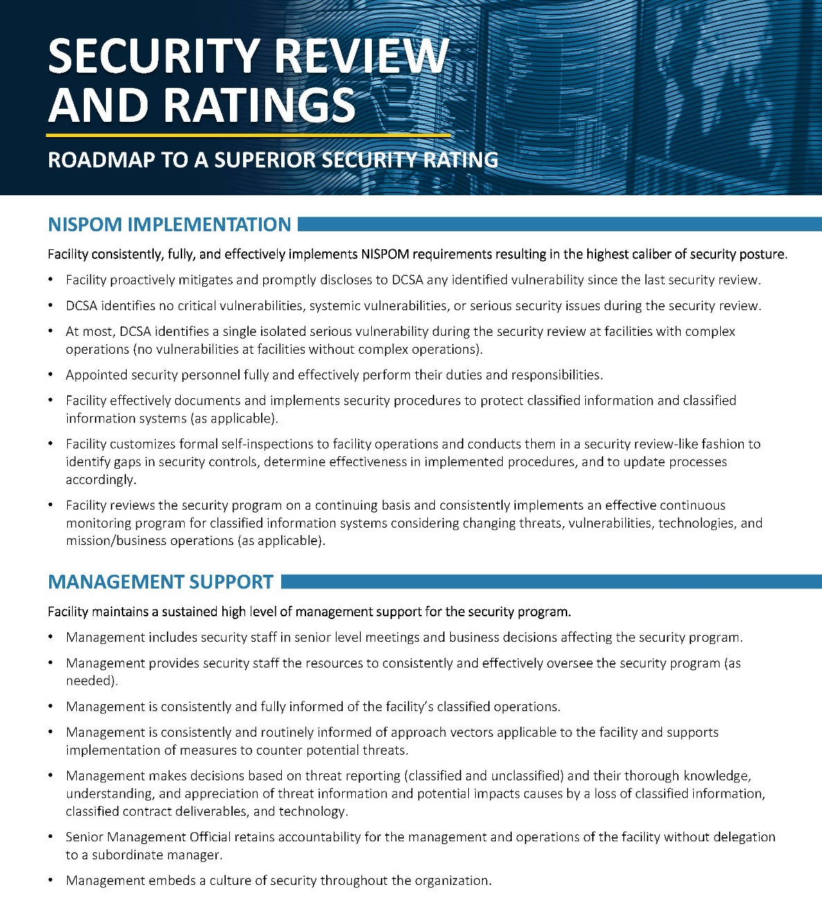
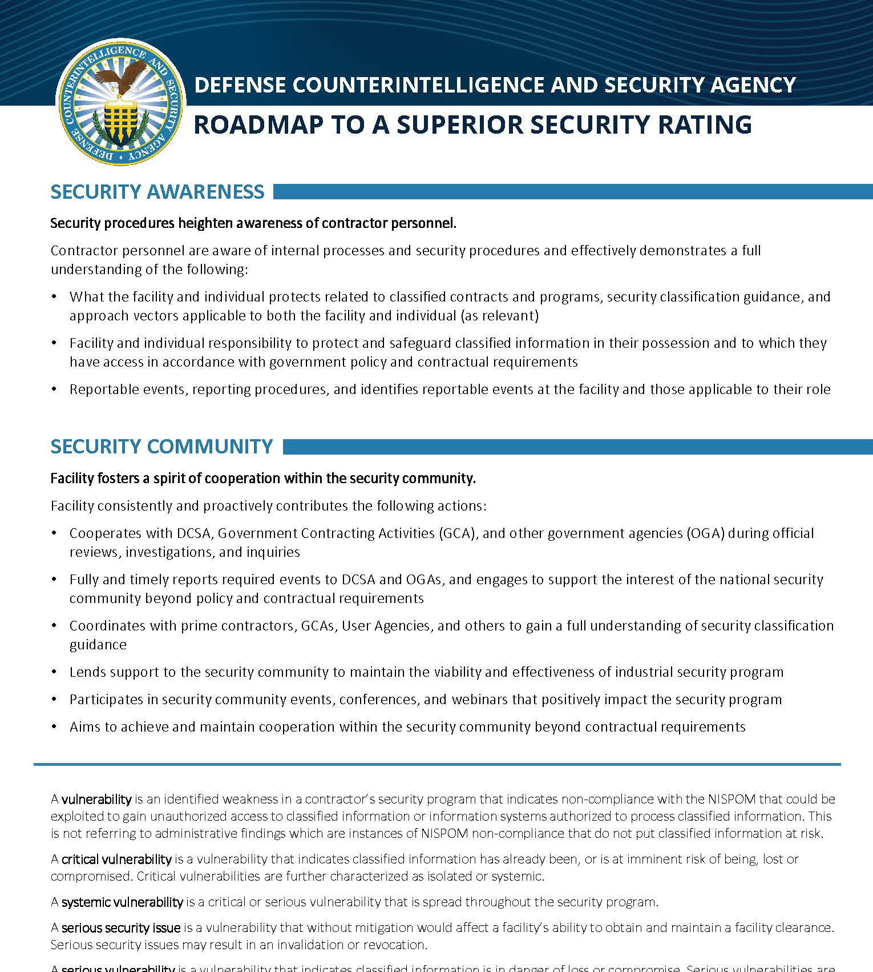
Creating Your Own SPP
Management is consistently and routinely informed of approach vectors applicable to the facility and supports implementation of measures to counter potential threats.
Use these roadmap items to develop sections that specifically speak to these capabilities. For this instance, work to get management’s agreement to include a periodic Threat Reporting meeting and include document it in the SPP.

Slide 23
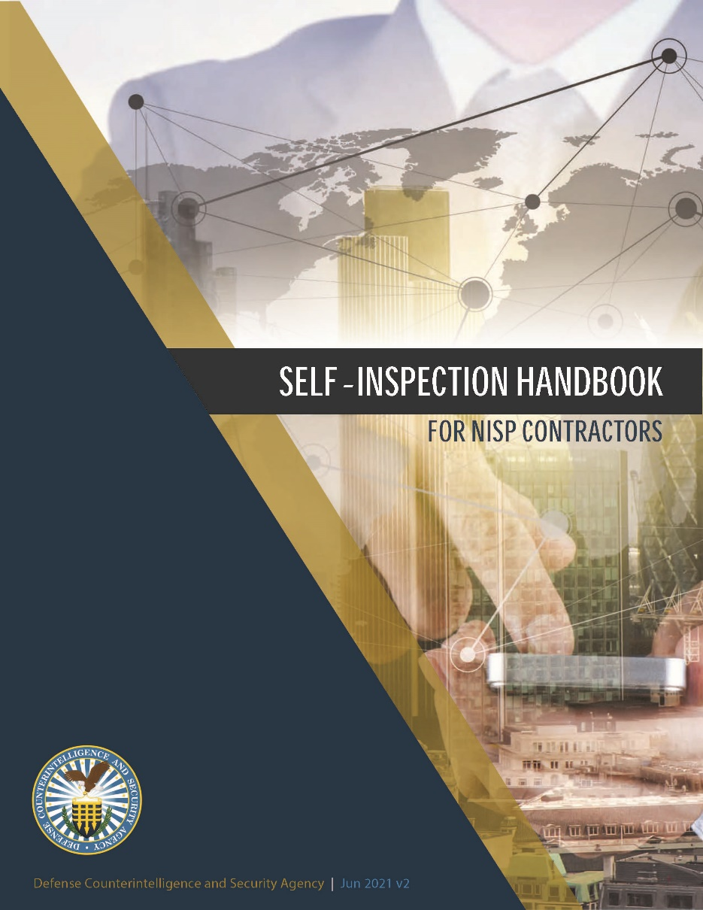
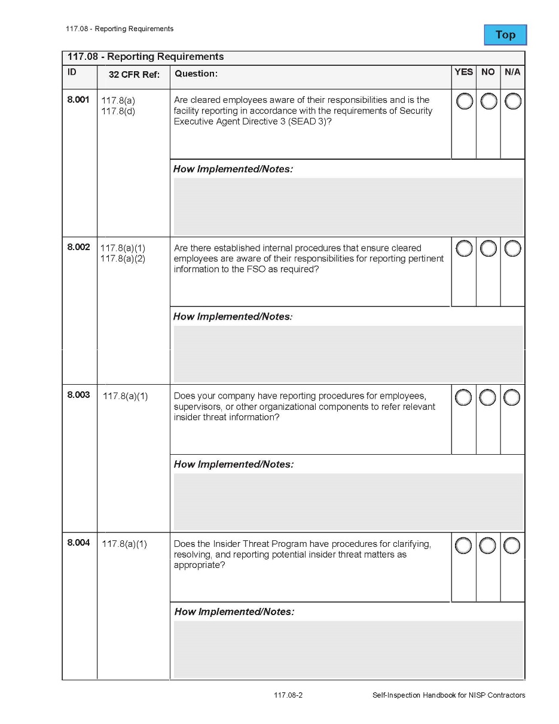
Creating Your Own SPP
The Self-Inspection Handbook is also extremely useful and can be used to help build out the scope of required sections for your SPP.
Matching corresponding sections to your SPP can enhance future Self-Inspections and ensures your program is hitting key points in ensuring security compliance.

Slide 24
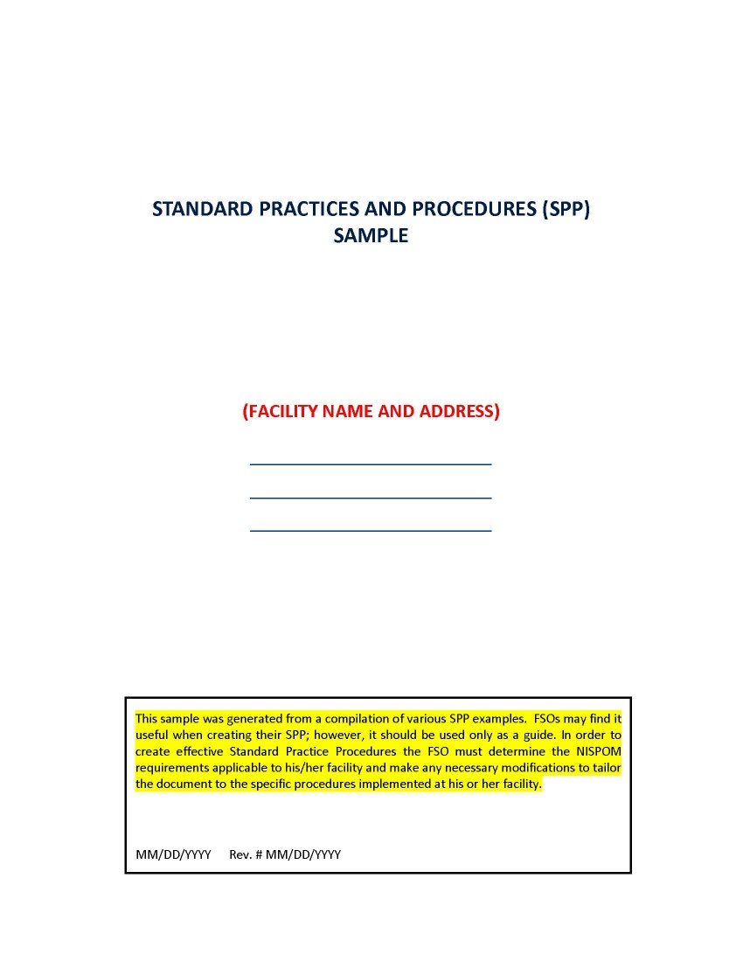
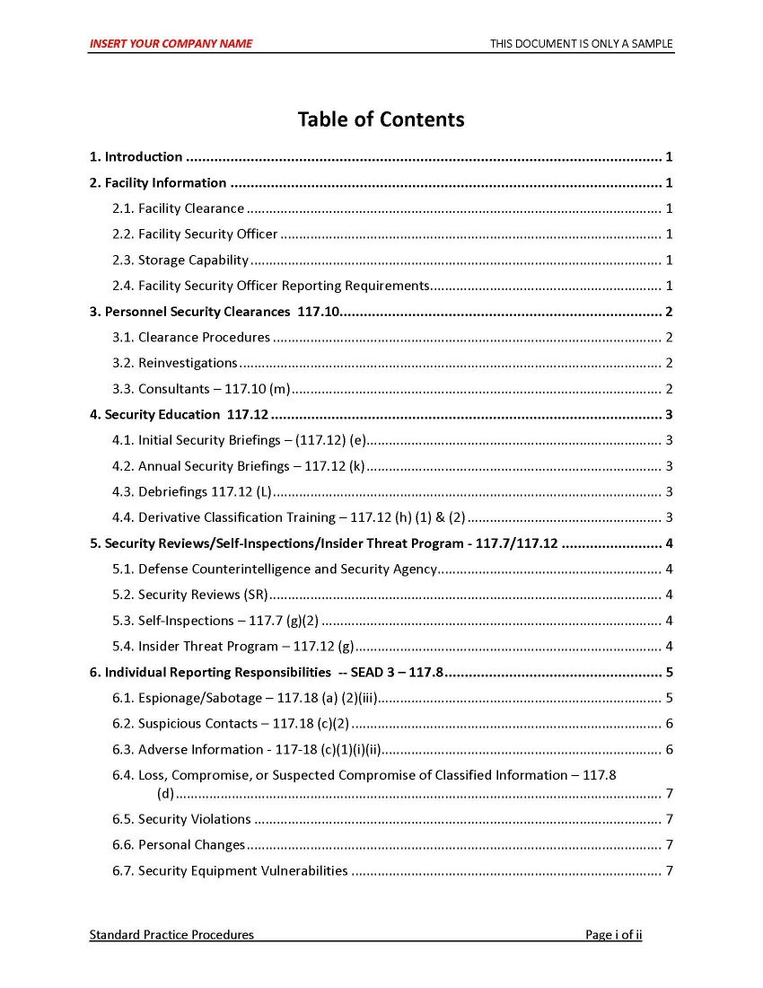
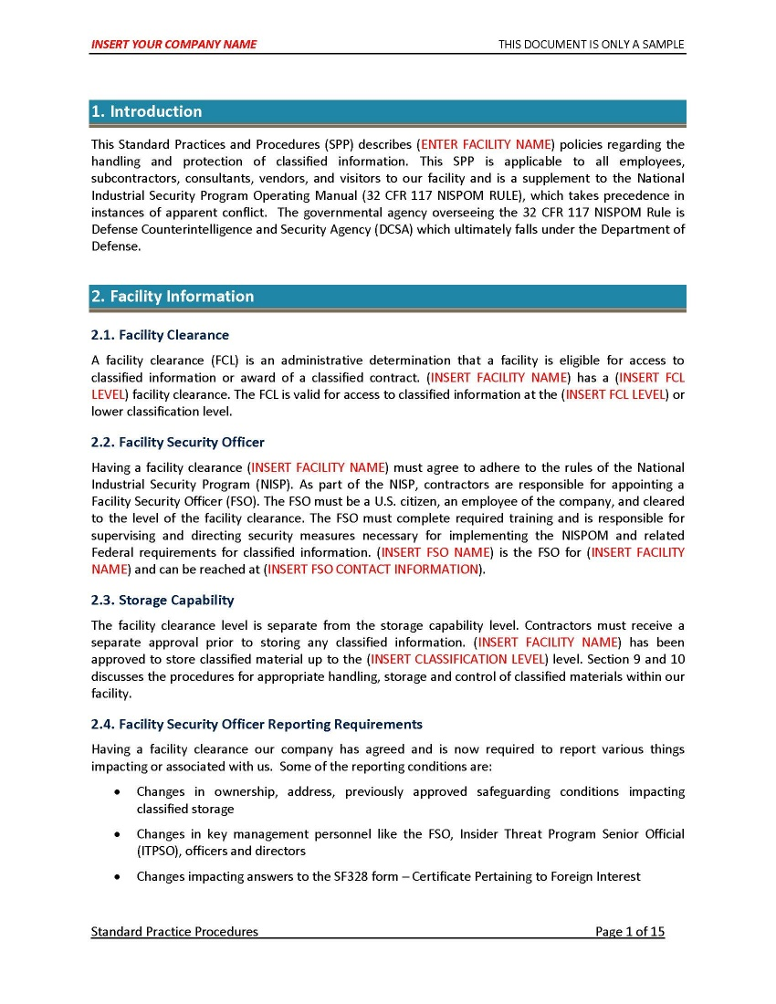
Creating Your Own SPP - Templates

Slide 25
My SPP (In Development)
Standard Practice Procedures: Industrial Security
Section I. Classified & Controlled Information
-Module: Threat Monitoring and Risk Assessment
-Module: Safeguarding
-Module: Classified Information Systems
-Module: Self-Inspection/Quality Assurance
-Module: Senior Management Integration
-Module: Position-Specific Threat Training Requirements
Section II. Insider Threat
Section III. OPSEC

Slide 26
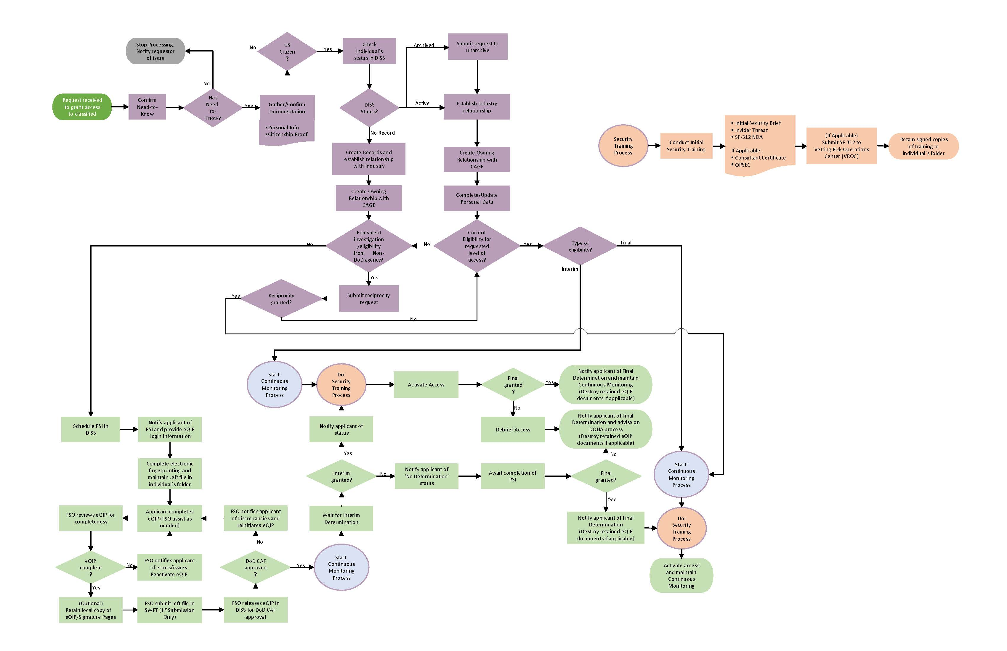
Personnel Clearance Processing Flowchart

Slide 30
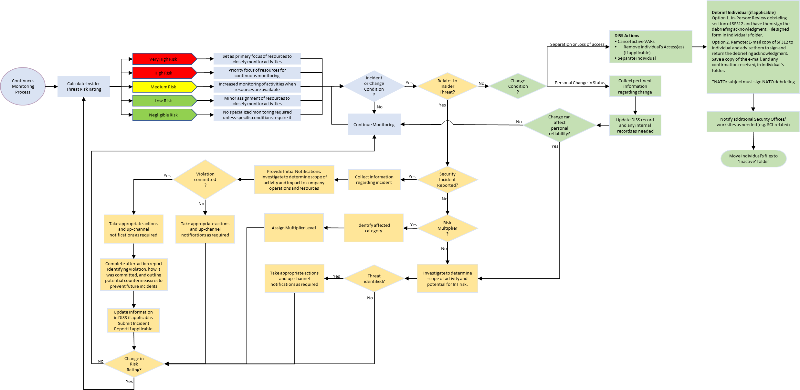
Continuous Monitoring Flowchart

Slide 33
Creating Your Own SPP – Final Thoughts
Remember, once it is in writing, your SPP must be followed.
Placing too many requirements in your program, or having unrealistic restrictions on task completion timelines, can lead to serious headaches.
Establishing ‘wiggle room’ where appropriate allows you additional flexibility when you need it (e.g., complete task within ‘x’ days as opposed to must be completed immediately).
Beware ambivalence in your plans. Not clearly defining requirements can lead to inconsistencies, such as listing something as a ‘Best Practice’ but not actually requiring it.

Slide 34
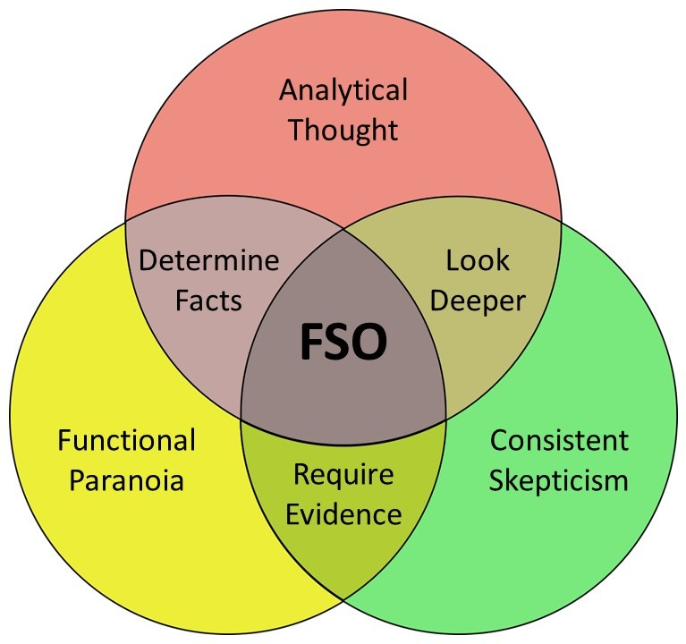
Questions?
Will McEllen, SAPPC, ISP
Armiger, LLC.
Industrial Security Consulting and Support
will.mcellen@armigerllc.com

