Slide 1
DISS/NBIS Industry Working Group Update
Presented by:
Quinton Wilkes
Director, Corporate Security
L3Harris Technologies
NISPPAC Industry DISS/NBIS Working Group
DISS/NBIS Industry Working groups are Sub Working Groups under the NISPPAC Systems working group

Slide 2
Agenda
Defense Information System for Security (DISS)
Owning & Servicing Relationships
DISS Update
National Background Investigation Services (NBIS)
Industry Onboarding
SMO Preparation
Industry NBIS Working Group
Challenges
Future of Personnel Security
Help

Slide 3
DISS

Slide 4
Owning and Servicing
Explore who is doing what actions in DISS
User roles
Relationships
Owning
Build the record
Grant Access to include special categories
Servicing
Service an existing access
Add FN Contact – with correct role
Initiate Investigation
View Investigation Detail
Eligibility Notification
Task inbox (CAF Messages)
Add FN Travel – with correct role
View Subject details
Visits request
Adverse (Only submitting SMO can see)
Own your personnel
Exception (SCI)
SCI owner owns the SCI accesses, Industry services SCI owning relationship
Service long term visitors, etc.

Slide 5
Owning and Servicing…cont.
Owning Relationships:
A Subject can have multiple owning relationships and multiple owners granting the same access
A Subject can have an owning relationship and not be in access
Assists when tracking Continuous Evaluation (CE)
CE Memo dated June 27, 2022
All Military Services and non-Intelligence Community DoD agencies
Business as usual until DCSA provides implementation guidance
Servicing Relationships:
A SMO can establish a servicing relationship on an owning SMO’s relationship
Grant New Access
Service Existing Access

Slide 6
DISS Release 13.12 (SEAD 3)
Projected changes to “Foreign Travel” functionality in JVS
Users must have the “Manage Foreign Travel” permission
Update “Passport Details” to “Travel Documents
Address Visited in Foreign Countries can be added as optional
Mode of Transportation (Auto, Train, Air, Walking, and Sea)
Post travel comments no longer required
Travel statuses (Initial, Draft, Reported) when travel is created
Upload Mass Foreign Travel
Subjects must be in user’s SMO
File size cannot exceed 1MB
JVS user manual will have details on required fields and formatting
User Acceptance Testing (UAT) scheduled for last week in July
DISS Industry team will test with VRO

Slide 7
NBIS

Slide 8
NBIS - Industry Onboarding
DISS Cleanup Initiative – “March Madness”
March 2022 month-long campaign to clean organization hierarchy data in DISS in preparation for transition to NBIS (Remove JPAS info, transition to one SMO, etc.)
Effort will support smoother hierarchy data migration from DISS to NBIS
Industry should continue to clean up hierarchies in DISS
Industry Case Testing Ongoing – Production Environment
Ten (10) industry users trained, provisioned, and conducting live case tests for initiation, review, and authorize (IRA) process in NBIS (4 cases initiated; 2/4 authorized; 1 scheduled and reflected in DISS)
Capturing user feedback, gaps, and defects in NBIS IRA process for Industry/VRO
Way Forward to Successfully Onboard Industry to NBIS
Migrate organization hierarchy data from DISS/NISS to NBIS
Establish Knowledge Center for Industry
Conduct crosswalks between DISS and NBIS for industry users
Research inherited user provisioning for DISS users to NBIS
Add NISPPAC working group members into NBIS Test Environment
Deployment of NBIS Industry Onboarding Portal to support provisioning users
Data Migration Team to migrate DISS data to NBIS
Five (5) Currently Onboarded Companies
Raytheon
Deloitte
Parsons
SI2 Technologies
Security First
Applying Lessons Learned from JPAS to DISS Transition
Data migration
Data synch
Training
DISS data points needed in NBIS
NBIS to DISS capability cross-walk
NBIS to DISS user role cross-walk
A Guide on when it is required to use two systems

Slide 9
SMO Preparation for NBIS Transition
Verify & Consolidate DISS Hierarchy SMO Data for Industry
Document posted on NCMS NISPPAC and DCSA NBIS websites
DCSA is migrating one organization (SMO) per Facility Clearance into NBIS
Requires all Industry hierarchy managers to consolidate their DISS SMO’s to a single SMO per CAGE code
Follow these steps to ensure the correct SMO (Organization) is transitioned into NBIS
Step 1: Review your hierarchy in DISS (must Have Hierarchy Manager role in DISS to make updates)
Step 2: Identify any SMOs that contain legacy JPAS levels (i.e. Levels 3, 4 or 5 at the end of your CAGE code) OR where you are operating in multiple SMOs per CAGE Code/Facility Clearance)
Step 3: Take appropriate actions to deactivate the extra SMOs
Clean-up any preconditions prior to deactivating a SMO in DISS, there can’t be any:
Subjects in that SMO
Users in the SMO
Child SMO’s under it
Step 4: Deactivate the SMOs no longer needed to ensure only a single SMO per CAGE Code/Facility Clearance
Step 5: Edit your DISS SMO Name Prefix so it contains only your CAGE Code

Slide 10
Industry NBIS Working Group
DCSA began to transition Industry hierarchy data from NISS & DISS to NBIS on April 1st
NISS - the authoritative source for facility clearances
Hierarchy information for cleared facilities
Industry does not have NBIS accounts to verify the data moved over correctly
DISS - the personnel security system of record and source of hierarchy used to manage personnel security programs
Does not include subject, accesses, visits or any other data
Industry access to NBIS projected later this year
Working on a transition plan for industry access to system
Auto-provisioning for current DISS Hierarchy Managers
Hierarchy Managers will create their organization accounts
Account creation by DCSA
No call center available today
Requires DCSA Service Now account
All account documentation uploaded to Service Now

Slide 11
ServiceNow
ServiceNow: The Pathway for NBIS Industry Onboarding
As part of Industry onboarding into NBIS system, DCSA will leverage the ServiceNow platform, to host an NBIS Industry Onboarding Portal. It is the same platform used for Secure Web Fingerprint Transmission (SWFT) and Defense Information Security System (DISS) statuses, notifications, and support services.
The Industry Onboarding Portal will enable Industry to easily, conveniently, and effectively onboard into the NBIS system. It will provide industry with an interactive readiness checklist, streamlined system access request process, a training repository, and the ability to request for support, if needed.
The portal is still being tested and prepared for Industry Onboarding. Additional details to follow.
In the meantime, please visit the NBIS Industry Onboarding website.

Slide 12
Industry NBIS Working Group…cont.
Testing NBIS IRA
Reviewing the investigation workflow for Industry
eAPP sends multiple emails directly to Subject
May change internal investigation processes
Partnering with VRO to test authorization/approval of investigations
Transfer of data
Working on data migration plan
Auto-populated vs. manual entry
Will drive dual system use (building records in DISS and NBIS)

Slide 13
NBIS challenges for Industry
No clear strategic plan moving from DISS to NBIS
Causes issues with functionality and data migration
No clear plan for data migration (how/when)
Auto-populated vs. manual entry
No training available
Difficult to create training when NBIS processes are still under development
DCSA is pushing use of NBIS by end of year
Even if system is not ready or is missing data

Slide 14
Personnel Security

Slide 15
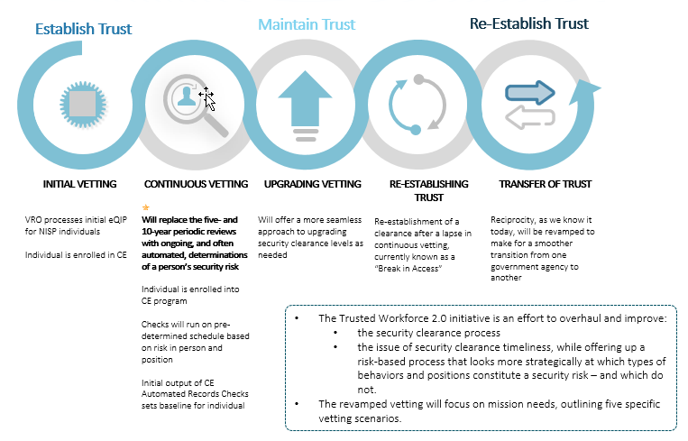
The Future of Personnel Security

Slide 16
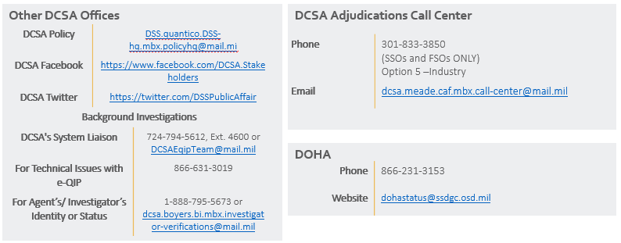
DCSA Support
Knowledge Center Inquiries
In an effort to continue to protect our workforce during the COVID-19 pandemic, Personnel Security Inquiries (option 1/option 2) of the DCSA Knowledge Center has been suspended until further notice. We will continue to provide status updates via DISS Customer Service Requests and VRO email dcsa.ncr.dcsa-dvd.mbx.askvroc@mail.mil. When calling (888) 282-7682, customers will have the following menu options:
Personnel Security Clearance Inquiries (e-QIP PIN Resets, Golden Questions & VRO)
For Industry PIN Resets: HANG UP and Call the Applicant Knowledge Center at 724-738-5090, or; Email DCSAAKC@mail.mil, or;
For all other PCL related inquiries email dcsa.ncr.dcsa-dvd.mbx.askvroc@mail.mil

Slide 17
Additional Resources
When you log into DISS there is a help link that will take you to the user guide
DCSA website at www.dcsa.mil
NISPPAC Resources (DISS Tips)
https://classmgmt.com/nisppac.php
Under the Resources Tab
Email the NISPPAC DISS/NBIS Working Groups your questions at NISPPACindustry@gmail.com

Slide 18
Questions?

